Slide 1
Android Activity Lifecycle
CS235AM
Android App Development
by Brian Bird
Spring 2016
Lane Community College

Slide 2
New Course Agenda (Syllabus updated)
Wk | Topic
1 | Intro + single-screen apps
2 | Multi-screen (multi-activity) apps
3 | Activity lifecycle and state
4 | Adapting to size and orientation: Layouts
5 | Fragments
Wk | Topic
6 | List View
7 | Managing data: SQLite
8 | Geolocation
9 | Publishing to an App Store
10 | Term Project
Notes:
This week we are going deeper into the activity lifecycle and we’ll be exploring ways to save and retrieve activity state.

Slide 3
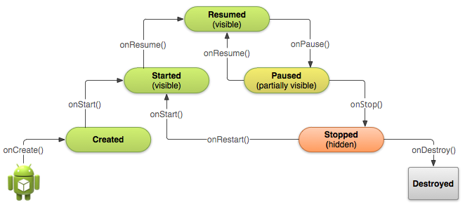
Activity Lifecycle
From http://developer.android.com/training/basics/activity-lifecycle/
Notes:
We will cover this in more detail next week

Slide 4
Lifecycle and Activity State
Values stored in variables or objects in an Activity are not retained when an Activity is destroyed and then re-created.
Activities are destroyed when:
The device is rotated.
The Activity is removed from the back-stack (system back button)
The Activity has stopped and subsequently the system needs to allocate some of its resources (like memory).
Code in an activity explicitly destroys it (uncommon).

Slide 5
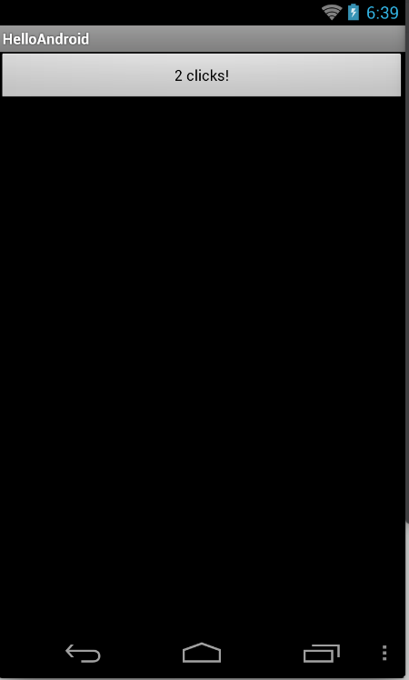
Experiment: Activity State
Build and run the default click-counter app
See what happens to the count when you:
Tap (click) the back button, then resume the activity
Tap (click) the home button
Start another activity
Turn off (sleep) the device
Rotate the device
Force-stop the app
Notes:
1. Count lost, 2. Count retained (activity still in back-stack), 3. Count retained, 4. Count retained? 5. Count lost, 6. Count lost.

Slide 6
Means for Saving Activity State
Values in input widgets (EditText, Spinner, RaidoButton, etc.) are automatically retained. (Similar to the behavior or HTML input elements).
Use OnSaveInstanceState to save data in a Bundle object. Mainly for configuration changes, like rotation.
Use OnRetainNonConfigurationInstance to save custom objects. Used when saving larger data objects.
Notes:
3. Deprecated in API 13! Use the new Fragment API setRetainInstance(boolean) instead.
developer.android.com/reference/android/app/Activity.html

Slide 7
Save State in a Bundle
Save the state in OnSaveInstanceState
protected override void OnSaveInstanceState(Bundle state)
{
state.PutInt("counter", c);
base.OnSaveInstanceState(state);
}
Bundle class PutInt method
First parameter: key
Second parameter: value
Notes:
https://developer.xamarin.com/api/member/Android.OS.Bundle.PutInt/p/System.String/System.Int32

Slide 8
Bundle Class
Stores information as key-value pairs (like a Dictionary or Map)
Has Put and Get methods for:
Primitive types | Arrays of primitive types
byte | byte[ ]
char | char[ ]
float | float[ ]
int | int[ ]
string | string[ ]
And more (see https://developer.xamarin.com/api/type/Android.OS.Bundle
Notes:
Xamarin API documentation: https://developer.xamarin.com/api/type/Android.OS.Bundle
Google Android docs: http://developer.android.com/reference/android/os/Bundle.html

Slide 9
Retrieve State from a Bundle
Retrieve state in OnCreate
c = bundle.GetInt ("counter", -1);
Bundle class GetInt method
First parameter: key
Second parameter: default value
Notes:
https://developer.xamarin.com/api/member/Android.OS.Bundle.GetInt/p/System.String/System.Int32/

Slide 10
Do it: Save the Count
Add the code shown in the previous slides to the click counter app.
Test it:
Rotate the device
Force stop the app and restart it
The count should be maintained
Notes:
https://developer.xamarin.com/api/member/Android.OS.Bundle.GetInt/p/System.String/System.Int32/

