Slide 1
An Introduction to Scrum
Brian Bird
Lane Community College

Slide 2
Origins of Agile
Agile is software development philosophy and movement
It was conceived as a solution to a problem in the software industry: too many failed software development projects!
The Standish Group published a study of IT projects in 1994:
  16.2% were completed on-time and on-budget, with all features and functions as initially specified.
  52.7% were completed and operational but over-budget, over the time estimate, and offers fewer features and functions than originally specified.
  31.1% were canceled at some point during the development cycle.
Notes:
Source: http://www.csus.edu/indiv/v/velianitis/161/chaosreport.pdf
Cost of cancelled software projects estimated at $81 billion

Slide 3
Causes of project failure
Participants in the survey listed these as the top three reasons IT projects failed:
  Lack of User Input
  Incomplete Requirements & Specifications
  Changing Requirements & Specifications

Slide 4
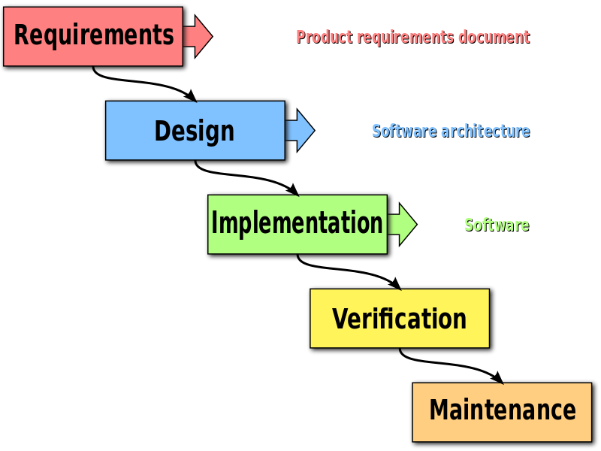
Waterfall approach to software development
By Peter Kemp / Paul Smith - Adapted from Paul Smith's work at wikipedia, CC BY 3.0

Slide 5
My 2016 Sabbatical
Goals for the Sabbatical:
Gain a better understanding of Agile practices and principles
Learn how Agile is being applied in local companies that hire our graduates
Determine what aspects of Agile are important to teach to our students

Slide 6
Companies developing and selling software
IDX
  Produces software for the real-estate industry
Symantec Corp, Norton Engineering Group
  Produces software for security and system tune-up.
Palo Alto Software, Inc.
  Develops and sells business software
All of these companies are highly committed to Agile Scrum and implement it in a rigorous and structured way

Slide 7
Company developing software for internal use
PacificSource
  Produces software to support the health insurance products they sell.
  This was the largest group of software developers that I observed: 5 teams with a total of 45 developers.
This company is also highly committed to Agile Scrum and implements it in a rigorous and structured way.

Slide 8
Companies developing software for other companies
Lunar Logic
  Develops software applications and web sites, with an emphasis on web marketing, for a very large number of external clients.
IEQ Technology
  Develops software applications and does software maintenance for external clients.
Mindbox Studios
  Develops software applications and does software maintenance for external clients.
These companies are committed to Agile principles, but apply Scrum methodologies in more loose and adapted ways.

Slide 9
Conclusions from My Sabbatical
  Agile is now the way to do software development
  Scrum is the Agile methodology used by most companies.
  Using a modified version of Agile Scrum is common.
  Women may find Agile project management as a new entry point to high-tech industry.
Based on Women in Agile, the Changing Face of Agile, a conference session, at Agile 2016.
  Agile works well for both collocated teams and remote teams.

Slide 10


The Agile Manifesto (2001)
A statement of values
Individuals and interactions
Process and tools
over
Working software
Comprehensive documentation
over
Customer collaboration
Contract negotiation
over
Responding to change
Following a plan
over
Source: https://www.agilealliance.org/agile101/the-agile-manifesto/

Slide 11
Scrum in 100 words
Scrum is an agile process that allows us to focus on delivering the highest business value in the shortest time.
It allows us to rapidly and repeatedly inspect actual working software (every two weeks to one month).
The business sets the priorities. Teams self-organize to determine the best way to deliver the highest priority features.
Every two weeks to a month anyone can see real working software and decide to release it as is or continue to enhance it for another sprint.

Slide 12
Characteristics
Self-organizing teams.
Product progresses in a series of two to four week “sprints”.
Requirements are captured as items in a list of “product backlog”.
No specific engineering practices prescribed.
Uses generative rules* to create an agile environment for delivering projects.
* A set of principles that you apply to all situations to generate appropriate practices for each situation.
One of the “agile processes”

Slide 13
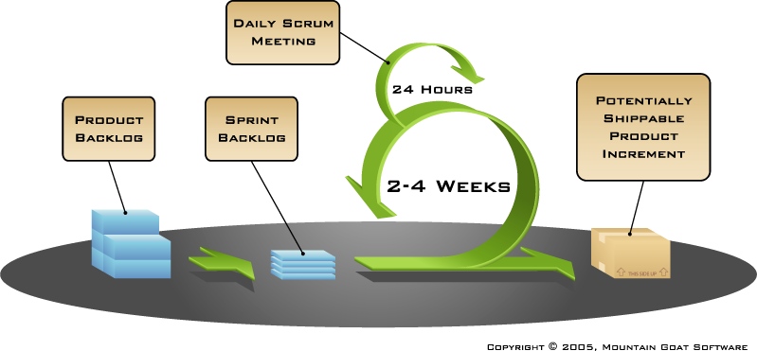
Putting it all together
Image available at www.mountaingoatsoftware.com/scrum

Slide 14
Sprints
Scrum projects make progress in a series of “sprints”
Typical duration is 2–4 weeks or a calendar month at most
A consistent duration leads to a better rhythm
Product is designed, coded, and tested during each sprint

Slide 15
Sequential vs. overlapping development
Requirements
Design
Code
Test
Rather than doing all of one thing at a time...
...Scrum teams do a little of everything all the time
Source: “The New New Product Development Game” by Takeuchi and Nonaka. Harvard Business Review, January 1986.

Slide 16


No changes during a sprint
Change
Plan sprint durations around how long you can commit to keeping change out of the sprint

Slide 17
User Stories
  Should represent an atomic operation like: Students can search for classes by CRN so that they can register.
    Epics (large stories) should be broken up into individual stories.
    Example epic: Students can enroll in the college
  Simple. Can be one sentence. A prompt to talk to the users to get the details- “just in time” analysis.

Slide 18
User Stories - Continued
  Priority. Classify into one of 5 (or some number) of priority levels.
  Non-functional requirements:
    Some teams include non-functional requirements like: Users can access the system using mobile browsers.
    Other teams prefer to just list non-functional requirements in the requirements document since they typically apply to multiple epics and user stories.

Slide 19
Story Points
Start by estimating hours, but call these ”story points”. Estimate relative difficulty of stories.
At the end of each sprint, “calibrate” your story points by calculating a calibration factor:
  actual hours / story points = calibration factor
  Example: 40 hours / 32 points = 1.25
Scale the story points in the next sprint:
  A story with 10 points will be expected to take 12 hours.

Slide 20
Scrum framework
Roles
Product owner
ScrumMaster
Team
Ceremonies
Sprint planning
Sprint review
Sprint retrospective
Daily scrum meeting
Artifacts
Product backlog
Sprint backlog
Burndown charts

Slide 21
Scrum framework
Roles
Product owner
ScrumMaster
Team
Ceremonies
Sprint planning
Sprint review
Sprint retrospective
Daily scrum meeting
Artifacts
Product backlog
Sprint backlog
Burndown charts

Slide 22

Product owner
Define the features of the product.
Decide on release date and content.
Be responsible for the profitability of the product (ROI).
Prioritize features according to market value.
Adjust features and priority every iteration, as needed.
Accept or reject work results.

Slide 23

The ScrumMaster
Represents management to the project.
Responsible for enacting Scrum values and practices.
Removes impediments.
Ensure that the team is fully functional and productive.
Enable close cooperation across all roles and functions.
Shield the team from external interferences.

Slide 24





The team
Typically 5-9 people.
Cross-functional:
  Programmers, testers, user experience designers, etc.
Members should be full-time.
    May be exceptions (e.g., database administrator).

Slide 25
The team
Teams are self-organizing
  Ideally, no titles but occasionally a possibility (like lead developer)
Membership should change only between sprints

Slide 26
Scrum framework
Roles
Product owner
ScrumMaster
Team
Ceremonies
Sprint planning
Sprint review
Sprint retrospective
Daily scrum meeting
Artifacts
Product backlog
Sprint backlog
Burndown charts

Slide 27


Team capacity
Sprint planning meeting
Sprint prioritization
Product backlog
Sprint
goal
Analyze and evaluate product backlog
Select sprint goal
Business conditions
Sprint planning
Decide how to achieve sprint goal (design)
Create sprint backlog (tasks) from product backlog items (user stories / features)
Estimate sprint backlog in hours
Current product
Sprint
backlog
Technology

Slide 28

Sprint planning
Team selects items from the product backlog they can commit to completing
Sprint backlog is created
  Tasks are identified and each is estimated (1-16 hours)
  Collaboratively, not done alone by the ScrumMaster
High-level design is considered
As a vacation planner, I want to see photos of the hotels.
Code the middle tier (8 hours)
Code the user interface (4)
Write test fixtures (4)
Code the foo class (6)
Update performance tests (4)

Slide 29
The daily scrum
Parameters
  Daily
  15-minutes
  Stand-up
Not for problem solving
  Whole world is invited
  Only team members, ScrumMaster, product owner, can talk
Helps avoid other unnecessary meetings

Slide 30

Everyone answers 3 questions
1
What did you do yesterday?
2
What will you do today?
3
Is anything in your way?
These are not status for the ScrumMaster
  They are commitments in front of peers

Slide 31
The sprint review
Team presents what it accomplished during the sprint
Typically takes the form of a demo of new features or underlying architecture
Informal
  2-hour prep time rule
  No slides
Whole team participates
Invite the world

Slide 32
Sprint retrospective
Periodically take a look at what is and is not working
Typically 15–30 minutes
Done after every sprint
Whole team participates
  ScrumMaster
  Product owner
  Team
  Possibly customers and others

Slide 33

Start / Stop / Continue
Whole team gathers and discusses what they’d like to:
Start doing
Stop doing
This is just one of many ways to do a sprint retrospective.
Continue doing

Slide 34
Scrum framework
Roles
Product owner
ScrumMaster
Team
Ceremonies
Sprint planning
Sprint review
Sprint retrospective
Daily scrum meeting
Artifacts
Product backlog
Sprint backlog
Burndown charts

Slide 35

Product backlog
The requirements
A list of all desired work on the project
Ideally expressed such that each item has value to the users or customers of the product
Prioritized by the product owner
Reprioritized at the start of each sprint
This is the product backlog

Slide 36
A sample product backlog
Backlog item | Estimate
Allow a guest to make a reservation | 3
As a guest, I want to cancel a reservation. | 5
As a guest, I want to change the dates of a reservation. | 3
As a hotel employee, I can run RevPAR reports (revenue-per-available-room) | 8
Improve exception handling | 8
... | 30
... | 50

Slide 37
The sprint goal
A short statement of what the work will be focused on during the sprint.
Life Sciences
Support features necessary for population genetics studies.
Database Application
Make the application run on SQL Server in addition to Oracle.
Financial services
Support more technical indicators than company ABC with real-time, streaming data.

Slide 38
Managing the sprint backlog
Individuals sign up for work of their own choosing.
  Work is never assigned.
Estimated work remaining is updated daily.

Slide 39
Managing the sprint backlog
Any team member can add, delete or change the sprint backlog.
Work for the sprint emerges.
If work is unclear, define a sprint backlog item with a larger amount of time and break it down later.
Update work remaining as more becomes known.

Slide 40
A sprint backlog
Tasks
Mon
Tues
Wed
Thur
Fri
Code the user interface
8
4
8
Code the middle tier
16
12
10
4
Test the middle tier
8
16
16
11
8
Write online help
12
Write the foo class
8
8
8
8
8
Add error logging
8
4
Notes:
A log of the hours of estimated work remaining after each day of the sprint

Slide 41

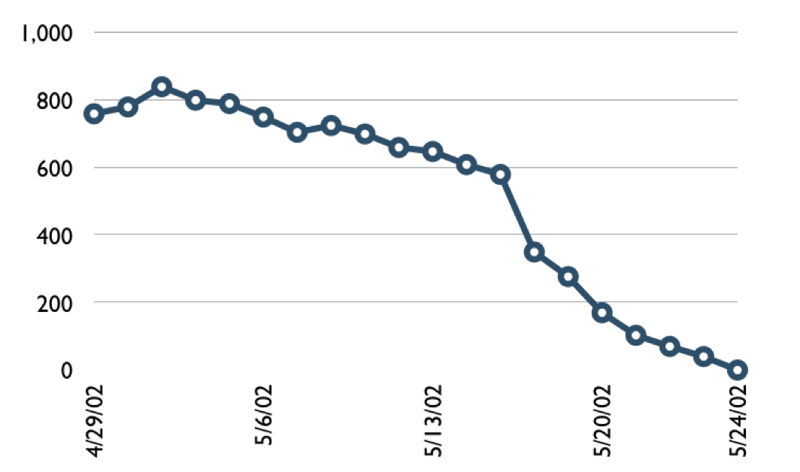
A sprint burndown chart
Hours

Slide 42
Tasks
Mon
Tues
Wed
Thur
Fri
Code the user interface
8
4
8
Code the middle tier
16
12
10
7
Test the middle tier
8
16
16
11
8
Write online help
12
50
40
30
Hours
20
10
0
Mon
Tue
Wed
Thu
Fri

Slide 43
Scalability
Typical individual team is 7 ± 2 people
  Scalability comes from teams of teams
Factors in scaling
  Type of application
  Team size
  Team dispersion
  Project duration
Scrum has been used on multiple 500+ person projects
Notes:
For capstone teams, 3 or 4 works best.

Slide 44
Where to go next
www.mountaingoatsoftware.com/scrum
www.scrumalliance.org
www.controlchaos.com
scrumdevelopment@yahoogroups.com

Slide 45
A Scrum reading list
Agile and Iterative Development: A Manager’s Guide by Craig Larman
Agile Estimating and Planning by Mike Cohn
Agile Project Management with Scrum by Ken Schwaber
Agile Retrospectives by Esther Derby and Diana Larsen

Slide 46
A Scrum reading list
Agile Software Development Ecosystems by Jim Highsmith
Agile Software Development with Scrum by Ken Schwaber and
Mike Beedle
Scrum and The Enterprise by Ken Schwaber
Succeeding with Agile by Mike Cohn
User Stories Applied for Agile Software Development by Mike Cohn

Slide 47
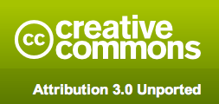
Copyright notice
You are free:
  to Share―to copy, distribute and transmit the work.
  to Remix―to adapt the work.
Under the following conditions
  Attribution. You must attribute the work in the manner specified by the author or licensor (but not in any way that suggests that they endorse you or your use of the work).
Nothing in this license impairs or restricts the author’s moral rights.
For more information see http://creativecommons.org/licenses/by/3.0/

Slide 48

Contact information
Presentation by: Mike Cohn
mike@mountaingoatsoftware.com
www.mountaingoatsoftware.com
(720) 890-6110 (office)
You can remove this (or any slide) but you must credit the source somewhere in your presentation. Use the logo and company name (as at bottom left, for example) or include a slide somewhere saying that portions (or all) of your presentation are from this source. Thanks.

