Slide 1

Deep Learning
Session 7
Model Selection and Hyperparameter Tuning
Applied Data Science
2024/2025

Slide 2


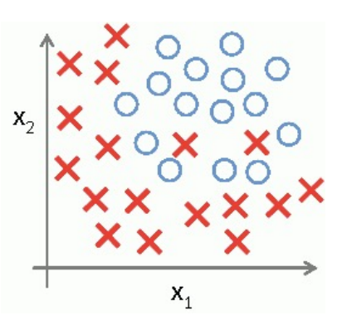
Exercise
Separate from
Using a straight line (linear function)
Using a parabola (quadratic function)
Using any curve
Model Selection and Hyperparameter Tuning
Session 7

Slide 3
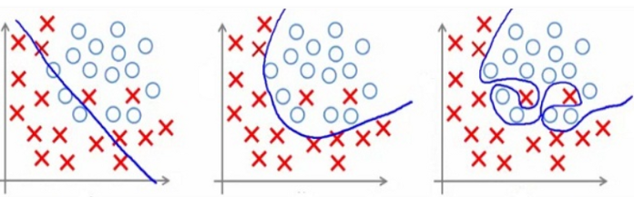
Exercise
Which model would you choose?
Model Selection and Hyperparameter Tuning
Session 7

Slide 4
Exercise
Which model would you choose?
Underfits: too simple to explain the data!
Overfits: too complex to generalize to new data!
Model Selection and Hyperparameter Tuning
Session 7

Slide 5
Exercise
Which model would you choose?
Key challenge for neural networks since they have many parameters!
Underfits: too simple to explain the data!
Overfits: too complex to generalize to new data!
Model Selection and Hyperparameter Tuning
Session 7

Slide 6
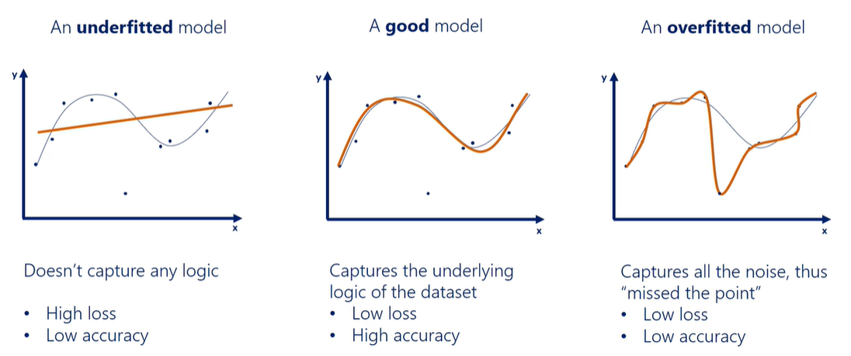
The Problem of Overfitting
Model Selection and Hyperparameter Tuning
Session 7

Slide 7
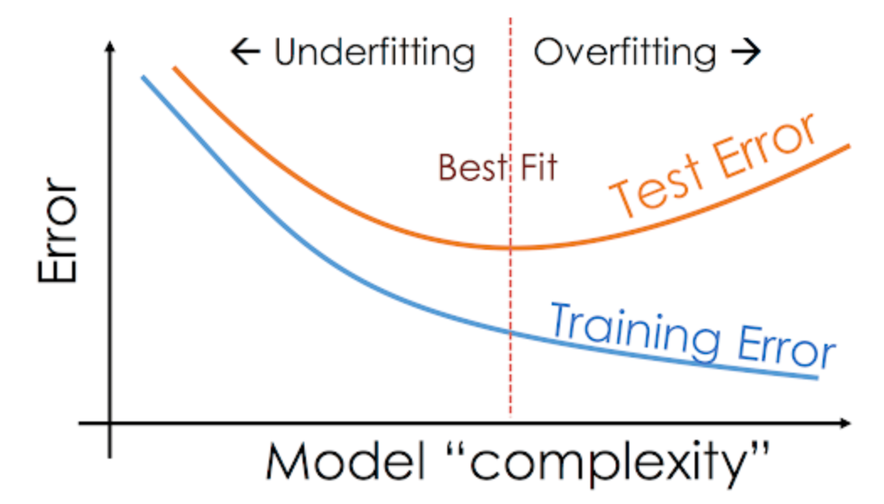
Overfitting
To detect overfitting, analyze error/loss for models tested on training data and test/validation data.
What happens to training data error as the number of training steps increases?
Error shrinks!
Model Selection and Hyperparameter Tuning
Session 7

Slide 8
Overfitting
To detect overfitting, analyze error/loss for models tested on training data and test/validation data.
What happens to test/validation error as the number of training steps increases?
Error shrinks and then grows!
Model Selection and Hyperparameter Tuning
Session 7

Slide 9
Overfitting
To detect overfitting, analyze error/loss for models tested on training data and test/validation data.
Why does training error shrink and test/validation error grow?
Modeling noise in the training data (i.e., overfitting) reduces training error and the expense of losing knowledge that generalizes to unobserved test data.
Model Selection and Hyperparameter Tuning
Session 7

Slide 10
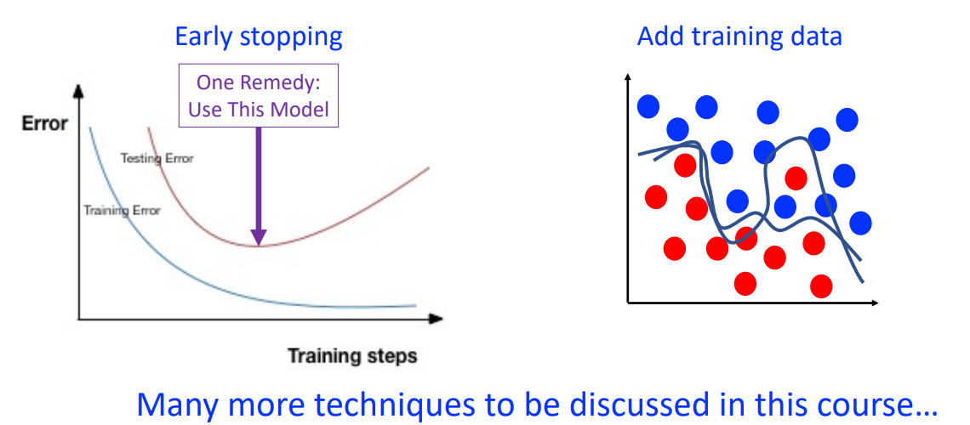
How to Avoid Overfitting?
Model Selection and Hyperparameter Tuning
Session 7

Slide 11
Underfitting
Underfits: too simple to explain the data!
Model Selection and Hyperparameter Tuning
Session 7

Slide 12
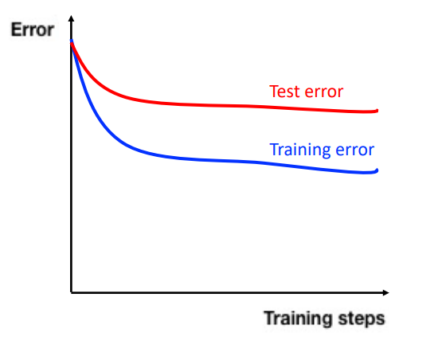
Underfitting
To detect overfitting, analyze error/loss for models tested on training data (and optionally test/validation data):
What happens to training data error as number of training steps increases?
Error remains high!
Model Selection and Hyperparameter Tuning
Session 7

Slide 13
Underfitting
To detect overfitting, analyze error/loss for models tested on training data (and optionally test/validation data):
What happens to test/validation data error as number of training steps increases?
Error remains high!
Model Selection and Hyperparameter Tuning
Session 7

Slide 14
How to Avoid Underfitting?
Increase representational complexity, for example increase the number of layers and/or units in a neural network.
Model Selection and Hyperparameter Tuning
Session 7

Slide 15
Underfitting vs Overfitting
Goal: learn a model with a capacity that is neither too small nor too large so it can generalize well when predicting on previously unseen test data.
Model Selection and Hyperparameter Tuning
Session 7

Slide 16
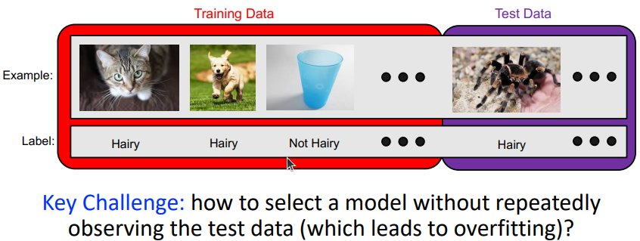
Selecting Model Hyperparameters
Our goal is to design models that generalize well to new, previously unseen examples (Test Data).
Model Selection and Hyperparameter Tuning
Session 7

Slide 17
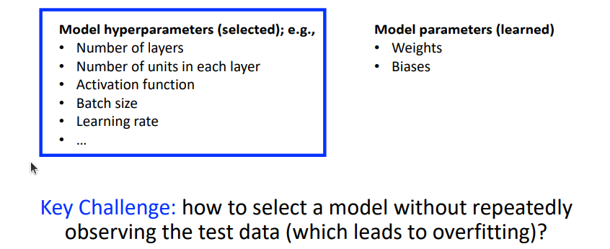
Model Design
Model Selection and Hyperparameter Tuning
Session 7

Slide 18
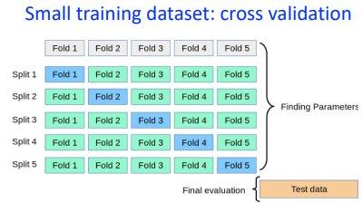
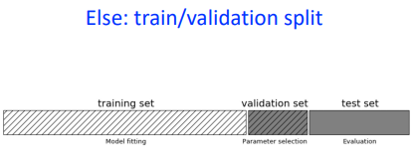
Hyperparameter Tuning
Split the training set so it can ve used to test different hyperparameters
For statistically strong results:
Model Selection and Hyperparameter Tuning
Session 7

Slide 19
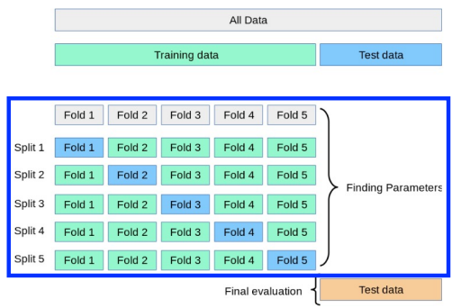
Cross-Validation
Limit influence of dataset split
Model Selection and Hyperparameter Tuning
Session 7

Slide 20

Validation Split
Split data into "train" and "validation" datasets
Hyperparameter selection: test models trained with different hyperparameter values on the validation set to find the best one
Final model: retrain using the model hyperparameters selected from validation set testing using the data in the training AND validation splits.
Model Selection and Hyperparameter Tuning
Session 7

Slide 21
Hyperparameters Summary
So far we found the following hyperparameters:
Model:
Network depth and width (number of layers, neurons per layer);
Type of activation functions (e.g., ReLU, Tanh).
Training process:
Optimizer settings (learning rate, momentum, etc.);
Number of epochs and batch size;
Validation strategy (cross-validation or holdout).
Dataset Considerations:
Data size (do we need more samples?);
Handling class imbalance.
Model Selection and Hyperparameter Tuning
Session 7

Slide 22
Manual Hyperparameter Tuning
Manual approach goal: achieve good performance on the test set
Some examples of effect of hyperparamaters on model capacity:
Number of layers/nodes: increases capacity when increased.
Learning rate: increases capacity when tuned optimally.
Weight decay: increases capacity when decreased.
Dropout rate: increases capacity when decreased.
Model Selection and Hyperparameter Tuning
Session 7

Slide 23
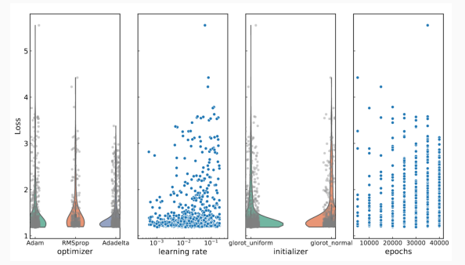
Automatic Hyperparameter Optimization Algorithms
Hyperparameter tuning is an optimization problem thus we can automate the process.
Common algorithms:
Grid Search;
Random Search;
Bayesian Optimization;
Gradient-Based Optimization;
Evolutionary Optimization.
Model Selection and Hyperparameter Tuning
Session 7

Slide 24
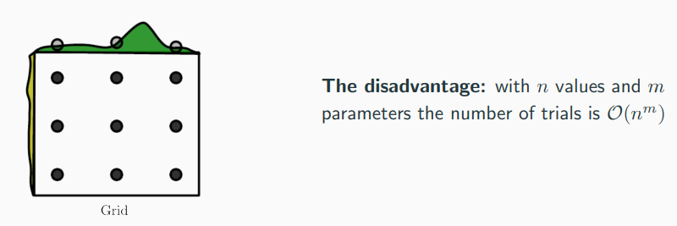
Grid Search
Grid search: searching through a manually subset range of the hyperparameter space.
Train model for every grid point of the hyperparameter space.
Monitor the best validation set error → best hyperparameter values.
Model Selection and Hyperparameter Tuning
Session 7

Slide 25
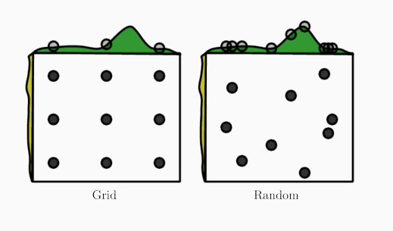
Random Search
Random search: sample trial points from a marginal distribution for each hyperparameter.
Do not discretize or bin the values of the hyperparameters.
The marginal distribution will perform independent explorations of hyperparameters.
Model Selection and Hyperparameter Tuning
Session 7

Slide 26
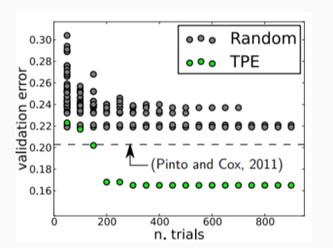
Model-Based Hyperparameter Optimization
Idea:
Perform a training using a set of hyperparameters
Define the cost function to be optimize as the validation set error
Use sequential model-based optimization (SMBO) approach, or algorithms which monitors the numerical gradient from the loss function.
Example:
Bayesian Optimization
Tree-structured Parzen Estimator (TPE)
Model Selection and Hyperparameter Tuning
Session 7

Slide 27
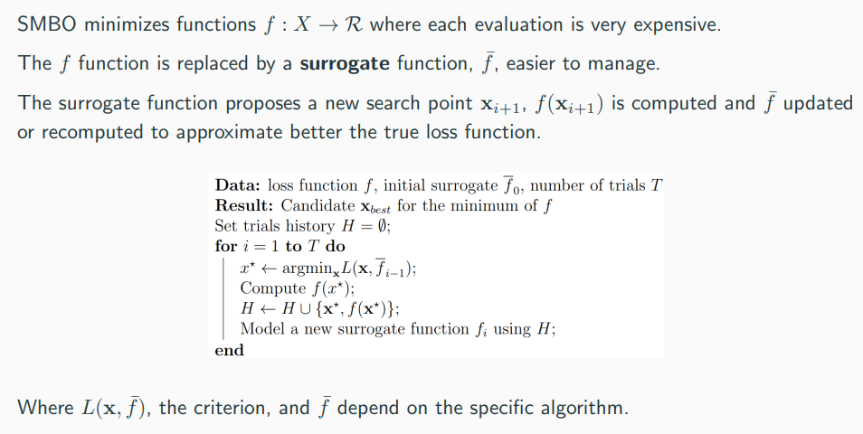
SMBO
Model Selection and Hyperparameter Tuning
Session 7

Slide 28
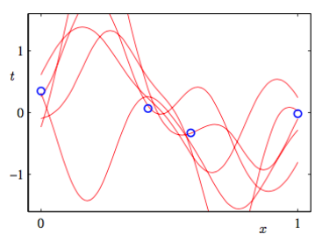
Bayesian Optimization
The function we’re trying to optimize (e.g. loss as a function of hyperparameters) is really complicated.
Bayesian Optimization tries to approximate it with a simpler function, called the surrogate function.
After we’ve tried a certian number of hyperparameter combinations, we can condition on these hyperparameters to infer the posterior over the surrogate function using for instance Bayesian linear regression.
Model Selection and Hyperparameter Tuning
Session 7

Slide 29
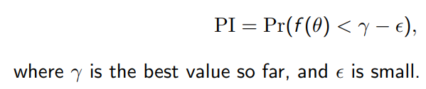
Bayesian Optimization
To choose the next point to query, we must define an acquisition function, which tells us how promising a candidate it is.
Candidate 1: probability of improvement (PI)
The problem with Probability of Improvement (PI): it queries points it is highly confident will have a small imporvement
Usually these are right next to ones we’ve already evaluated
PI: Probability of Improvement.
Pr: Probability.
f(θ): The objective function value at a specific point θ in the parameter space. This function represents the performance measure being optimized (e.g., accuracy, loss).
γ: The best value obtained so far (the optimal value) during the optimization process.
ε: A small positive value that represents a margin of improvement. It is used to define how much better a new sample must be compared to the current best value γ to be considered an improvement.
Model Selection and Hyperparameter Tuning
Session 7

Slide 30

Bayesian Optimization
A better choice: Expected Improvement (EI)
The idea: if the new value is much better, we win by a lot; if it’s much worse, we haven’t lost anything
The Expected Improvement (EI) metric balances exploitation (sampling where the model predicts good performance) and exploration (sampling where uncertainty is high).
EI: Expected Improvement.
E: Expectation (or average) over the distribution of possible function values at θ.
max(γ - f(θ), 0): The improvement at a particular point θ, which is the difference between the best value γ and the predicted value f(θ). If the predicted value is worse than γ, the improvement is set to 0 (i.e., no improvement).
Model Selection and Hyperparameter Tuning
Session 7

Slide 31
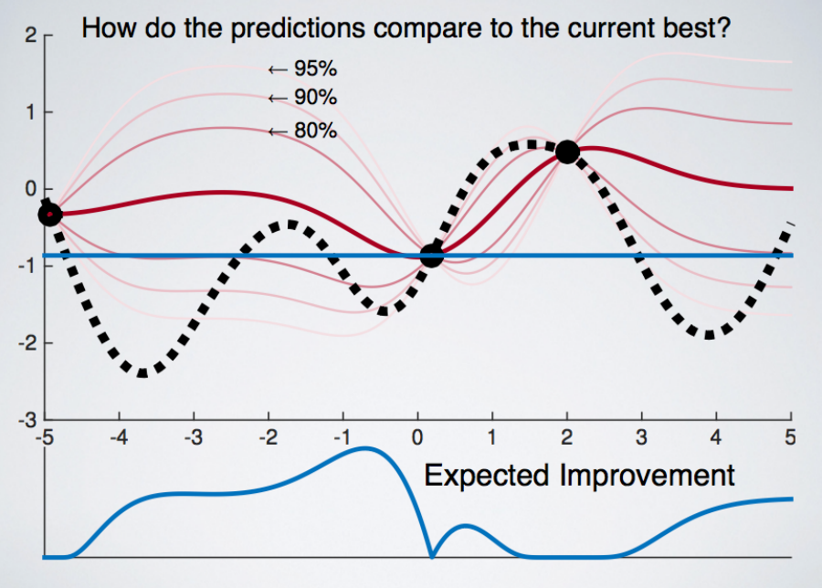
Bayesian Optimization
Model Selection and Hyperparameter Tuning
Session 7

Slide 32



TPE
Also a SMBO that uses surrogates.
Key idea:
x = value of single hyperparameter
y = loss
Two surrogate models are mantained:
A distribution for bad values:
A distribution for good values:
y* : threshold that determines good/bad splits
Model Selection and Hyperparameter Tuning
Session 7

Slide 33


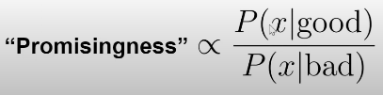

TPE
How to get new promising candidates?
Idea: a promising candidate is likely to
Have low probability under the bad distribution
Have high probability under the good distribution
Model Selection and Hyperparameter Tuning
Session 7

Slide 34
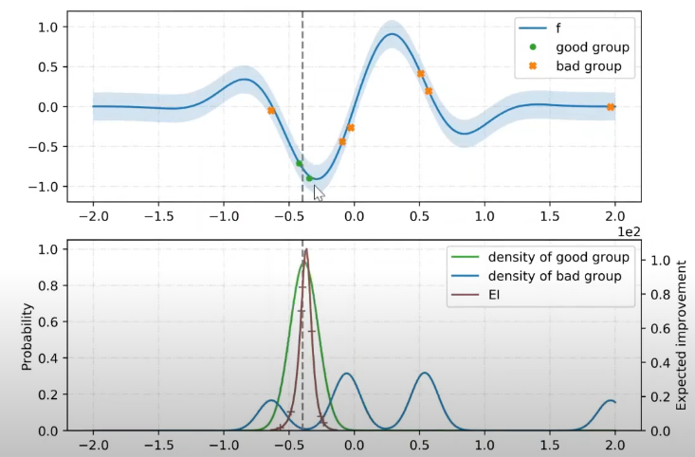
TPE
Model Selection and Hyperparameter Tuning
Session 7

Slide 35
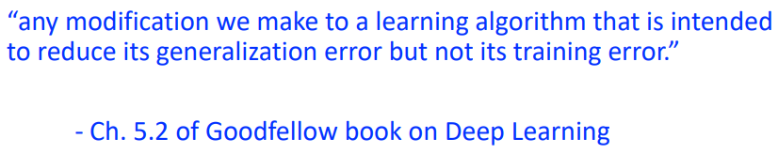
Next Session: Regularization
What is it?
Technique that constrains our optimization problem to discourage complex models.
Why do we need it?
Improve generalization of our model on unseen data.
Model Selection and Hyperparameter Tuning
Session 7

