Slide 1

Deep Learning
Session 4
Introduction to PyTorch
Applied Data Science
2024/2025

Slide 2
What is PyTorch?
Open-source deep learning framework developed by Facebook's AI Research lab.
Allows for flexible model building and debugging.
Pythonic nature with intuitive APIs.
Extensive resources, tutorials, and an active user community.
Optimized for both CPU and GPU computation.
Introduction to PyTorch
Session 4

Slide 3

Other Libraries
Introduction to PyTorch
Session 4

Slide 4
Getting Started with PyTorch
Installation:
https://pytorch.org/get-started/locally/
PyTorch installation depends on:
OS: Linux, Mac, Windows
Package manager: Conda, Pip, LibTorch, from Source
Language: Python, C++/Java
Cimpute Platform: CPU, CUDA
Introduction to PyTorch
Session 4

Slide 5
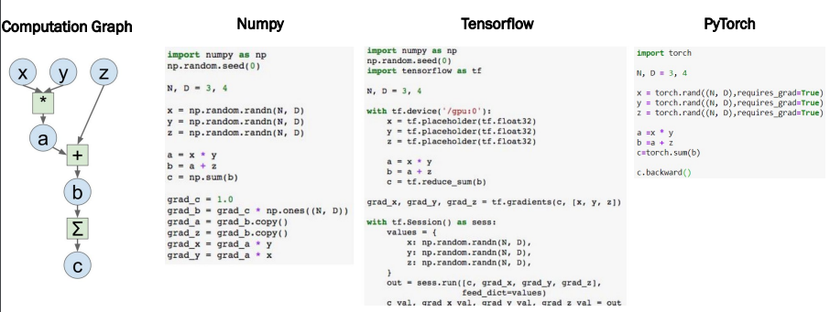
Pytorch Preview
Introduction to PyTorch
Session 4

Slide 6
Tensors
A tensor is a multi-dimensional array that generalizes scalars, vectors, and matrices (similar to numpy arrays).
Easy integration with GPU for accelerated computation, unlike standard NumPy arrays.
Tensor operations are also similar to numpy (rand, ones, zeros, indexing, slicing, reshape, transpose, cross product, matrix product, element wise multiplication, etc).
Introduction to PyTorch
Session 4

Slide 7
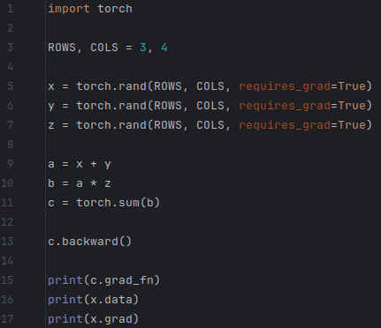
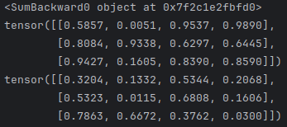
Tensors
Attributes of a tensor:
t = torch.randn(1)
requires_grad – making a trainable parameter
By default False
To turn on:
t.requires_grad_() or
t = torch.randn(1, requires_grad=True)
Accessing tensor values:
t.data
Accessing tensor gradient:
t.grad
grad_fn – hystory of operations for autograd
t.grad_fn
Introduction to PyTorch
Session 4

Slide 8
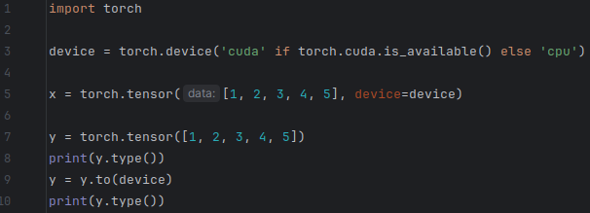

Loading Data, Devices and CUDA
Numpy arrays to PyTorch tensors:
torch.from_numpy(x) - returns a cpu tensor!
PyTorch tensor to numpy:
t.numpy()
Using GPU acceleration:
t.to()
Sends to the chosen device (cuda or cpu)
Fallback to cpu if gpu is unavailable:
torch.cuda.is_available()
Introduction to PyTorch
Session 4

Slide 9
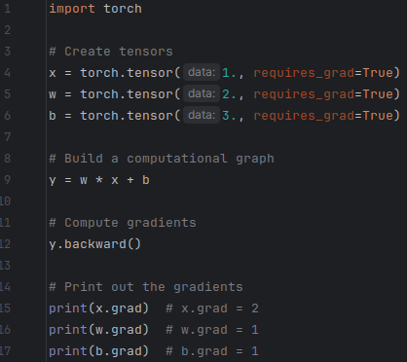

Autograd
Automatic Differentiation Package
We do not need to worry about partial
differentiation, chain rule, etc.
backward() does the trick!
loss.backward()
Gradients are accumulated for each step by default:
Need to zero out gradients after each update:
t.zero_grad()
Introduction to PyTorch
Session 4

Slide 10
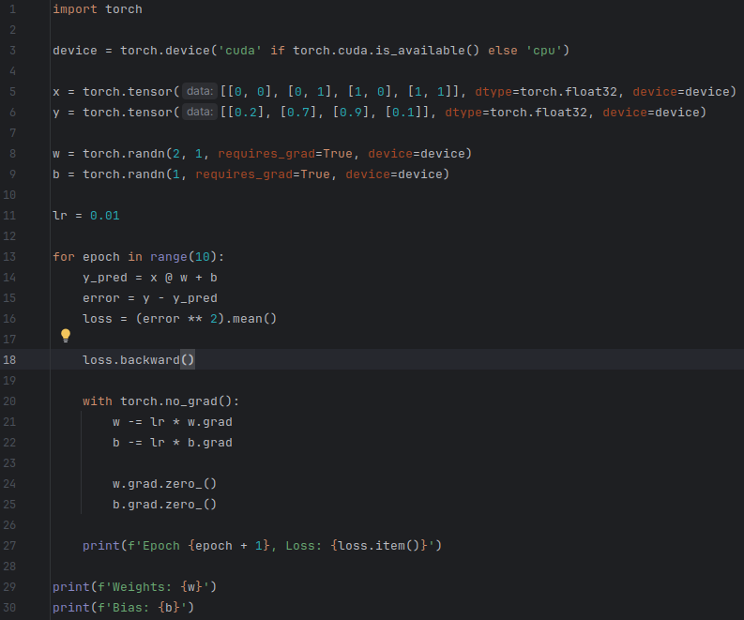
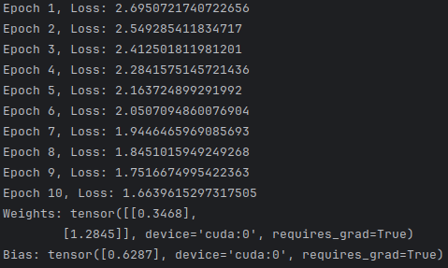
Autograd
Manual Weight Update Example
Introduction to PyTorch
Session 4

Slide 11
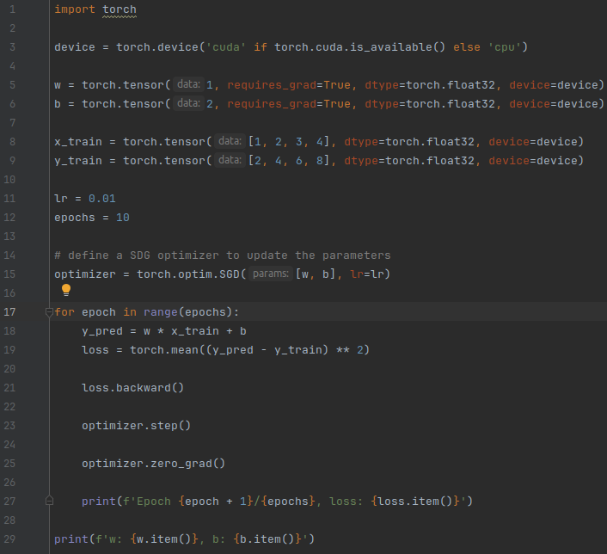
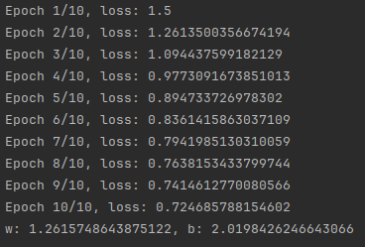
Optimizers
Optimizers (optim subpackage):
Adam, Adagrad, Adadelta, SGD, etc
Manually updating is ok if small number of weights
Imagine updating 100k parameters!
An optimizer takes the parameters we want to update, the learning rate we want to use (and possibly many other hyper-parameters as well!) and performs the updates.
Introduction to PyTorch
Session 4

Slide 12
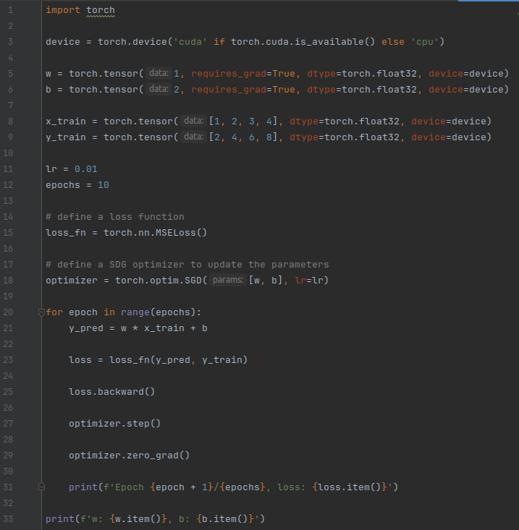
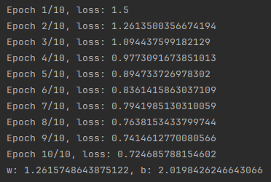
Loss
Various predefined loss functions:
L1 (MAE), MSE, CrossEntropy, BCE, etc
Introduction to PyTorch
Session 4

Slide 13
Model
In PyTorch, a model is represented by a regular Python class that inherits ftom the Module class.
Two components:
__init__(self): it defines the parts that make up the model - in our case, two parameters, w and b (but can be anything!)
forward(self, x): it performs the actual computation, that is, it outputs a prediction, given the input x
Introduction to PyTorch
Session 4

Slide 14
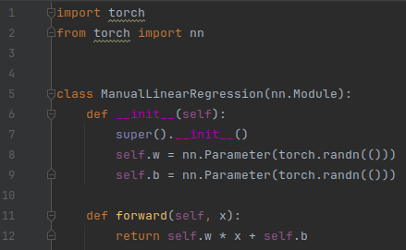
Model
Example:
Properties:
model = ManualLinearRegression()
model.state_dic() - returns a dictionary of trainable parameters with their current values
model.parameters() - returns a list of all trainable parameters in the model
model.train() or model.eval()
Introduction to PyTorch
Session 4

Slide 15
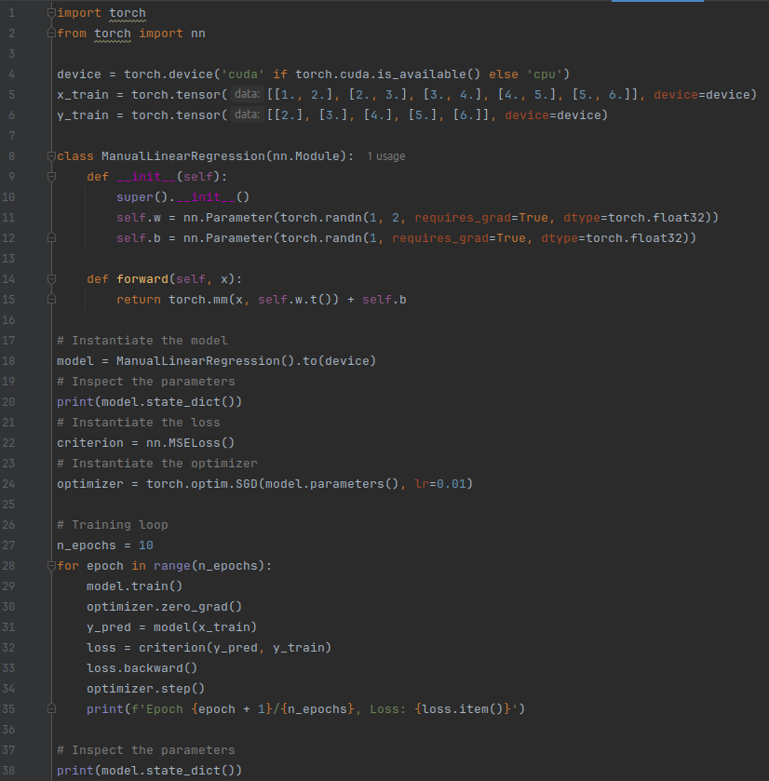
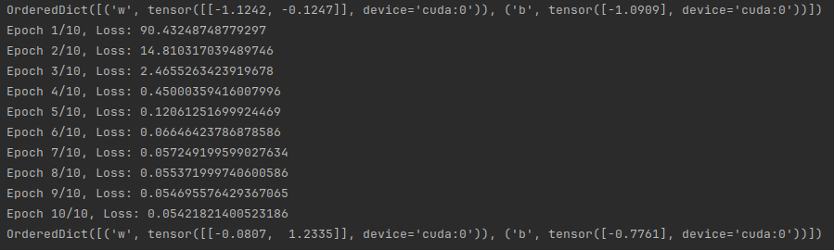
Putting Thinghs Together
Introduction to PyTorch
Session 4

Slide 16
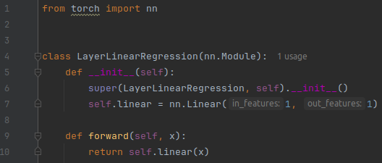
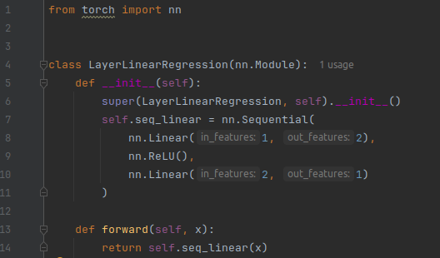
Complex Models
Predefined "layer" modules
"Sequential" layer modules
Introduction to PyTorch
Session 4

Slide 17
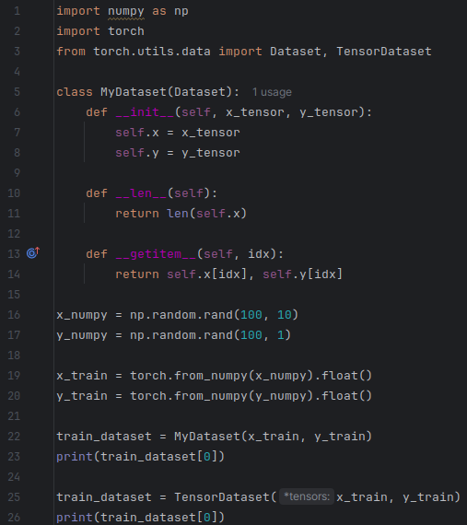

Dataset
In PyTorch, a dataset is represented by a regular Python class that inherits from the Dataset class.
3 components:
__init__(self)
__get_item__(self, index)
__len__(self)
Unless the dataset is huge and cannot fit in memory, you don’t explictly need to define this class. Use TensorDataset!
Introduction to PyTorch
Session 4

Slide 18
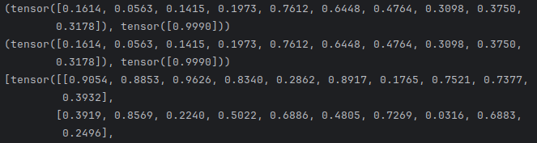

DataLoader
But if we have a huge dataset? We need to train in 'batches'!
Use PyTorch's Dataloader class!
We tell it which dataset to use, the desired mini-batch size and if we’d like to shuffle it or not. That’s it!
Our loader will behave like an iterator, so we can loop over it and fetch a different mini-batch every time.
Introduction to PyTorch
Session 4

Slide 19
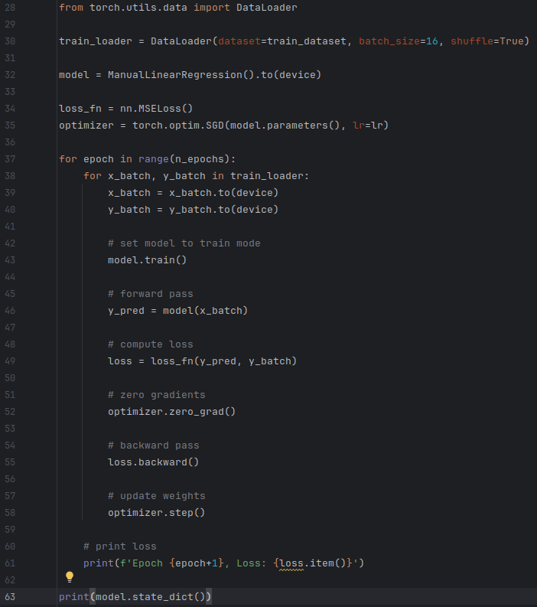
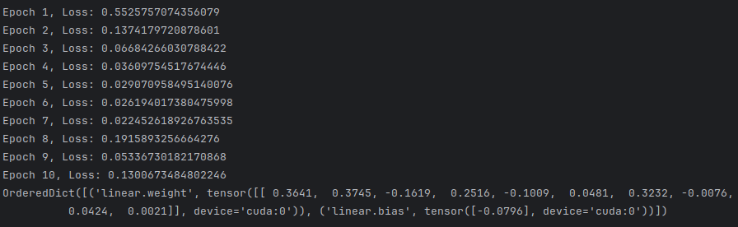
DataLoader in Practice
Introduction to PyTorch
Session 4

Slide 20
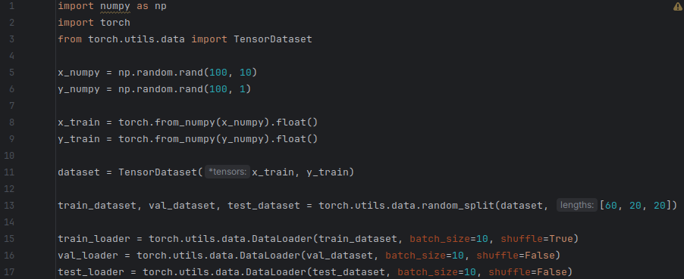
Split Data
Random train, validationa and test split
random_split()
Introduction to PyTorch
Session 4

Slide 21


Saving/Loading Weights
Method 1:
Only inference/evaluation - we only need state_dict
Save:
Load:
A common PyTorch convention is to save models using either a .pt or .pth file extension.
Introduction to PyTorch
Session 4

Slide 22
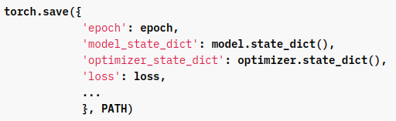
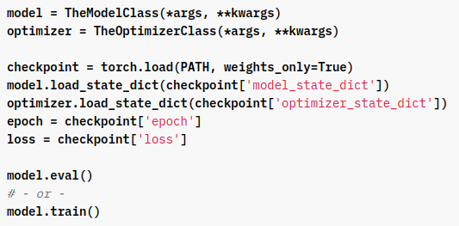
Saving/Loading Weights
Method 2:
Checkpoints – to resume training / inference
Save:
Load:
Introduction to PyTorch
Session 4

Slide 23
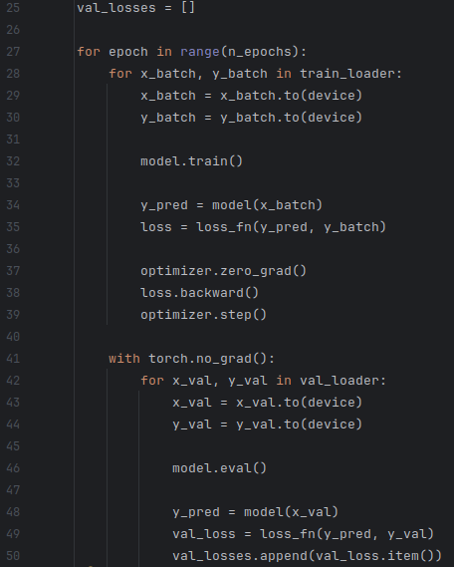
Evaluation
Two important things:
torch.no_grad()
Don't store the history of all computations.
model.eval()
Tell the compliler which mode to run on.
Introduction to PyTorch
Session 4

Slide 24
Visualization
TensorboardX (visualize training)
Introduction to PyTorch
Session 4

Slide 25
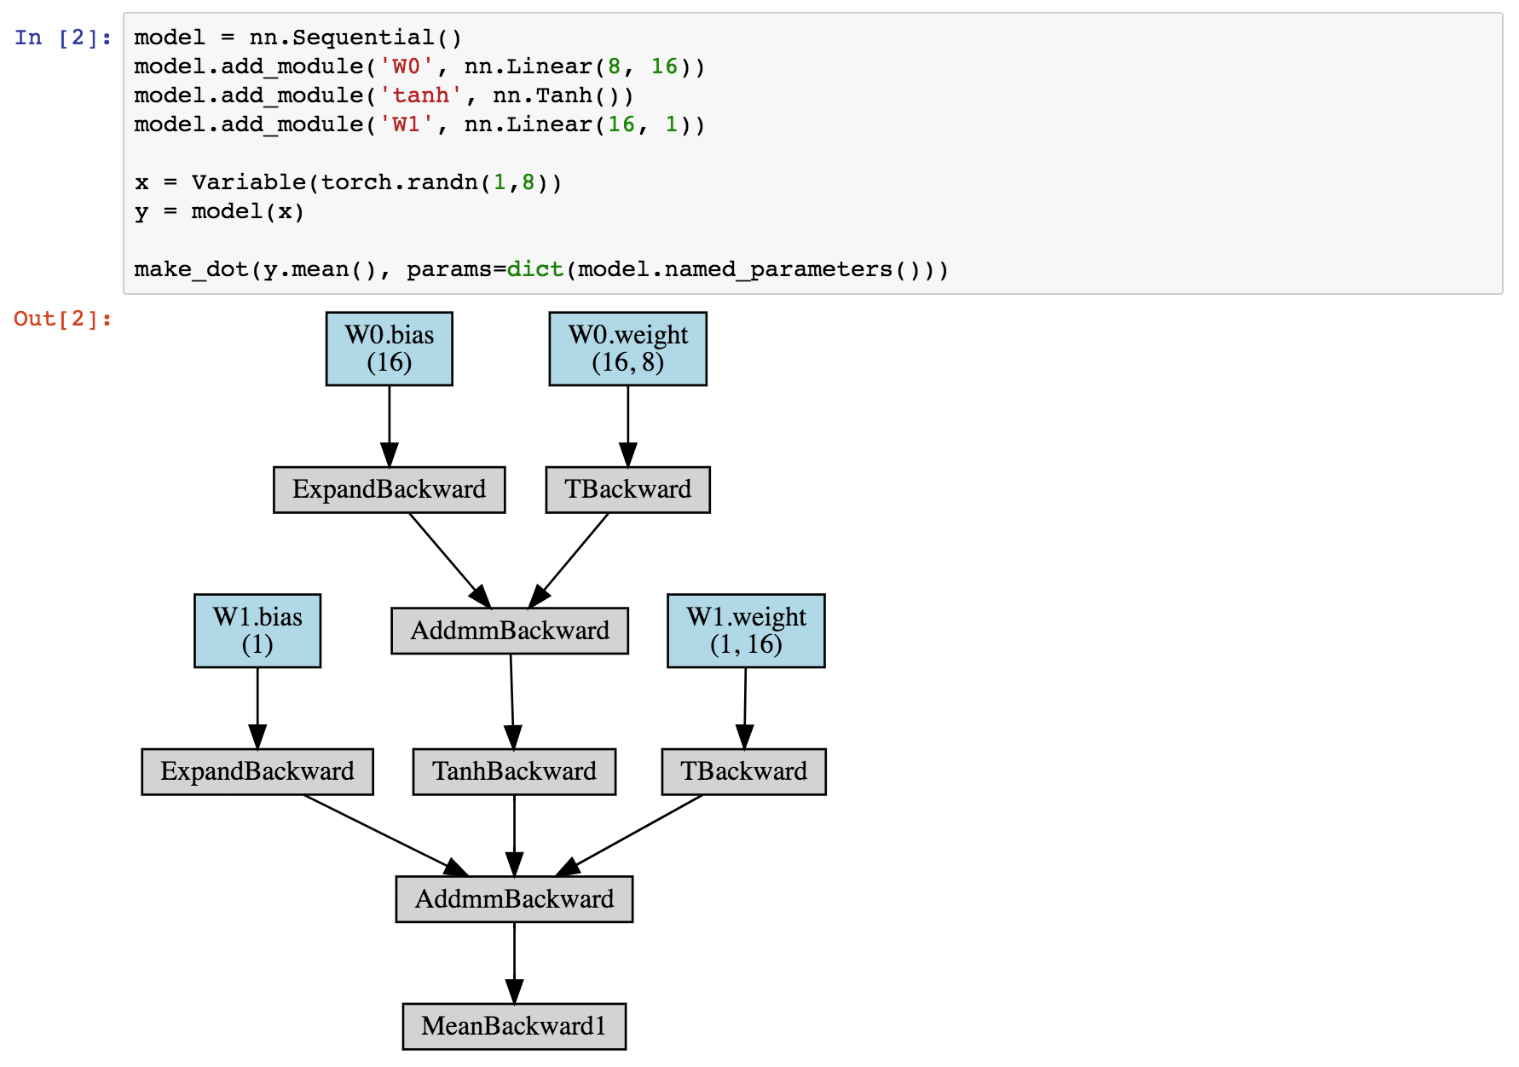
Visualization
PyTorchViz (visualize computation graph)
Introduction to PyTorch
Session 4

Slide 26
Resources
PyTorch Documentation
https://pytorch.org/
https://github.com/pytorch/pytorch
Tutorials:
https://github.com/hunkim/PyTorchZeroToAll
https://pytorch.org/tutorials/beginner/deep_learning_60min_blitz.html
https://www.learnpytorch.io/
Introduction to PyTorch
Session 4

Slide 27
Exercise
End-to-End PyTorch exercise
1. Load the data
2. Define the model
3. Define the loss function
4. Define the optimizer
5. Train the model
6. Make predictions
Introduction to PyTorch
Session 4

