Slide 1

Deep Learning
Session 2
Deep Learning Fundamentals with Python
Applied Data Science
2024/2025

Slide 2
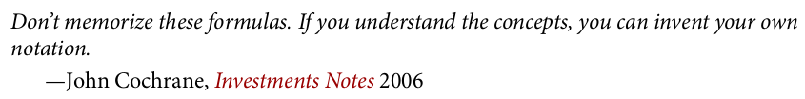
Deep Learning Fundamentals with Python
Deep Learning Fundamentals with Python
Session 2

Slide 3
GitHub SetUp
Lectures will be provided both on GitHub and Moodle.
https://github.com/LCDA-UCP/tac-hands-on
You will need to fork the repository and then clone it to your local machine.
Setup a python/conda environment and install the requirements.
$ pip install –r requirements.txt
Deep Learning Fundamentals with Python
Session 2

Slide 4
Deep Learning Fundamentals with Python
NumPy
NumPy is a fast Python library for numeric computation, primarily using multidimensional arrays (especially two- or three-dimensional) to handle data in neural networks.
The ndarray class enables intuitive and efficient operations on these arrays.
Deep Learning Fundamentals with Python
Session 2

Slide 5

Deep Learning Fundamentals with Python
NumPy
First, we need to import the NumPy package and set seeds for reproducibility so that we get the exact same results every time.
Deep Learning Fundamentals with Python
Session 2

Slide 6
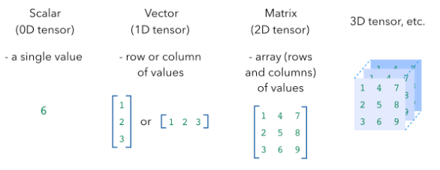
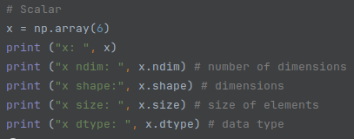
Deep Learning Fundamentals with Python
NumPy: Basics
Deep Learning Fundamentals with Python
Session 2

Slide 7
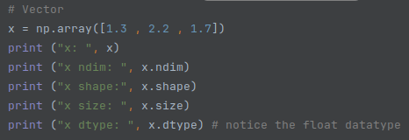
Deep Learning Fundamentals with Python
NumPy: Basics
Deep Learning Fundamentals with Python
Session 2

Slide 8
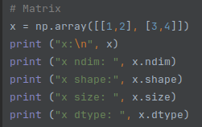
Deep Learning Fundamentals with Python
NumPy: Basics
Deep Learning Fundamentals with Python
Session 2

Slide 9
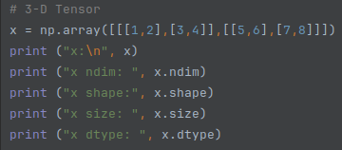
Deep Learning Fundamentals with Python
NumPy: Basics
Deep Learning Fundamentals with Python
Session 2

Slide 10
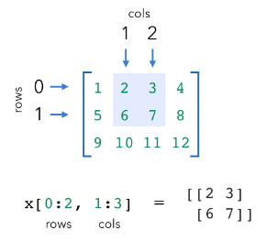
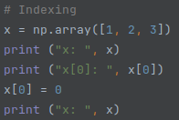
Deep Learning Fundamentals with Python
NumPy: Indexing
We can extract specific values from arrays using indexing.
Deep Learning Fundamentals with Python
Session 2

Slide 11
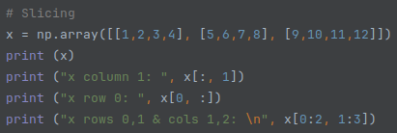
Deep Learning Fundamentals with Python
NumPy: Indexing
We can extract specific values from arrays using indexing.
Deep Learning Fundamentals with Python
Session 2

Slide 12
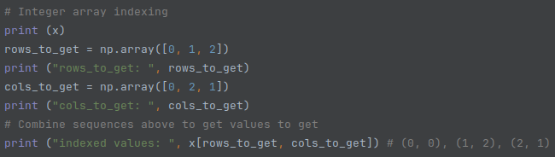
Deep Learning Fundamentals with Python
NumPy: Indexing
We can extract specific values from arrays using indexing.
Deep Learning Fundamentals with Python
Session 2

Slide 13
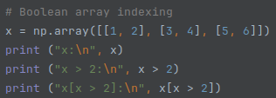
Deep Learning Fundamentals with Python
NumPy: Indexing
We can extract specific values from arrays using indexing.
Deep Learning Fundamentals with Python
Session 2

Slide 14
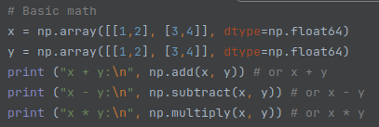
Deep Learning Fundamentals with Python
NumPy: Arithmetic
Deep Learning Fundamentals with Python
Session 2

Slide 15
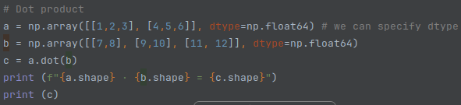
Deep Learning Fundamentals with Python
NumPy: Dot Product
Deep Learning Fundamentals with Python
Session 2

Slide 16
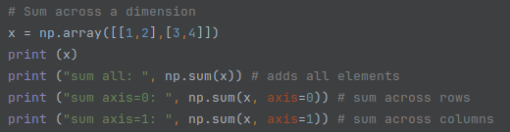
Deep Learning Fundamentals with Python
NumPy: Axis Operations
Deep Learning Fundamentals with Python
Session 2

Slide 17
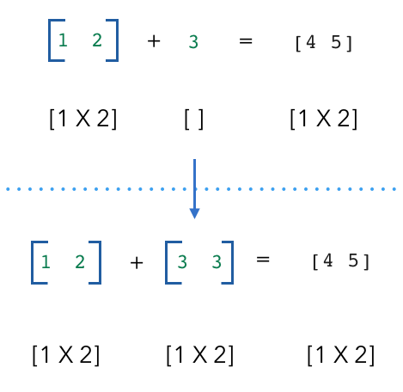
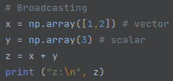
Deep Learning Fundamentals with Python
NumPy: Brodcast
Deep Learning Fundamentals with Python
Session 2

Slide 18
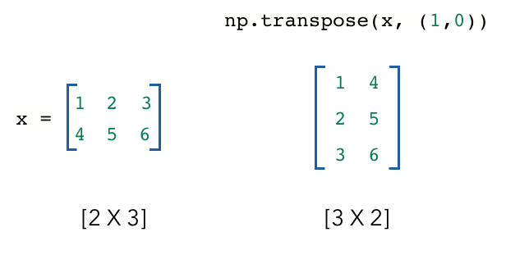
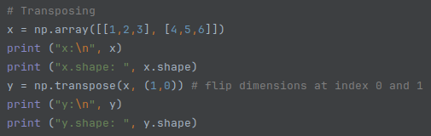
Deep Learning Fundamentals with Python
NumPy: Transpose
Deep Learning Fundamentals with Python
Session 2

Slide 19
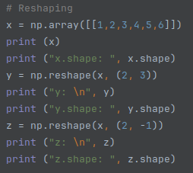
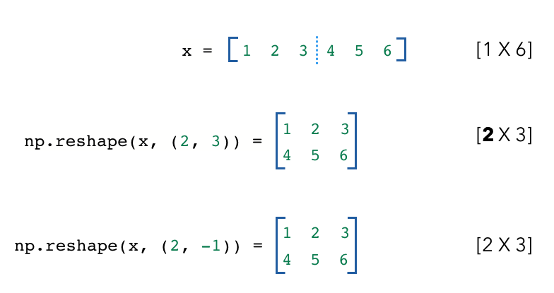
Deep Learning Fundamentals with Python
NumPy: Reshape
Deep Learning Fundamentals with Python
Session 2

Slide 20



Deep Learning Fundamentals with Python
NumPy: Joining
We can join arrays via concatentation or stacking.
Deep Learning Fundamentals with Python
Session 2

Slide 21
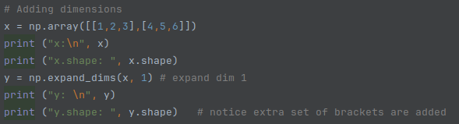
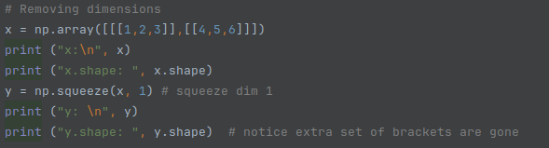
Deep Learning Fundamentals with Python
NumPy: Expanding/Reducing
We can also easily add and remove dimensions to our arrays.
Deep Learning Fundamentals with Python
Session 2

Slide 22
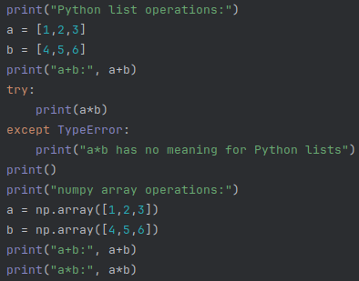
Deep Learning Fundamentals with Python
NumPy Arrays vs Lists
Deep Learning Fundamentals with Python
Session 2

Slide 23
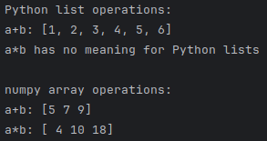
Deep Learning Fundamentals with Python
NumPy
Deep Learning Fundamentals with Python
Session 2

Slide 24
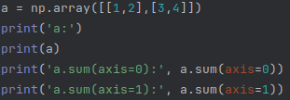

Deep Learning Fundamentals with Python
NumPy
Deep Learning Fundamentals with Python
Session 2

Slide 25
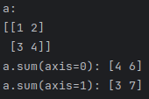

Deep Learning Fundamentals with Python
NumPy
Deep Learning Fundamentals with Python
Session 2

Slide 26

Deep Learning Fundamentals with Python
Type-hints and docstings in Python
If you are given this function what assumptions can you make?
Deep Learning Fundamentals with Python
Session 2

Slide 27
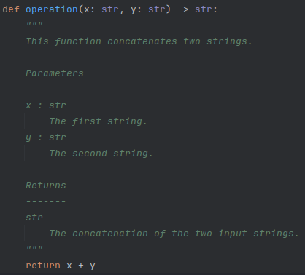
Deep Learning Fundamentals with Python
Type-hints and docstings in Python
If you are given this function what assumptions can you make?
What about this one?
Deep Learning Fundamentals with Python
Session 2

Slide 28
Deep Learning Fundamentals with Python
Type-hints and docstings in Python
Type hints improve code clarity by indicating expected argument and return types.
Docstrings explain a function's purpose and usage, aiding readability and maintenance.
Deep Learning Fundamentals with Python
Session 2

Slide 29

Deep Learning Fundamentals with Python
Functions: A reusable block of code that performs a specific task.
Math:
These functions will take as input x and transform it to x², in the case of f₁, and max(x, 0), in the case of f₂.
Exercise 1: Implement the f₁ and f₂ functions with Python and NumPy (python_intro_for_dl.ipynb)
Deep Learning Fundamentals with Python
Session 2

Slide 30
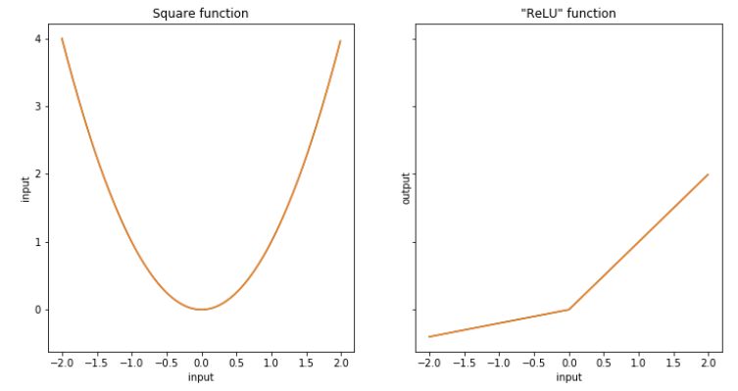
Deep Learning Fundamentals with Python
Functions: A reusable block of code that performs a specific task.
Diagrams: To depict a function, we can dra an x-y plane, plot points with x-coordinates as inputs and y-coordinates as outputs.
Exercise 2: Plot these functions
using Python and matplotlib.
Deep Learning Fundamentals with Python
Session 2

Slide 31


Deep Learning Fundamentals with Python
Derivatives: A measure of how a function's output changes as its input changes, represented as the slope of the tangent line at a specific point.
Math:
This limit can be approximated numerically by setting a very small value for Δ, such as 0.001, so we can compute the derivative as:
Deep Learning Fundamentals with Python
Session 2

Slide 32
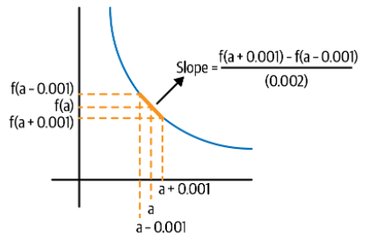
Deep Learning Fundamentals with Python
Derivatives: A measure of how a function's output changes as its input changes, represented as the slope of the tangent line at a specific point.
Diagrams: Like functions, derivatives can be depicted in a graphic.
Deep Learning Fundamentals with Python
Session 2

Slide 33
Deep Learning Fundamentals with Python
Derivatives:
Exercise: Implement a function that returns the derivative of the input function at the input value.
Exercise: Test it with the f1 function at the point x=1.0.
What do you expect the derivative on point x=0.0 to be?
Deep Learning Fundamentals with Python
Session 2

