Slide 1

Deep Learning
Session 9
Regularization
Applied Data Science
2024/2025

Slide 2
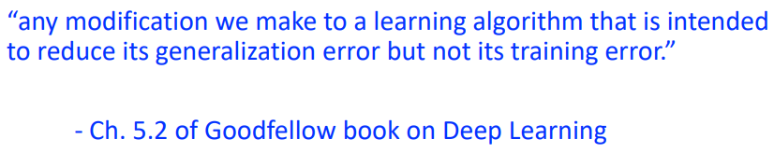
Regularization
What is it?
A technique that constrains our optimization problem to discourage complex models by limiting the model's capacity, preventing it from fitting the noise in the training data.
Why do we need it?
To improve the generalization of our model on unseen data by balancing model capacity, ensuring it captures the underlying patterns without overfitting.
Regularization
Session 9

Slide 3
Preventing Overfitting
Get more data: Increasing the amount of data helps the model generalize better.
Use a model with the right capacity:
Too much capacity: The model becomes overly complex and learns noise (overfitting).
Too little capacity: The model fails to capture important patterns (underfitting).
Early stopping: Stop training when the model starts to overfit, based on validation performance.
Parameter Norm Penalty: Add a penalty to the loss function for large weights, discouraging complexity.
Regularization
Session 9

Slide 4
Preventing Overfitting
Dropout: Randomly drop neurons during training to prevent co-adaptation and reduce overfitting.
Batch Normalization: Normalize activations in each layer, stabilizing learning and acting as a regularizer.
Ensemble methods: Combine predictions from multiple models (like bagging or boosting) to reduce variance and improve generalization.
Regularization
Session 9

Slide 5
Get More Data
If possible, gathering more data is always the best solution!
However, data collection can be expensive or time-consuming.
More data may require more computational resources.
Data Augmentation:
Data augmentation involves applying various transformations to your existing dataset to artificially increase its size and diversity.
Leverage Pre-trained Models:
Transfer learning from models trained on larger datasets can help when gathering more data is difficult.
Regularization
Session 9

Slide 6
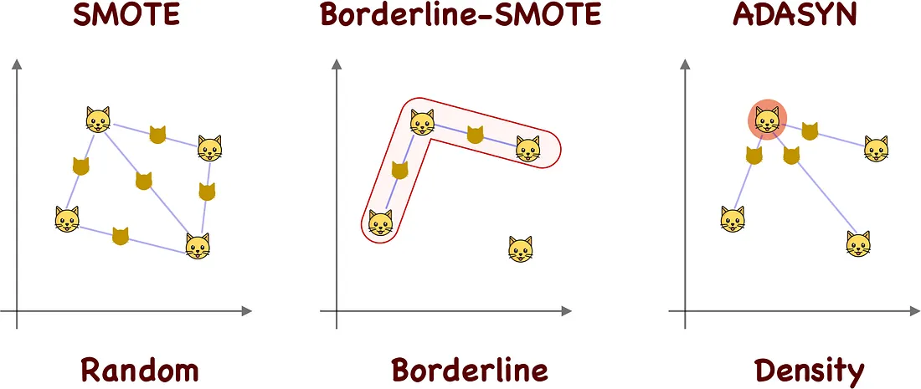
Data Augmentation
https://towardsdatascience.com/smote-synthetic-data-augmentation-for-tabular-data-1ce28090debc
Regularization
Session 9

Slide 7
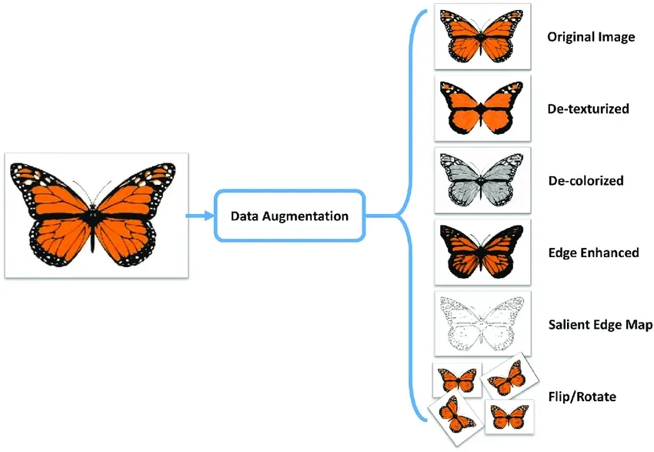
Data Augmentation
https://www.labellerr.com/blog/what-is-data-augmentation-techniques-examples-benefits/
Regularization
Session 9

Slide 8
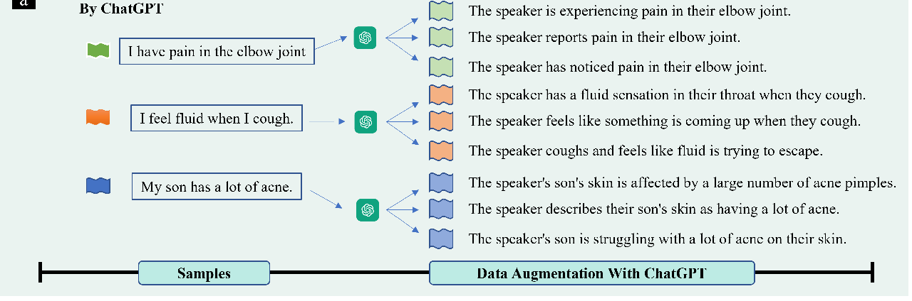
Data Augmentation
https://www.catalyzex.com/paper/auggpt-leveraging-chatgpt-for-text-data
Regularization
Session 9

Slide 9
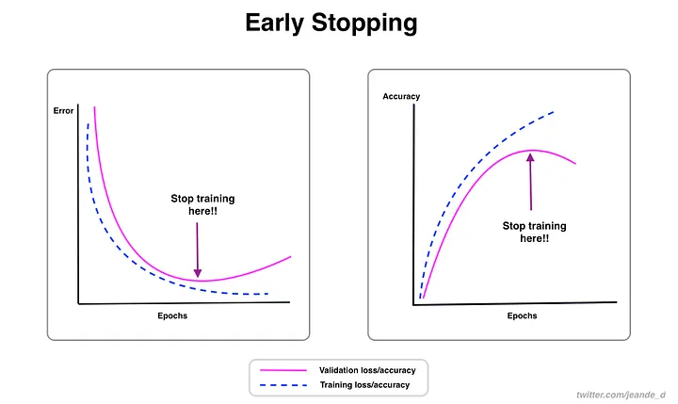
Early Stopping
Stop training before we have a chance to overfit
Regularization
Session 9

Slide 10
Parameter Norm Penalty
Key Insight: Large weights are often a sign of overfitting.
Solution: Apply a penalty to the size of the weights to reduce overfitting.
Analogy: It's like tightening a belt on oversized pants.
Regularization
Session 9

Slide 11


Parameter Norm Penalty
Idea: Penalize large weights in the objective function
e.g., objective is to minimize sum of squared errors over training examples
L2 norm (Ridge): penalize squated weight values
L1 norm (Lasso): penalize absolute weight values
Note: only weights are penalized, not bias terms
Regularization
Session 9

Slide 12


Parameter Norm Penalty
e.g., objective is to minimize sum of squared errors over training examples.
L2 norm (Ridge): penalize squated weight values
L1 norm (Lasso): penalize absolute weight values
Hyperparameter determines relative contribution of norm penalty term.
Regularization
Session 9

Slide 13
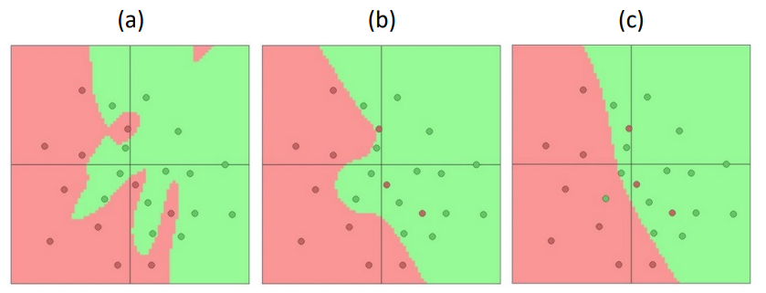
Parameter Norm Penalty: How to Set Alpha?
Shown is the same neural network with different levels of regularization. Which model has the largest value for alpha (i.e., largest norm penalty contribution)?
Regularization
Session 9

Slide 14
Dropout
Dropout is a stochastic regularization method.
In each forward pass, randomly set some neurons to zero for one pass.
Forces the network to not rely on any single node.
The probability of dropping a neuron is defined by an hyperparameter; 0.5 is commonly used.
Note: During inference dropout is not applied!
Regularization
Session 9

Slide 15
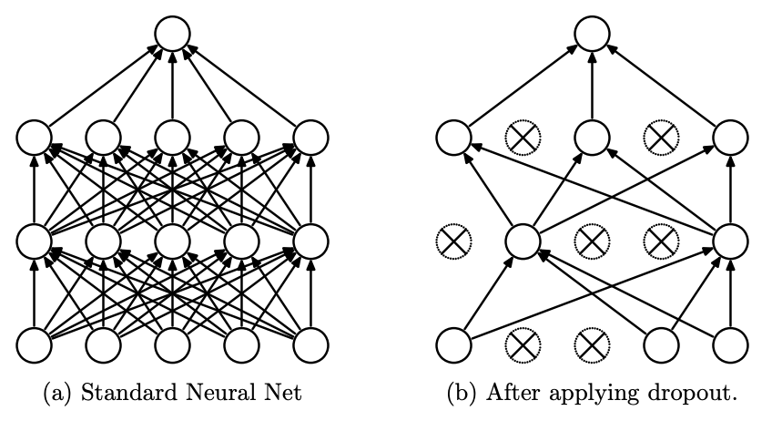
Dropout
Regularization
Session 9

Slide 16
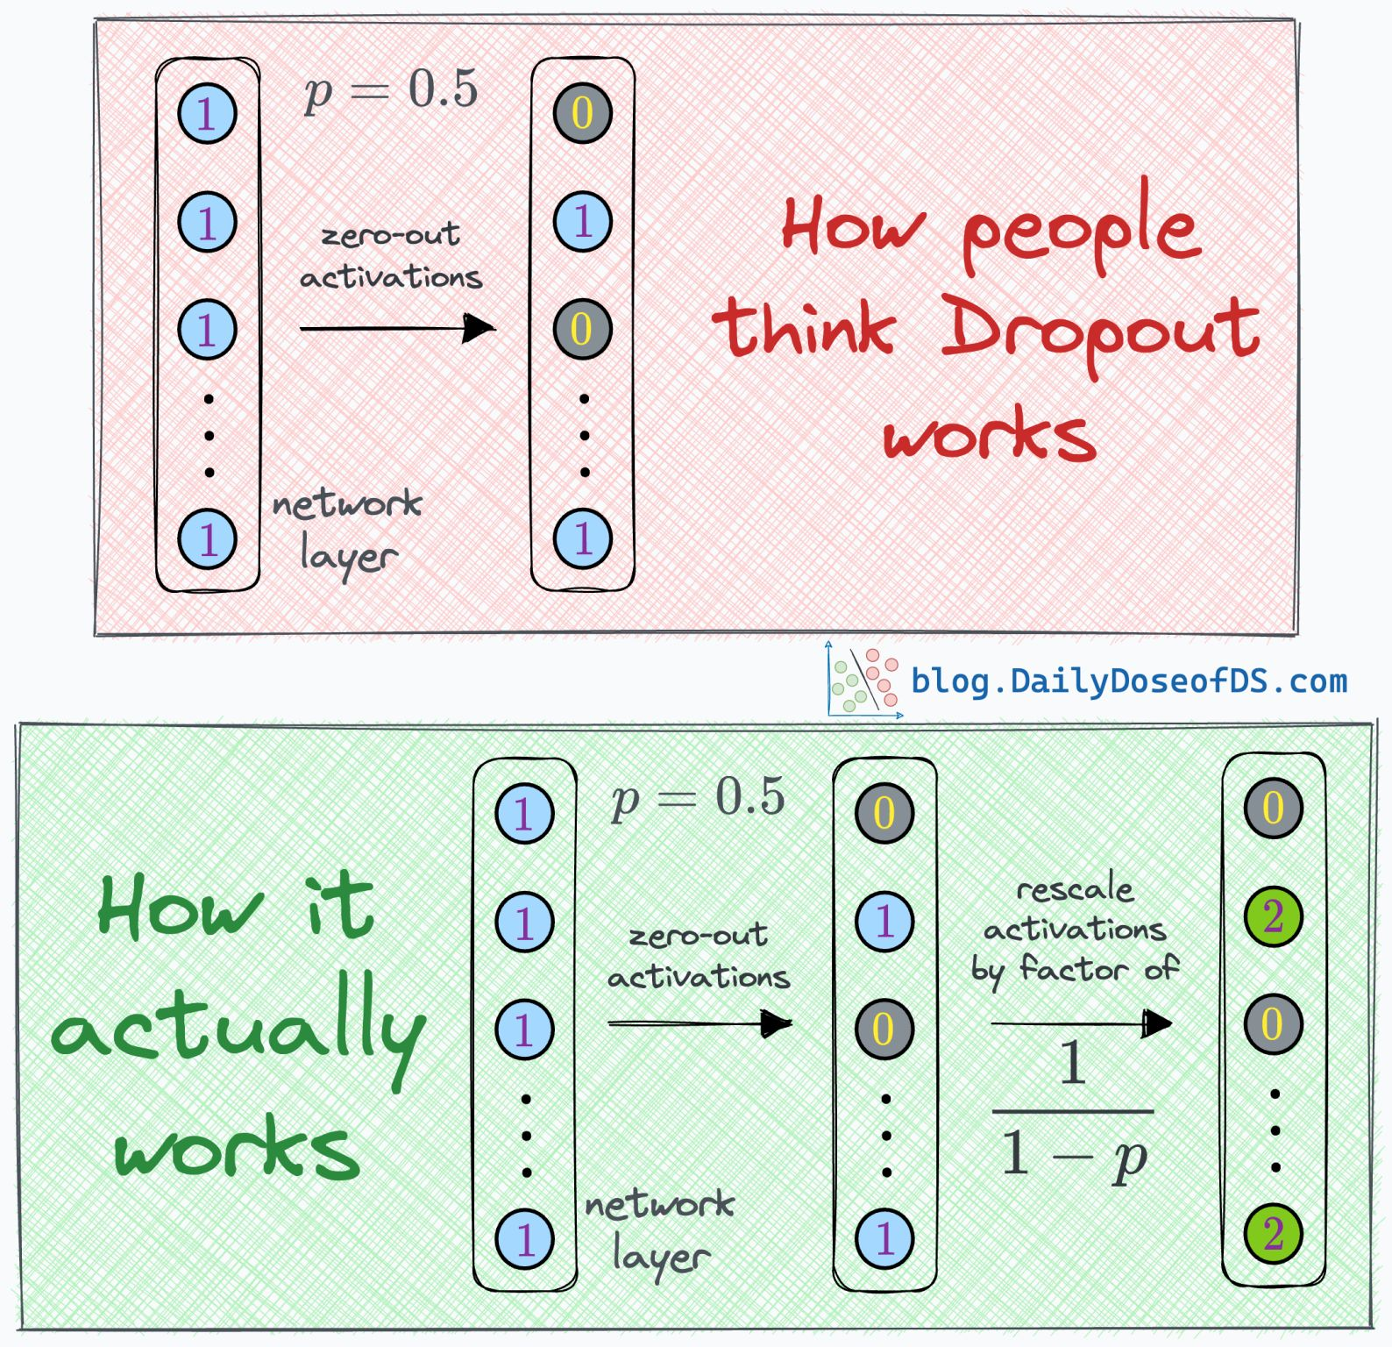
Dropout
Regularization
Session 9

Slide 17
Batch Normalization
Motivation: Features on different scales can cause learning to be slower and poor performance
We normalize all training data so that it resembles a normal distribution (that means, zero mean and a unitary variance)
In the intermediate layers the distribution of the activations is constantly changing during training
This slows down the training process because each layer must learn to adapt themselves to a new distribution in every training step.
Batch normalization is a method we can use to normalize the inputs of each layer, in order to fight the internal covariate shift problem.
Regularization
Session 9

Slide 18
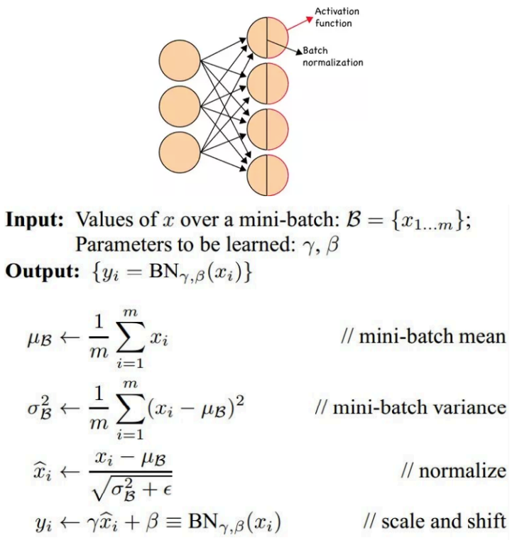
Batch Normalization
During training time, a batch normalization layer does the following:
Calculate the mean and variance of the layers input
Normalize the layer inputs using the previously calculated batch statistics
Scale and shift in order to obtain the output of the layer
γ and β are learned during training along with the original parameters of the network.
During inference, the mean and the variance are fixed. They are estimated using the previously calculated means and variances of each training batch.
Regularization
Session 9

Slide 19
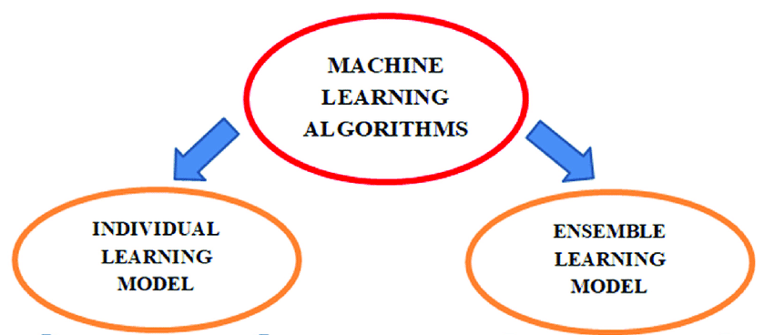
Ensemble Methods
Idea: Use the wisdom of the crowd
Why Choose Ensemble vs One Predictor?
Reduces probability for making a wrong prediction
Regularization
Session 9

Slide 20

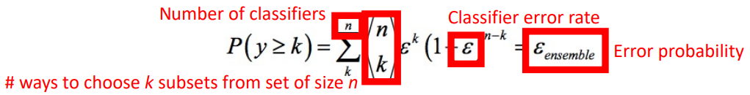
Ensemble Methods
Suppose:
n classifiers for binary classification task
Each classifier has same error rate
Classifiers are independent (not true in practice!)
Probability mass function indicates the probability of error from an ensemble:
e.g., n = 11, = 0.25; k = 6: probability of error is ~0.034 which is much lower than probability of error from a single algorithm (0.25)
Regularization
Session 9

Slide 21
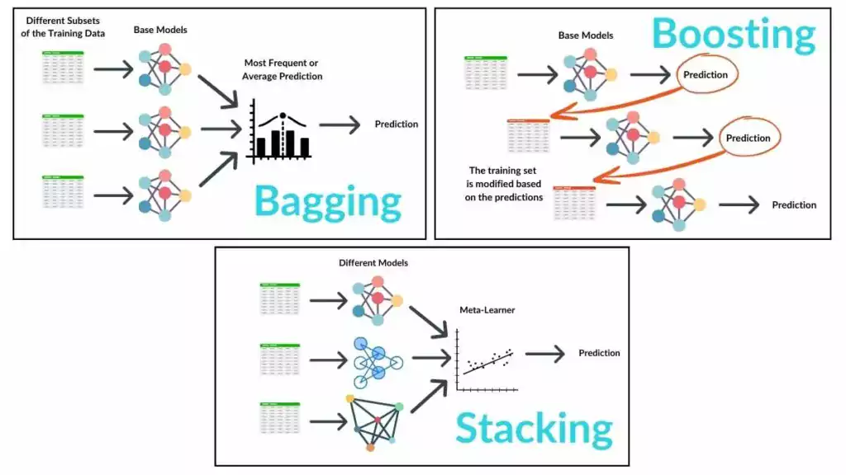
How to Produce an Ensemble?
Regularization
Session 9

Slide 22
Ensembles for Neural Networks
Why could ensembling neural networks be difficult?
Hyperparameter Tuning: Finding optimal hyperparameters for each model is time-consuming.
High Resource Usage: Ensembles require significant memory and computational power.
Extended Training Time: Training multiple models increases total time.
Increased Complexity: Managing multiple architectures and data pipelines adds complexity.
Diminishing Returns: Additional models may only slightly improve performance.
Deployment Issues: Ensemble models increase inference time and hardware needs.
Regularization
Session 9

Slide 23
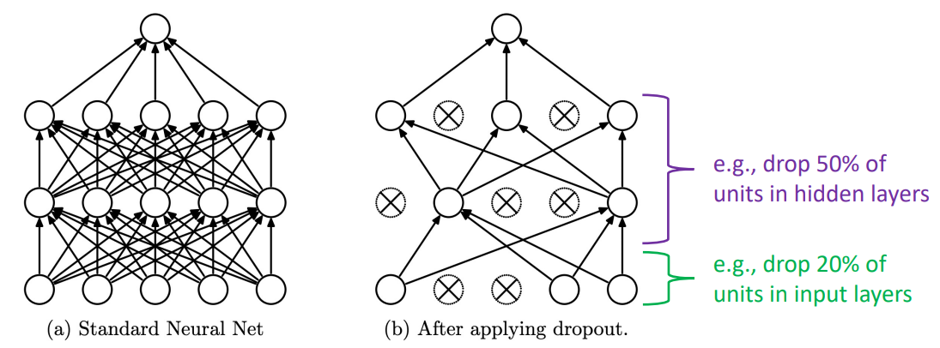
Ensembles for Neural Networks
Idea: approximate bagging with dropout during training so different sub-models in the network are trained with different training data
Regularization
Session 9

Slide 24
Regularization with Pytorch
Dropout: https://pytorch.org/docs/stable/generated/torch.nn.Dropout.html
L2 Regularization: https://discuss.pytorch.org/t/how-to-add-a-l2-regularization-term-in-my-loss-function/17411/5
Batch Normalization: https://medium.com/@aidant0001/batch-normalization-with-pytorch-959744b05325
Early Stopping: https://www.geeksforgeeks.org/how-to-handle-overfitting-in-pytorch-models-using-early-stopping/#step-6-train-the-model-with-early-stopping
Regularization
Session 9

