Slide 1

Machine Learning
Session 1 - T​
Introduction to Machine Learning
Degree in Applied Data Science
2024/2025

Slide 2
Objectives
Learn the theoretical foundations of advanced machine learning concepts;
Implement advanced machine learning algorithms using Python;
Introduction to Machine Learning
Session 1

Slide 3
Classes
Typically, classes will be divided in two parts:
Foundations of Data Science and Machine Learning (1 hour).
Hands-on Implementation in Python (1 hour).
Introduction to Machine Learning
Session 1

Slide 4
Evaluation
Exam (35%)
Minimum passing grade of 9.5
Group project (35%)
Groups of 3 students;
Presentation;
Jupyter Notebook;
Minimum passing grade of 9.5.
ML package (30%)
Group development of an ML package from scratch on GitHub.
Introduction to Machine Learning
Session 1

Slide 5
Introduction to Machine Learning

Slide 6
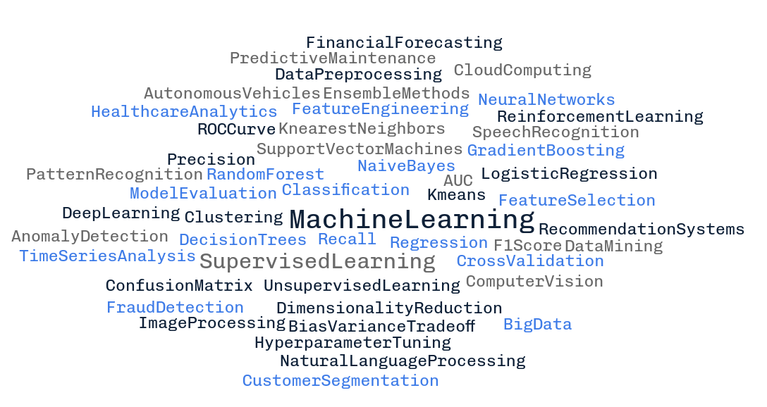
Terminology
Introduction to Machine Learning
Session 1

Slide 7
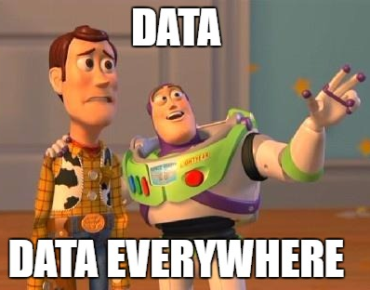
Data everywhere!
328.77 million terabytes of data are created each day.*
By 2025, it is expected to skyrocket to a staggering 181 zettabytes.*
Last two years alone, account for 90% of the world's data.*
* https://news.wildintelligence.xyz/p/328-million-terabytes-of-data
Introduction to Machine Learning
Session 1

Slide 8
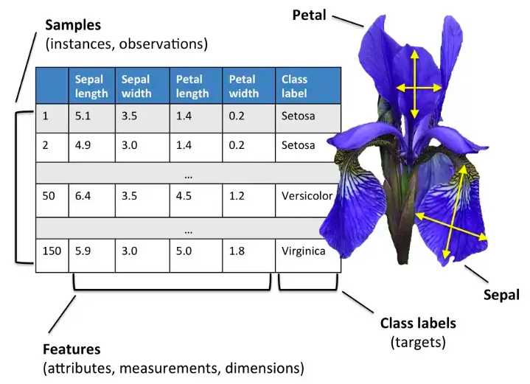
Data Types
Tabular data:
https://eminebozkus.medium.com/exploring-the-iris-flower-dataset-4e000bcc266c
Introduction to Machine Learning
Session 1

Slide 9
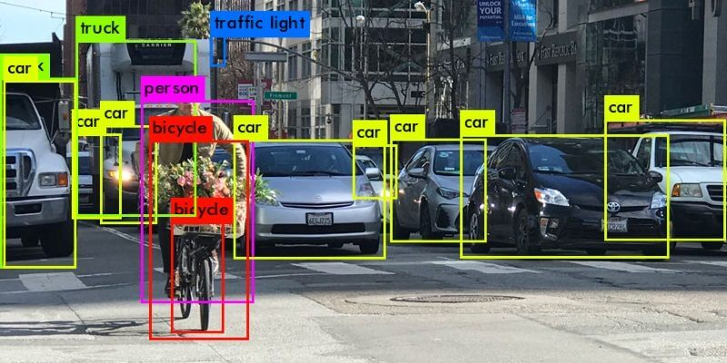
Data Types
Image data:
Introduction to Machine Learning
Session 1

Slide 10
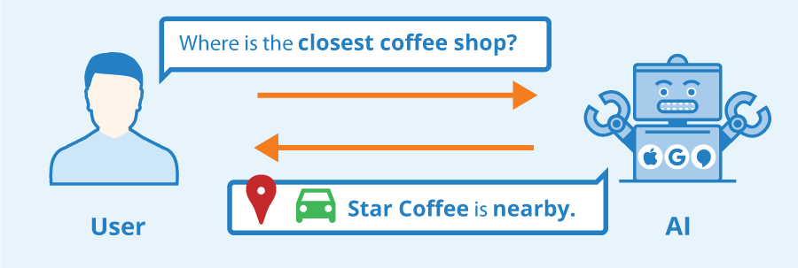
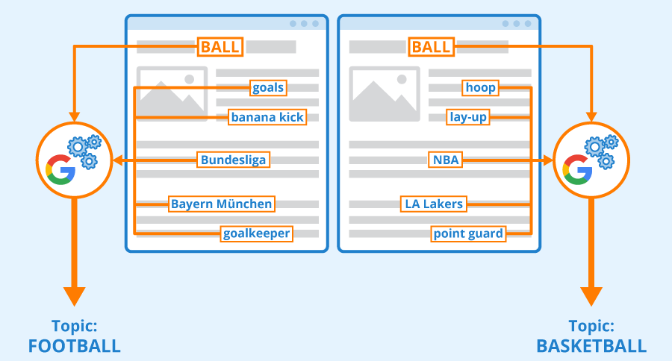
Data Types
Text data:
Introduction to Machine Learning
Session 1

Slide 11

Data Types
Audio data:
Introduction to Machine Learning
Session 1

Slide 12
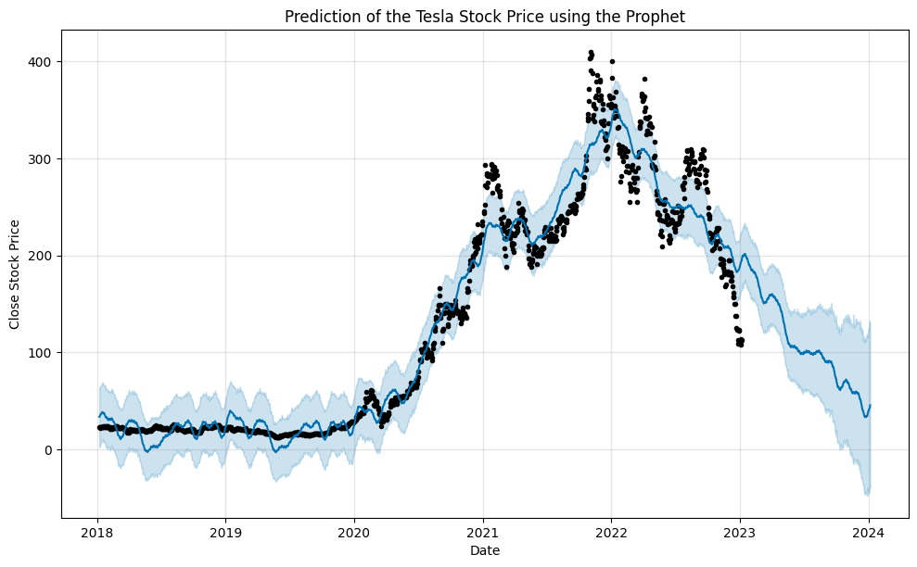
Data Types
Time series data:
Introduction to Machine Learning
Session 1

Slide 13
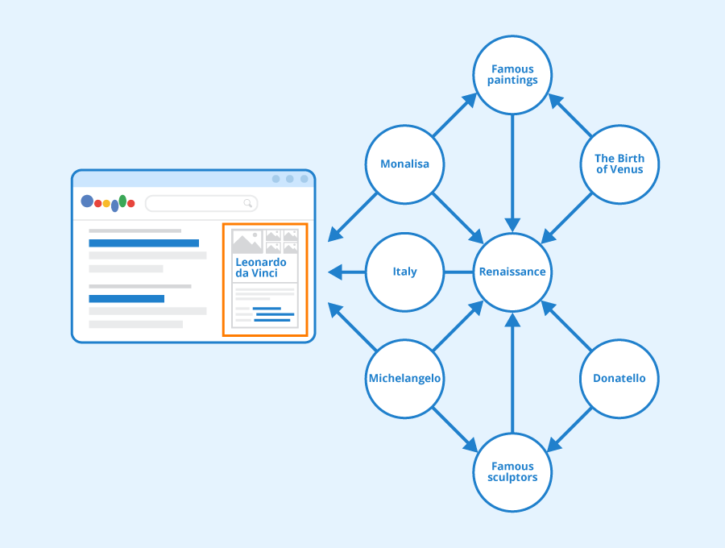
Data Types
Graph data:
Introduction to Machine Learning
Session 1

Slide 14



The Components of Learning
Inferences
Data storage: every learning process starts with data. Both humans and computers rely on data storage as a fundamental basis for more advanced reasoning..
Abstraction: involves extracting knowledge from stored data by forming general concepts that represent the data as a whole.
Generalization involves leveraging abstracted data to generate knowledge and inferences, which subsequently inform actions in novel situations.
Evaluation: serves as a feedback mechanism, measuring the effectiveness of acquired knowledge and offering insights for possible enhancements.
Data
Concepts
Data Storage
Abstraction
Generalization
Evaluation
Introduction to Machine Learning
Session 1

Slide 15
Machine Learning
“A computer program is said to learn from experience E with respect to some class of tasks T and performance measure P, if its performance at tasks in T, as measured by P, improves with experience E. ”
Tom Mitchell. Machine Learning 1997.
Introduction to Machine Learning
Session 1

Slide 16
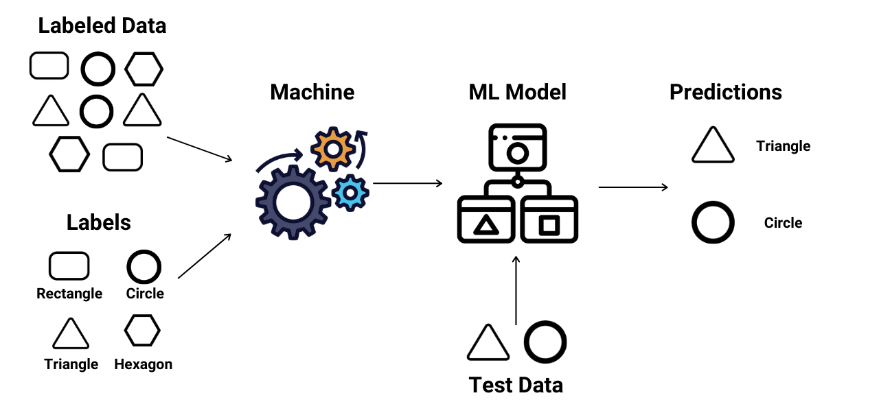
Machine Learning Paradigms
Supervised: the algorithm is trained on a labeled dataset, where the input data is paired with corresponding output labels. The goal is to learn a mapping from inputs to outputs, allowing the algorithm to make predictions on new, unseen data.
https://www.enjoyalgorithms.com/blogs/supervised-unsupervised-and-semisupervised-learning
Introduction to Machine Learning
Session 1

Slide 17
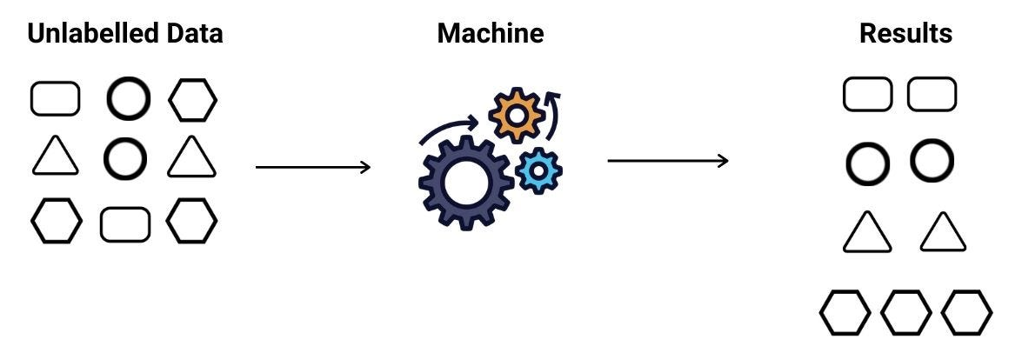
Machine Learning Paradigms
Unsupervised: involves working with unlabeled data, where the algorithm explores the inherent structure and patterns within the input without explicit output guidance.
https://www.enjoyalgorithms.com/blogs/supervised-unsupervised-and-semisupervised-learning
Introduction to Machine Learning
Session 1

Slide 18
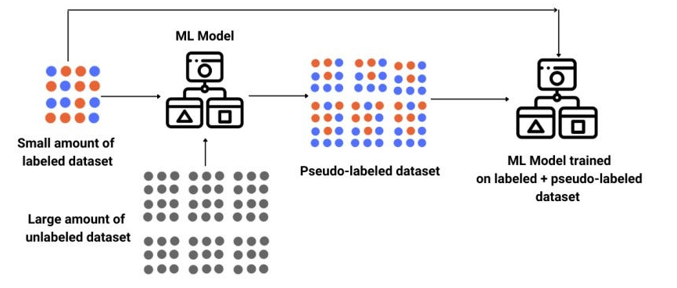
Machine Learning Paradigms
Semi-supervised: combines labeled and unlabeled data for training. It aims to leverage the benefits of both supervised and unsupervised learning, often useful when obtaining labeled data is costly or time-consuming.
https://www.enjoyalgorithms.com/blogs/supervised-unsupervised-and-semisupervised-learning
Introduction to Machine Learning
Session 1

Slide 19
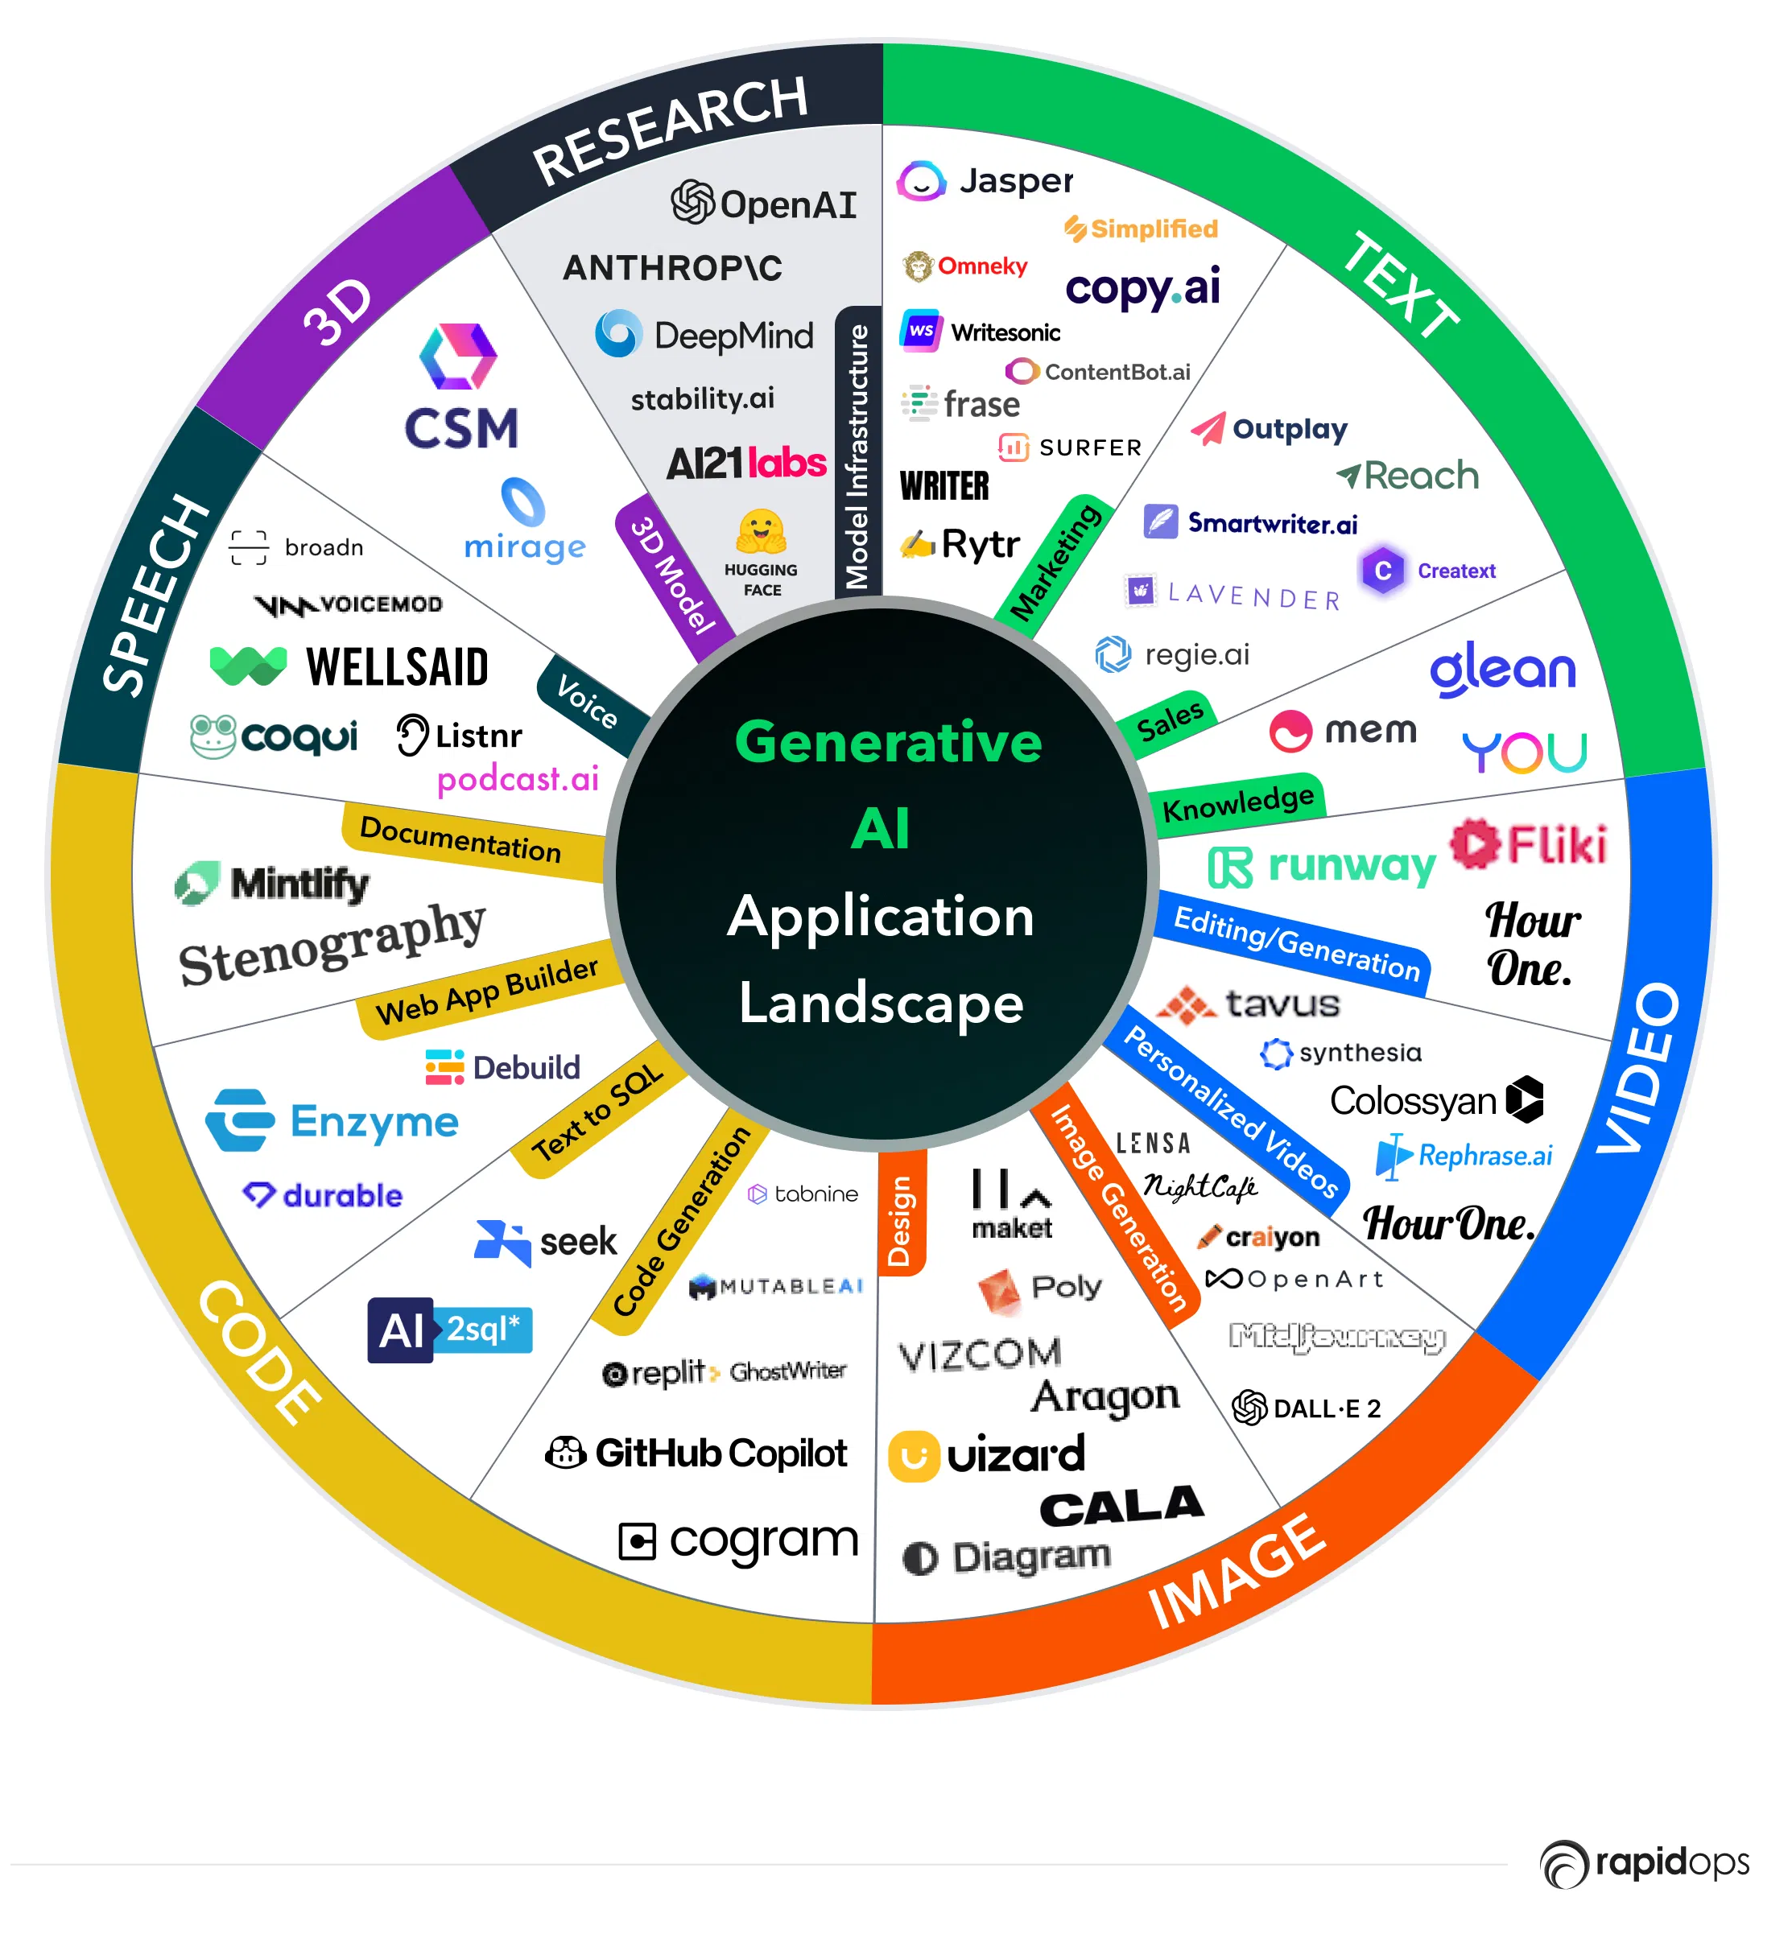
Machine Learning Paradigms
Generative: the focus is on learning the underlying probability distribution of the input data. It can generate new, synthetic samples that resemble the training data.
https://www.rapidops.com/blog/generative-ai-tools/
Introduction to Machine Learning
Session 1

Slide 20
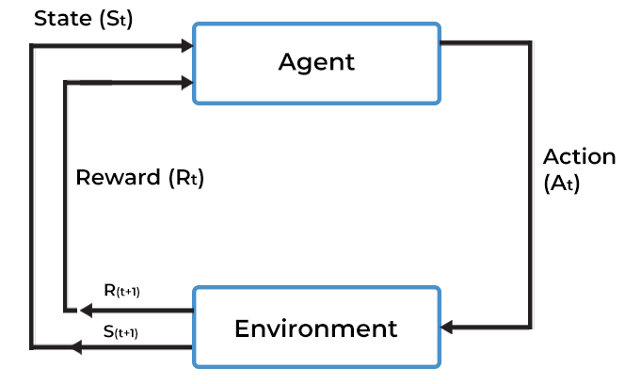
Machine Learning Paradigms
Reinforcement Learning: an agent learns to make decisions by interacting with an environment. The agent receives feedback in the form of rewards or penalties, enabling it to learn optimal strategies over time.
Introduction to Machine Learning
Session 1

Slide 21
Machine Learning Applications
Spam filtering;
Fraud detection;
Disease detection;
Drug discovery;
Recommendation systems;
Forecasting;
Autonomous Vehicles;
Chatbots;
Object detection;
Anomaly detection;
...
Introduction to Machine Learning
Session 1

Slide 22
Resources
Kelleher, J. D., Namee, B. M., & D’Arcy, A. (2015). Fundamentals of machine learning for predictive data analytics. London, England: MIT Press.
Guido, S., & Mueller, A. C. (2016). Introduction to machine learning with python. Sebastopol, CA: O’Reilly Media.
Introduction to Machine Learning
Session 1

