Slide 1

Behavior Analysis Technologies
Session 9
Data Collection and Scrapping
Applied Data Science
2024/2025

Slide 2
The First Step of Data Science
The first step in data science...
… is to get some data!
You will typically get data in one of four ways:
Directly download a data file(s) manually!
Query data from a database.
Query an API (Application Programming Interface).
Scrap data from a webpage.
Data Collection and Scrapping
Session 9

Slide 3
Data Formats
The three most common formats:
CSV - Comma Separate Values
JSON - JavaScript Object Notation
HTML/XML - HyperText Markup Language / eXtensible Markup Language
Data Collection and Scrapping
Session 9

Slide 4
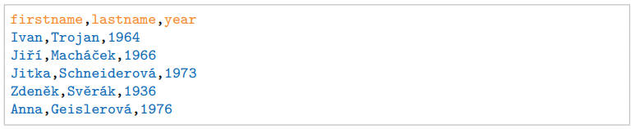
CSV Files
A CSV file is a file where information is separated by commas.
Well, not always by commas!
CSVs are plain text files
Data can be saved in tabular format (meaning a table of rows and columns)
Data Collection and Scrapping
Session 9

Slide 5
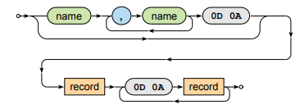

CSV Structure
Document
Optional header + list of records
Record
Comma separated list of fields
Data Collection and Scrapping
Session 9

Slide 6
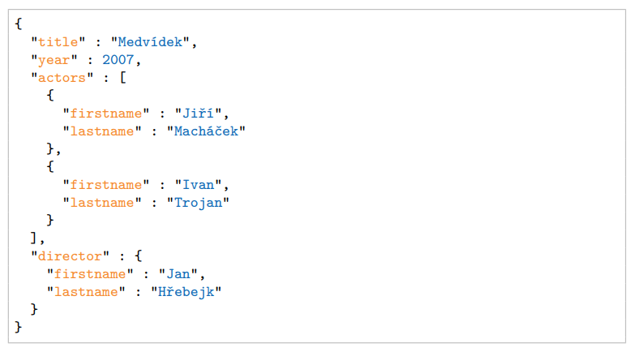
JSON Files
JSON originated as a way of encapsulating Javascript objects
JSON files are often used for transmitting data in web applications (e.g. sending some data from the server to the client)
Data Collection and Scrapping
Session 9

Slide 7


JSON Structure
Unordered collection of name‐value pairs (properties)
Correspond to structures such as objects, records, structs, dictionaries, hash tables, keyed lists, associative arrays, …
Values can be of different types, names should be unique
Examples:
Data Collection and Scrapping
Session 9

Slide 8
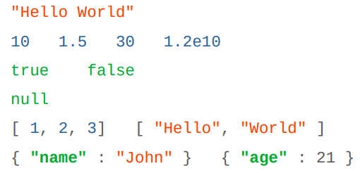
JSON Data Types
There are 6 data types in JSON
Strings
Numbers
Booleans
Null
Array
Object
Data Collection and Scrapping
Session 9

Slide 9
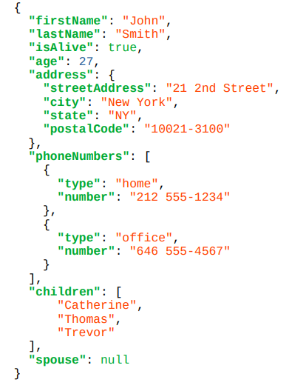
JSON Example … Again
Data Collection and Scrapping
Session 9

Slide 10
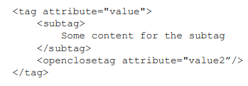
HTML/XML Files
The main format for the web (though XML seems to be loosing a bit of popularity to JSON for use in APIs / file formats)
XML files contain hiearchical content delineated by tags
HTML is syntactically like XML but horrible (e.g., open tags are not always closed), more fundamentally, HTML is mean to describe appearance
Data Collection and Scrapping
Session 9

Slide 11
JSON vs XML
Which is better?
JSON has largely won over XML
You can occasionally still find hierarchical data as XML, but it usually is JSON.
XML is still relevant in data science for one reason: it is a generalization of HTML, the language used to specify webpages.
Data Collection and Scrapping
Session 9

Slide 12
Web Scrapping
Web scraping is the process of automatically extracting data from websites.
Why is Web Scapping Useful?
Collect data for research, analysis, and insights.
Track prices, news, and trends.
Gather large datasets for machine learning or statistical models.
Common use cases:
Price comparison websites.
Sentiment analysis on social media or reviews.
Market research by extracting competitor data.
Academic research in data mining or behavior analysis.
Data Collection and Scrapping
Session 9

Slide 13
Web Scrapping – Before Getting Started
Warnings and Ethical Considerations:
Respect robots.txt and Terms of Service
Always check if the website allows scraping by reviewing the robots.txt file and terms of service. - add /robots.txt to the end of the URL
Avoid Overloading Servers
Be considerate: Use rate limiting to prevent sending too many requests too quickly.
Data Privacy
Avoid scraping personal or sensitive data that is not publicly available or intended for scraping.
Legal Risks
Some sites explicitly prohibit scraping. Ignoring this can lead to legal consequences (e.g., bans, lawsuits).
Consider using APIs
Many websites offer public APIs that provide structured data legally and efficiently.
Data Collection and Scrapping
Session 9

Slide 14
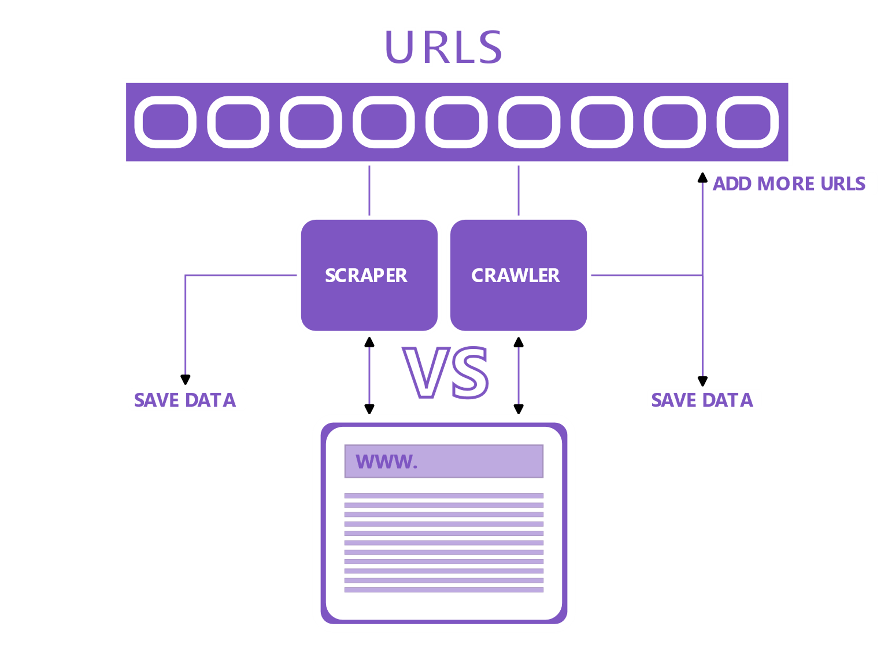
Web Scrapping vs Web Crawling
Web scraping and crawling are often used interchangeably but refer to different techniques.
Web scraping: Any automated process that collects data from websites.
Web crawling: A specific form of web scraping that involves systematically exploring websites, often for indexing purposes (e.g., search engines).
Data Collection and Scrapping
Session 9

Slide 15
Devtools and Reverse Engineering
The first step in web scraping is understanding how the target website works, often referred to as reverse engineering.
DevTools: A development suite built into modern browsers used for debugging and inspecting web pages.
DevTools is essential for reverse engineering and is crucial in web scraping projects.
Data Collection and Scrapping
Session 9

Slide 16
Devtools and Reverse Engineering
The DevTools console can typically be opened using the F12 key (in Chrome and Firefox) or by right-clicking on the page and selecting "Inspect".
The tool suite is divided into multiple tabs, each offering different functionalities.
For web scraping, the most relevant tab is the Elements tab, which allows you to inspect and analyze the structure of the webpage's HTML.
Data Collection and Scrapping
Session 9

Slide 17
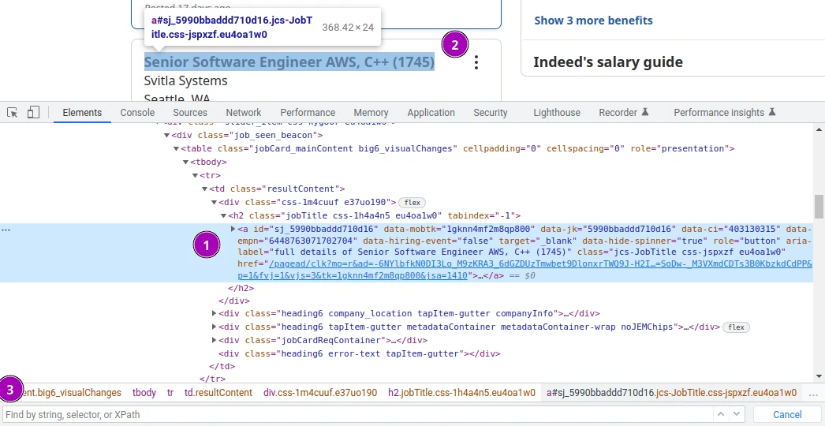
Elements Tab
In web scraping, the Elements tab in DevTools helps in understanding the website's structure.
You can use this tool to build parsing logic for your scraper by inspecting the HTML elements and identifying patterns.
Data Collection and Scrapping
Session 9

Slide 18
Elements Tab
The navigation tree where we can see and interact with all of the HTML elements.
The selected elements will be highlighted on the page.
We can search for elements by CSS selectors, XPath or just text.
Data Collection and Scrapping
Session 9

Slide 19

HTTP
HyperText Transfer Protocol (HTTP) is the foundation of the web and essential for web scraping.
Understanding HTTP is key to writing effective web scrapers, as it governs how we retrieve web pages.
In Python, you can use HTTP to retrieve a webpage with a script like this one:
The script above is sending a request to URL http://httpbin.org/html. In return we get a response from the server with the web page data.
Data Collection and Scrapping
Session 9

Slide 20
HTTP
The goal of a web scraper is to send a valid HTTP request to receive response data from the server.
To ensure the request is valid, it must match the server’s expectations.
This means the requests should appear as if they are coming from a real user using a web browser.
Data Collection and Scrapping
Session 9

Slide 21
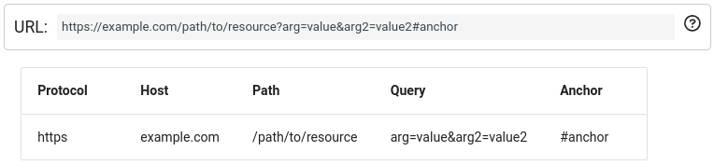
URL
A Universal Resource Locator (URL) indicates the address of a web resource.
It consists of several key parts, each with a role in web scraping:
Protocol: Specifies how data is transferred (e.g., HTTP or HTTPS).
Domain: Identifies the website (e.g., www.example.com).
Path: Points to a specific page or resource on the website.
Query Parameters: Provide additional information or filters for the request (e.g., ?id=123).
Anchor/Fragment: Refers to a specific section of a page (e.g., #section1).
Data Collection and Scrapping
Session 9

Slide 22
Request Types
There are various types of HTTP requests, but in web scraping, we primarily use:
GET: Requests data from a specified resource (commonly used to retrieve web pages).
POST: Sends data to a server to create or update a resource (e.g., submitting forms).
HEAD: Similar to GET, but only retrieves metadata, not the actual content.
Data Collection and Scrapping
Session 9

Slide 23
Response Status Code
After sending a request, we will receive either a success, failure, or timeout response (servers can also ignore the request).
Each response includes a status code indicating the outcome:
200 range: Success!
However, for websites with anti-scraping protection, a 200 response may be misleading—HTML content might indicate blocking.
300 range: Redirection.
The page location has changed, but most HTTP clients handle redirects automatically.
400 range: Client-side error or blocking.
This can indicate the server is blocking the scraper or that there's an issue with the request (e.g., missing headers, cookies, or a bad URL).
500 range: Server-side error or blocking.
This typically means the server is unable to process the request due to internal issues or blocking the client.
Data Collection and Scrapping
Session 9

Slide 24
HTML
Hypertext Markup Language: the language that provides a template for web pages
See HTML when inspecting the source of a webpage
Made up of tags that represent different elements (links, text, photos, etc)
Data Collection and Scrapping
Session 9

Slide 25
HTML Tags
<html>, indicates the start of an html page (end tag </html>)
<body>, contains the items on the actual webpage (text, links, images, etc)
<p>, the paragraph tag. Can contain text and links
<a>, the link tag. Contains a link url, and possibly a description of the link
<input>, a form input tag. Used for text boxes, and other user input
<form>, a form start tag, to indicate the start of a form
<img>, an image tag containing the link to an image
Many other tags! Check it out: https://html.com/tags/
Data Collection and Scrapping
Session 9

Slide 26
Web Scrapping
Let's build our first web scraper!
Follow the instructions in the notebook "web_scraping_exercises.ipynb".
Data Collection and Scrapping
Session 9

