Slide 1

Behavior Analysis Technologies
Session 4
Text Similarity
Applied Data Science
2024/2025

Slide 2
Text Similarity
Text similarity is a measure of how closely related two pieces of text are, either based on their form (lexical similarity) or their meaning (semantic similarity).
Lexical Similarity:
Based on surface forms (e.g., common words or n-grams);
Example: Comparing “quick brown fox” vs “quick blue fox”
Semantic Similarity:
Focuses on meaning and context.
Example: “He bought a car” vs. “He purchased an automobile”
Text Similarity
Session 4

Slide 3
Lexical vs Semantic Similarity
Lexical | Semantic
Quick and Easy | Rich in meaning
Surface-level | Context-aware
Example: "big" vs "large" (not similar lexically) | Example: "big" vs "large" (semantically similar)
Text Similarity
Session 4

Slide 4
Measures of Lexical Similarity
Lexical similarity measures how much the surface forms (i.e., words, characters) of two texts overlap.
Quick and straightforward to implement.
Useful for tasks like duplicate detection, spell checking, and clustering similar documents
Text Similarity
Session 4

Slide 5
Lexical Similarity Metrics
Jaccard Similarity
Cosine Similarity
Edit Distance (Levenshtein Distance)
Text Similarity
Session 4

Slide 6

Jaccard Similarity
Jaccard similarity:
Measures the overlap between two sets of tokens (e.g., words).
Values range from 0 (no overlap) to 1 (complete overlap).
Defined as the ratio of shared tokens and total tokens in two documents:
where X and y represent the terms that appear in documents d₁ and _{d2}, respectively.
Text Similarity
Session 4

Slide 7


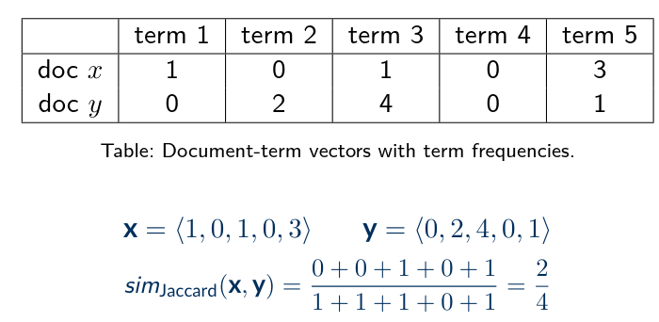
Jaccard Similarity
Jaccard similarity for term vector-based representations:
here is an indicator function (1 if x > 0 and 0 otherwise).
Example:
Text Similarity
Session 4

Slide 8
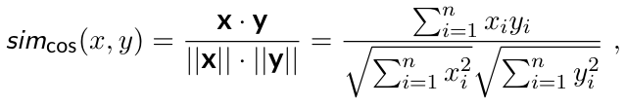
Cosine Similarity
Cosine Similarity:
Measures the cosine of the angle between two vectors (the larger the angle, the more dissimilar the documents are).
Typically applied to TF-IDF or Bag-of-Words vectors.
Ranges from 0 to 1, where 1 means identical vectors.
where x and y are the term vectors corresponding to documents d₁ and d₂, respectively.
Text Similarity
Session 4

Slide 9
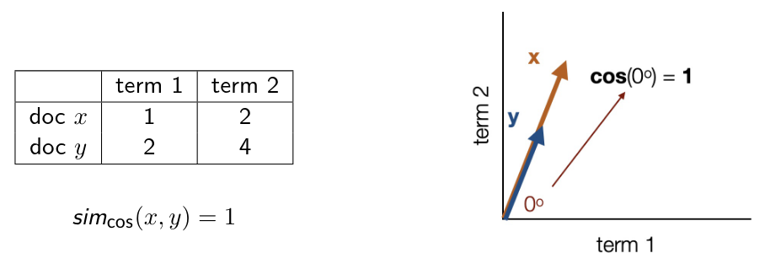
Cosine Similarity – Geometric Interpretation
Text Similarity
Session 4

Slide 10
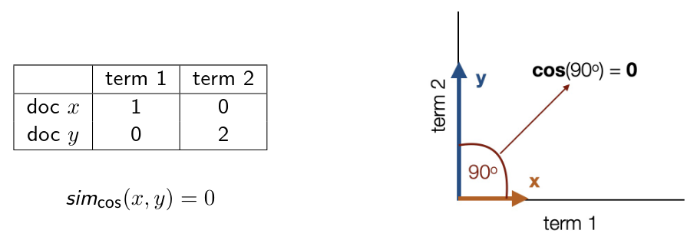
Cosine Similarity – Geometric Interpretation
Text Similarity
Session 4

Slide 11
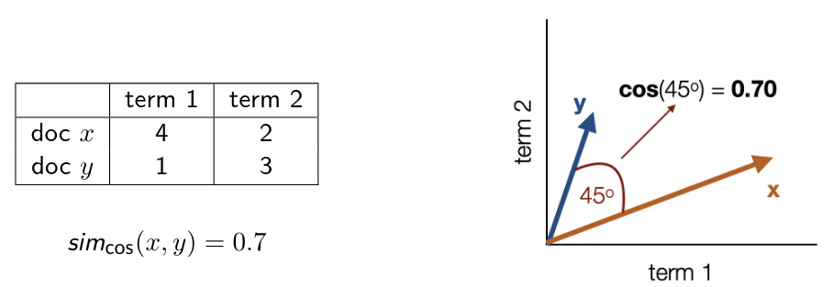
Cosine Similarity – Geometric Interpretation
Text Similarity
Session 4

Slide 12
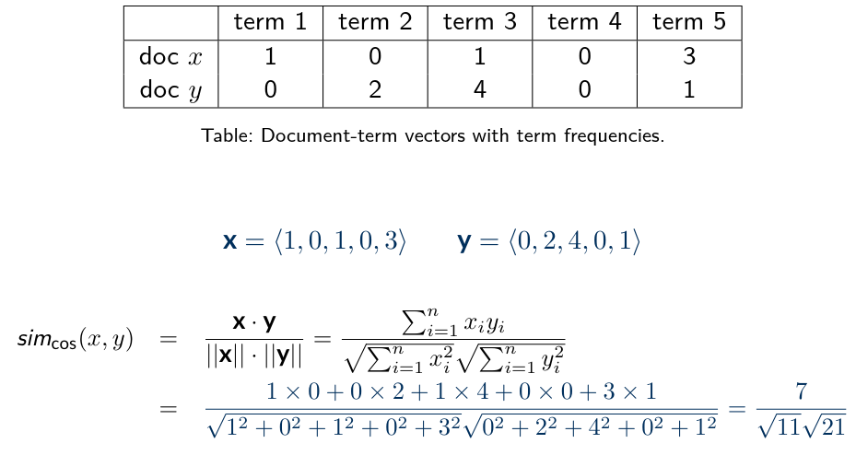
Cosine Similarity
Example:
Text Similarity
Session 4

Slide 13
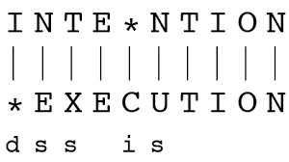
Edit (Levenshtein) Distance
The minimum number of single-character edits (insertions, deletions, substitutions) required to transform one string into another.
Text Similarity
Session 4

Slide 14
Text Similarity
Tasks requiring text similarity
Clustering Documents
Recommending Similar Products
Detecting Plagiarism
Search Engines and Information Retrieval
Text Similarity
Session 4

Slide 15
Exercises
Implement jaccard and cosine similarity with numpy.
Test the implemented functions. Create na heat map to compare sentence similarity.
Implement a simple spell checker.
Text Similarity
Session 4

