Slide 1

Behavior Analysis Technologies
Session 2
Text Preprocessing
Applied Data Science
2024/2025

Slide 2
Question
What are the challenges in processing and analyzing natural language text?
Text Preprocessing
Session 2 -

Slide 3
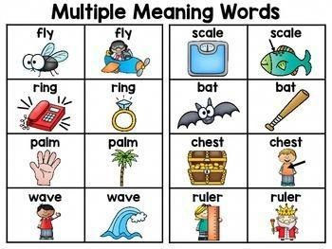
Ambiguity in Language
Lexical Ambiguity:
Many words have multiple meanings.
Text Preprocessing
Session 2

Slide 4
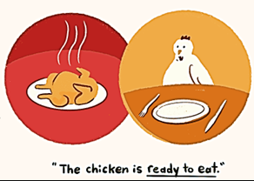
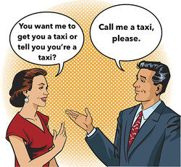
Ambiguity in Language
Syntatic Ambiguity:
The structure of sentences can be ambiguous.
Text Preprocessing
Session 2

Slide 5
Ambiguity in Language
Semantic Ambiguity:
It occurs when the meaning of a sentence is unclear because the relationships between concepts or words are not well-defined.
"Visiting relatives can be annoying."
This could mean:
You find visiting your relatives annoying.
Your relatives, when they visit, are annoying.
Text Preprocessing
Session 2

Slide 6
Variability and Flexibility of Language
Synonyms: Different words can express the same concept (e.g., "car" vs. "automobile").
Polysemy: A single word can have multiple related meanings (e.g., "mouse" could refer to an animal or a computer device).
Paraphrasing: The same idea can be expressed in numerous ways (e.g., "He completed the project ahead of schedule." and "He finished the work earlier than planned.").
Text Preprocessing
Session 2

Slide 7
Context Dependence
Contextual Understanding: The meaning of a word or phrase often depends on surrounding words (e.g., "bat" can be a flying mammal or a sports equipment). Systems must grasp local context to understand the true meaning.
Long-Distance Dependencies: Words in a sentence may influence each other even if they are far apart, complicating syntactic and semantic analysis.
Text Preprocessing
Session 2

Slide 8
Informality and Noise in Text
Informal Language: Aight, text data be hella messy with mad slang, abbrevs, and all that emoji biz. Grammar's all over the place, makin' it a total pain to figure out what’s what. 😅🗯️📱
Typos and errors human generated text is often noisy with typos grammatical mistakes or incomplete sentences handling this requires sophisticated error correction or tolerance mechanisms
Text Preprocessing
Session 2

Slide 9
Informality and Noise in Text
Informal Language: Text data often includes informal language (e.g., social media posts, chats) with slang, abbreviations, emojis, and non-standard grammar, making it hard to analyze accurately.
Typos and Errors: Human-generated text is often noisy, with typos, grammatical mistakes, or incomplete sentences. Handling this requires sophisticated error correction or tolerance mechanisms.
Text Preprocessing
Session 2

Slide 10
High Dimensionality
Sparse Representation: Text data, especially in large corpora, is often represented as high-dimensional vectors. Most of these dimensions are sparse, which makes computations slow and can lead to overfitting.
Unstructured Nature of Text: Unlike structured data (e.g., databases), text data doesn't follow a predefined schema, making it harder to index, search, and analyze. Extracting useful information from free-text requires sophisticated techniques to identify structure.
Lack of Structure
Text Preprocessing
Session 2

Slide 11
And Others
Subjectivity and Sentiment
Language Evolution
Multilingualism
Scalability and Efficiency
Text Preprocessing
Session 2

Slide 12
Question
How is raw text prepared for machine learning models?
Text Preprocessing
Session 2 - T

Slide 13
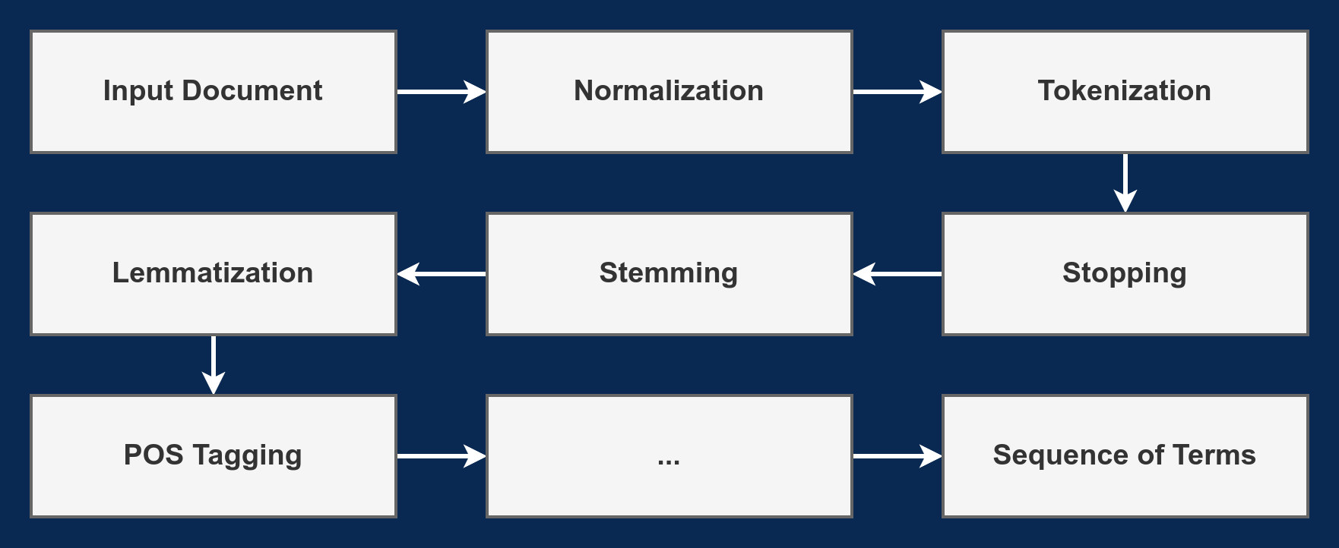
The Text Preprocessing Pipeline
Text Preprocessing
Session 2

Slide 14
Text Normalization
Normalization is the process of standardizing text to reduce variation and improve consistency across the data before analysis.
It transforms text to a common format, making it easier to process in downstream tasks.
Common tasks: "I’m fine, don’t worry."
Lowecasing: "i’m fine, don’t worry."
Removing punctuation: "im fine dont worry"
Expanding contratctions: "i am fine do not worry"
Text Preprocessing
Session 2

Slide 15
Exercise: Text Normalization
Text normalization with Python:
Follow the instruction os the script text_normalization.py
Implement functions to:
Lowercase text
Remove punctuation from text
Expand contractions
Text Preprocessing
Session 2

Slide 16
Tokenization
Tokenization is the process of breaking down text into smaller, manageable units called tokens.
Splitting is usually done along white spaces, punctuation marks, or other predefined rules.
Types of tokens:
Word tokens: Breaking text into individual words.
"Word tokens" → ["Word", "tokens"]
Subword Tokens: Breaking text into smaller units than words.
"unhappy" → ["un", "happy"]
Character tokens:
"character" → ['c', 'h', 'a', 'r', 'a', 'c', 't', 'e', 'r']
Text Preprocessing
Session 2

Slide 17
Tokenization
Tokenization sounds easy but can be surprisingly complex!
Ambiguity: Words with multiple meanings or contexts.
Compound Words: Identifying and splitting multi-word expressions (e.g., "New York").
Special Characters: Important part of tags, URLs, email addresses, etc (e.g., C++, C#).
Numbers can be important: nokia 3310, top 10 courses, Rua 25 de Abril.
Periods can occur in numbers, abbreviations, URLs, ends of sentences, and other situations: john.doe@example.com, weight: 68.5 kg, report.pdf.
Text Preprocessing
Session 2

Slide 18
Exercise: Tokenization
Tokenization with Python:
Follow the instruction os the script tokenization.py
Implement a function that tokenizes text based on some condition.
Use the implemented function to split text based on:
Spaces
"#" character
Implement a function that tokenizes text based on punctuation.
Text Preprocessing
Session 2

Slide 19
Stopword Removal
Function words that have little meaning apart from other words:
Articles: "the," "a," "an";
Demonstratives: "this," "that," "these," "those";
Propositions: "in," "on," "at," "by";
Conjunctions: "and," "but," "or," "so";
Pronouns: "he," "she," "it," "they";
Auxiliary verbs: "is," "are," "was," "were".
These are considered stopwords and are generaly removed.
In general, these constitute the most common words on documents.
Text Preprocessing
Session 2

Slide 20
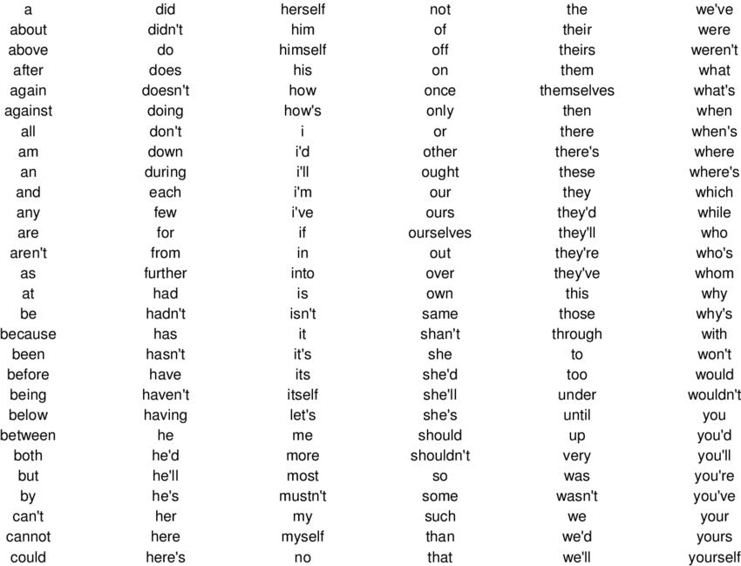
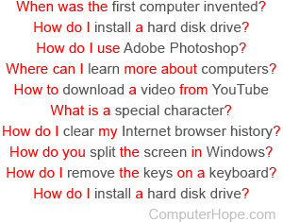
Stopword Removal
Text Preprocessing
Session 2

Slide 21
Exercise: Stopword Removal
Stopword Removal with Python:
Follow the instruction os the script stopword_removal.py
Implement a function that removes stopwords from a sequence of tokens, given a set of stopwords.
Text Preprocessing
Session 2

Slide 22
Stemming
Process of reducing words to their root or base form.
Inflectional forms: Variations of a word that indicate grammatical changes such as tense, number, or case.
"run," "runs," "running" (all forms of the verb "run")
"cat," "cats" (singular and plural forms)
Derivational forms: Variations that change the meaning or part of speech of a word, often by adding prefixes or suffixes.
"happy," "happiness" (noun derived from the adjective "happy")
"connect," "connection" (noun derived from the verb "connect")
In most cases, these have the same or very similar meanings.
Text Preprocessing
Session 2

Slide 23
Stemming
Basic types of stemmers:
Algorithmic
Dictionary-based
Hybrid algorithmic-dictionary
Text Preprocessing
Session 2

Slide 24
Suffix-s Stemmer
Assumes that any word ending with an ‘s’ is plural
dogs → dog; cars → car
Cannot detect many plural relationships (false negatives)
centuries → century
In rare cases it detects a relationship where it does not exist (false positives)
bus → bu
Text Preprocessing
Session 2

Slide 25
Porter Stemmer
Most popular algorithmic stemmer
Consists of 5 steps, each step containing a set of rules for removing suffixes
Produces stems not words
Makes a number of errors and difficult to modify
Text Preprocessing
Session 2

Slide 26
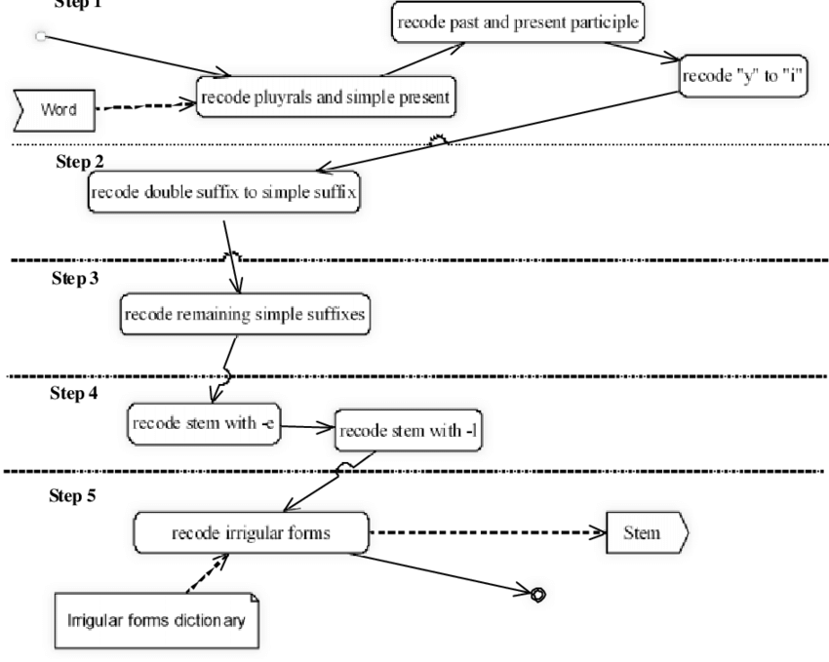
Porter Stemmer
Karaa, W. B. A. (2013). A New Stemmer to Improve Information Retrieval. In International Journal of Network Security &amp; Its Applications (Vol. 5, Issue 4, pp. 143–154). Academy and Industry Research Collaboration Center (AIRCC). https://doi.org/10.5121/ijnsa.2013.5411
Text Preprocessing
Session 2

Slide 27
Krovetz Stemmer
Hybrid algorithmic-dictionary
Word checked in dictionary
If present, either left alone or replaced with exception stems
If not present, word is checked for suffixes that could be removed
After removal, dictionary is checked again
Produces words not stems
Text Preprocessing
Session 2

Slide 28
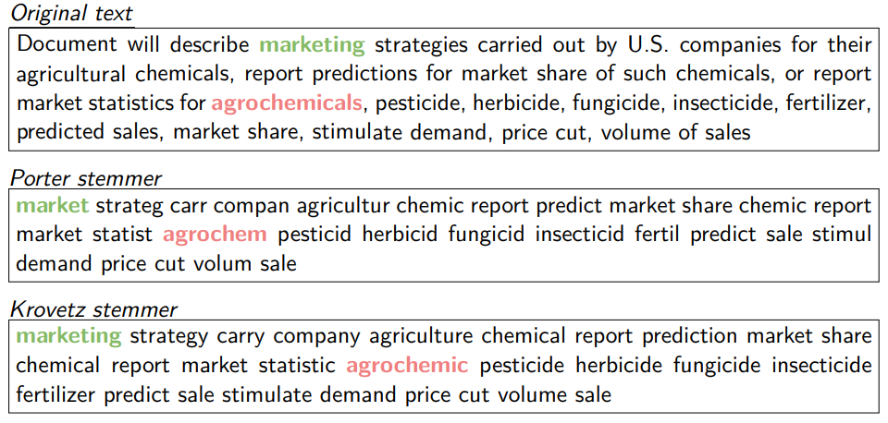
Stemmer Comparison
Text Preprocessing
Session 2

Slide 29
Exercise: Stemming
Stemming with Python:
Follow the instruction os the script stemming.py
Implement the Suffix-s Stemmer.
Text Preprocessing
Session 2

Slide 30
Lemmatization
Lemmatization is the process of reducing a word to its base or dictionary form (lemma).
Unlike stemming, which strips prefixes or suffixes, lemmatization uses a dictionary to map a word to its canonical form.
Examples:
"running"
Lemma: "run" (as a verb)
"better"
Lemma: "good" (when used as na adjective)
Text Preprocessing
Session 2

Slide 31
Exercise: Lemmatization
Lemmatization with Python:
Follow the instruction os the script lemmatization.py
Implement a function that performns lemmatization based on a dictionary.
Text Preprocessing
Session 2

Slide 32
POS Tagging
Part-of-Speech (POS) Tagging is the process of labeling each word in a sentence with its part of speech (noun, verb, adjective, etc.) based on both its definition and context within the sentence.
How POS Tagging Works?
Input: A sentence or text is provided for tagging.
Tokenization: The sentence is split into individual words or tokens.
Tagging Algorithm: Each token is tagged with its corresponding part of speech based on context.
Text Preprocessing
Session 2

Slide 33
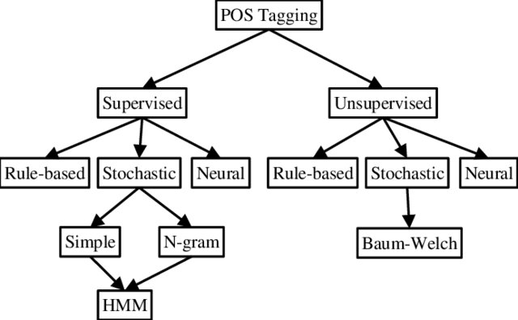
POS Tagging
Tagging Methods
https://www.researchgate.net/publication/331684946_PART_OF_SPEECH_TAGGER_FOR_ARABIC_TEXT_BASED_SUPPORT_VECTOR_MACHINES_A_REVIEW
Text Preprocessing
Session 2

Slide 34
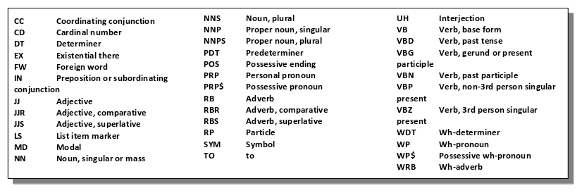
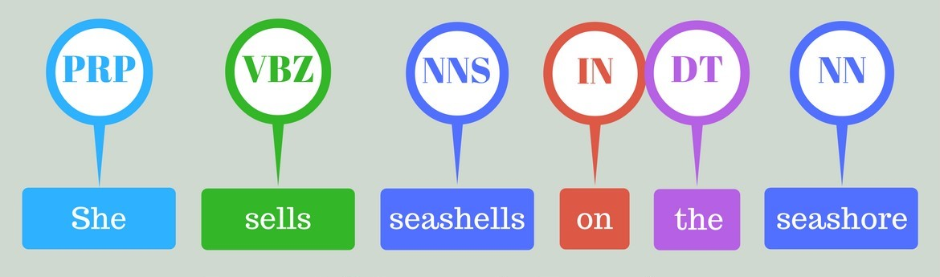
POS Tagging
Text Preprocessing
Session 2

Slide 35
Exercise: POS Tagging
POS Tagging with Python:
Follow the instruction os the script pos_tagging.py
Implement a function that performns POS Tagging based on a dictionary.
Text Preprocessing
Session 2

Slide 36
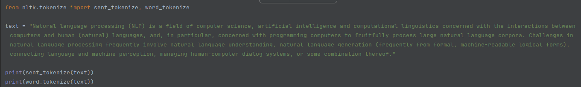
The nltk package
Tokenization:
And many more:
https://www.nltk.org/api/nltk.tokenize.html
Text Preprocessing
Session 2

Slide 37
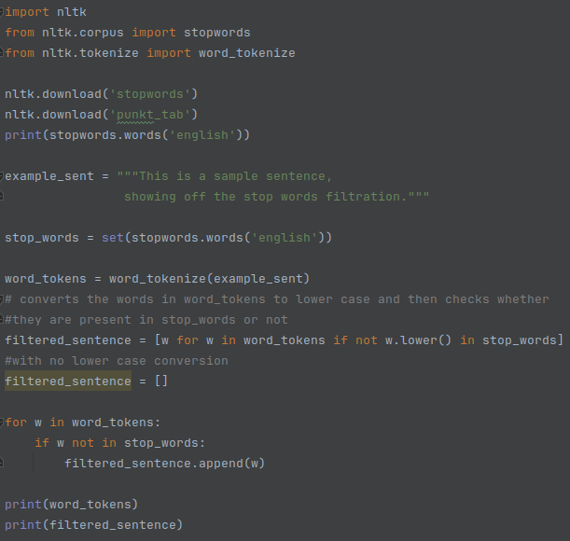
The nltk package
Stop Words:
Many other languages including portuguese!
Text Preprocessing
Session 2

Slide 38
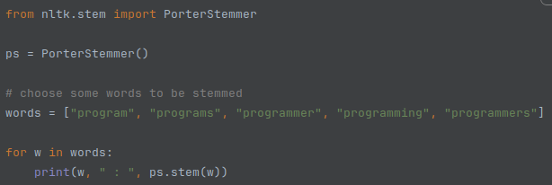
The nltk package
Stemming:
And many more:
https://www.nltk.org/api/nltk.stem.html
Text Preprocessing
Session 2

Slide 39
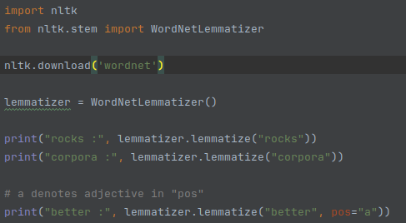
The nltk package
Lemmatization:
Text Preprocessing
Session 2

Slide 40
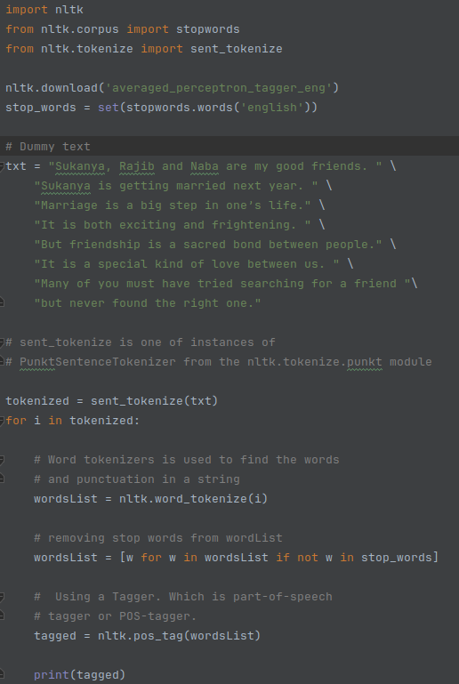
The nltk package
POS Tagging:
https://www.nltk.org/api/nltk.tag.html
Text Preprocessing
Session 2

Slide 41
Exercise: nltk package
Take-home assignment:
Test the previous nltk scripts
Explore the package!
Text Preprocessing
Session 2

