Slide 1

Behavior Analysis Technologies
Session 14
Named Entity Recognition
Applied Data Science
2024/2025

Slide 2
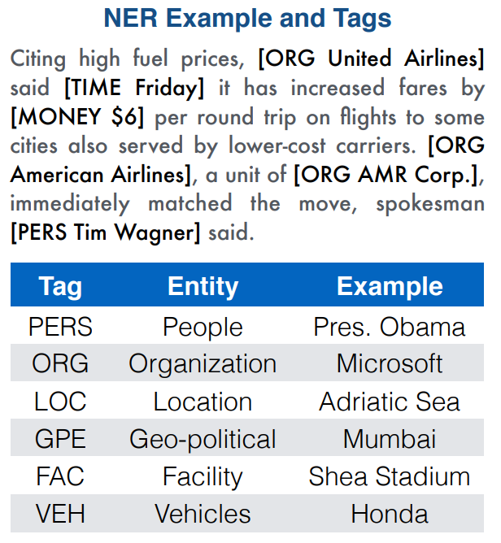
Named Entity Recognition (NER)
NER is a subtask of information extraction that identifies named entities in text and classifies them into predefined categories.
Examples of entities:
Person names (e.g., Albert Einstein)
Locations (e.g., Paris)
Organizations (e.g., United Nations)
Dates, monetary values, etc.
Named Entity Recognition
Session 14

Slide 3
Named Entity Recognition (NER)
Clauses are typically assigned an entity type from a predefined list, with each type having distinct contextual indicators that help identify entities of that category.
For example, dates and times often appear in recognizable formats, while names of people are frequently introduced with specific cues in the surrounding text (e.g., "Dr. John Smith" or "Ms. Jane Doe").
Named Entity Recognition
Session 14

Slide 4
Why is NER Important?
Applications:
Information Extraction: Extract key information from documents.
Question Answering: Identify answers within large texts.
Sentiment Analysis: Analyze opinions tied to specific entities (e.g., brands).
Search Engines: Improve search relevance by identifying named entities.
Named Entity Recognition
Session 14

Slide 5
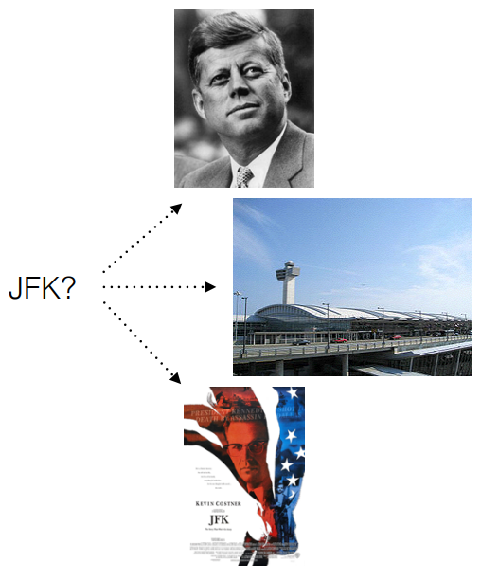
Ambiguity in NER
NER systems often have to deal with several important types of ambiguity:
Reference resolution: the same name can refer to different entities of the same type. For instance, JFK can refer to a former US president or his son.
Cross-type Confusion: the identical entity mentions can refer to entities of different types. For instance, JFK also names an airport, several schools, bridges, etc.
Named Entity Recognition
Session 14

Slide 6
How does NER work?
Key steps:
Tokenization: Splits text into words or phrases.
Feature Extraction: Uses features like shape, POS tags, and surrounding words.
Classification: Models predict entity types based on extracted features.
Named Entity Recognition
Session 14

Slide 7
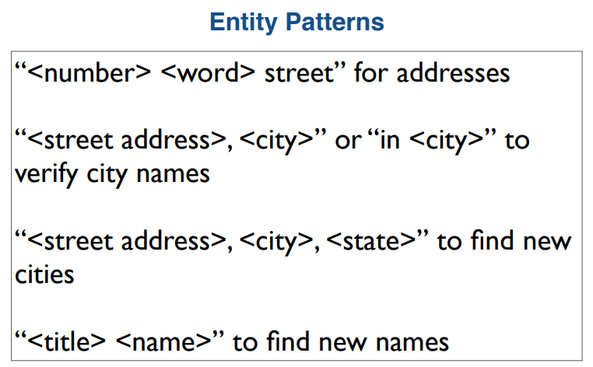
Rule-Based NER
Rule-based systems for NER are effective for certain entity classes.
Many of them use lexicons, which lists names, organizations, locations, etc.
Rules can also be crafted using regular expressions or other pattern matching tools. The rules may be built by hand, or with machine learning.
Fast and interpretable but limited by language rules.
Named Entity Recognition
Session 14

Slide 8
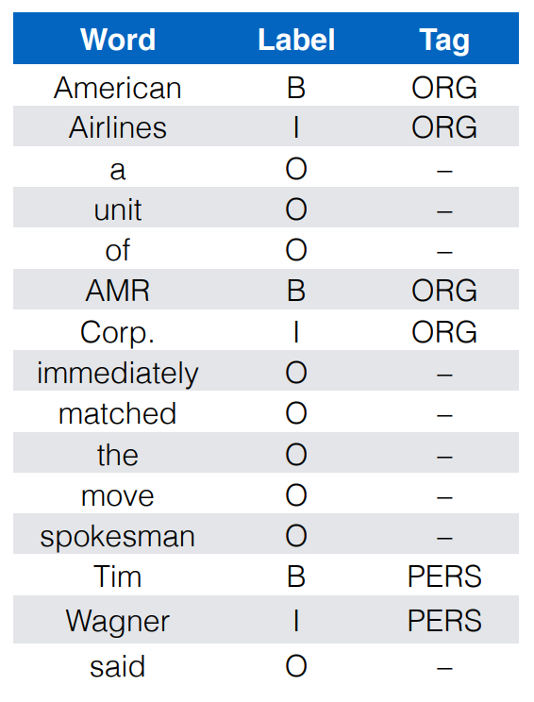
NER with Sequence Tagging
Sequence tagging is a common ML approach to NER.
Tokens are labeled as one of:
B: Beginning of an entity
I: Inside an entity
O: Outside an entity
Machine Learning models are trained on a variety of text features to accomplish this.
Named Entity Recognition
Session 14

Slide 9
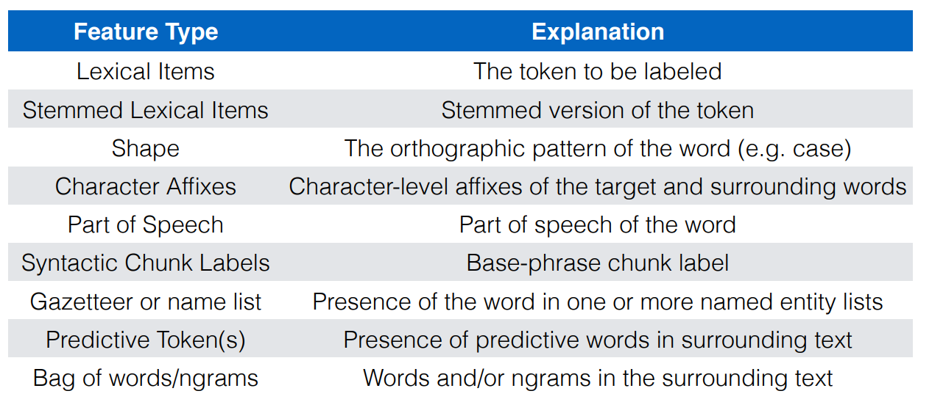
Features for Sequence Tagging
Named Entity Recognition
Session 14

Slide 10
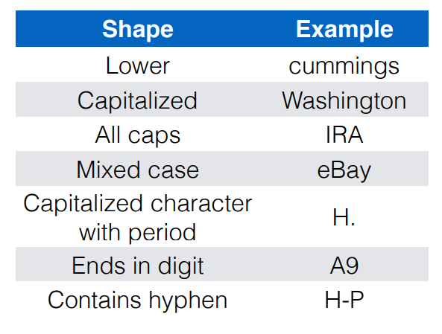
Word Shape
In English, the shape feature is one of the most predictive of entity names.
It is particularly useful for identifying businesses and products like Yahoo!, eBay, or iMac.
Shape is also a strong predictor of certain technical terms, such as gene names.
Named Entity Recognition
Session 14

Slide 11
Context-Based NER
Rule-based NER systems will inevitably miss some entities.
All lexicons are incomplete, because new names are continually invented.
Pattern matching doesn’t work for every entity type, and is at odds with the creativity put into writing.
Statistical NER techniques instead identify entities using the terms in and around them.
Named Entity Recognition
Session 14

Slide 12
Machine Learning Approaches
Traditional machine learning approaches for NER rely on hand-crafted features and supervised algorithms to classify tokens as specific entities.
Some common algorithms used are Conditional Random Fields (CRFs) and Hidden Markov Models (HMMs).
Named Entity Recognition
Session 14

Slide 13
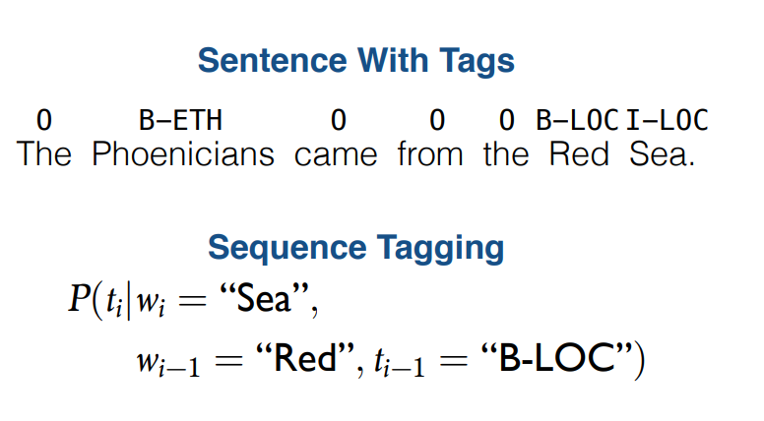
Hidden Markov Models
Hidden Markov Model (HMM): A machine learning framework for labeling sequences.
Sequential Labeling: Each item in a sequence is tagged based on the assumption that its label depends on a limited number of preceding items.
Dependency on Prior Decisions: Decisions made for previous items influence the labeling of the next item in the sequence.
Named Entity Recognition
Session 14

Slide 14
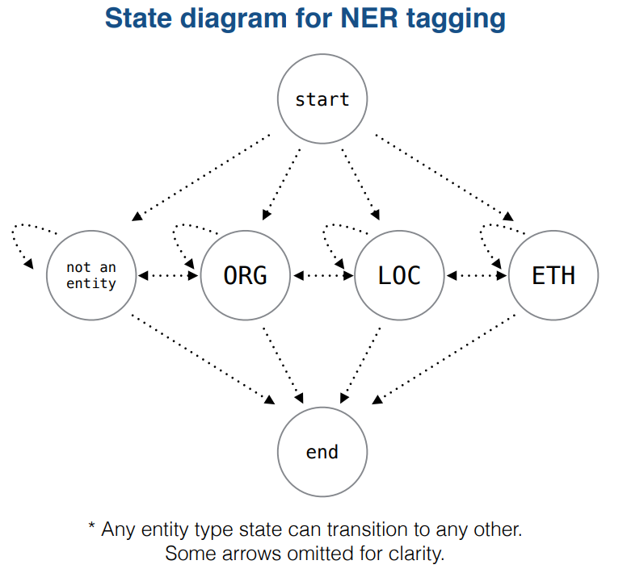
Hidden Markov Models
A HMM describes a process as a series of states, each with some probability distribution over the vocabulary.
When we want to assign a tag to some word w_{i} in a sentence, we only consider:
The properties of w_{i}
The properties and tags assigned to w_{i-1} through w_{i-k} for some small constant k
We assume that for words before w_{i-k} or after w_{i} have no information about the tag for w_{i}, mainly because this simplifies computation.
Named Entity Recognition
Session 14

Slide 15
Forward-Backward Algorithm
HMMs are commonly trained using a dynamic programming technique called the Forward-Backward algorithm. This algorithm has three steps:
Forward step: Move through the sequence in increasing order calculating P(t_{i}|w₁, …, w_{i}).
Backward step: Move backward through the sequence, calculating P(t_{i}|w_{i+1}, …, w_{n}).
Smoothing step: Smooth together the two probabilities to calculate P(t_{i}|w₁, …, w_{n})
Named Entity Recognition
Session 14

Slide 16
Deep Learning Approaches
Deep learning has significantly advanced NER performance, especially with models that can automatically learn complex features and contextual relationships from data.
Some popular deep learning models for NER include Recurrent Neural Networks (RNNs) and Transformer-based models like BERT.
Named Entity Recognition
Session 14

Slide 17
Challenges in NER
Ambiguity: Words may belong to multiple entity types (e.g., "Apple" as fruit or company).
Complex Phrases: Multi-word entities are harder to detect
Domain Adaptation: Different fields require specific entity types and vocabularies.
Low-resource Languages: Less data for effective training in some languages.
Named Entity Recognition
Session 14

Slide 18
NER in Practice
Libraries and Tools:
SpaCy: Fast and easy-to-use NLP library.
NLTK: Classic NLP library, though not optimized for NER.
Hugging Face Transformers: Pre-trained models for advanced NER tasks.
Named Entity Recognition
Session 14

Slide 19
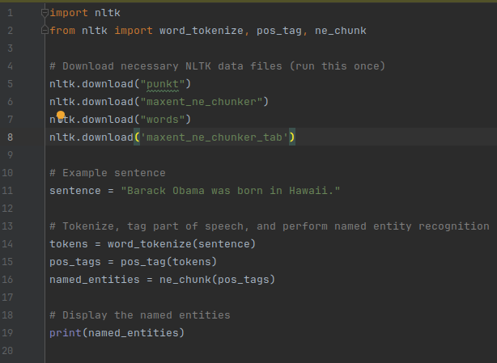
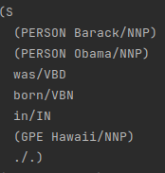
NER with nltk
Named Entity Recognition
Session 14

