Slide 1

Behavior Analysis Technologies
Session 5
Text Classification
Applied Data Science
2024/2025

Slide 2
Text Classification
Text classification involves assigning text documents to predefined categories.
Types of Text Classification:
Binary Classification: Assigns one of two labels (0/1) (e.g., spam vs. not spam).
Multiclass Classification: Assigns one label from multiple categories
( classes) (e.g., classifying news into finance, weather, politics, etc.).
Multilabel Classification: Assigns multiple labels to a single document (e.g., tagging a movie as both "comedy" and "romance").
Text Classification
Session 5

Slide 3
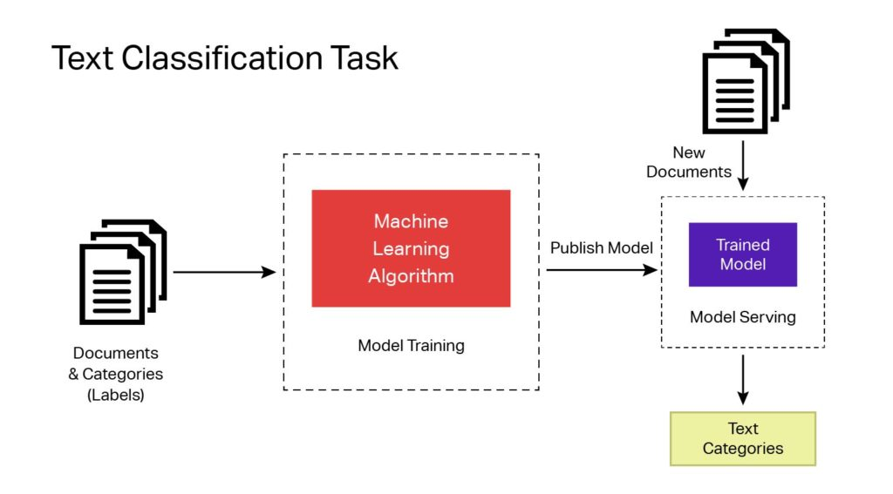
General Approach
https://imerit.net/blog/23-best-text-classification-datasets-for-machine-learning-all-pbm/
Text Classification
Session 5

Slide 4



Formally
Given a training sample , where is a set of documents with corresponding labels , from a set of possible labels, the task is to learn a function that can predict the class for na unseen document .
Text Classification
Session 5

Slide 5
Text Classification
Feature-based approaches ("traditional" machine learning);
Rely on handcrafted features extracted from text, such as:
Bag-of-Words;
TF-IDF;
N-grams;
Linguistic features;
These approaches often use classifiers like Naive Bayes, Support Vector Machines (SVM), or Logistic Regression.
Neural approaches (deep learning).
Leverage neural networks to automatically learn features from text, often involving:
Word embeddings (e.g., Word2Vec, GloVe);
Recurrent Neural Networks;
Transformers (e.g., BERT, GPT)
These methods allow for deeper, more context-aware text representations.
Text Classification
Session 5

Slide 6
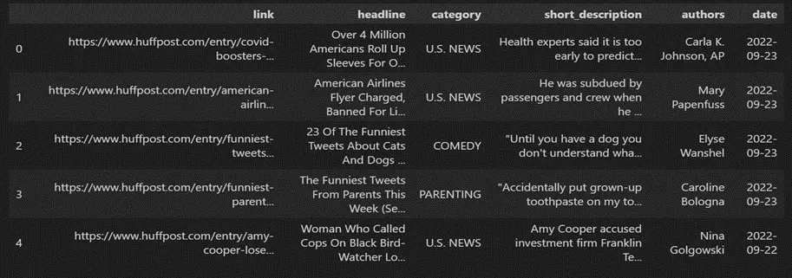
Text Classification Example
Assume we have the following dataset:
Text Classification
Session 5

Slide 7
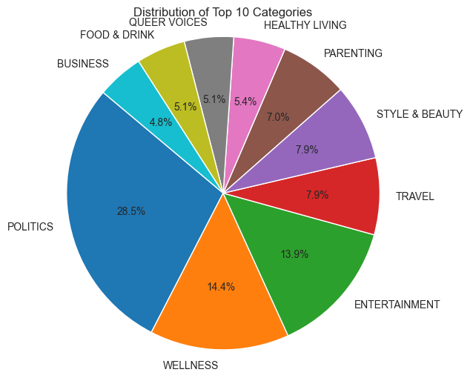
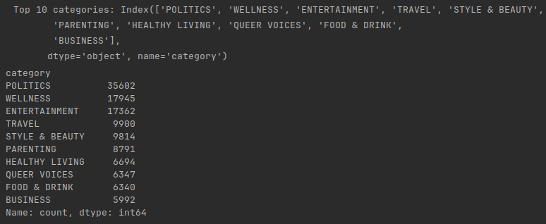
Text Classification Example
Assume we have the following dataset:
Text Classification
Session 5

Slide 8
Text Classification Example
We need to pre-process our dataset to remove unwanted/ irrelevant parts (short description field).
Make it lowercase, removing text in square brackets,removing links, removing punctuation, and removing words containing numbers, etc;
Remove stop words;
Apply stemming/lemmatization;
Etc.
Text Classification
Session 5

Slide 9
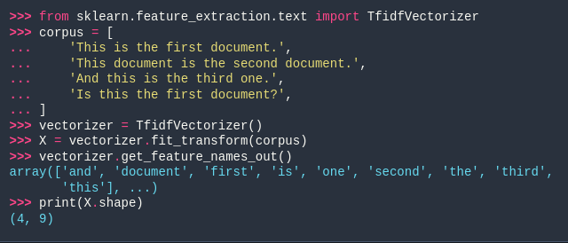
Text Classification Example
Convert text data into numerical vectors:
TF-IDF;
Bag-of-Words;
N-grams;
Etc.
Text Classification
Session 5

Slide 10
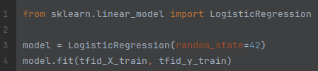
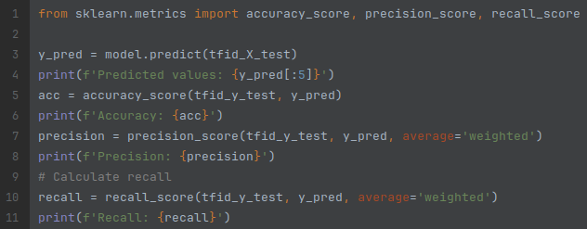
Text Classification Example
Train a model
Evaluate the model
Text Classification
Session 5

Slide 11
Text Classification Evaluation
Assessing Classifier Performance:
Compare predicted labels (𝑦′) with true labels (𝑦) for each document in a dataset.
Confusion Matrix:
Summarizes correct and incorrect predictions in a table.
Metrics:
Use the confusion matrix to calculate performance metrics like accuracy, precision, recall, and F1-score.
Text Classification
Session 5

Slide 12
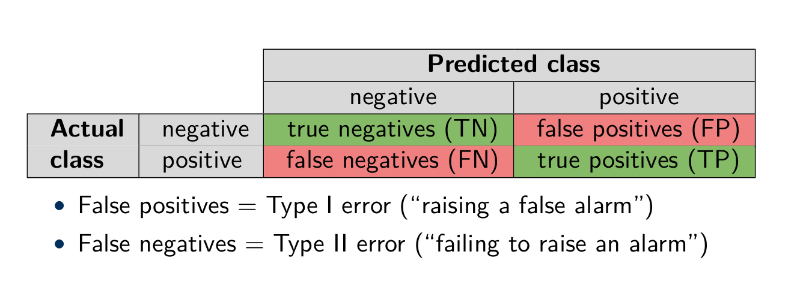
Evaluating Binary Predictions
Which of Type I or Type II error is worse?
Text Classification
Session 5

Slide 13
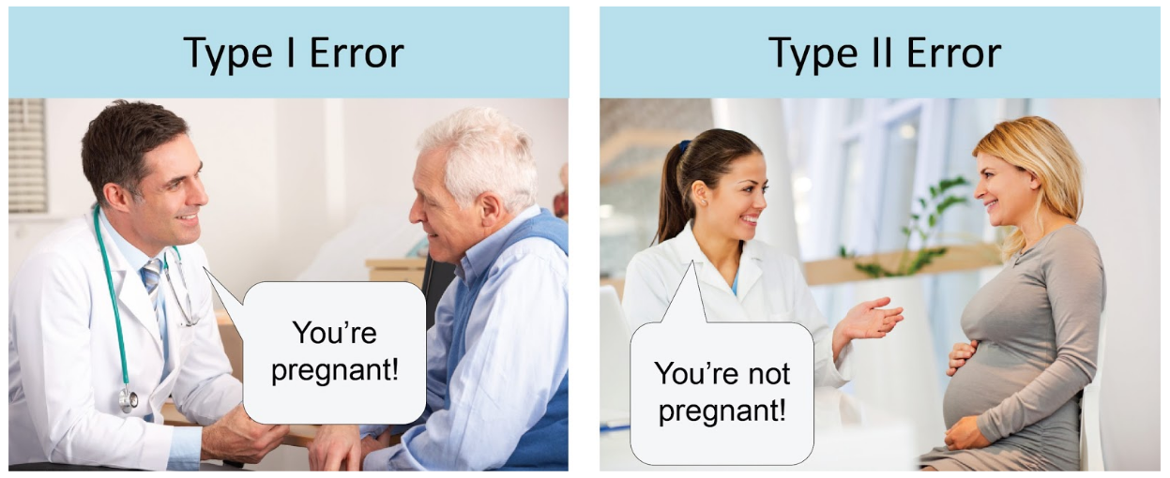
Type I vs. Type II Errors
https://www.analyticsindiamag.com/understanding-type-i-and-type-ii-errors/
Text Classification
Session 5

Slide 14
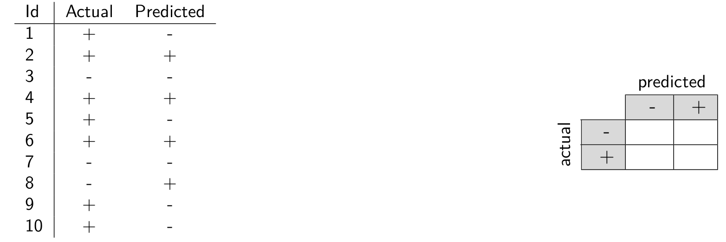
Confusion Matrix Example
Text Classification
Session 5

Slide 15
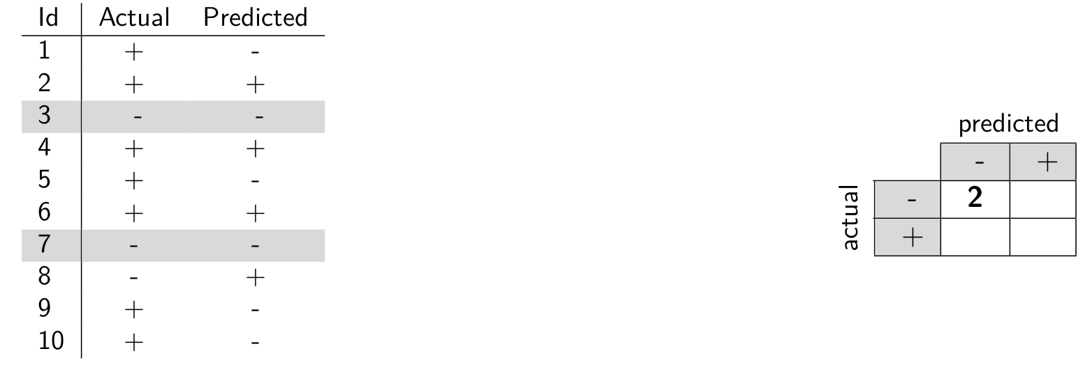
Confusion Matrix Example
Text Classification
Session 5

Slide 16
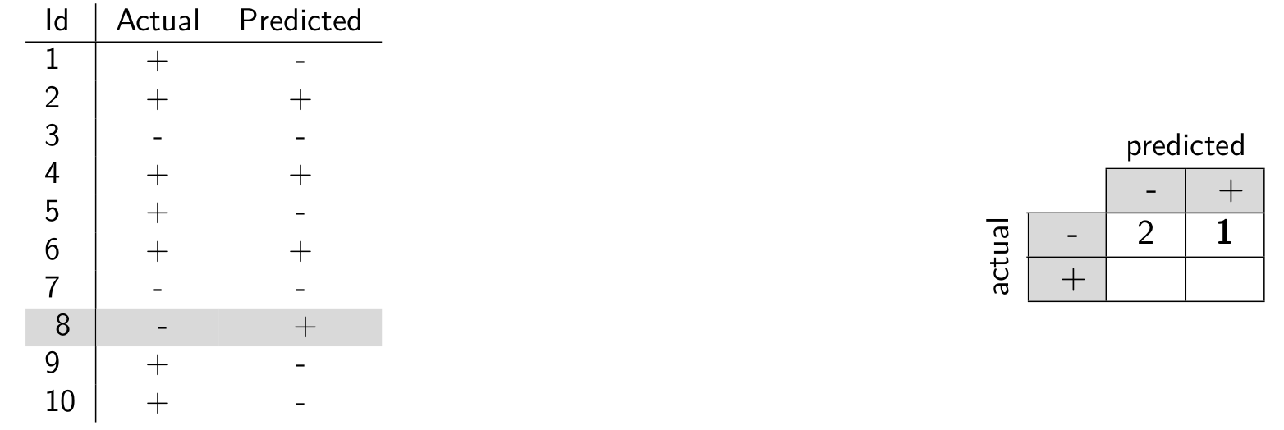
Confusion Matrix Example
Text Classification
Session 5

Slide 17
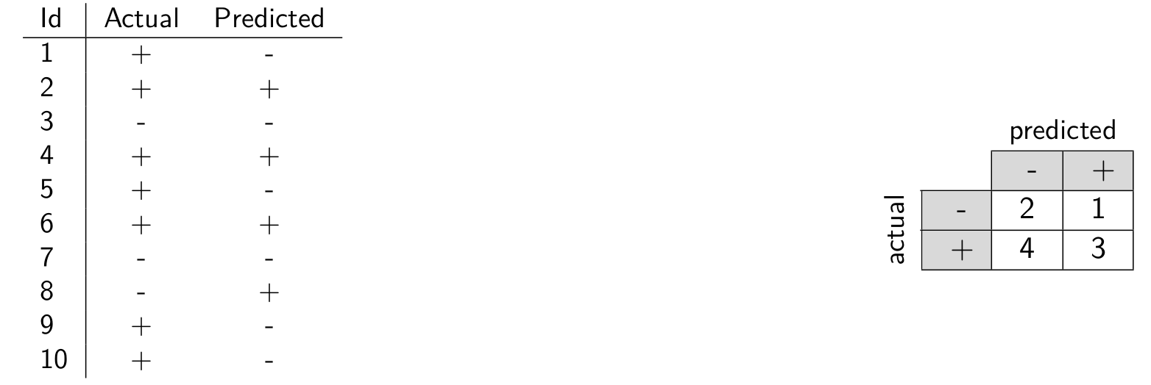
Confusion Matrix Example
Text Classification
Session 5

Slide 18
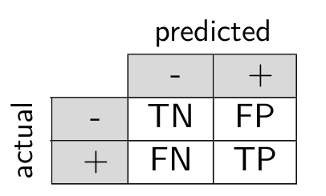
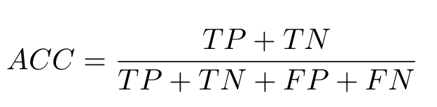
Evaluation Measures
Summarizing performance in a single number
Accuracy
Fraction of correctly classified items out of all items
Text Classification
Session 5

Slide 19
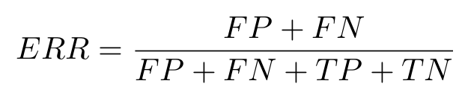
Evaluation Measures
Summarizing performance in a single number
Error rate
Fraction of incorrectly classified items out of all items
Text Classification
Session 5

Slide 20
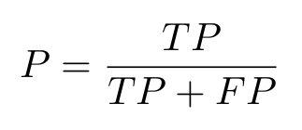
Evaluation Measures
Summarizing performance in a single number
Precision
Fraction of items correctly identified as positive out of the total items identified as positive.
Text Classification
Session 5

Slide 21
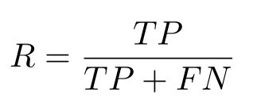
Evaluation Measures
Summarizing performance in a single number
Recall (also called Sensitivity or True Positive Rate)
Fraction of items correctly identified as positive out of the total actual positives
Text Classification
Session 5

Slide 22
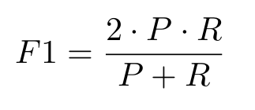
Evaluation Measures
Summarizing performance in a single number
F1-Score
The harmonic mean of precision and recall
Text Classification
Session 5

Slide 23
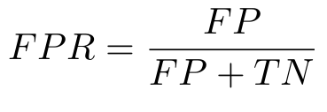
Evaluation Measures
Summarizing performance in a single number
False Positive rate (Type I Error)
Fraction of items wrongly identified as positive out of the total actual negatives
Text Classification
Session 5

Slide 24
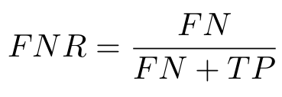
Evaluation Measures
Summarizing performance in a single number
False Negative Rate (Type II Error)
Fraction of items wrongly identified as negative out of the total actual positives
Text Classification
Session 5

Slide 25
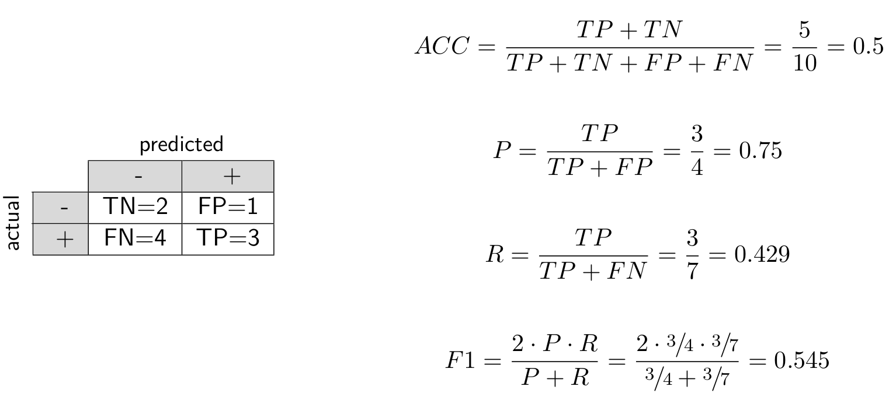
Metrics Example
Text Classification
Session 5

Slide 26
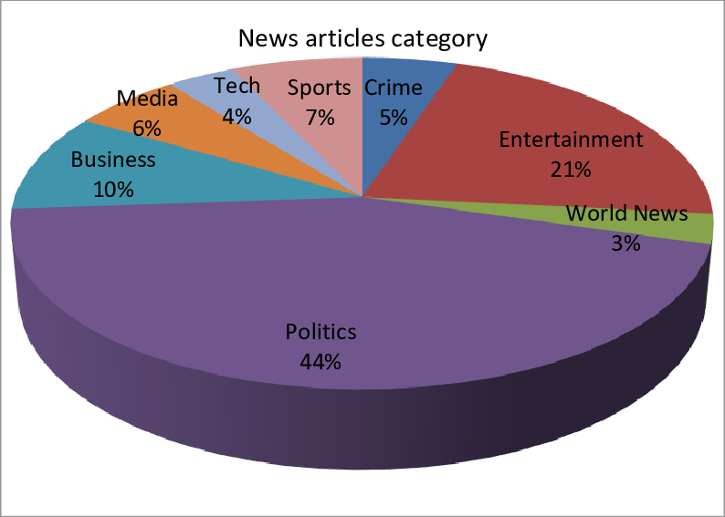
Multiclass Classification
Imagine that we need to automatically sort news stories according to their topical categories.
Text Classification
Session 5

Slide 27
Multiclass Classification
Many algorithms are originally built for binary classification.
Sometimes, those can be adapted for multiclass:
One-vs-Rest: Train one classifier per class vs. all others.
One-vs-One: Train classifiers for every pair of classes.
Voting Scheme: Combine predictions through voting, with tie-breaking mechanisms if needed.
Text Classification
Session 5

Slide 28
One-vs-Rest
Setup:
For 𝑘 target classes (𝑦₁, …, 𝑦_{𝑘}), train one classifier per class.
Training:
Class 𝑦_{𝑖}: positive examples.
All other classes (𝑦𝑗, 𝑗 ≠ 𝑖): negative examples.
Combining Predictions:
Each classifier votes for its class if it predicts positive.
The class with the most votes wins.
Text Classification
Session 5

Slide 29
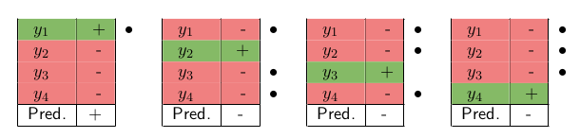
One-vs-Rest
4 classes (𝑦₁, 𝑦₂, 𝑦₃, 𝑦₄)
Classifying a given test intance (dots indicate the votes cast):
Sum votes received: (𝑦₁, ••••) (𝑦₂, ••) (𝑦₃, ••) (𝑦₄, ••)
Text Classification
Session 5

Slide 30
One-vs-One
Setup:
For 𝑘 target classes (𝑦₁, …, 𝑦_{𝑘}), build a binary classifier for each pair (𝑦₁, …, 𝑦_{𝑘}).
Number of classifiers:
A total of 𝑘 ⋅ (𝑘 - 1) / 2 classifiers.
Combining Predictions:
Each pairwise comparison gives a vote to the predicted class.
The class with the most votes wins.
Text Classification
Session 5

Slide 31
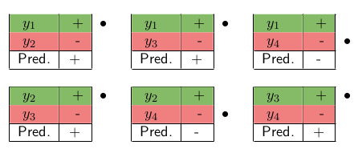
One-vs-One
4 classes (𝑦₁, 𝑦₂, 𝑦₃, 𝑦₄)
Classifying a given test instance (dots indicate the votes cast):
Sum votes received: (𝑦₁, ••) (𝑦₂, •) (𝑦₃, •) (𝑦₄, ••)
Text Classification
Session 5

Slide 32
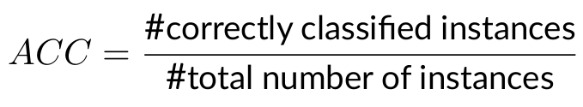
Evaluating Multiclass Classification
Accuracy can still be computed as:
For other metrics:
View it as a set of 𝑘 binary classification problems (𝑘 is the number of classes)
Create confusion matrix for each class by evaluating "one agains the rest"
Average over all classes
Text Classification
Session 5

Slide 33
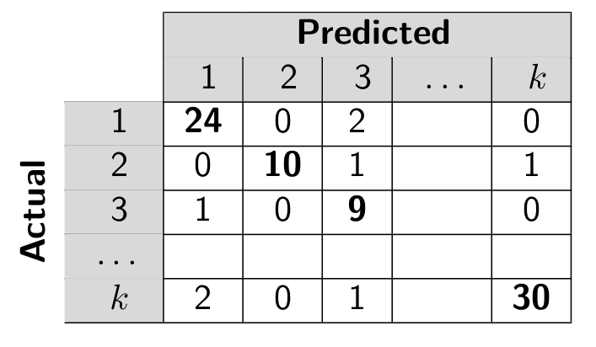
Confusion Matrix
Text Classification
Session 5

Slide 34
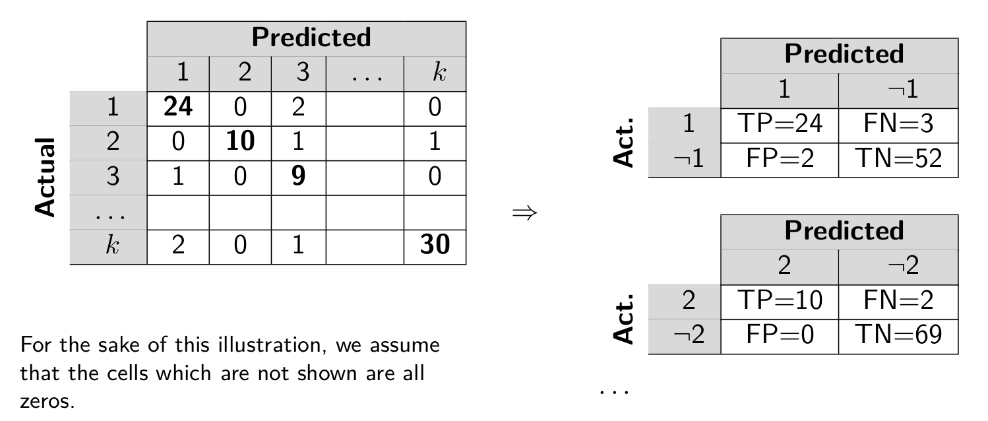
Binary Confusion Matrices (One-Against-Rest)
Text Classification
Session 5

Slide 35
Averaging over classes
Averaging can be performed on the instance level or on the class level.
Micro-averaging aggregates the results of individual instances across all classes.
All instances are treated equal
Macro-averaging computes the measure independently for each class and then take the average.
All classes are treated equal
Text Classification
Session 5

Slide 36
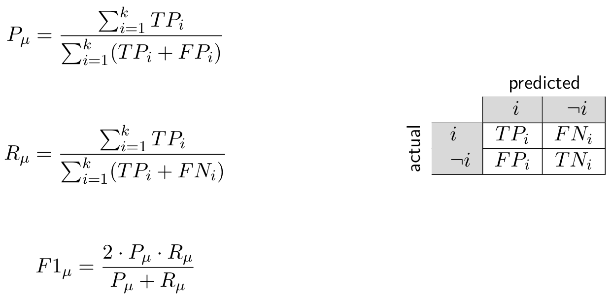
Micro-Averaging
Precision
Recall
F1-Score
Text Classification
Session 5

Slide 37
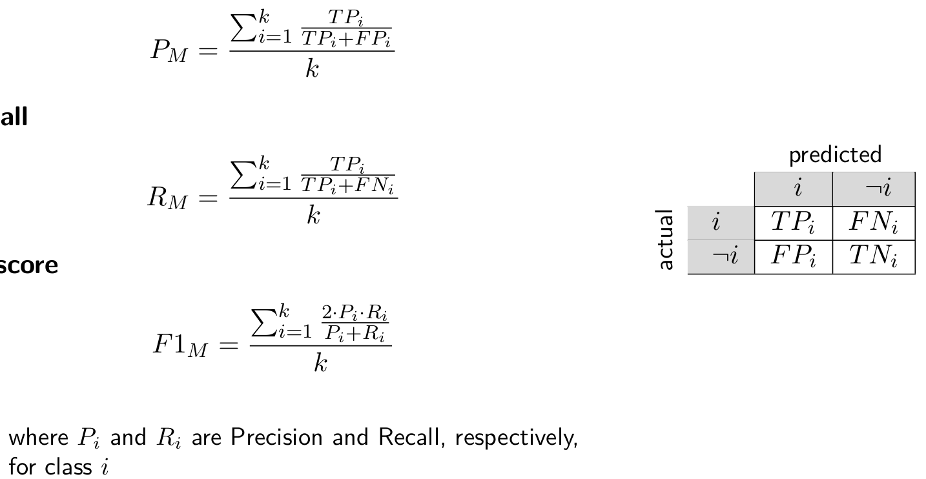
Macro-Averaging
Precision
Recall
F1-Score
Text Classification
Session 5

Slide 38
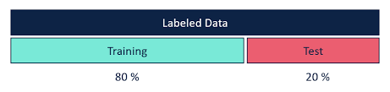
Model Evaluation – Holdout Method
Idea: hold out part of the training data for testing
This data is not used during training, allowing for an independent evaluation of model performance.
Helps prevent overfitting by providing an estimate of how the model generalizes to unseen data.
Single train/validation split
Split the training data into X% training split and 100 − X% validation split (e.g., 80%/20%).
https://community.alteryx.com/t5/Data-Science/Holdouts-and-Cross-Validation-Why-the-Data-Used-to-Evaluate-your/ba-p/448982
Text Classification
Session 5

Slide 39
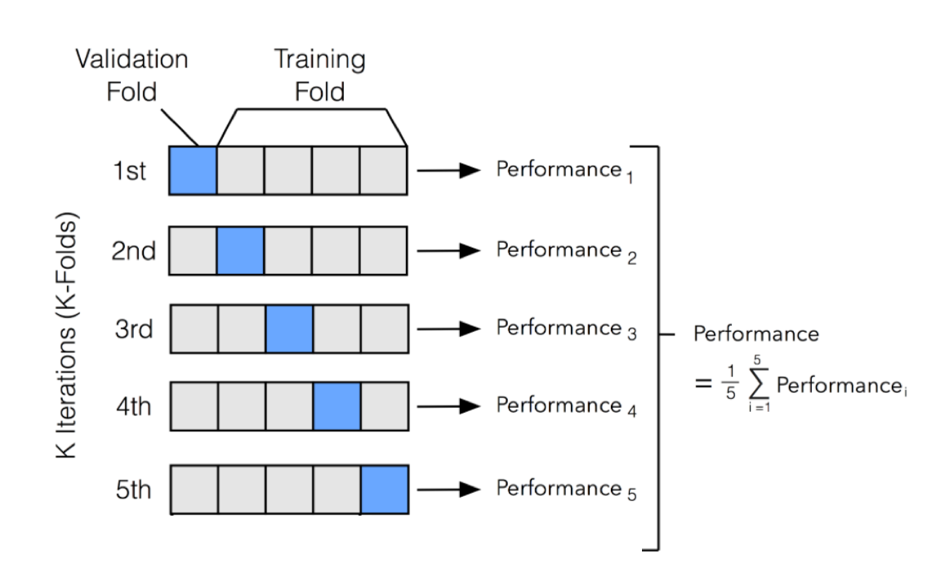
Model Evaluation - 𝑘-fold Cross-Validation
Divide the training data randomly into 𝑘 folds;
Use 𝑘-1 folds for training and test on the 𝑘th fold;
Repeat 𝑘 times (each fold is used for testing exactly once).
Specific case when 𝑘 is equal
to the the number of data
points is called:
"leave-one-out" evaluation.
http://ethen8181.github.io/machine-learning/model_selection/model_selection.html
Text Classification
Session 5

