Slide 1

Behavior Analysis Technologies
Session 24
Power BI and Sentiment Analysis
Applied Data Science
2024/2025

Slide 2

Power BI
A business intelligence (BI) tool by Microsoft.
A suite of software services, apps, and connectors that transform unrelated data sources into coherent, visually immersive, and interactive insights.
Enables data-driven decision-making through powerful visualizations.
Power BI and Sentiment Analysis
Session 24

Slide 3







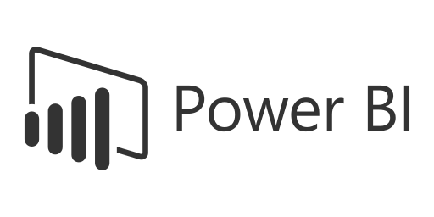


Why Use Power BI?
Usability: User-friendly interface; no coding required.
Affordability: Free desktop version.
Visualizations: Create visually engaging, interactive insights.
Customization: Tailor dashboards and reports for specific needs.
Collaboration: Share and track changes; access via mobile apps.
Power BI and Sentiment Analysis
Session 24

Slide 4
Why Use Power BI?
Connectivity: Supports diverse sources: Excel, SQL, Google Analytics.
Cloud-Based: No installation; automatic updates for all users.
Real-Time Updates: Auto-refresh ensures data is always current.
Security: SaaS ensures safe data sharing and compliance.
Power BI and Sentiment Analysis
Session 24

Slide 5
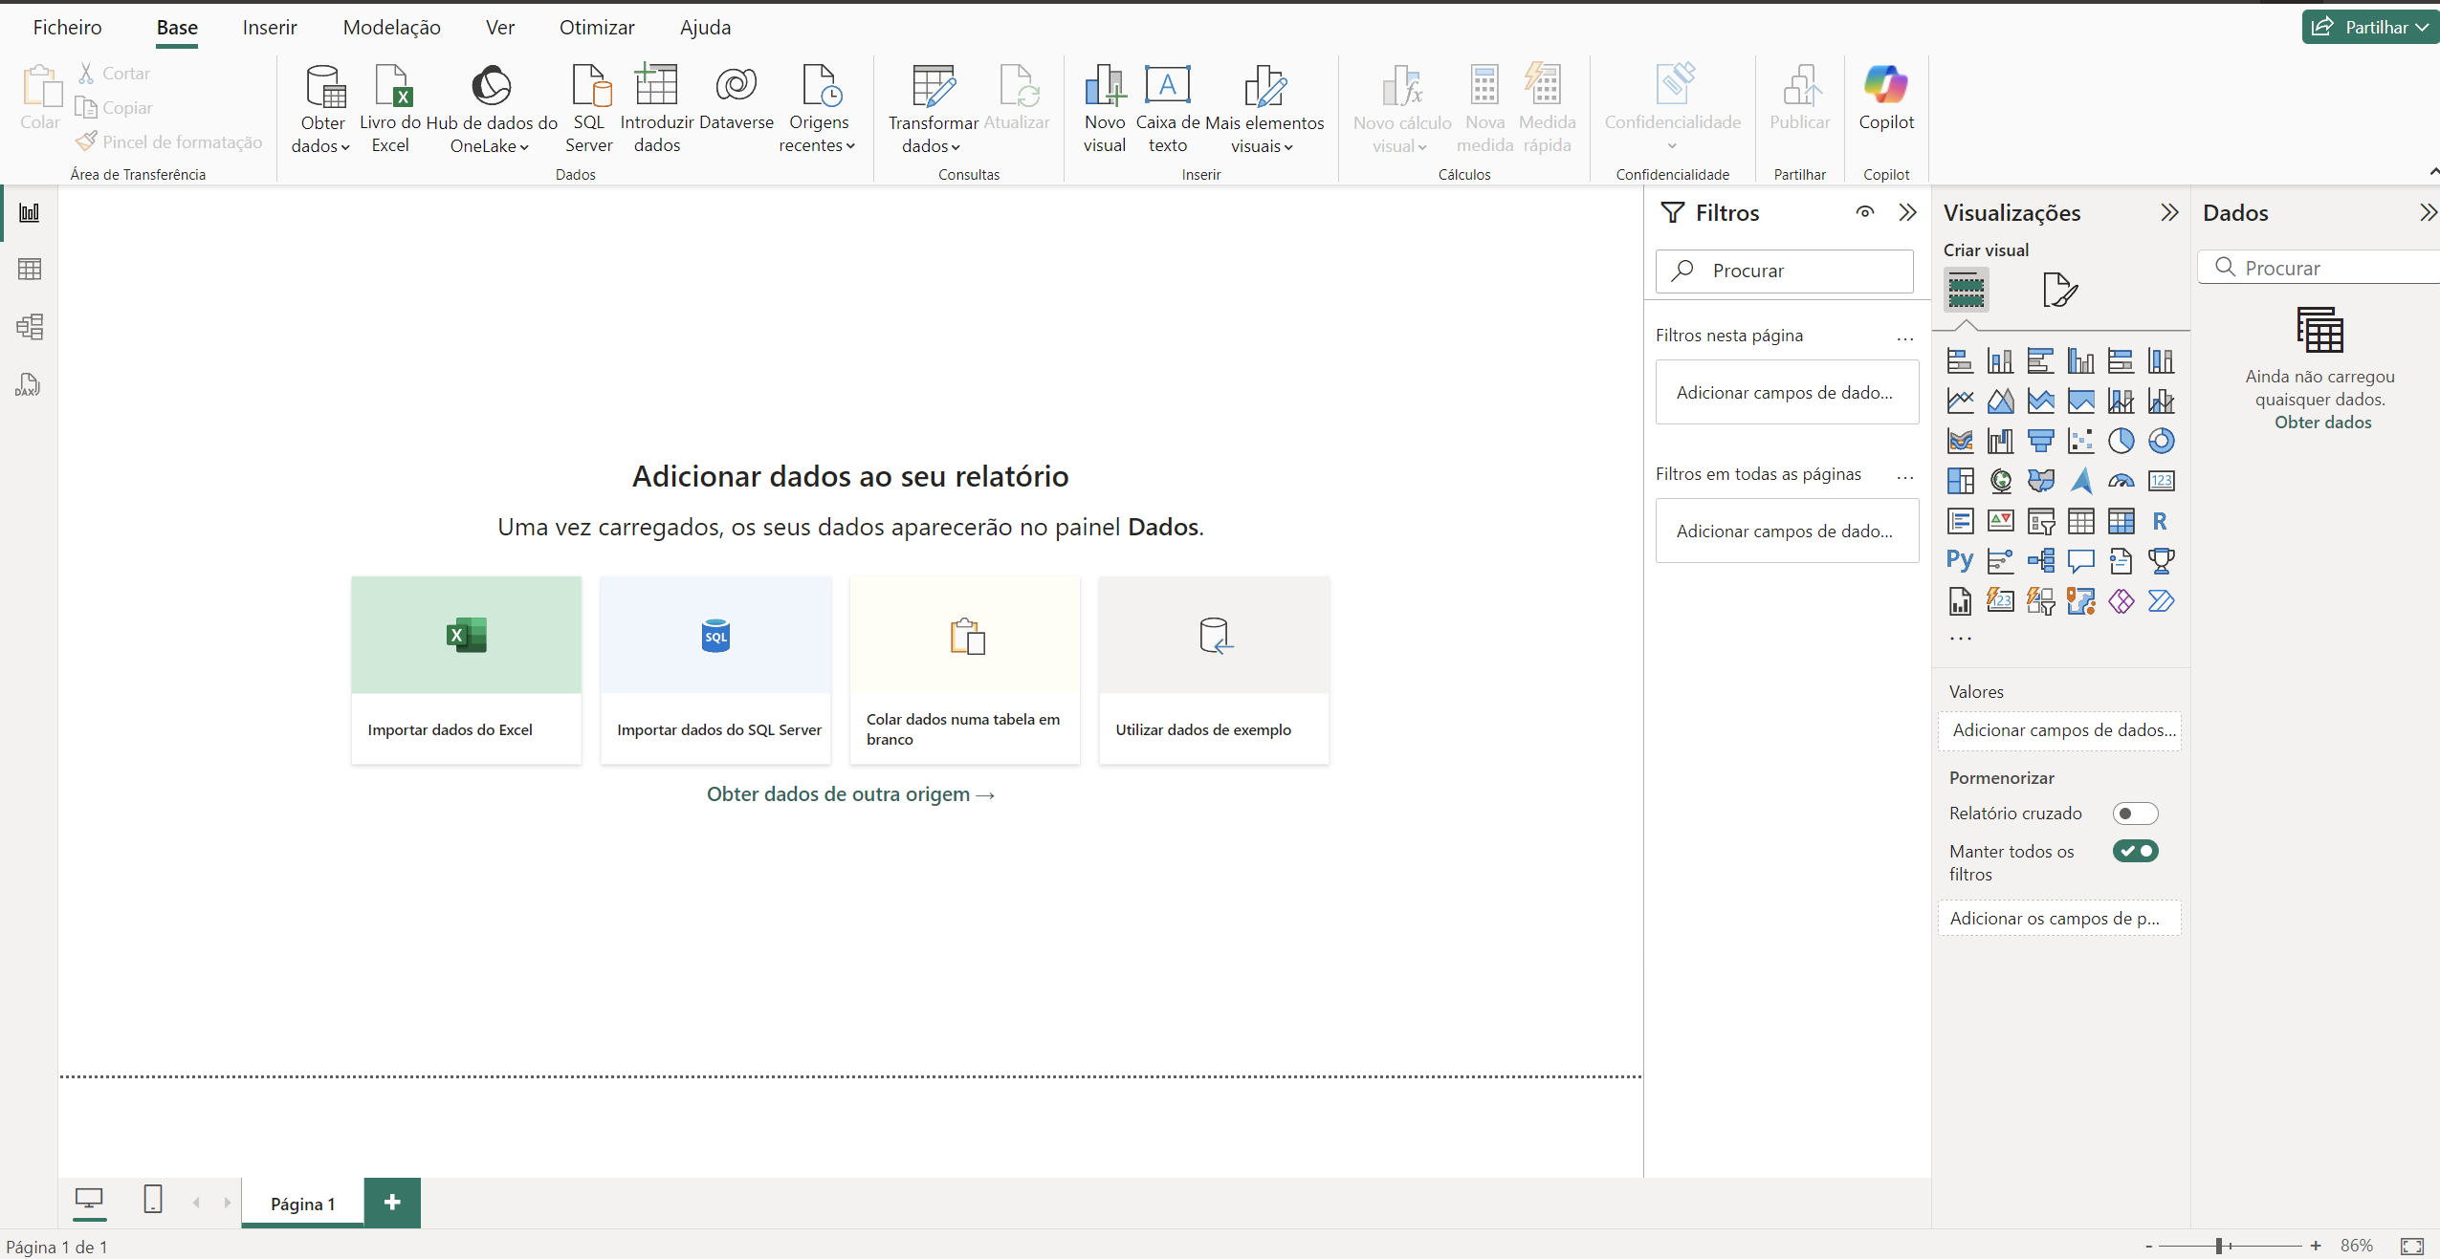
Recap: Power BI Concepts
Ribbon
Report button
Data button
Model button
Canvas
Filter pane
Visualizations pane
Fields pane
Power BI and Sentiment Analysis
Session 24

Slide 6
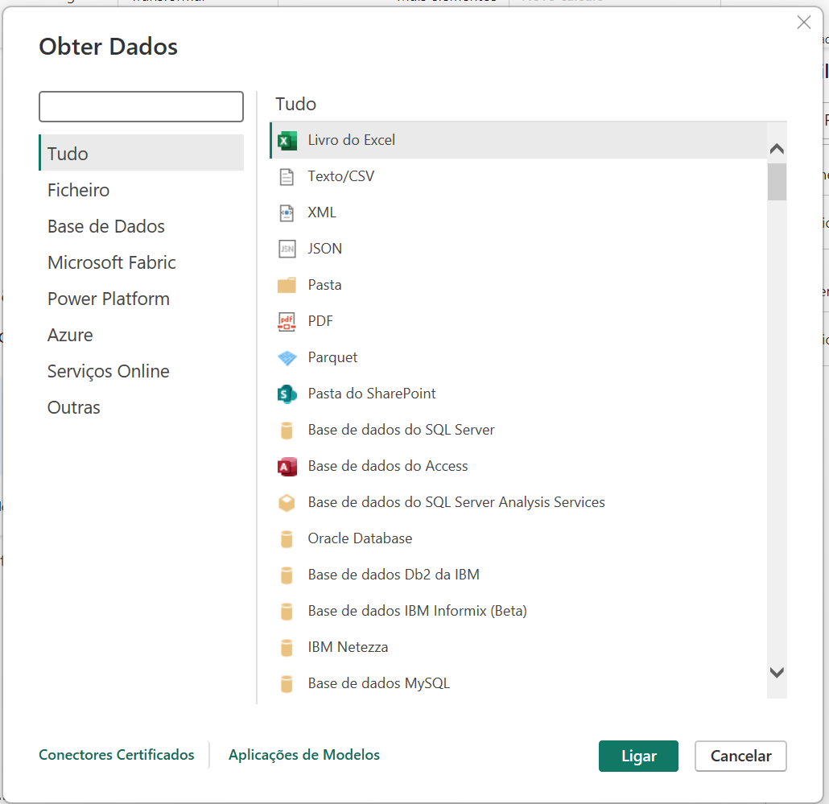
Recap: Power BI Concepts
Power BI and Sentiment Analysis
Session 24

Slide 7
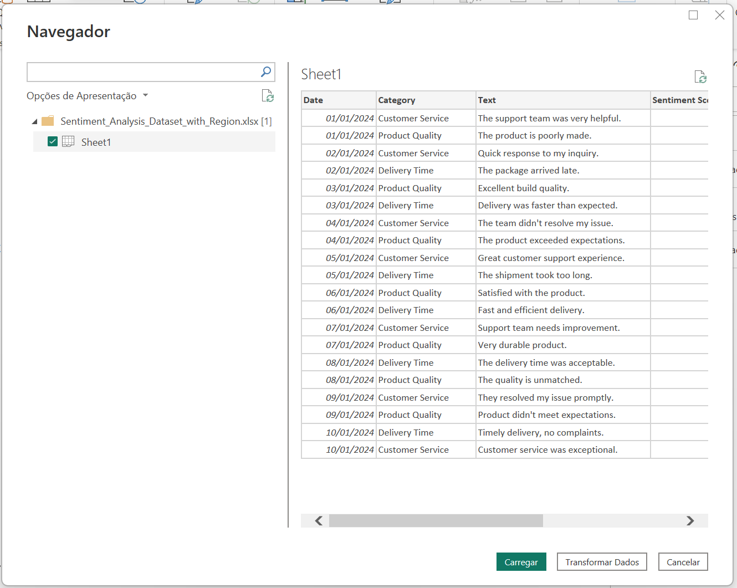
Recap: Power BI Concepts
Power BI and Sentiment Analysis
Session 24

Slide 8
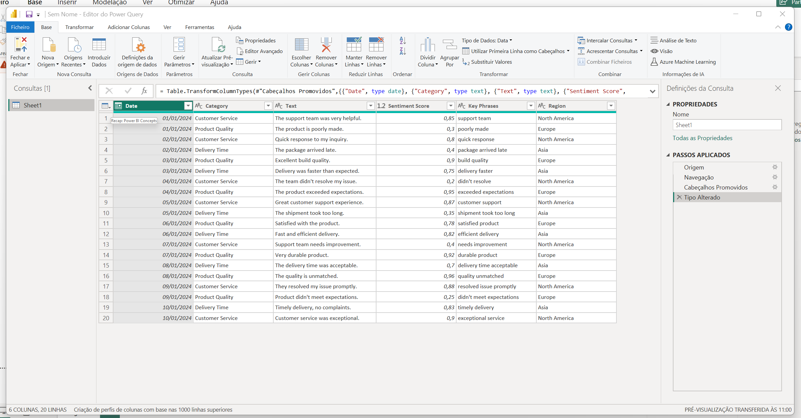
Recap: Power BI Concepts
Power Query
Data transformation and preparation tool that allows users to connect, clean, and shape data from various sources to create a reliable foundation for analysis and visualization.
Power BI and Sentiment Analysis
Session 24

Slide 9
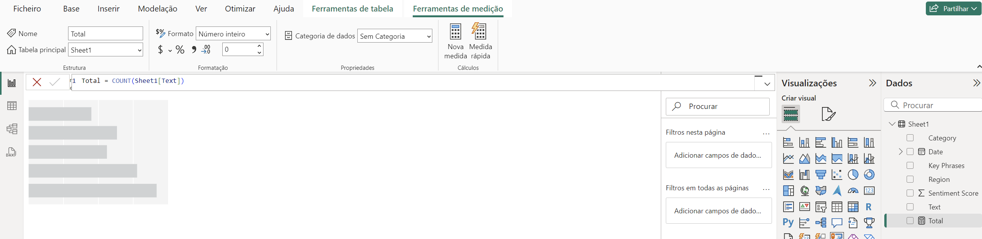
Recap: Power BI Concepts
Measures
Dynamic calculations created using DAX (Data Analysis Expressions) to perform advanced data analysis, track KPIs and generate insights within reports and dashboards.
Power BI and Sentiment Analysis
Session 24

Slide 10
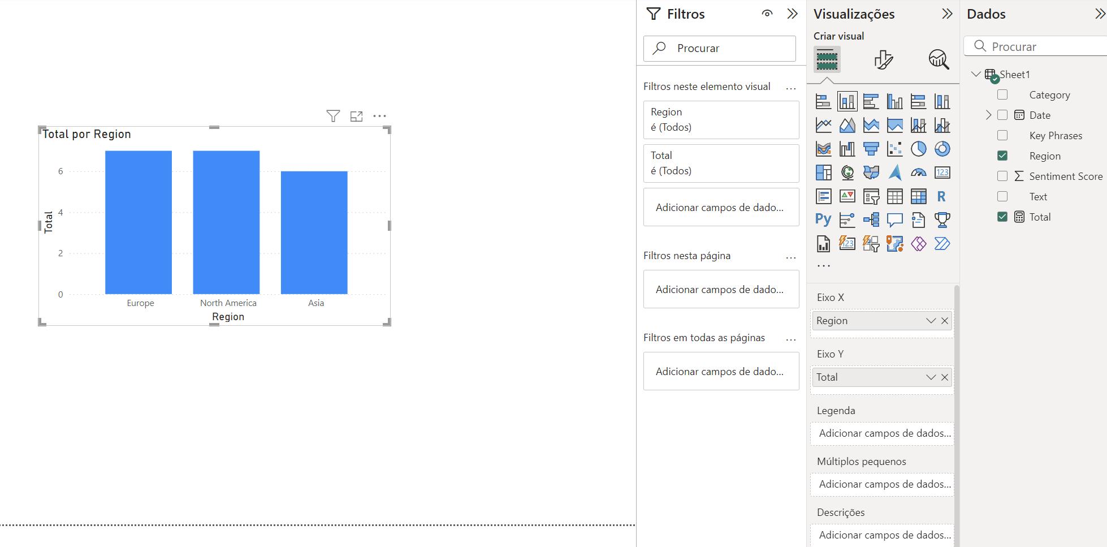
Recap: Power BI Concepts
Visuals
Interactive charts, graphs, and representations that transform data into meaningful insights, enabling users to analyze trends and make informed decisions effectively.
Power BI and Sentiment Analysis
Session 24

Slide 11
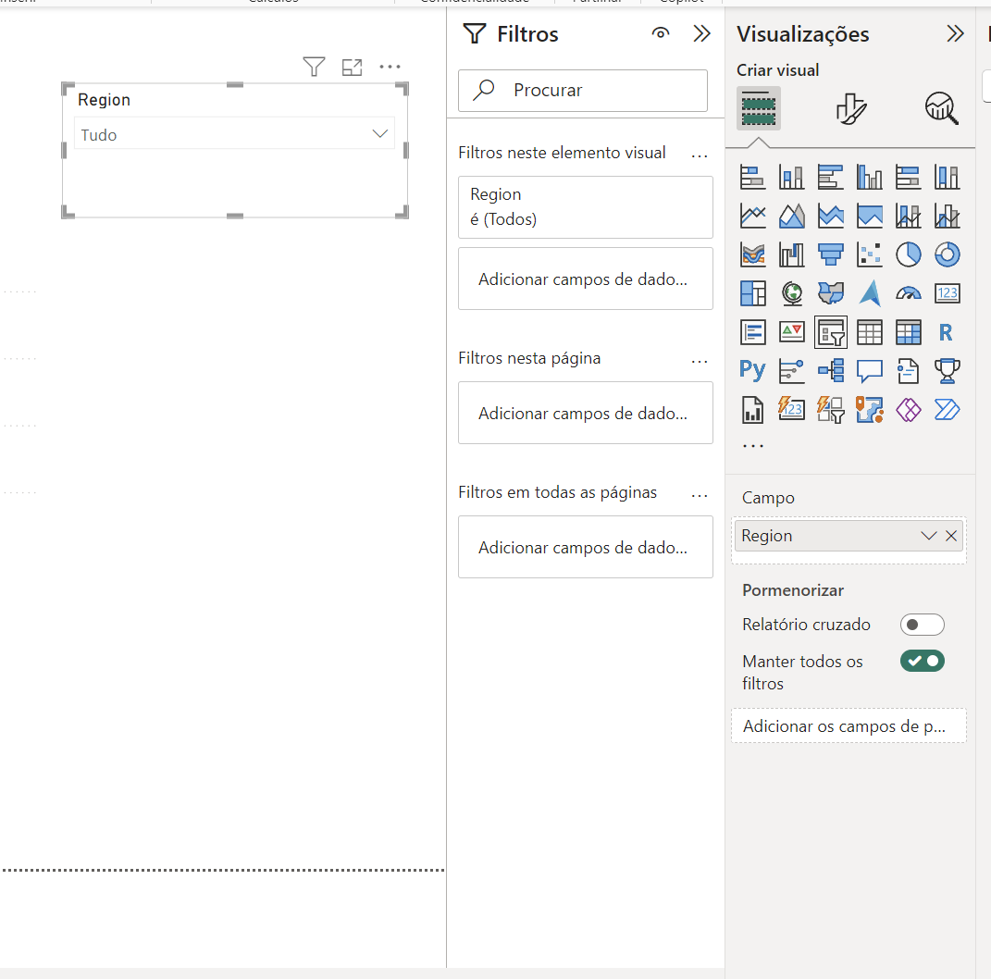
Recap: Power BI Concepts
Filters
Power BI and Sentiment Analysis
Session 24

Slide 12
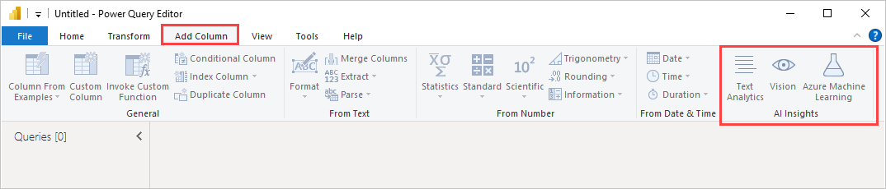
Key Features For Sentiment Analysis
Integration with Azure Cognitive Services:
Sentiment Scoring: Power BI connects seamlessly with Azure Cognitive Services to analyze text and assign a sentiment score.
Key Phrase Extraction: Extracts significant phrases from text for insights into trends and topics.
Power BI and Sentiment Analysis
Session 24

Slide 13
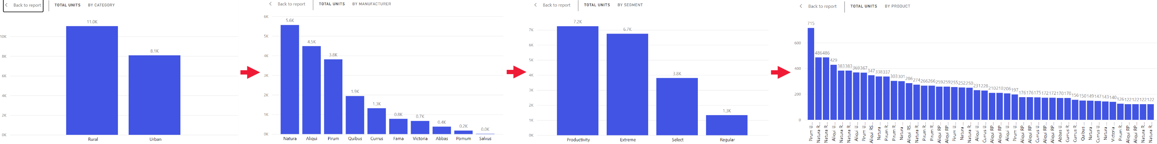
Key Features For Sentiment Analysis
Data Connectivity
Multiple data sources and real-time data refresh
Advanced Visualization
Customizable Dashboards: Build tailored, interactive visuals to represent sentiment data.
Data Drill-Down: Explore specific data points for granular sentiment insights.
Power BI and Sentiment Analysis
Session 24

Slide 14
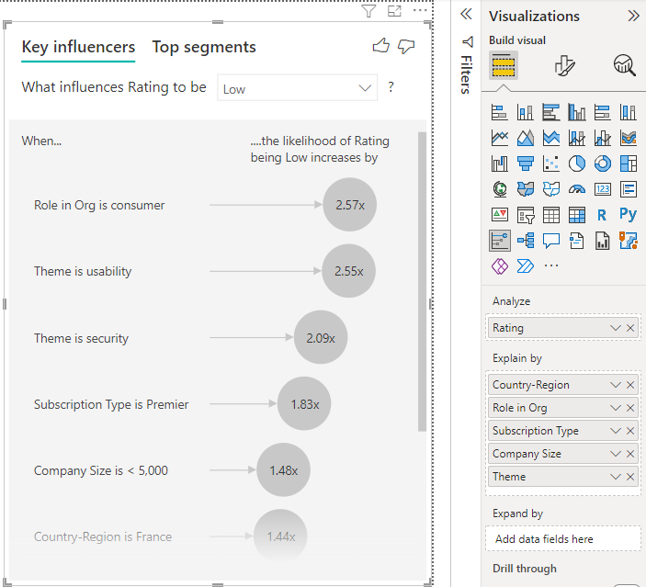
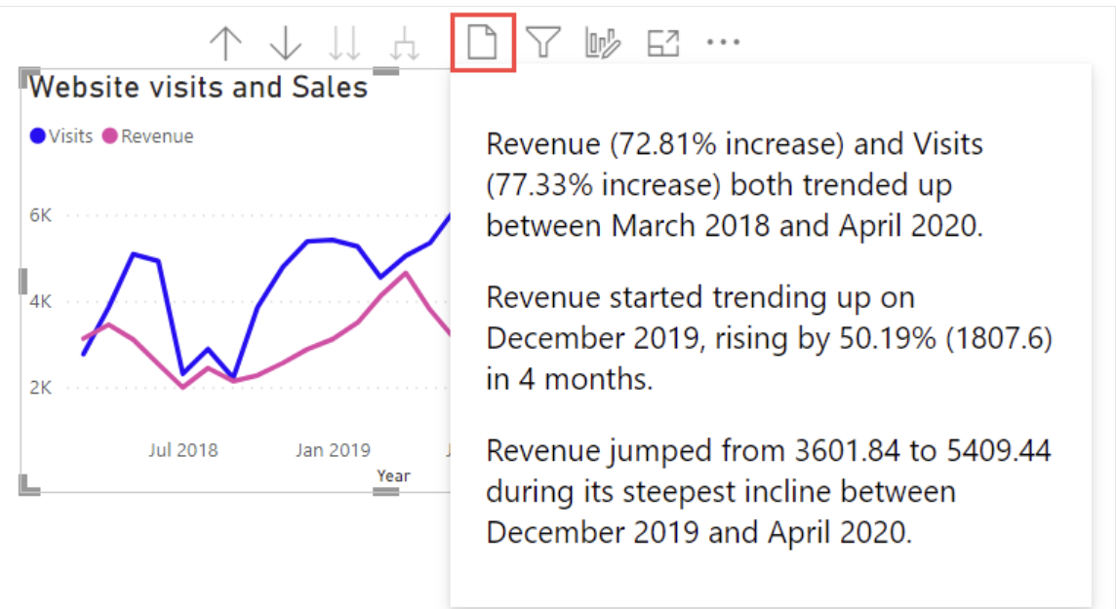
Key Features For Sentiment Analysis
AI-Driven Insights
Smart Visualizations: Features like Smart Narrative and AI visuals highlight trends and anomalies in sentiment data.
Natural Language Querying: Use Q&A features to get instant visualizations by typing queries like "Show sentiment trends over time."
Power BI and Sentiment Analysis
Session 24

Slide 15
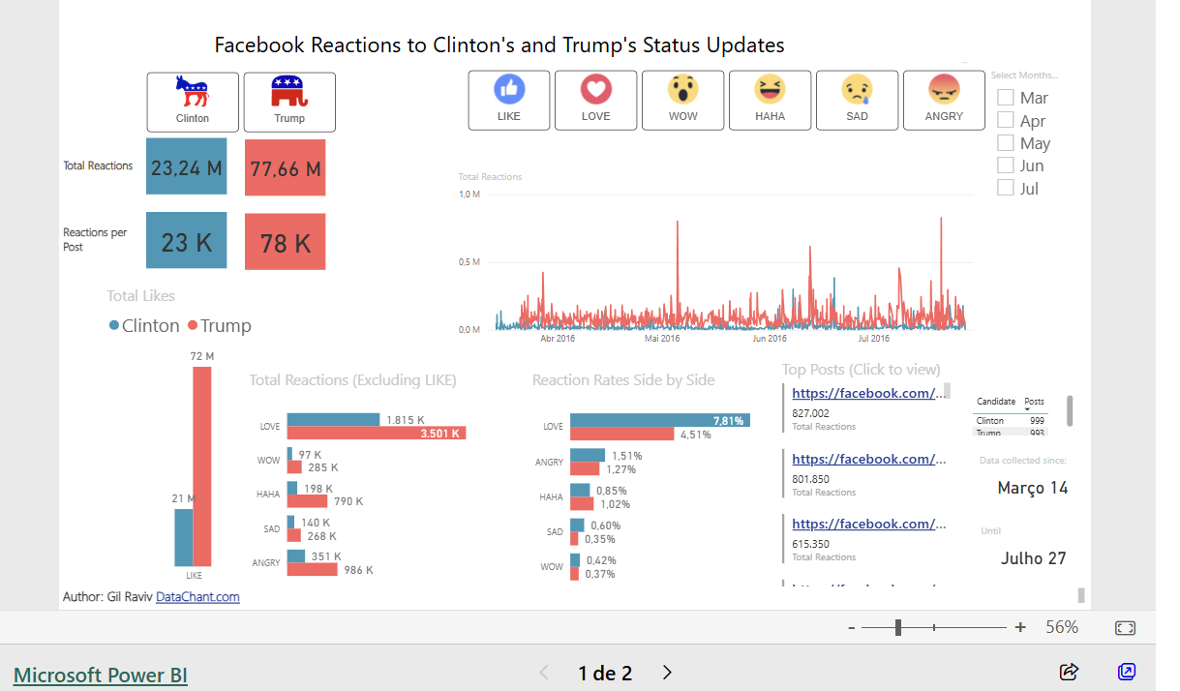
Sentiment Analysis Dashboard Example
https://app.powerbi.com/view?r=eyJrIjoiMTZmYjQ3MGYtYWM1MS00NzExLWFlNTUtNTkyNjNkM2Y3NDlhIiwidCI6IjIyNzNjNDFiLWI4ZDAtNDVhZi1iZWU2LWUwODQ5NmFlNjcxOCIsImMiOjN9
Power BI and Sentiment Analysis
Session 24

Slide 16
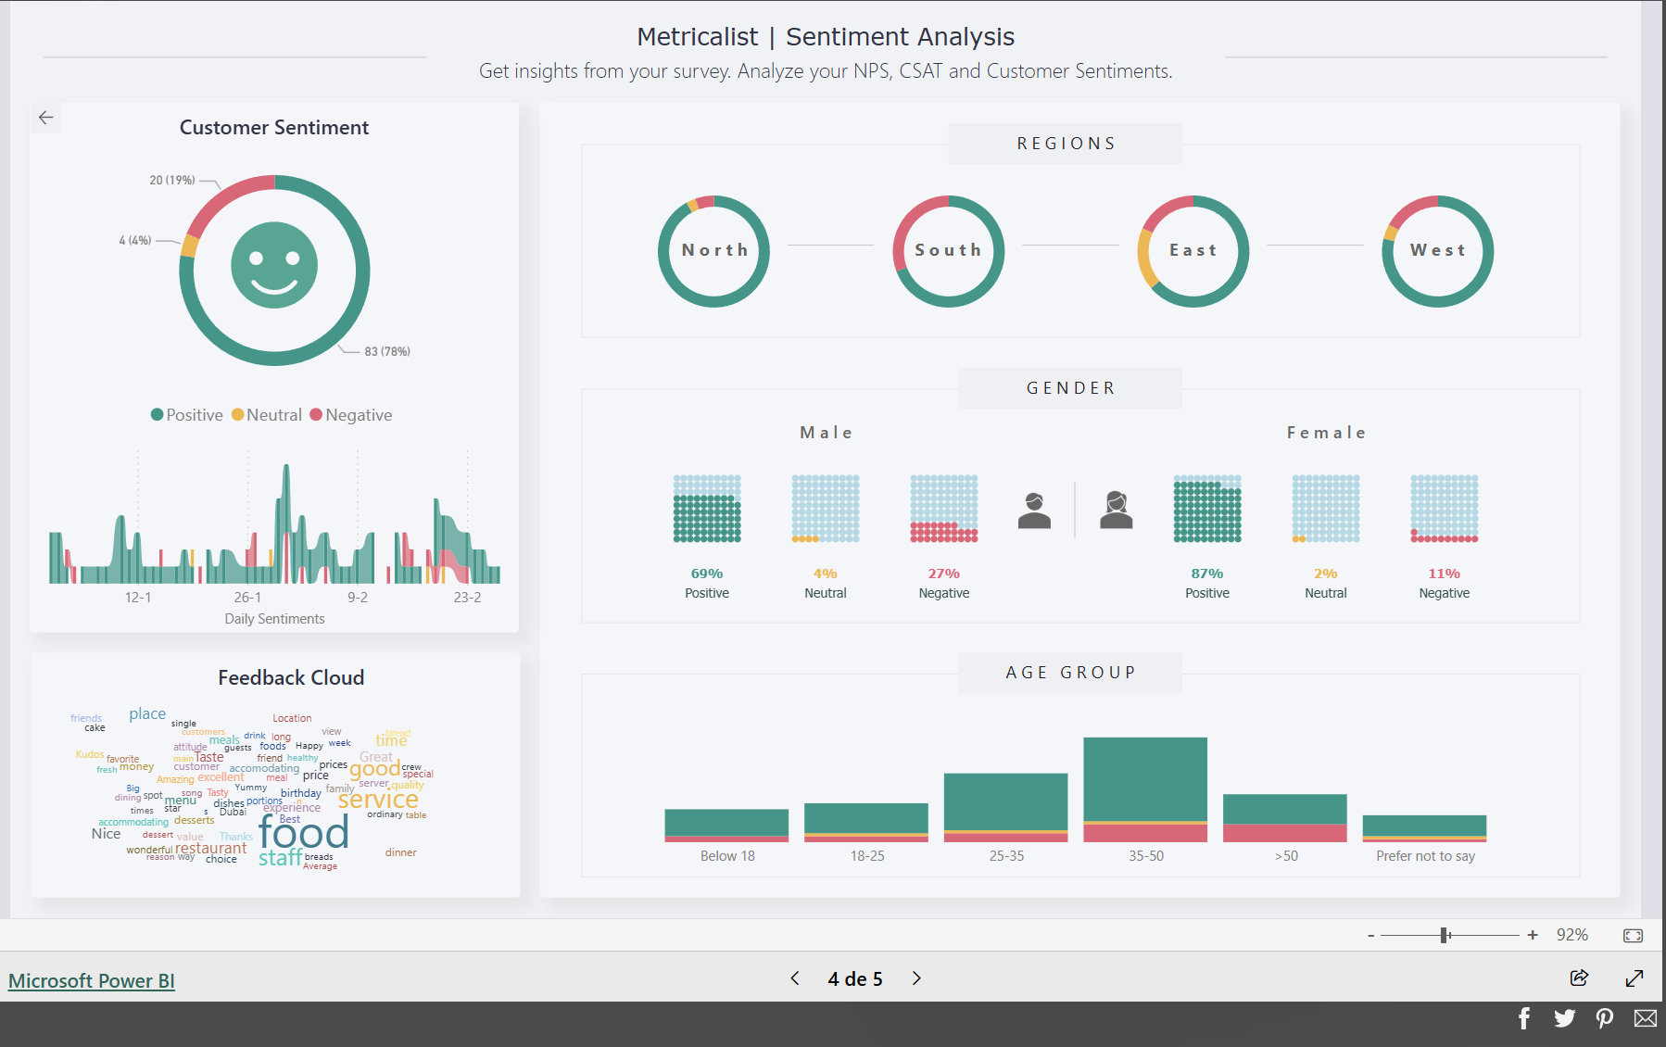
Sentiment Analysis Dashboard Example
https://community.fabric.microsoft.com/t5/Data-Stories-Gallery/Customer-Satisfaction-Report-by-Metricalist/m-p/3724415
Power BI and Sentiment Analysis
Session 24

Slide 17
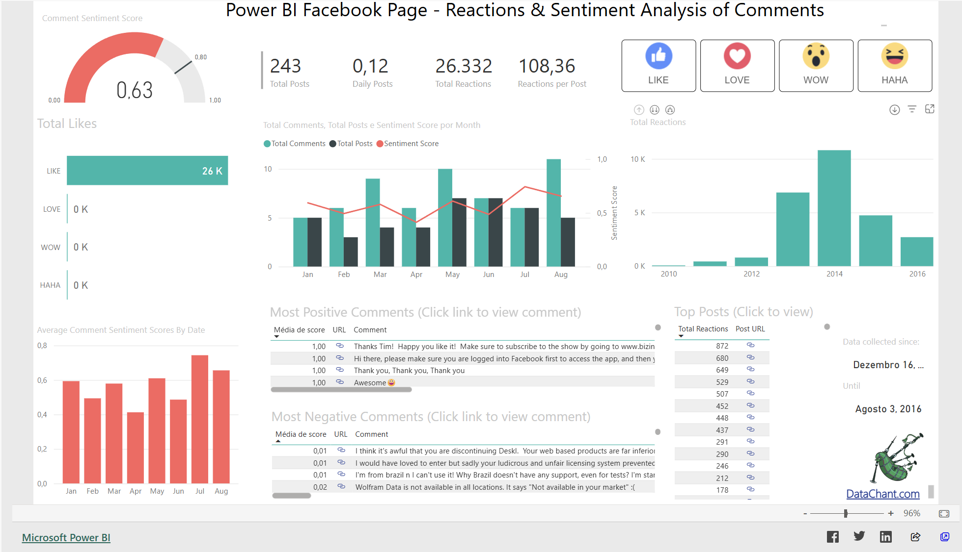
Sentiment Analysis Dashboard Example
https://community.fabric.microsoft.com/t5/Data-Stories-Gallery/Sentiment-Analysis-of-Comments-amp-Reactions-to-Power-BI/m-p/56351
Power BI and Sentiment Analysis
Session 24

Slide 18
Exercise
Using the results from the previous exercise in Power Automate, create an interactive and visual sentiment analysis dashboard in Power BI. The dashboard should allow users to explore and analyze the sentiment data in an intuitive way.
Suggested Visuals:
Sentiment Score Distribution (Bar or Column Chart): Display the distribution of sentiment scores (positive, neutral, negative) across the dataset.
Sentiment Trend (Line Chart): Show how sentiment changes over time (e.g., by month or week).
Key Phrases Analysis (Word Cloud or Bar Chart): Display the most frequent key phrases extracted from the data, highlighting the most discussed topics.
Sentiment by Region (Map or Bar Chart): Visualize sentiment scores by geographic region, if applicable.
Sentiment Breakdown (Donut or Pie Chart): Show the percentage of positive, neutral, and negative sentiment in the dataset.
Power BI and Sentiment Analysis
Session 24

