Slide 1

Behavior Analysis Technologies
Session 7
Text Clustering
Applied Data Science
2024/2025

Slide 2
Clustering
Definition: Grouping similar objects together (e.g., documents, sentences, words, users, etc.)
Purpose: A key data mining technique for exploring large datasets
Uncovers hidden patterns or structures in large datasets
Facilitates data exploration, content organization, and redundancy detectionI
Type: An unsupervised learning problem
Text Clustering
Session 7

Slide 3
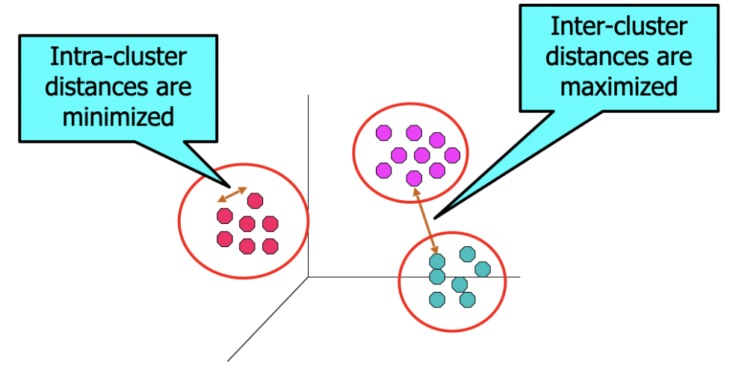
Clustering
Objective: Identify groups of objects where:
Objects within a group are similar (or related) to each other
Objects in different groups are dissimilar (or unrelated)
Text Clustering
Session 7

Slide 4
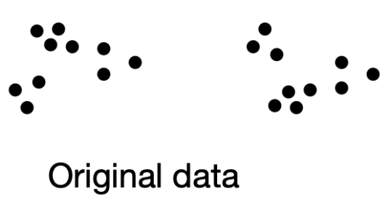
Clustering
How many clusters should be formed?
Text Clustering
Session 7

Slide 5
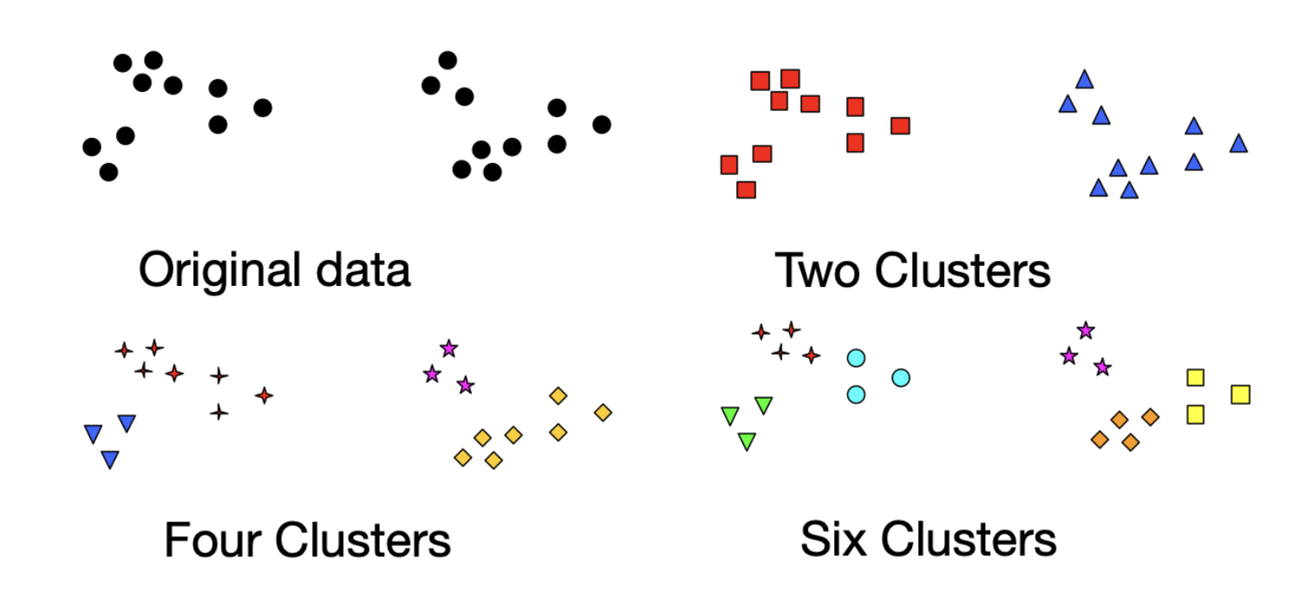
Clustering
The notion of a cluster can be ambiguous!
Text Clustering
Session 7

Slide 6
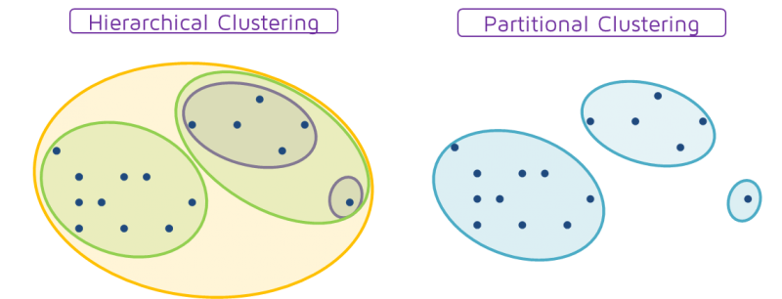
Types of Clustering
Partitional vs. Hierarchical:
Partitional: Creates non-overlapping clusters; each data object belongs to exactly one cluster.
Hierarchical: Forms a nested structure of clusters organized in a tree format.
Text Clustering
Session 7

Slide 7
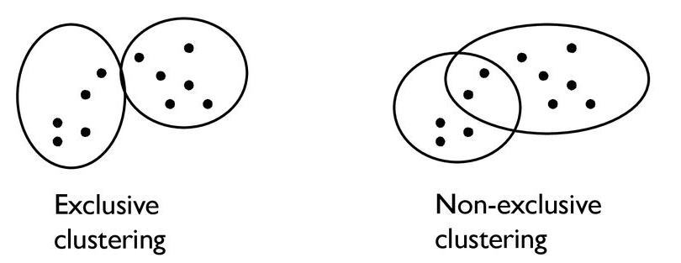
Types of Clustering
Exclusive vs. Non-exclusive:
Exclusive: Objects belong to a single cluster.
Non-exclusive: Objects can belong to multiple clusters.
Text Clustering
Session 7

Slide 8
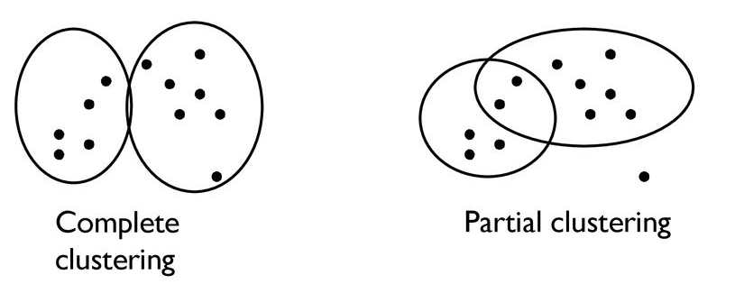
Types of Clustering
Partial vs. Complete:
Partial: Clustering focuses on a subset of the data.
Text Clustering
Session 7

Slide 9
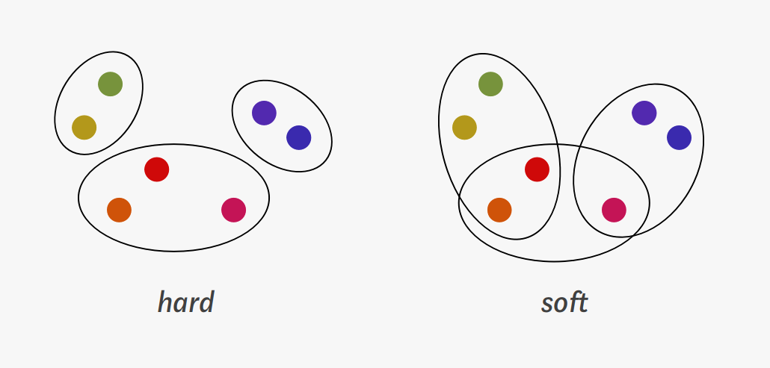
Types of Clustering
Hard vs. Soft:
Hard Clustering: Each object belongs to one cluster only.
Soft (Fuzzy) Clustering: Objects can belong to multiple clusters with varying probabilities.
Text Clustering
Session 7

Slide 10
Clustering Techniques
Similarity-based Clustering: Utilizes a similarity function; each object belongs to one cluster (hard clustering).
Agglomerative Clustering: Merges similar objects incrementally to form clusters (bottom-up approach).
Divisive Clustering: Divides the entire dataset into smaller clusters (top-down approach).
Model-based Techniques: Rely on probabilistic models to capture the underlying structure of data.
Typically represent soft clustering, allowing objects to belong to multiple clusters with associated probabilities.
Text Clustering
Session 7

Slide 11


Similarity-Based Clustering
Both agglomerative and divisive clustering methods rely on a document-document similarity measure, denoted as:
Requirements for the Similarity Measure:
Symmetric:
Normalized:
The choice of similarity measure is closely linked to the representation of documents.
Text Clustering
Session 7

Slide 12
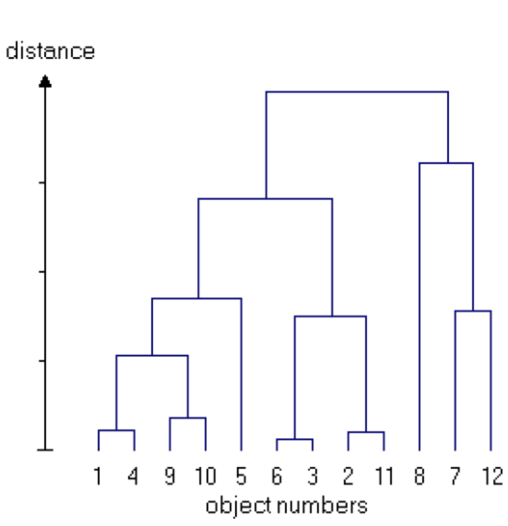
Agglomerative Hierarchical Clustering
Progressively builds clusters to create a hierarchy of merged groups (bottom-up approach).
Process:
Begin with each document as its own cluster.
Gradually merge clusters into larger groups until only one cluster remains.
Output: This series of merges results in a dendrogram.
Cluster Selection:
The dendrogram can be segmented to obtain the desired number of clusters
Alternatively, merging can be stopped once the target number of clusters is reached.
Text Clustering
Session 7

Slide 13
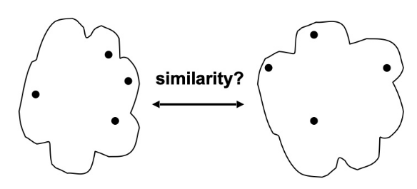
Measuring Inter-Clustering Similarity
Single-link
Complete-link
Average-link
Prototype-based (centroid)
Text Clustering
Session 7

Slide 14
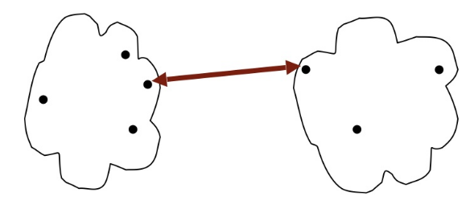
Single-link ("min")
Similarity of two clusters is based on the most similar (closest) points in the different clusters.
Results in "looser" clusters, as it can result in elongated shapes.
Text Clustering
Session 7

Slide 15
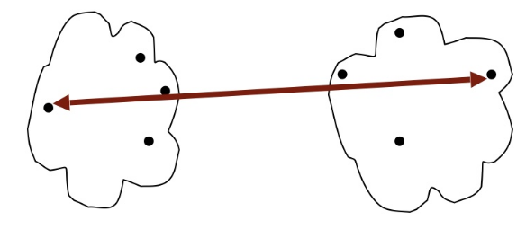
Complete-link ("max")
Similarity of two clusters is based on the two least similar (most distant) points in the different clusters.
Results in “tight” and “compact” clusters (tends to break large clusters)
Text Clustering
Session 7

Slide 16
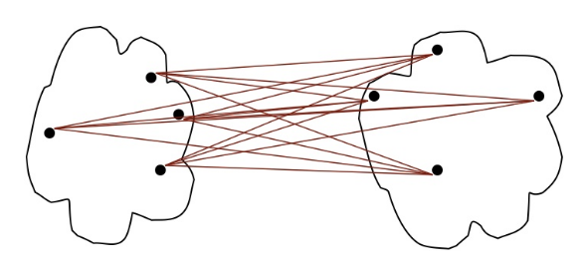
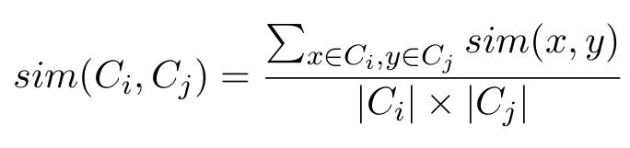
Average-link ("avg")
Similarity of two clusters is the average of pairwise similarity between points in the two clusters
Less susceptible to noise and outliers than single- and complete-link
cardinality of a set
(number of elements in a mathematical set)
Text Clustering
Session 7

Slide 17
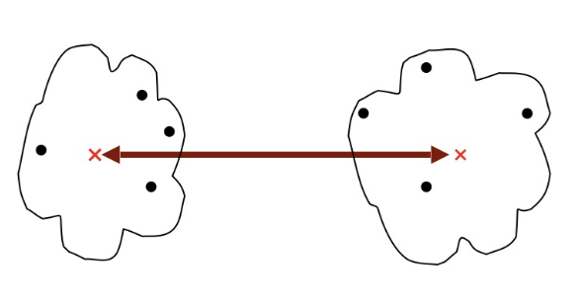
Prototype-based (centroid)
Represent clusters by their centroids and base their similarity on the similarity of the centroids.
To find the centroid, we need to compute the (arithmetic) mean of the points’ positions separately for each dimension
Text Clustering
Session 7

Slide 18
K-means Clustering
A form of divisive clustering.
Process: Begins with an initial clustering and iteratively refines it until a stopping criterion is met.
Each cluster is represented by a centroid, which is the average of all members' values within the cluster.
Identifies a user-specified number of clusters, denoted as K.
Text Clustering
Session 7

Slide 19
Basic K-means Algorithm
Select K points as initial centroids
Repeat
2.1 Form K clusters by assigning each point to its closest centroid
2.2 Recompute the centroid of each cluster
Until centroids do not change
Text Clustering
Session 7

Slide 20
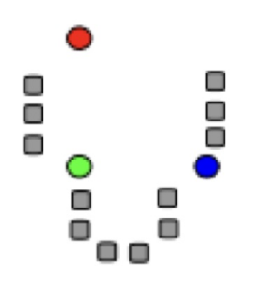
Basic K-means Algorithm
Select K points as initial centroids
Repeat
2.1 Form K clusters by assigning each point to its closest centroid
2.2 Recompute the centroid of each cluster
Until centroids do not change
Text Clustering
Session 7

Slide 21
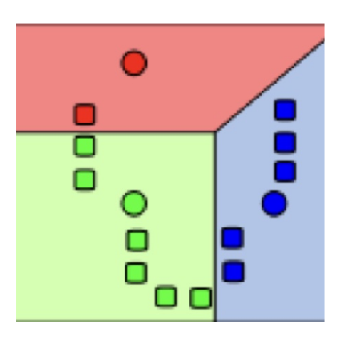
Basic K-means Algorithm
Select K points as initial centroids
Repeat
2.1 Form K clusters by assigning each point to its closest centroid
2.2 Recompute the centroid of each cluster
Until centroids do not change
Text Clustering
Session 7

Slide 22
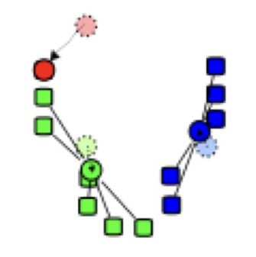
Basic K-means Algorithm
Select K points as initial centroids
Repeat
2.1 Form K clusters by assigning each point to its closest centroid
2.2 Recompute the centroid of each cluster
Until centroids do not change
Text Clustering
Session 7

Slide 23
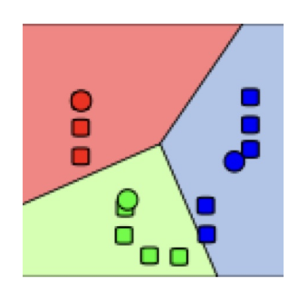
Basic K-means Algorithm
Select K points as initial centroids
Repeat
2.1 Form K clusters by assigning each point to its closest centroid
2.2 Recompute the centroid of each cluster
Until centroids do not change
Text Clustering
Session 7

Slide 24
Basic K-means Algorithm
Select K points as initial centroids
Repeat
2.1 Form K clusters by assigning each point to its closest centroid
2.2 Recompute the centroid of each cluster
Until centroids do not change
Text Clustering
Session 7

Slide 25
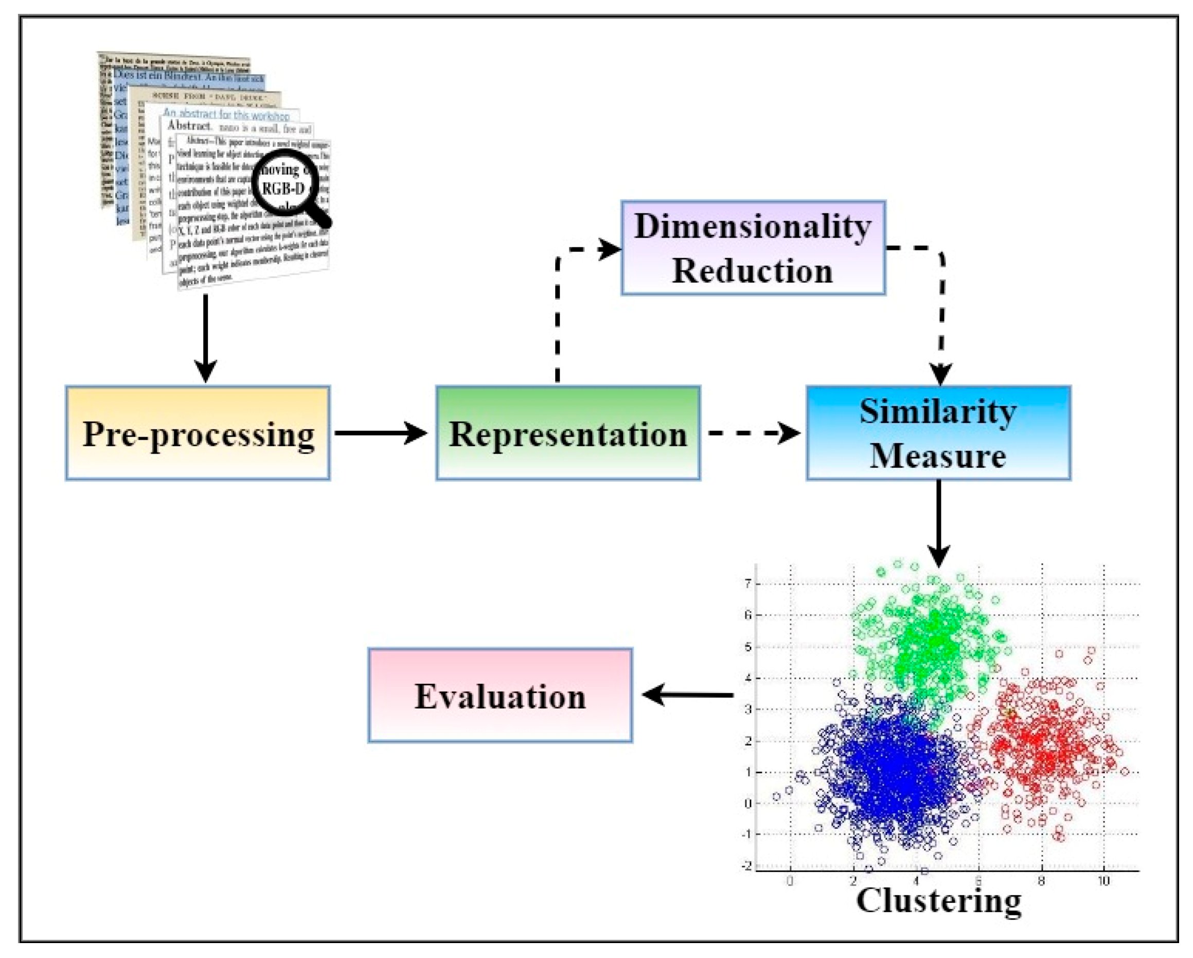
Components for text-data clustering
Text Clustering
Session 7

