Slide 1

Behavior Analysis Technologies
Session 15
Word Embeddings
Applied Data Science
2024/2025

Slide 2
Word Meaning via Language Use
The meaning of a word can be given by its distribution in language usage:
One way to define "usage": words are defined by their environments
Neighboring words or grammatical environments
Intuitions: Zellig Harris (1954):
“oculist and eye-doctor … occur in almost the same environments”
“If A and B have almost identical environments we say that they are synonyms.”
Word Embeddings
Session 15

Slide 3
Words Representations
How can we represent the meaning of words?
So we can ask:
How similar is cat to dog, or Paris to London?
How similar is document A to document B?
Word Embeddings
Session 15

Slide 4
Words as Vectors
Can we represent words as vectors?
The vector representations should:
Capture semantics
similar words should be close to each other in the vector space
relation between two vectors should reflect the relationship between the two words
Be efficient (vectors with fewer dimensions are easier to work with)
Be interpretable
Word Embeddings
Session 15

Slide 5
Words as Vectors
How similar are the following two words? (not similar 0–10 very similar)
Smart and intelligent
Easy and big
Easy and difficult
Hard and difficult
Word Embeddings
Session 15

Slide 6
Words as Vectors
How similar are the following two words? (not similar 0–10 very similar)
Smart and intelligent: 9.20
Easy and big: 1.12
Easy and difficult: 0.58
Hard and difficult: 8.77
(SimLex-999 dataset, https://fh295.github.io/simlex.html)
Word Embeddings
Session 15

Slide 7
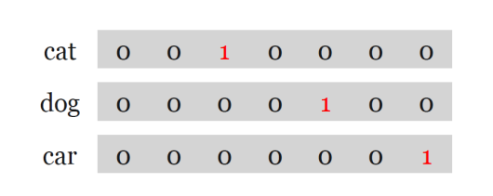
Recap: One-Hot-Encoding
Map each word to a unique identifier (e.g. cat (3) and dog (5))
Vector representation: all zeros, except 1 at the ID
Word Embeddings
Session 15

Slide 8
Recap: One-Hot-Encoding
Map each word to a unique identifier (e.g. cat (3) and dog (5))
Vector representation: all zeros, except 1 at the ID
What are the limitations of one-hot-encoding?
Word Embeddings
Session 15

Slide 9
Recap: One-Hot-Encoding
Map each word to a unique identifier (e.g. cat (3) and dog (5))
Vector representation: all zeros, except 1 at the ID
High number of dimensions!
Related words have distinct vectors.
Word Embeddings
Session 15

Slide 10
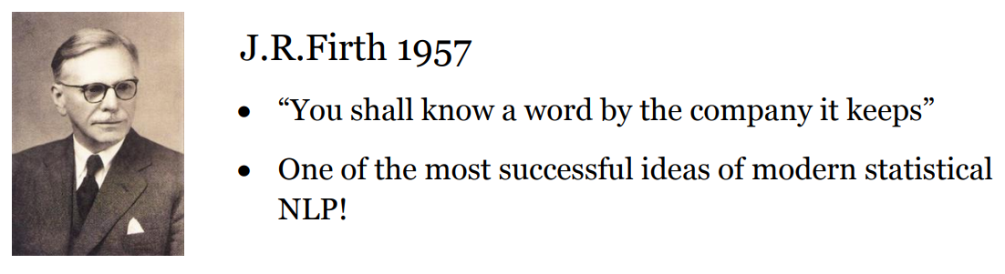
Distributional Hypotesis
Words that occur in similar contexts tend to have similar meanings.
Word Embeddings
Session 15

Slide 11
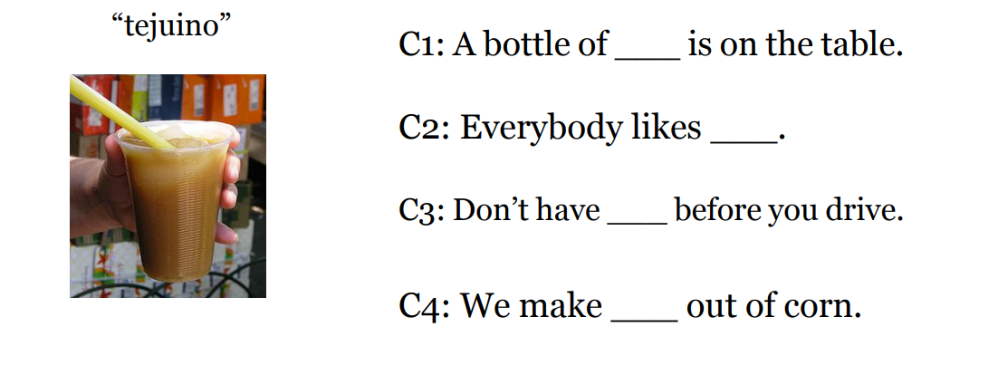
Distributional Hypotesis
Word Embeddings
Session 15

Slide 12
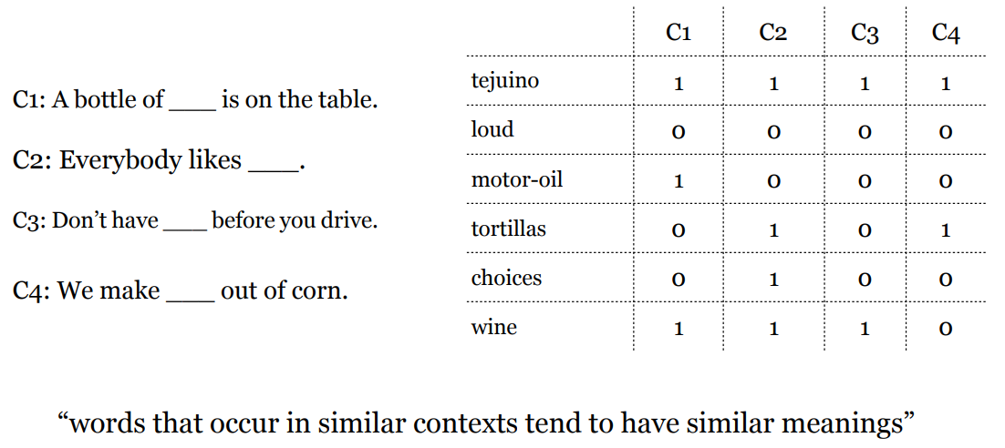
Distributional Hypotesis
Word Embeddings
Session 15

Slide 13
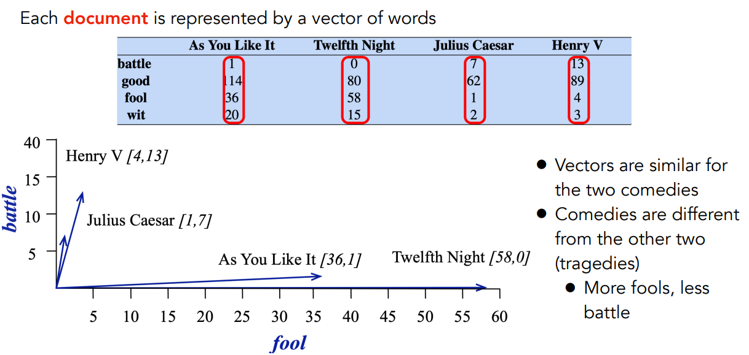
Term Document Matrix and Document Vectors
Word Embeddings
Session 15

Slide 14
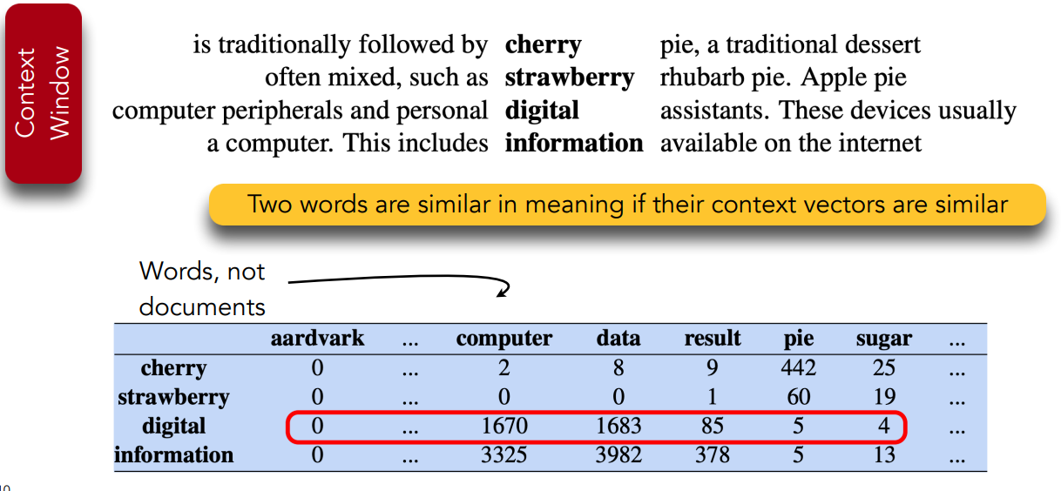
Word-Word Co-Occurrence Matrix
Word Embeddings
Session 15

Slide 15
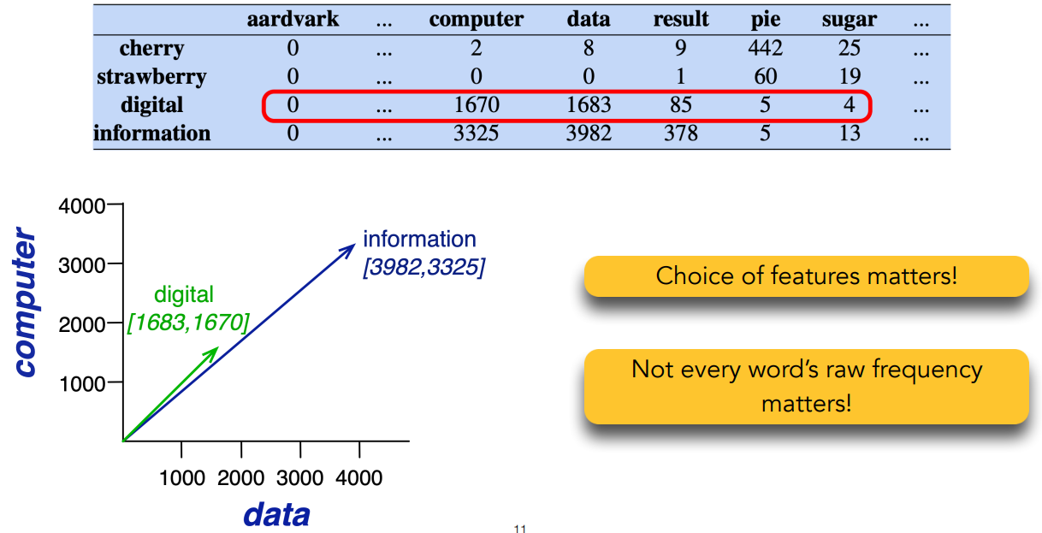
Word-Word Co-Occurrence Matrix
Word Embeddings
Session 15

Slide 16
Word Vectors Based on Co-Occurrences
There are many variants:
Context (words, documents, which window size, etc.)
Weighting (raw frequency, etc.)
Vectors are sparse: Many zero entries.
Therefore: Dimensionality reduction is often used.
These methods are sometimes called count-based methods as they work directly on co-occurrence counts.
Word Embeddings
Session 15

Slide 17
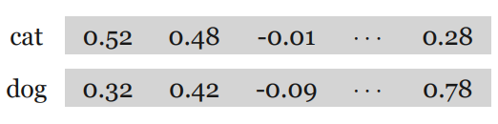
Sparse vs Dense Vectors
As we have seen, count-based methods are sparse (most are 0's) and long (high dimensionality).
Alternatively, we want to represent words as short (50-1024 dimensional) and dense (real-valued) vectors
On the other hand, individual dimensions are less interpretable!
Word Embeddings
Session 15

Slide 18
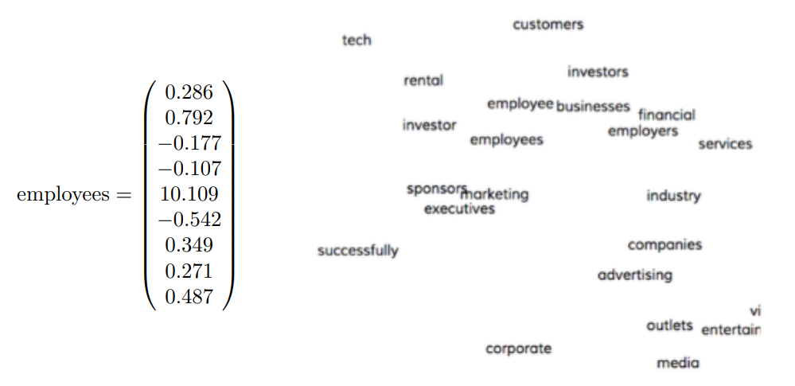
Dense Vectors
Word Embeddings
Session 15

Slide 19
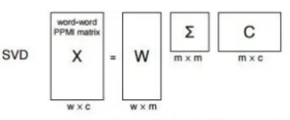
Why Dense Vectors?
Short vectors are easier to use as features in ML systems
Dense vectors may generalize better than storing explicit counts
They do better at capturing synonyms
Different methods for getting dense vectors:
Singular value decomposition (SVD)
word2vec and friends: “learn” the vectors!
Word Embeddings
Session 15

Slide 20
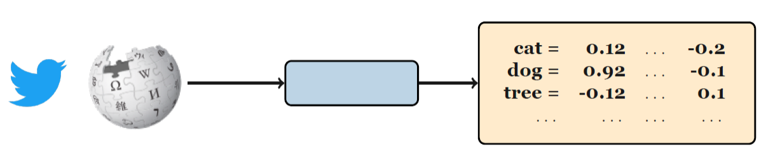
Learning Word Embeddings
Word Embeddings
Session 15

Slide 21
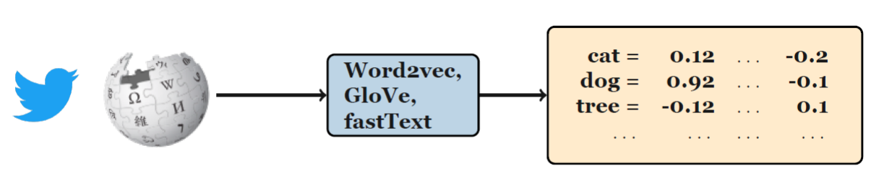
Learning Word Embeddings
Word Embeddings
Session 15

Slide 22
Training Data for Word Embeddings
Use text itself as training data for the model!
A form of self-supervision.
Train a classifier (neural network, logistic regression, or SVM, etc.) to predict the next word given previous words.
Word Embeddings
Session 15

Slide 23

Exercise: Word Prediction Task
Yesterday I went to the ?
A new study has highlighted the positive ?
Word Embeddings
Session 15

Slide 24
Word2Vec
Popular embedding method
Very fast to train
Idea: predict rather than count
https://projector.tensorflow.org/
Word Embeddings
Session 15

Slide 25
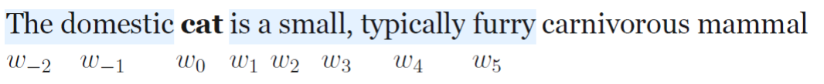
Word2Vec
We have target words (cat) and context words (here: window size = 5).
Word Embeddings
Session 15

Slide 26
Word2Vec
Instead of counting how often each word w occurs near a target word
Train a classifier on a binary prediction task:
Is w likely to show up near target?
We don’t actually care about this task
But we'll take the learned classifier weights as the word embeddings
Big idea: self-supervision
A word c that occurs near target in the corpus as the gold "correct answer" for supervised learning
No need for human labels
Bengio et al. (2003); Collobert et al. (2011)
Word Embeddings
Session 15

Slide 27
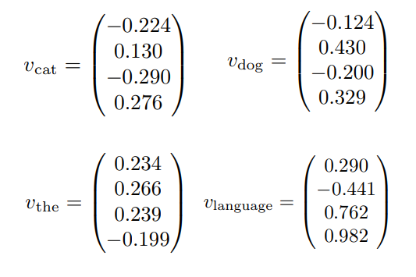

Word2Vec
Input: a large text corpora, V, d
V: a pre-defined vocabulary
d: dimension of word vectors (e.g. 300)
Text corpora:
Wikipedia + Gigaword 5: 6B
Twitter: 27B
Common Crawl: 840B
Output:
Word Embeddings
Session 15

Slide 28
Word2Vec
Two different tasks (context):
Continuous Bag-of-Words
Skipgram
Two training regimes (reducing compute cost):
Hierarchical Softmax
Negative Sampling
Word Embeddings
Session 15

Slide 29
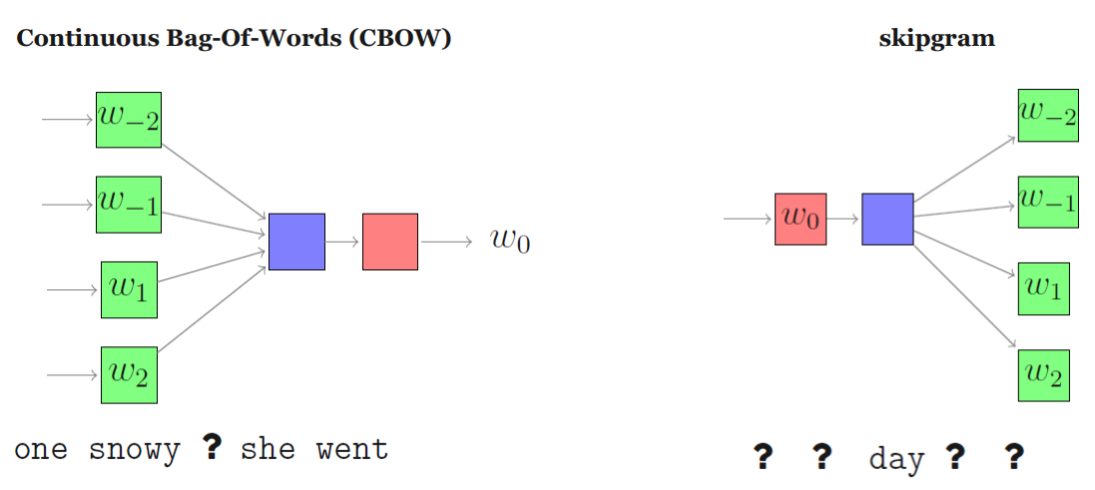
Word2Vec Algorithms
Word Embeddings
Session 15

Slide 30
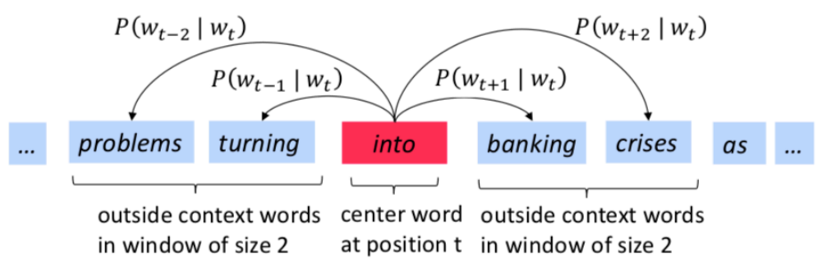
The Skipgram Model
The idea: we want to use words to predict their context words
Context: a fixed window of size 2m
Word Embeddings
Session 15

Slide 31
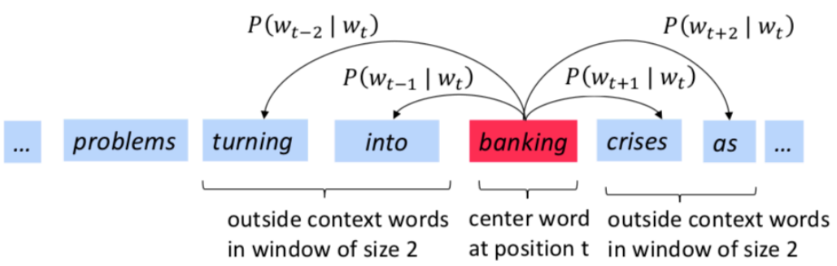
The Skipgram Model
The idea: we want to use words to predict their context words
Context: a fixed window of size 2m
Word Embeddings
Session 15

Slide 32
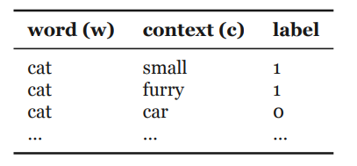
Skipgram: Overview
Create examples:
Positive examples: target word and neighboring context
Negative examples: target word and randomly sampled words from the lexicon (negative sampling)
Train a logistic regression model to distinguish between the positive and negative examples
The resulting weights are the embeddings!
Word Embeddings
Session 15

Slide 33


Skipgram: Overview
We have target words (cat) and context words (here: window=5).
The probability that c is a real context word:
The probability that c is not a real context word:
Word Embeddings
Session 15

Slide 34


Skipgram: Overview
Intuition: A word c is likely to occur near the target if its embedding is similar to the target embedding.
Turn this into a probability using the sigmoid function
Word Embeddings
Session 15

Slide 35
Skipgram: Training
We initialize the embeddings with random values
During training:
Maximize the similarity between the embeddings of the target word and context words from the positive examples
Minimize the similarity between the embeddings of the target word and context words from the negative examples
After training:
frequent word-context pairs in data: w · c high
not word-context pairs in data: w · c low
So: Words occurring in same contexts are close to each other
Word Embeddings
Session 15

Slide 36
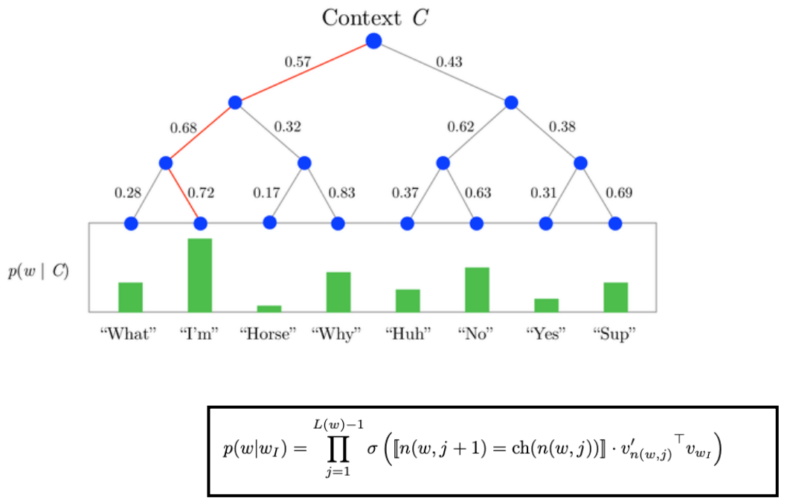
Hierarchical Softmax
Word Embeddings
Session 15

Slide 37
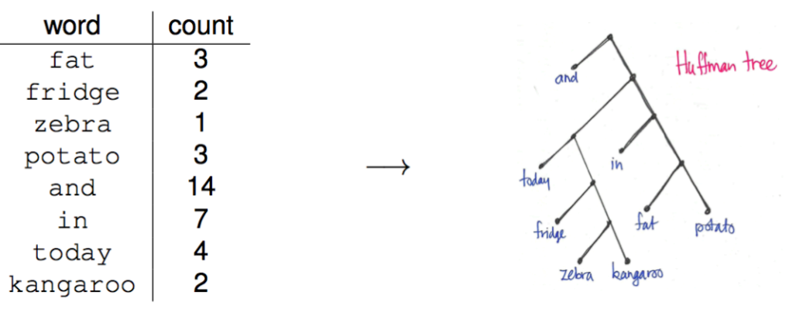
Hierarchical Softmax
Huffman tree:
Word Embeddings
Session 15

Slide 38
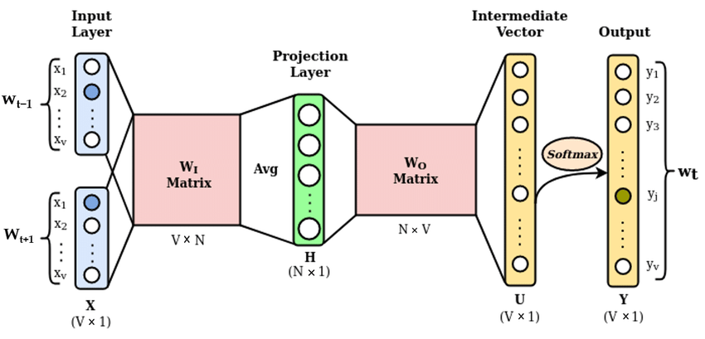
Continuous Bag-of-Words
Word Embeddings
Session 15

Slide 39
Other Embeddings: fastText
Limitation of word2vec: Can’t handle unknown words
fastText is very similar to word2vec, but each word is represented as a bag of character n-grams (+ the word itself). ≤ and ≥ mark word boundaries.
Example: where with n = 3: <wh, whe, her, ere, re> and <where>
Representation of a word: The sum of the vector representations of its n-grams.
Word Embeddings
Session 15

Slide 40
Other Embeddings: GloVe
First create a global word-word co-occurrence matrix (how frequent pairs of words occur with each other). Requires a pass through the entire corpus at the start!
Training objective: learn word embeddings so that their dot products equals the log of the words’ co-occurrence probability.
Word Embeddings
Session 15

Slide 41
Pre-Trained Embeddings
I want to build a system to solve a task (e.g. sentiment analysis)
Use pre-trained embedddings. Should I fine-tune?
Lots of data: yes
Just a small dataset: no
Analysis (e.g. bias, semantic change):
Train embeddings from scratch
Word Embeddings
Session 15

Slide 42
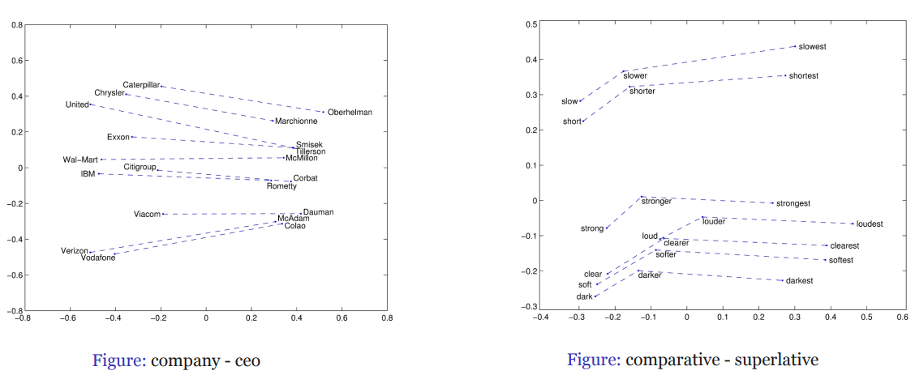
Properties of Word Embeddings
Word Embeddings
Session 15

Slide 43
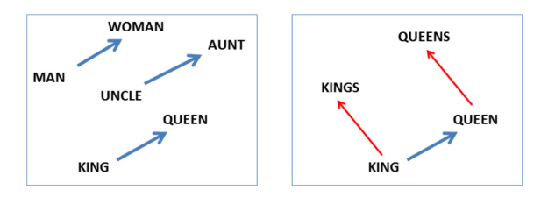
Properties of Word Embeddings: Analogies
We can look at analogies in the vector space, for example:
king - man + woman ≈ queen
Word Embeddings
Session 15

Slide 44
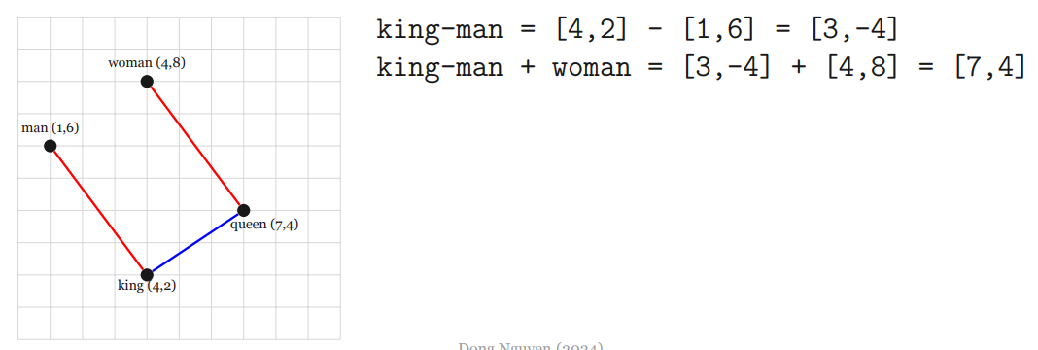
Properties of Word Embeddings: Analogies
We can look at analogies in the vector space, for example:
king - man + woman ≈ queen
Word Embeddings
Session 15

Slide 45
Embeddings Evaluation
How would you evaluate word embeddings?
E.g., how do you know whether a new word embedding algorithm is an improvement over previous ones?
Word Embeddings
Session 15

Slide 46
Embeddings Evaluation
Types of evaluation:
Extrinsic evaluation
Intrinsic evaluation
Word Embeddings
Session 15

Slide 47
Embeddings Evaluation
Types of evaluation:
Extrinsic evaluation
Intrinsic evaluation
Extrinsic Evaluation:
Evaluation based on performance on external tasks (e.g., part of speech tagging, sentiment analysis)
I.e., plug in different embeddings into the same NLP system and measure difference in task performance.
Word Embeddings
Session 15

Slide 48
Embeddings Evaluation
Types of evaluation:
Extrinsic evaluation
Intrinsic evaluation
Intrinsic Evaluation:
Evaluation based only on the embeddings
Similarities
Analogies
Probing classifiers
Word Embeddings
Session 15

Slide 49
Intrinsic Evaluation: Similarities
Input: Dataset with relatedness or similarity scores for pairs of words.
Goal: High (pearson or spearman) correlation between scores and the cosine similarity of the embeddings for the two words.
Example from WordSim353:
wood and forest: 7.73
money and cash: 9.15
month and hotel: 1.81
Word Embeddings
Session 15

Slide 50
Intrinsic Evaluation: Analogies
Base/3rd Person Singular Present
see:sees return: ?
Singular/Plural
year:years law: ?
Meronyms
player:team fish: ?
UK city county
york:yorkshire Exeter: ?
Word Embeddings
Session 15

Slide 51
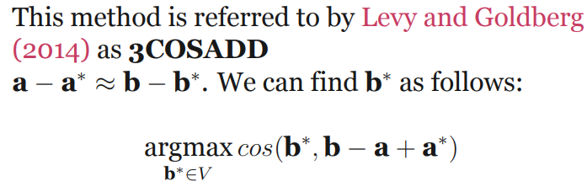
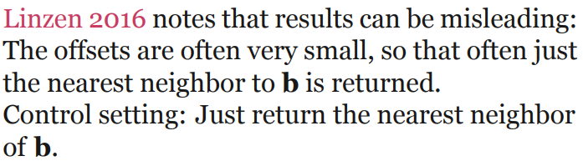
Intrinsic Evaluation: Analogies
Word Embeddings
Session 15

Slide 52
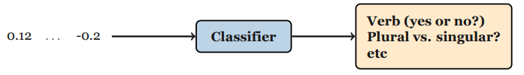
Intrinsic Evaluation: Probing Classifiers
Also called diagnostic classifiers
Mostly used to evaluate sentence embeddings, but sometimes also used for analyzing word embeddings.
But, be careful! Performance might seem high, but classifier might learn other signals (e.g. word frequency, part of speech classes) than what you focus on.
Word Embeddings
Session 15

Slide 53
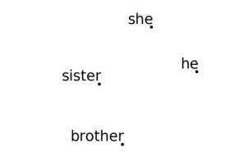
Biases in Word Embeddings
Measuring gender bias:
To assess NLP models and investigate the impact of ‘bias mitigation’ techniques
To study societal trends
Word Embeddings
Session 15

Slide 54
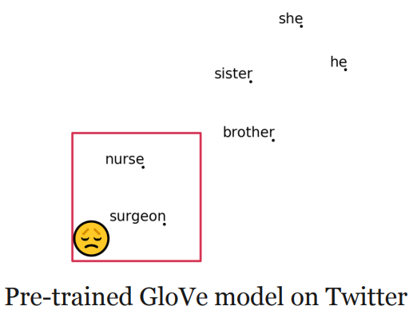
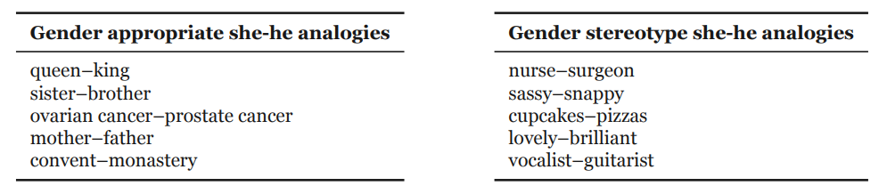
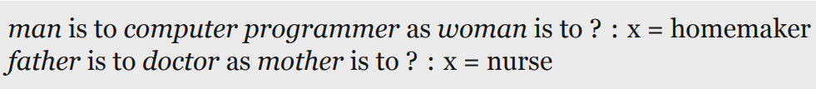
Biases in Word Embeddings
Measuring gender bias:
To assess NLP models and investigate the impact of ‘bias mitigation’ techniques
To study societal trends
Word Embeddings
Session 15

Slide 55
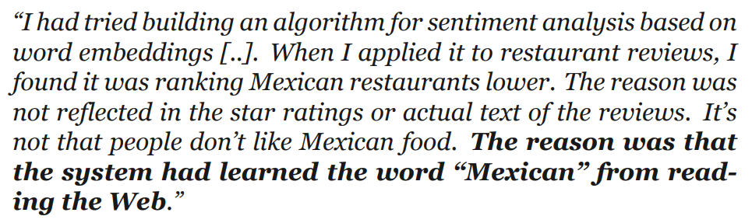
Perpetuation of Bias in Sentiment Analysis
Word Embeddings
Session 15

Slide 56
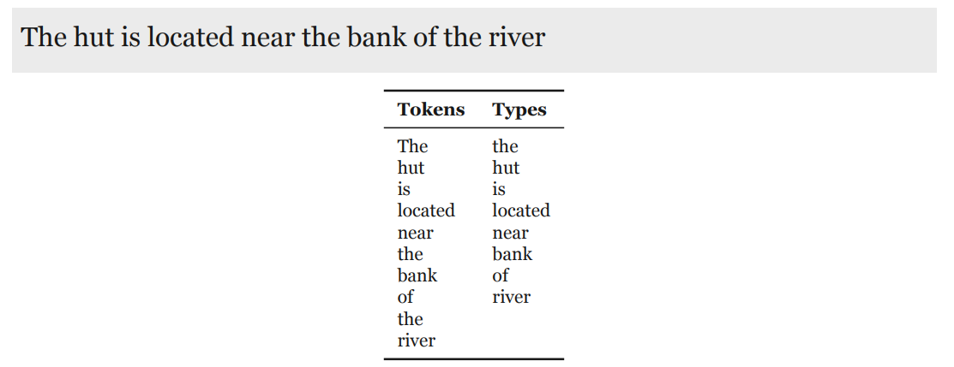
Contextual Word Embeddings
So far: an embedding for each word (type).
Word Embeddings
Session 15

Slide 57
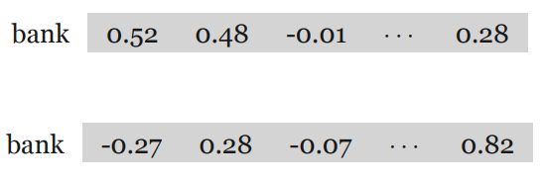
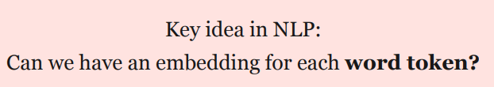
Contextual Word Embeddings
So far: an embedding for each word (type).
Today, I went to the bank to deposit a check.
The hut is located near the bank of the river.
Word Embeddings
Session 15

Slide 58
Contextualized Word Embeddings
Key idea: Have embeddings for each word token
Previously:
One embedding for each word type
A table where each word is mapped to a vector.
Now:
One embedding for each work token
Embeddings for a token are created based on the context
There is no single embedding for a word anymore
Word Embeddings
Session 15

Slide 59
BERT
Two tasks:
Masked Language Model
Next Sentence Prediction
Word Embeddings
Session 15

Slide 60
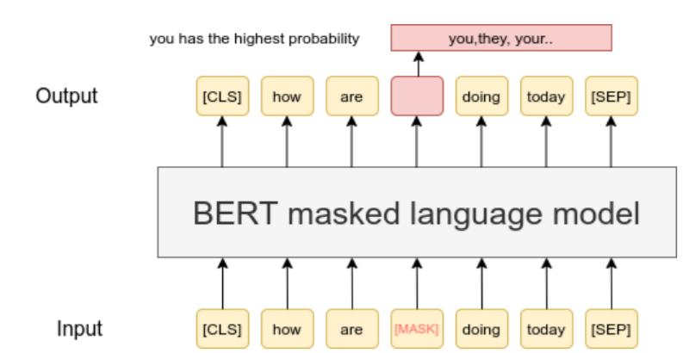
BERT
Two tasks:
Masked Language Model
Word Embeddings
Session 15

Slide 61
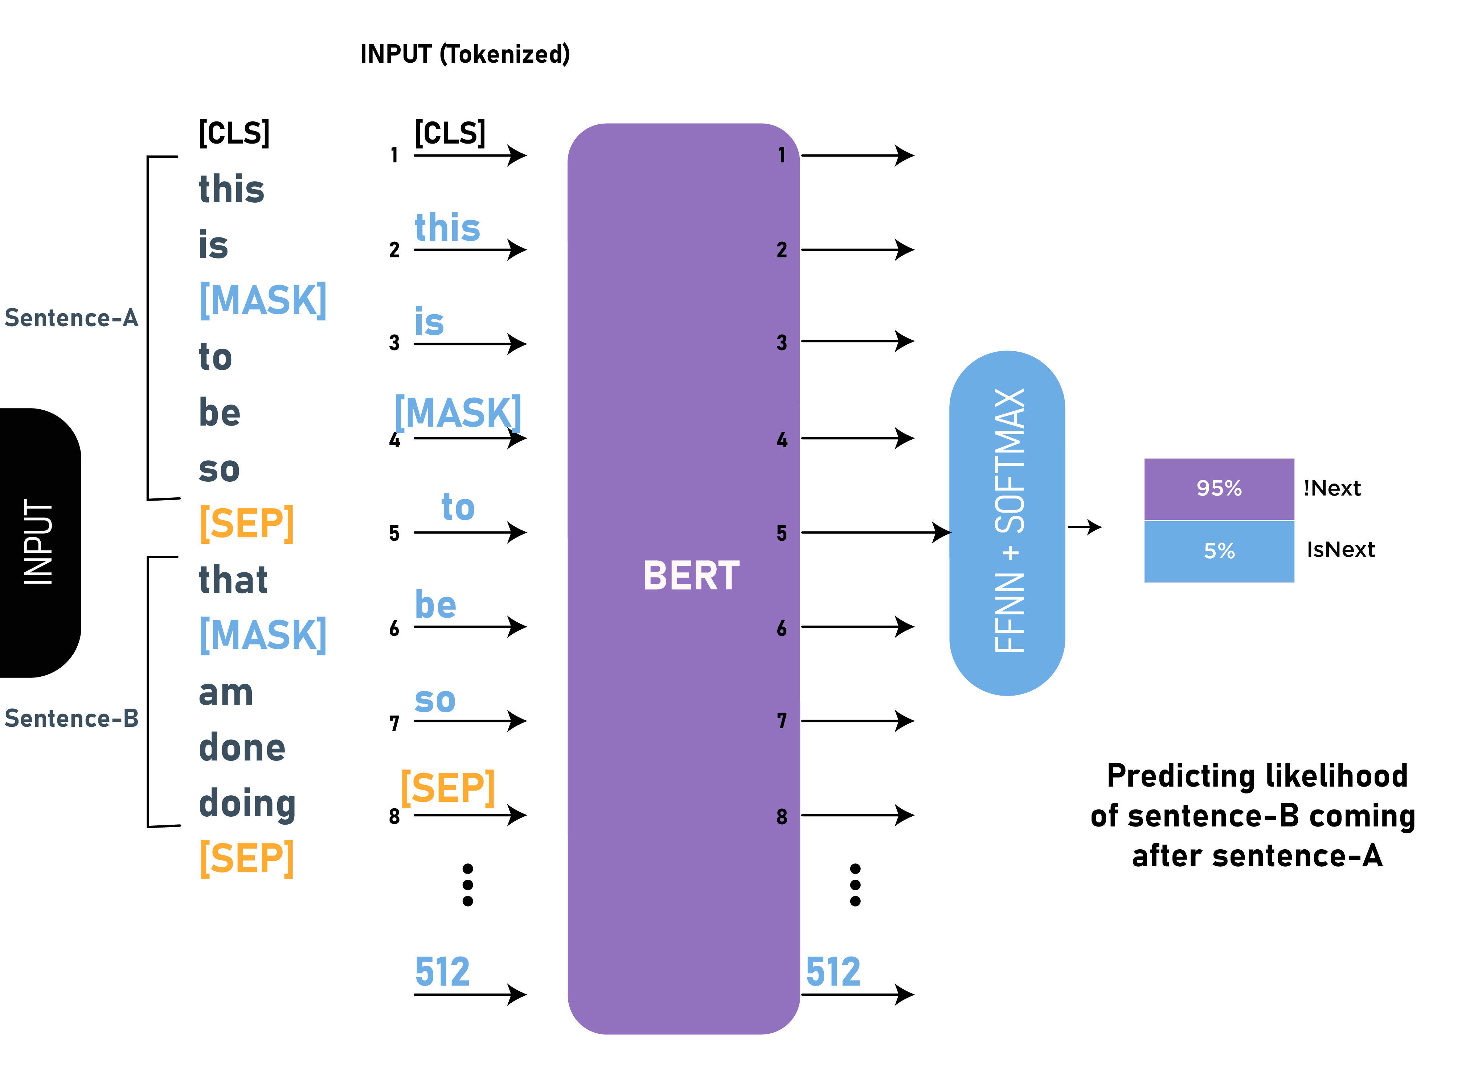
BERT
Two tasks:
Next Sentence Prediction
Word Embeddings
Session 15

Slide 62
Software
word2vec: gensim (https://radimrehurek.com/gensim/) and official implementation (https://code.google.com/archive/p/word2vec/).
fasttext: official implementation (https://fasttext.cc/)
GloVe: official implementation (https://nlp.stanford.edu/projects/glove/)
Hugging Face: for BERT and other transformer models (https://huggingface.co/)
Word Embeddings
Session 15

