Slide 1

Behavior Analysis Technologies
Session 1
Course Introduction
Applied Data Science
2024/2025

Slide 2
Course Objectives
Understand and apply key concepts of opinion and sentiment analysis;
Develop proficiency in using various technological tools and platforms for text mining and sentiment analysis;
Integrate multiple analytical tools to create comprehensive data-driven insights for decision-making.
Course Introduction
Session 1

Slide 3
Classes
Thursdays | 14:30 - 16:30
Fridays | 09:00 - 11:00
Theory Session
Focus: Foundations of Behavior Analysis Technologies, including concepts of opinion and sentiment analysis.
Hands-On Session
Focus: Hands-on exploration of text mining and sentiment analysis tools and techniques applied to real-world data.
Course Introduction
Session 1

Slide 4
Evaluation
 | % of Final Course Grade
Exam | 30%
Text Mining Python Project | 35%
Sentiment Analysis Dashboard in Power BI Project | 35%
Course Introduction
Session 1

Slide 5

Opinion and Sentiment Analysis
Opinion Analysis:
The process of extracting subjective information from text.
It goes beyond just identifying whether the sentiment is positive, negative or neutral.
It can include identifying the target of the opinion, the strength of the opinion, and the emotions involved.
Course Introduction
Session 1

Slide 6

Opinion and Sentiment Analysis
Sentiment Analysis:
A subset of opinion analysis focused on identifying emotions and attitudes.
Course Introduction
Session 1

Slide 7

Positive or negative movie review?
A heartwarming film with great performances and a feel-good story. It leaves you smiling!
Disappointing and dull. The plot was weak, and the characters were uninteresting. Not worth the watch.
Oh, what a masterpiece! If you enjoy endless clichés and predictable plots, this film is a true gem. You'll be on the edge of your seat—wondering why you bothered.
Course Introduction
Session 1

Slide 8
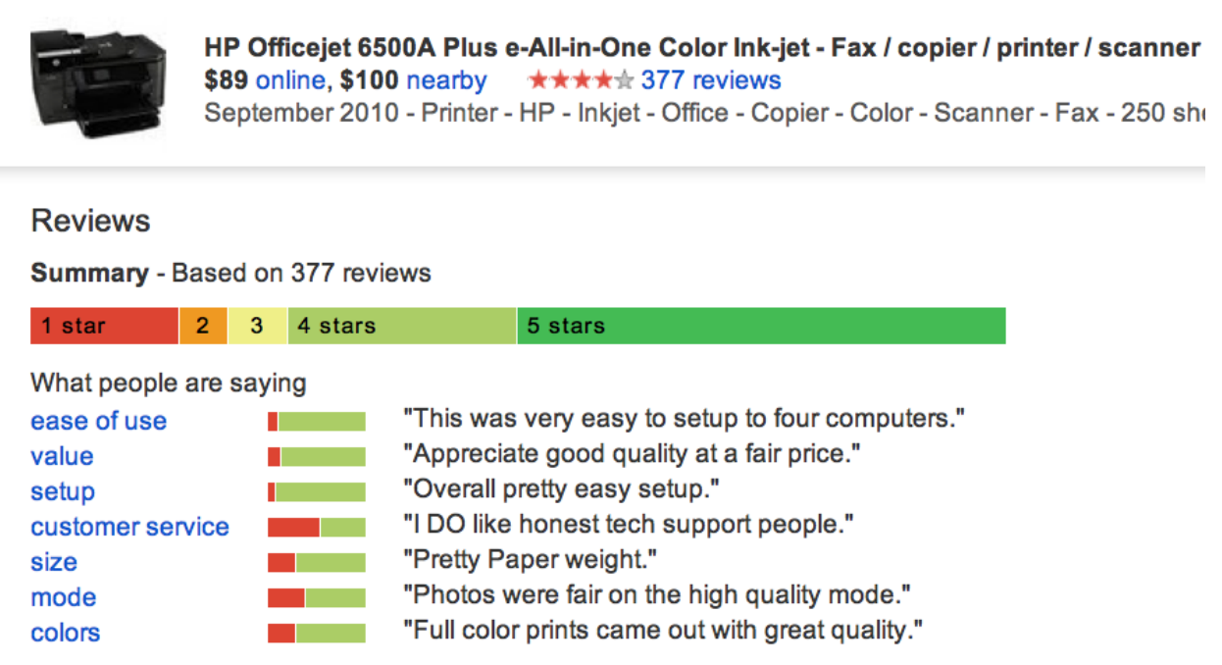
Google Product Search
Course Introduction
Session 1

Slide 9
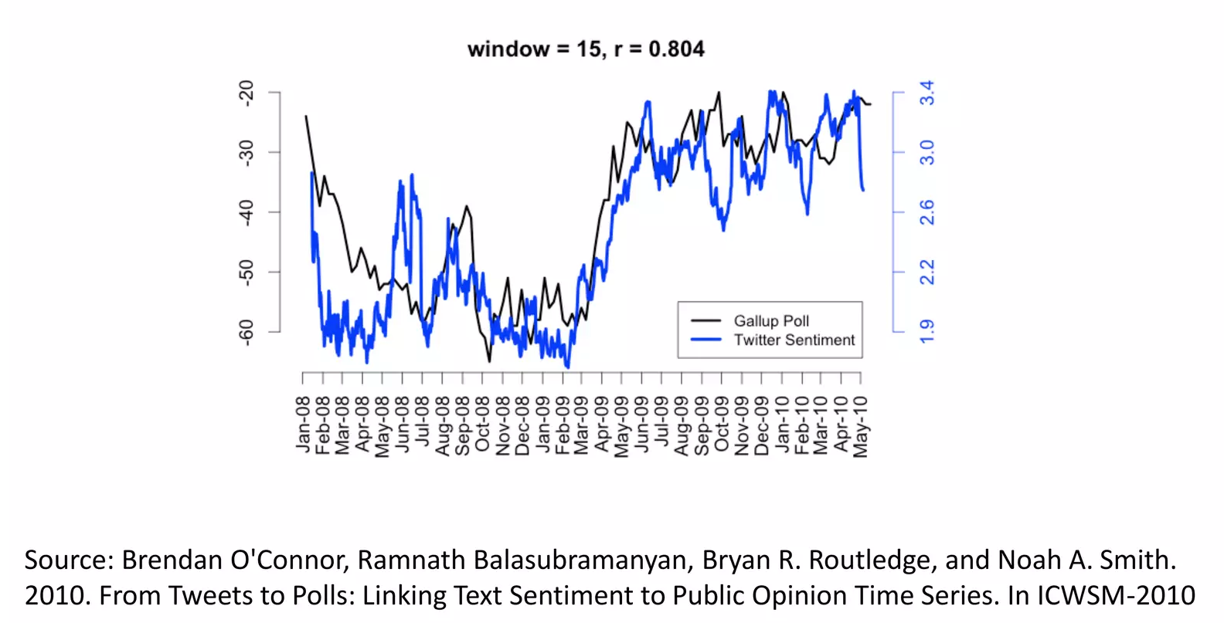
Twitter Sentiment vs Consumer Confidence
Course Introduction
Session 1

Slide 10

Why Organizations Use Sentiment Analysis?
Customer Feedback: Understanding consumer opinions
Course Introduction
Session 1

Slide 11

Why Organizations Use Sentiment Analysis?
Brand Monitoring: Tracking brand reputation
Course Introduction
Session 1

Slide 12
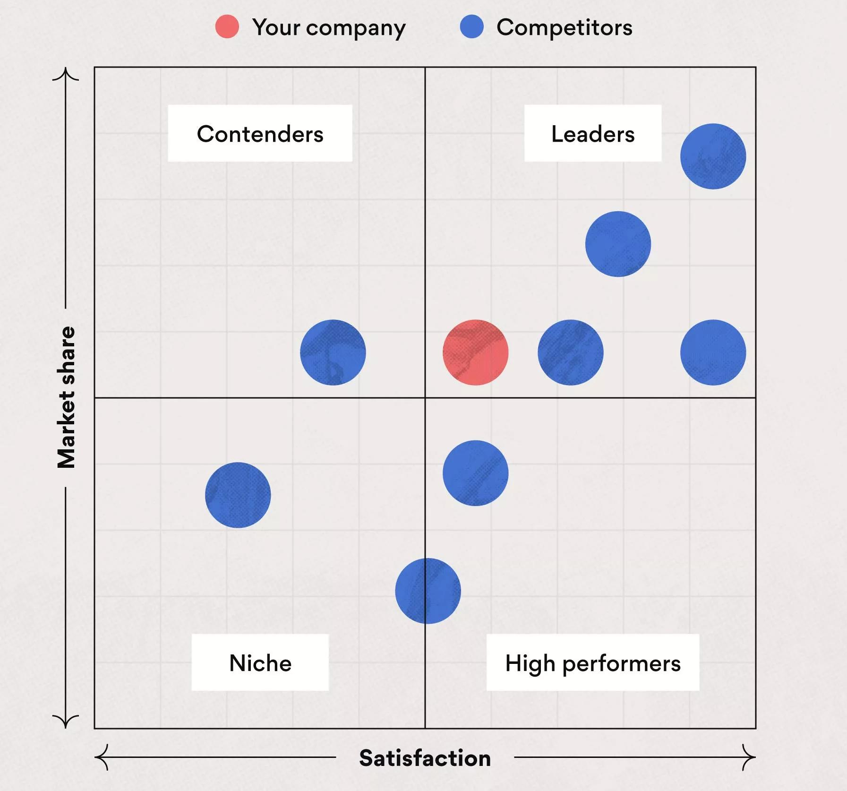
Why Organizations Use Sentiment Analysis?
Competitive Analysis: Analyzing how competitors are perceived
Course Introduction
Session 1

Slide 13
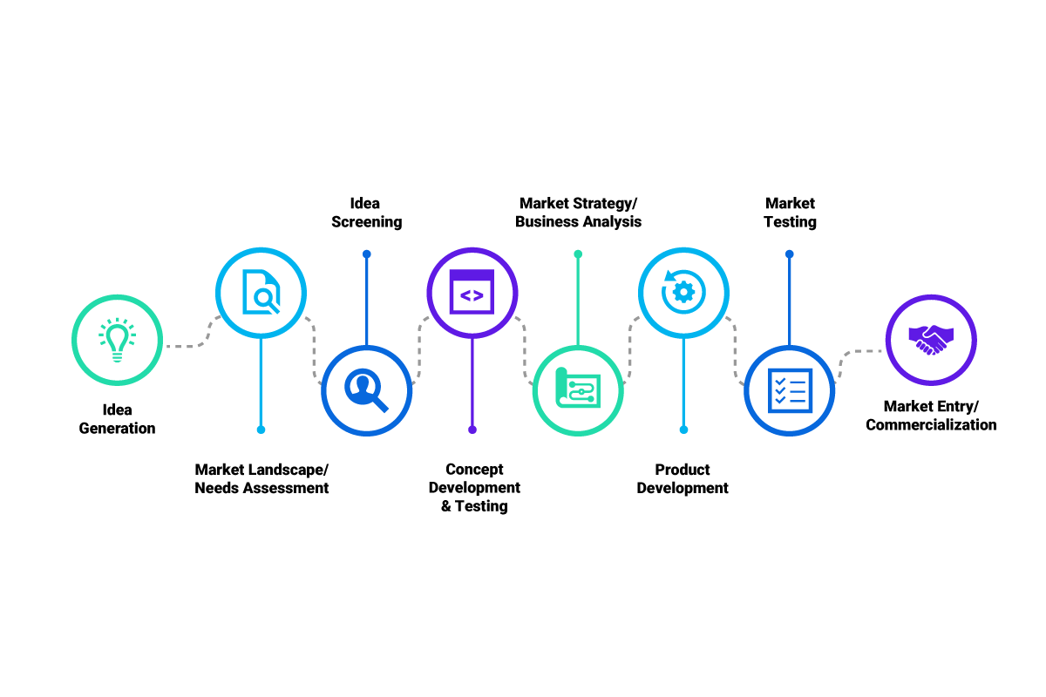
Why Organizations Use Sentiment Analysis?
Product Improvement: Gathering insights for product development
Course Introduction
Session 1

Slide 14
About this Course
We will focus manly on these three topics:
Text Retrieval
Text Mining
Sentiment Analysis
Course Introduction
Session 1

Slide 15
Contact
For all course-related matters you can contact me:
joacorreia@ucp.pt
OR
Jfscorreia95@gmail.com
Course Introduction
Session 1

Slide 16
GitHub SetUp
Lectures will be provided both on GitHub and Moodle.
https://github.com/LCDA-UCP/tac-hands-on
You will need to fork the repository and then clone it to your local machine.
Setup a python/conda environment and install the requirements.
$ pip install –r requirements.txt
Course Introduction
Session 1

