Slide 1

Behavior Analysis Technologies
Session 23
Microsoft Power Automate Cognitive Services
Applied Data Science
2024/2025

Slide 2

Microsoft Power Automate
Cloud-based service that allows the creation automated workflows.
The flows can incorporate various popular applications and services (Teams, Excel, SharePoint, OneDrive, etc.).
Simplifies and streamlines repetitive tasks, data integration, and process automation without requiring extensive coding knowledge.
Microsoft Power Automate Cognitive Services
Session 23

Slide 3
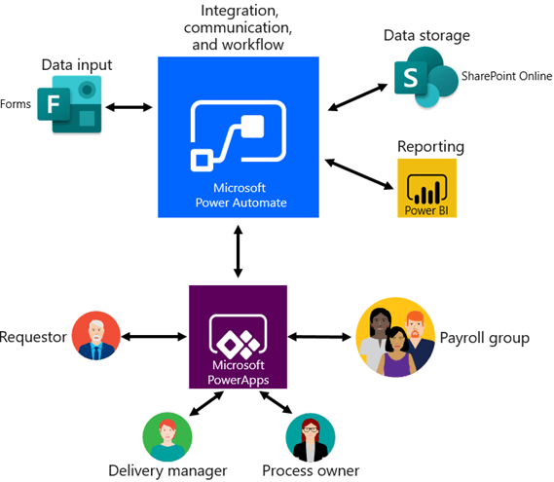
Key features
Low-Code/No-Code Tool: Designed for users of all technical levels.
Triggers and Actions: Flows are built using "triggers" (an events that start the process) and "actions" (task).
Connectors: Integrates hundreds of apps and services, including Microsoft 365 and Google services.
Cloud Compatibility: Supports both cloud-based and locally hosted data.
AI and Analytics Integration: Easily integrates with Azure Cognitive Services for tasks like sentiment analysis, translation, and image recognition.
Microsoft Power Automate Cognitive Services
Session 23

Slide 4


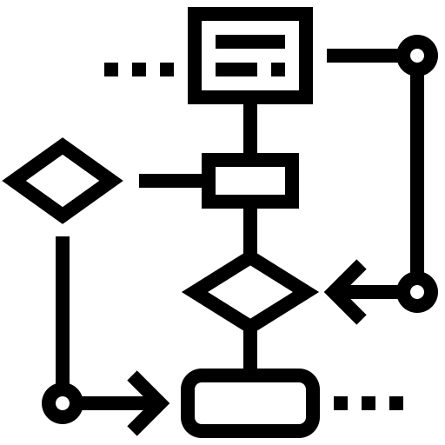
Why use Power Automate?
Automates repetitive tasks
saving time and reducing manual effort.
Boosts Productivity also eliminating manual errors and bottlenecks.
Simplifies Data and Document Management centralizing storage and making data organization and retrieval effortless.
Standardized Workflows with AI-Driven Insights and Broad Compatibility. Automates processes with strict rules, utilizing built-in connectors to seamlessly integrate multiple apps and services
Microsoft Power Automate Cognitive Services
Session 23

Slide 5
Power Automate Flow
Trigger
Action
Output
Microsoft Power Automate Cognitive Services
Session 23

Slide 6
Power Automate Flow
Action A
Trigger
Action
Condition
Action B
Microsoft Power Automate Cognitive Services
Session 23

Slide 7
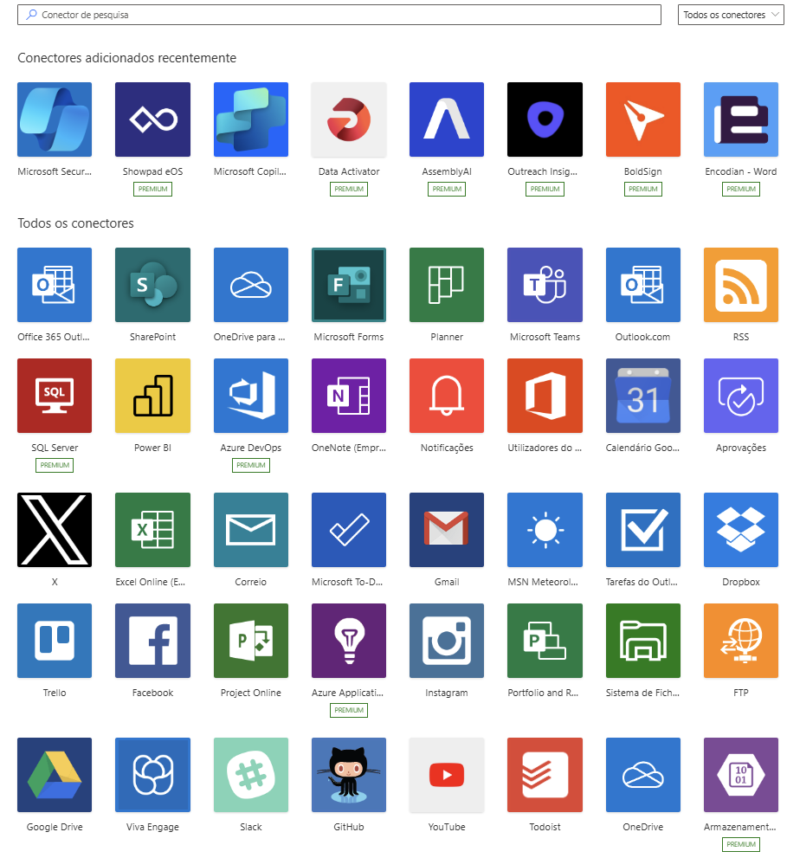
Connectors
Microsoft Power Automate Cognitive Services
Session 23

Slide 8
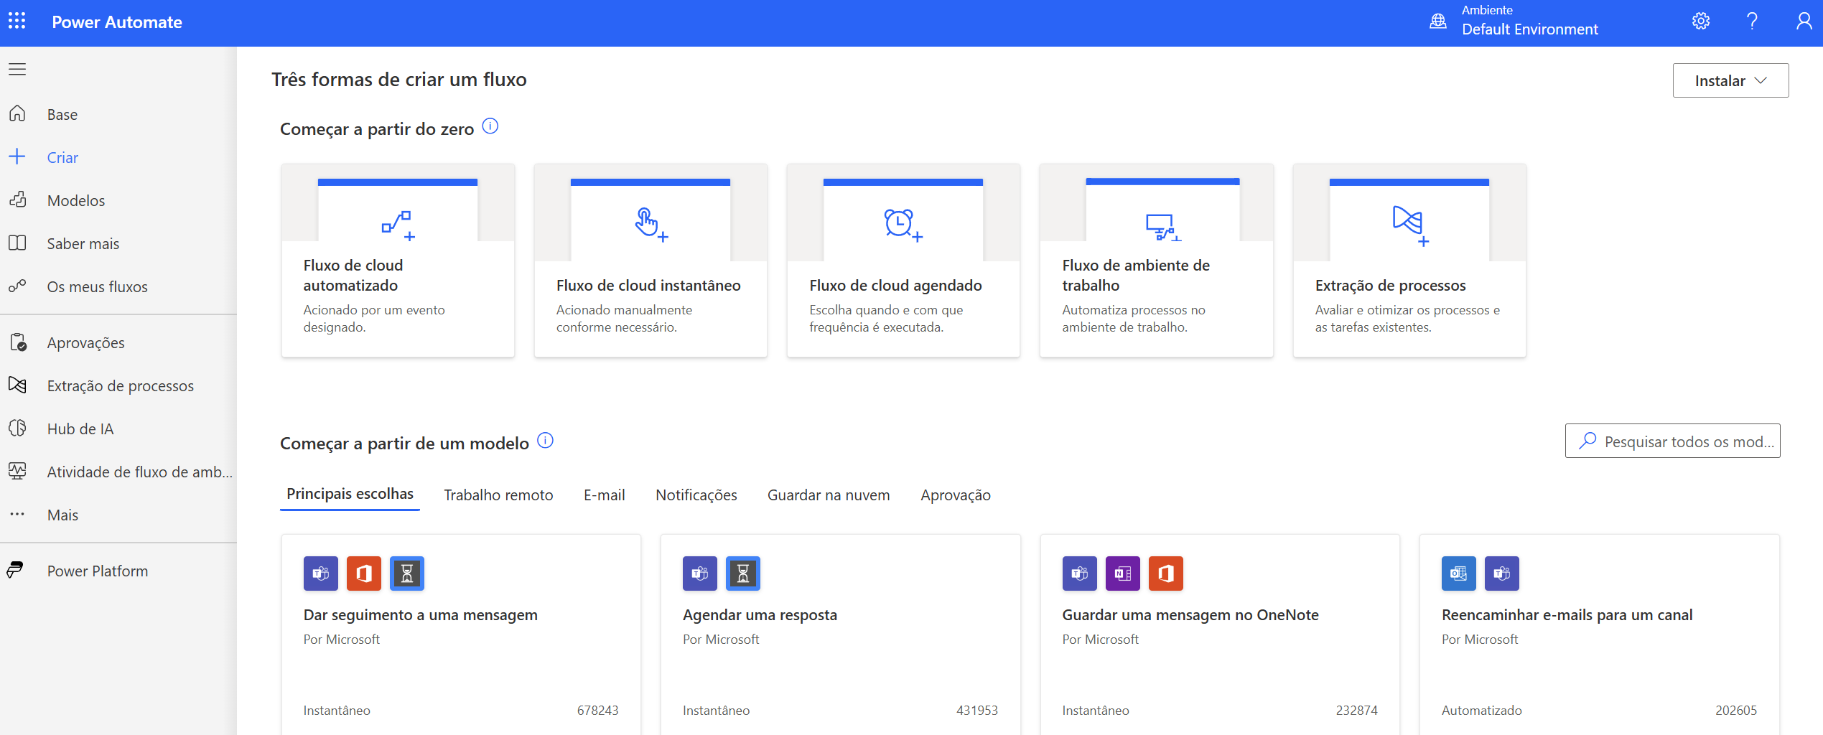
Power Automate
Microsoft Power Automate Cognitive Services
Session 23

Slide 9
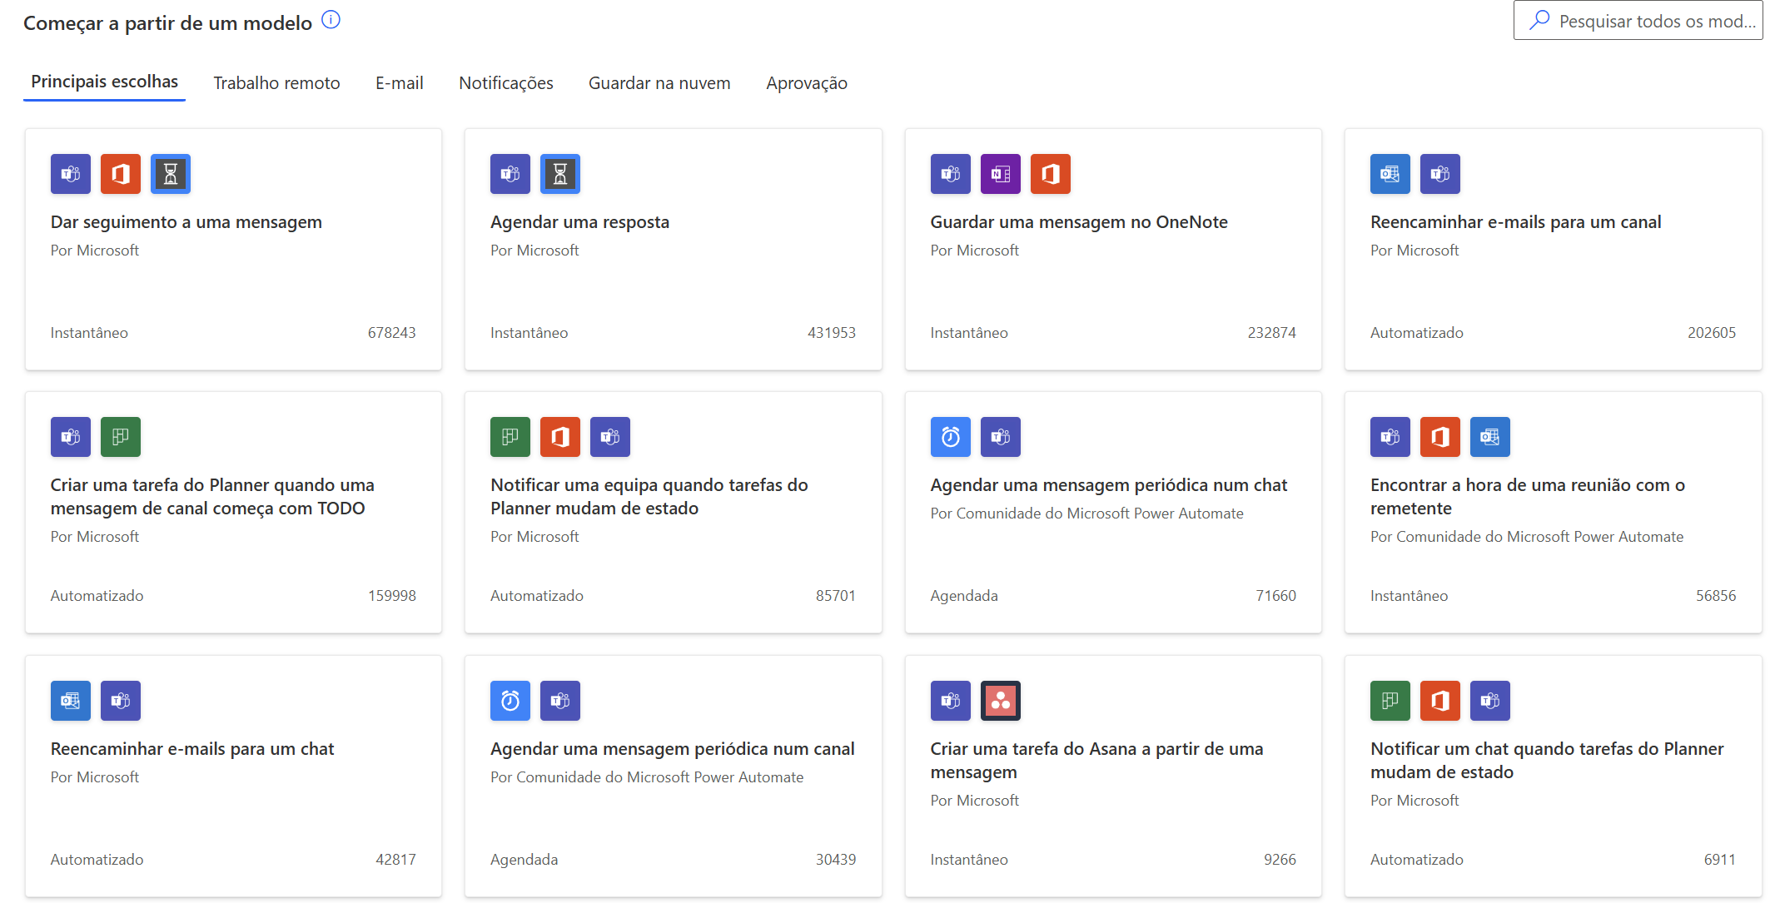
Power Automate Flows
Microsoft Power Automate Cognitive Services
Session 23

Slide 10
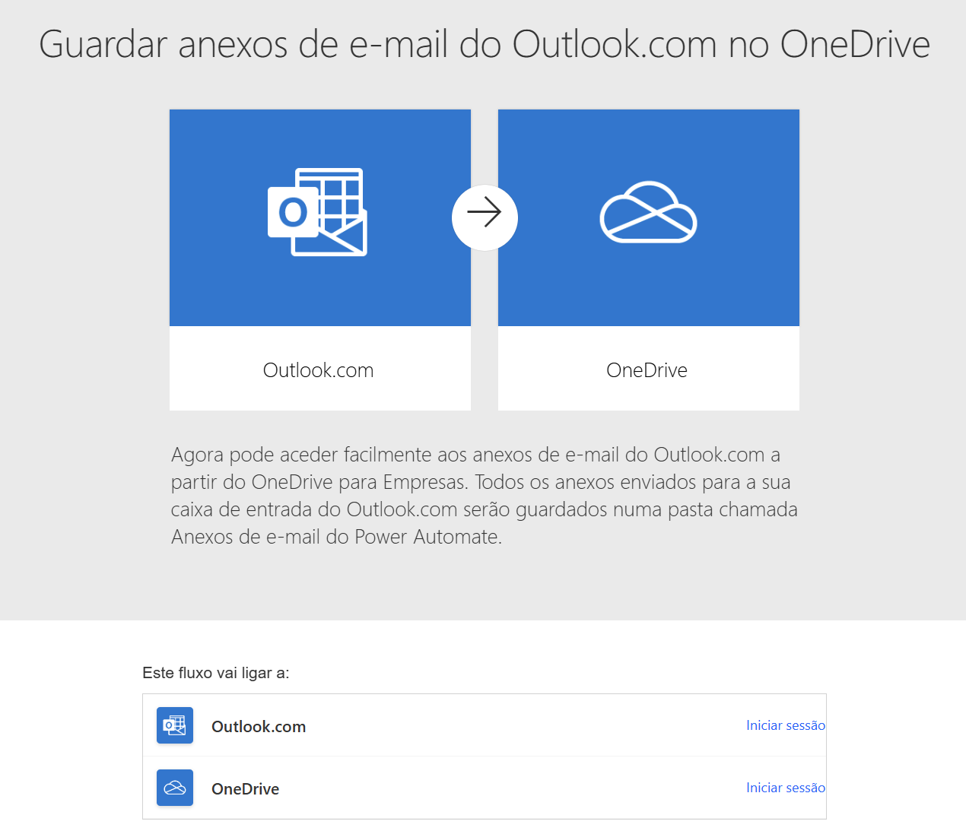
Power Automate Flows
Microsoft Power Automate Cognitive Services
Session 23

Slide 11
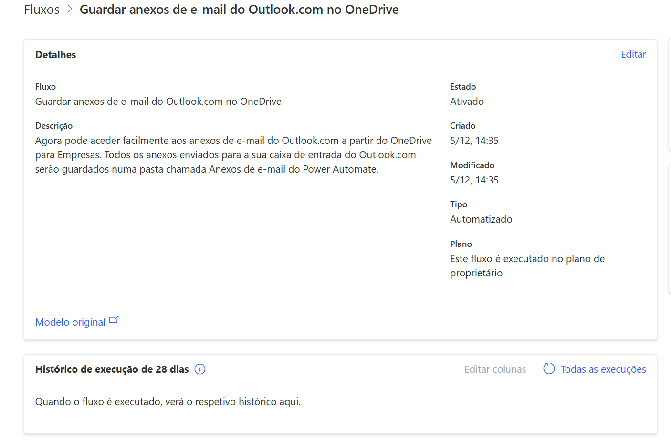
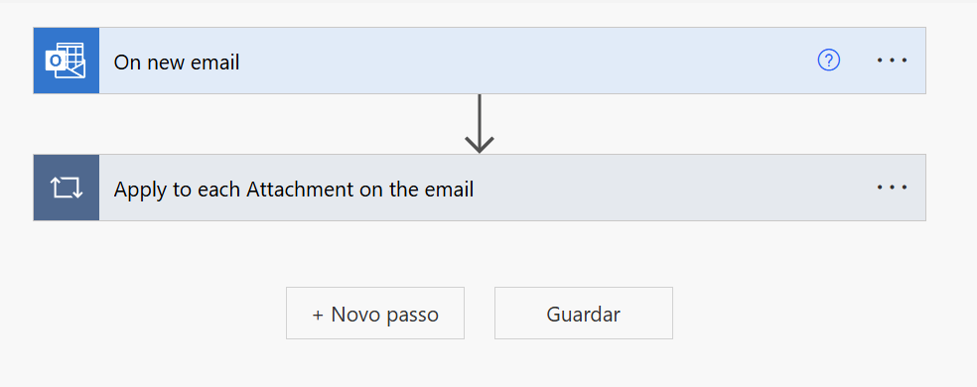
Power Automate Flows
Trigger
Action
Microsoft Power Automate Cognitive Services
Session 23

Slide 12
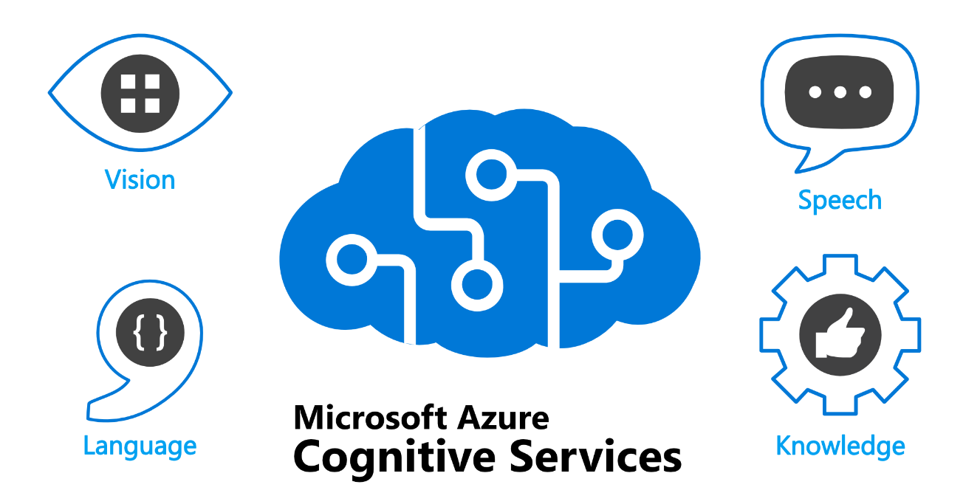
Azure Cognitive Services
What Are Cognitive Services?
A collection of Microsoft AI-based APIs and services (e.g.: text analytics, speech recognition, computer vision and translation)
Use Case Examples:
Sentiment Analysis: Evaluate the tone of customer feedback or reviews
Image Recognition: Automatically classify or analyze images.
Real-Time Translation: Translate texts into multiple languages.
Text Extraction: Identify key information from documents or emails.
Microsoft Power Automate Cognitive Services
Session 23

Slide 13
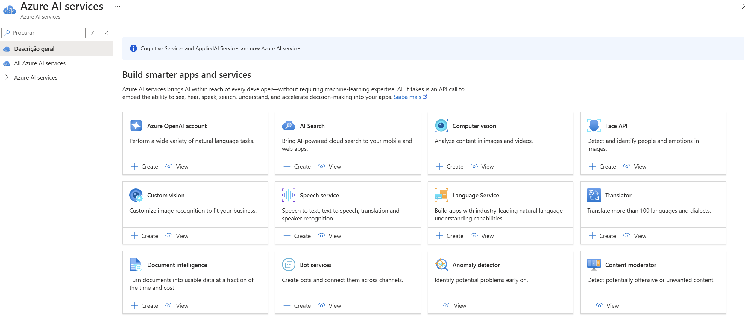
Azure Cognitive Services
Microsoft Power Automate Cognitive Services
Session 23

Slide 14

Using Cognitive Services for Sentiment Analysis
Customer Feedback Analysis
Analyze customer reviews, survey responses, or emails to understand customer sentiment
Social Media Monitoring
Monitor social media posts in real-time about a specific brand.
Employee Sentiment in Surveys
Analyze internal employee feedback from forms or polls.
Automated Support Ticket Prioritization
Use sentiment analysis to prioritize incoming support tickets based on customer emotions.
Marketing Insights
Analyze public reactions to product launches or campaigns from various sources.
Enhancing Chatbots
Integrate sentiment analysis into chatbot conversations to adjust responses dynamically.
Microsoft Power Automate Cognitive Services
Session 23

Slide 15
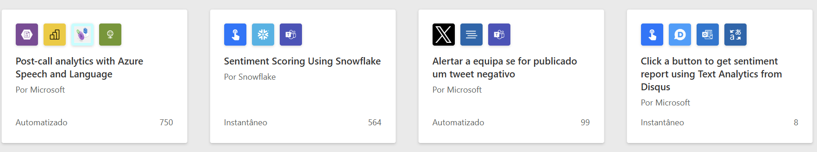
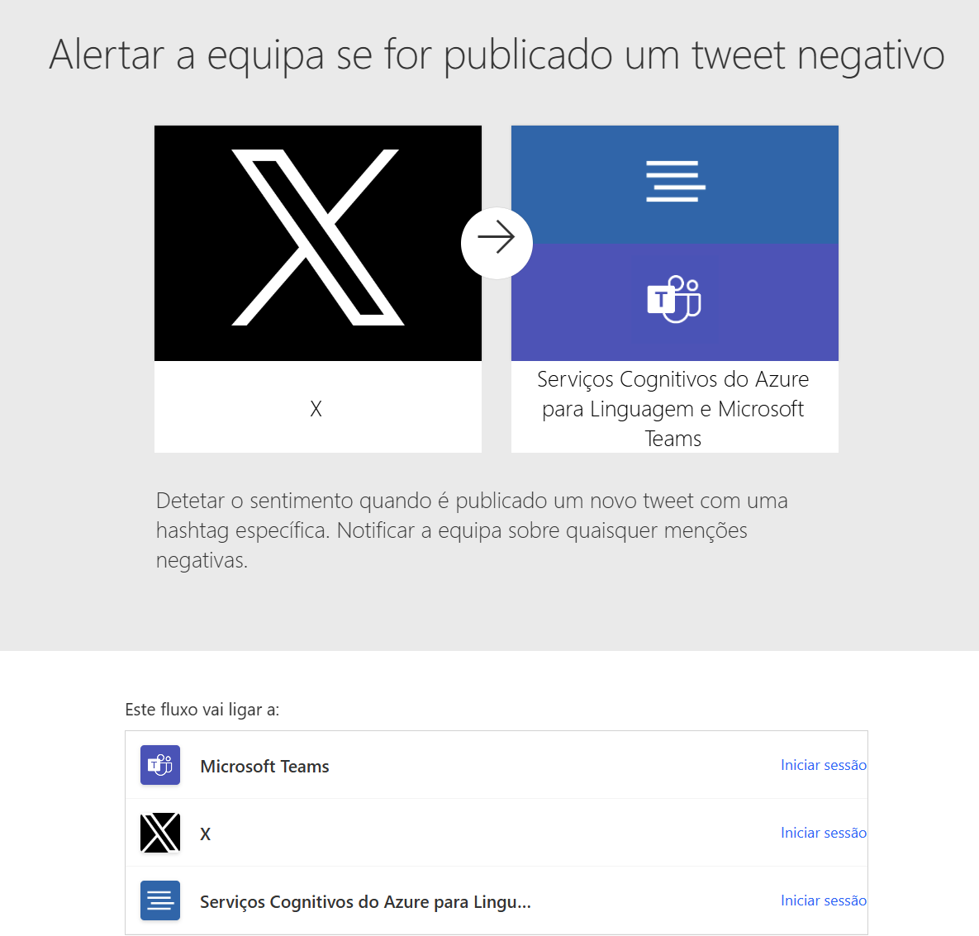
Flow exemple for sentiment analysis
Microsoft Power Automate Cognitive Services
Session 23

Slide 16
Exercise
Develop a Power Automate flow that performs sentiment analysis on the comments of an excel file.
Microsoft Power Automate Cognitive Services
Session 23

