Slide 1

Behavior Analysis Technologies
Session 11
Introduction to APIs
Applied Data Science
2024/2025

Slide 2
What is an API?
API stands for application programming interface.
Interface: allows a user to interact with a system.
Graphical User Interface (GUI): interact with a program using a point/click/type interface
Command-Line Interface (CLI): interact with a program via the command line
API: interact with an existing program programmatically
APIs
Session 11

Slide 3
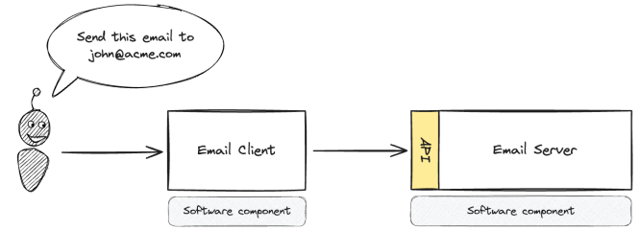
What is an API?
API serves as a communication layer, or interface, between systems
Enables different systems to interact without needing to understand exactly what the others do
APIs
Session 11

Slide 4
What is an API?
APIs exist in various forms:
Operating system APIs: enables applications to interact with the underlying operating system (e.g., turning on camera/audio during a Zoom call);
Web APIs: Manage web actions like liking Instagram photos or fetching tweets;
All APIs follow a similar process:
You make a request for data, and the API returns a response
Example: Opening Twitter or scrolling Instagram sends a request to the API, which responds with updated content
This process is called calling an API
APIs
Session 11

Slide 5
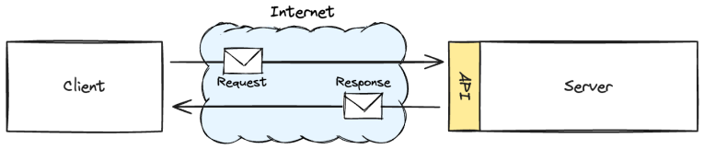
Web APIs
Gives you a way to ask for and receive data over the internet using hyper-text transfer protocol (HTTP)
Client sends a request message to a Server
Server returns a response message to the Client
APIs
Session 11

Slide 6
Types of Web APIs
SOAP
Declined in popularity due to complexity and inflexibility compared to REST and GraphQL
Standardized method for software communication in the early 2000s
Enterprise applications
REST
Most common type of API today
Web-based, allowing information exchange over the internet
When making a request, a REST API provides all available data in response
GraphQL
Newer and less common but growing in popularity
Work similarly to REST but only return specific data requested
Allows you to specify the exact fields you need, reducing data load and improving speed
APIs
Session 11

Slide 7
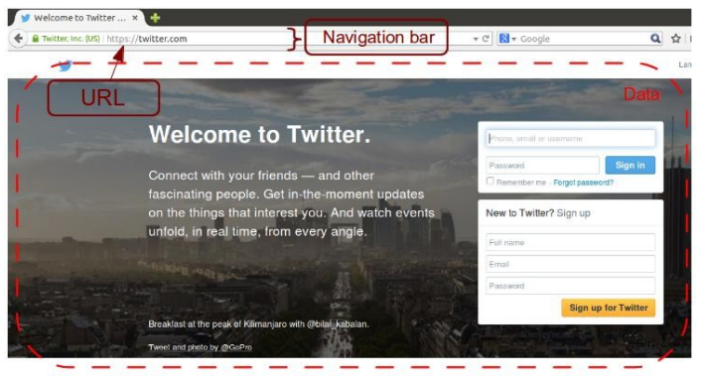
Asking for Data
When you type a URL into the navigation bar of your browser, you are requesting data for that webpage
APIs
Session 11

Slide 8
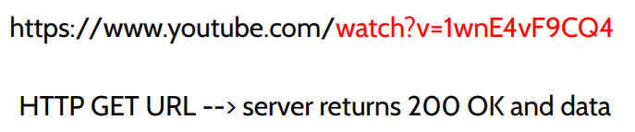
Asking for Data with URLs
We will be asking for data with URLs (Universal Resource Locator)
e.g., If you want to see a specific YouTube video, you ask YouTube for the video by encoding its ID in the URL:
APIs
Session 11

Slide 9
Receiving Data
When requesting to view a webpage in your browser, the information is sent back to you as HTML
Your browser parses and displays the page based on the HTML it receives!
APIs often return data in JSON format, as it is easy to parse and display information
APIs
Session 11

Slide 10
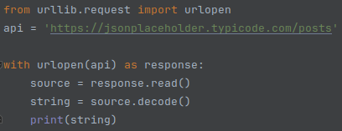
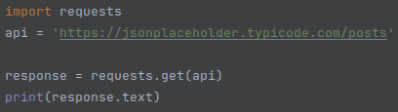
Working with APIs in Python
urllib
Bundled with Python
Powerful but not very developer-friendly
requests
Many built-in features
Easier to use
APIs
Session 11

Slide 11
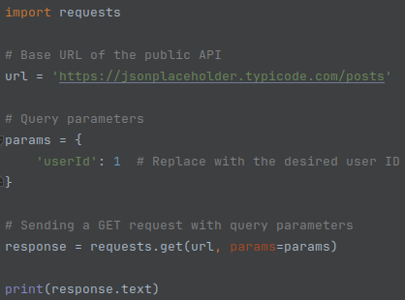
Adding Query Parameters with requests
APIs
Session 11

Slide 12
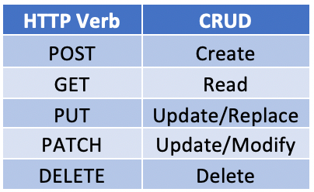
HTTP Verbs
Actions
APIs
Session 11

Slide 13
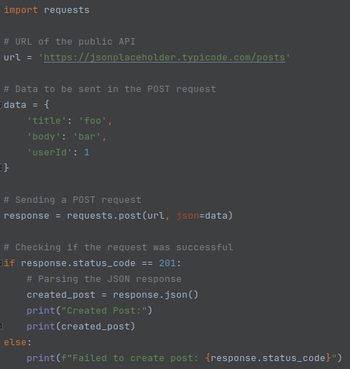
HTTP Verbs
POST
APIs
Session 11

Slide 14
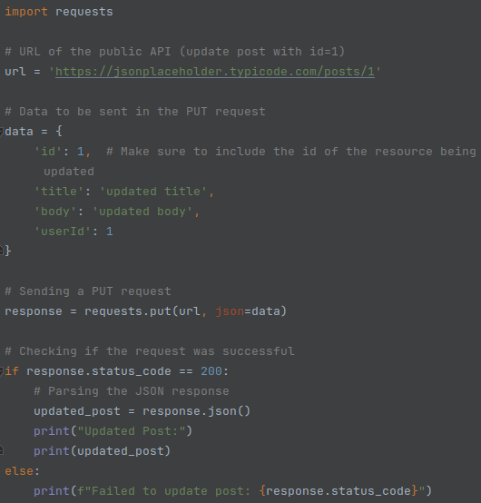
HTTP Verbs
PUT
APIs
Session 11

Slide 15
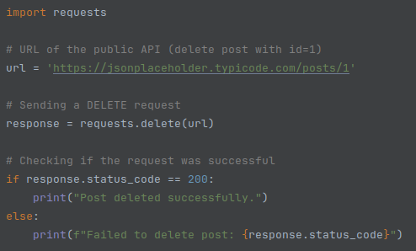
HTTP Verbs
DELETE
APIs
Session 11

Slide 16
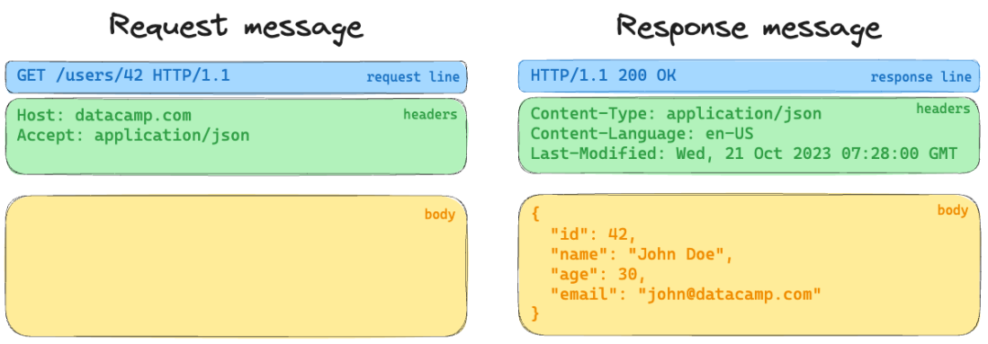
Request and Response Message Anatomy
APIs
Session 11

Slide 17
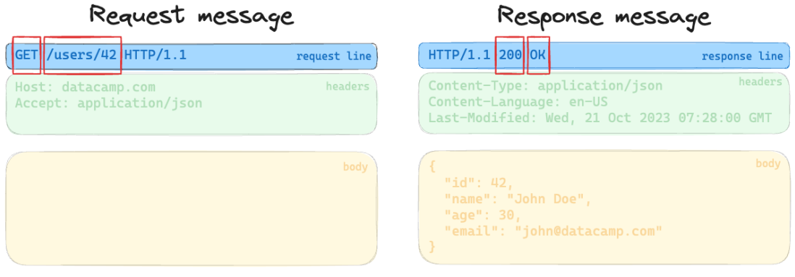
Request and Response Message Anatomy
A server will always include a numeric status code in the response message
APIs
Session 11

Slide 18
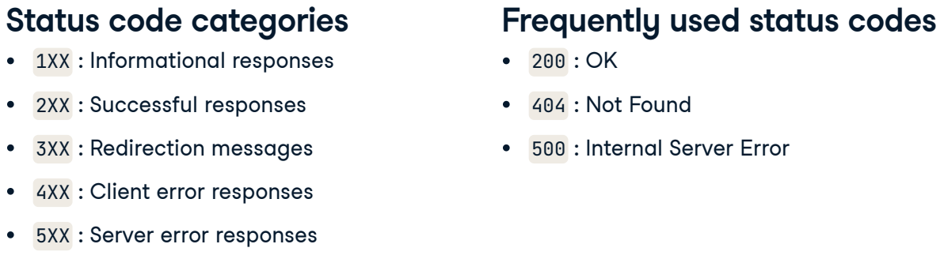
Status Codes
APIs
Session 11

Slide 19
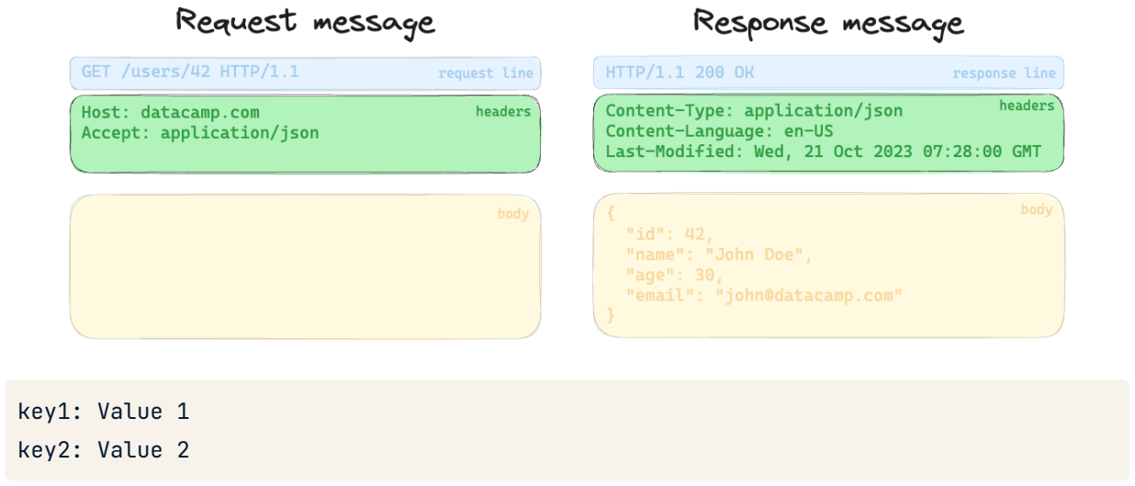
Headers
APIs
Session 11

Slide 20
Exercises
Let's practice with the Reddit API using PRAW (Python Reddit API Wrapper).
Follow the instructions on the notebook: "reddit_api.ipynb".
APIs
Session 11

