Slide 1





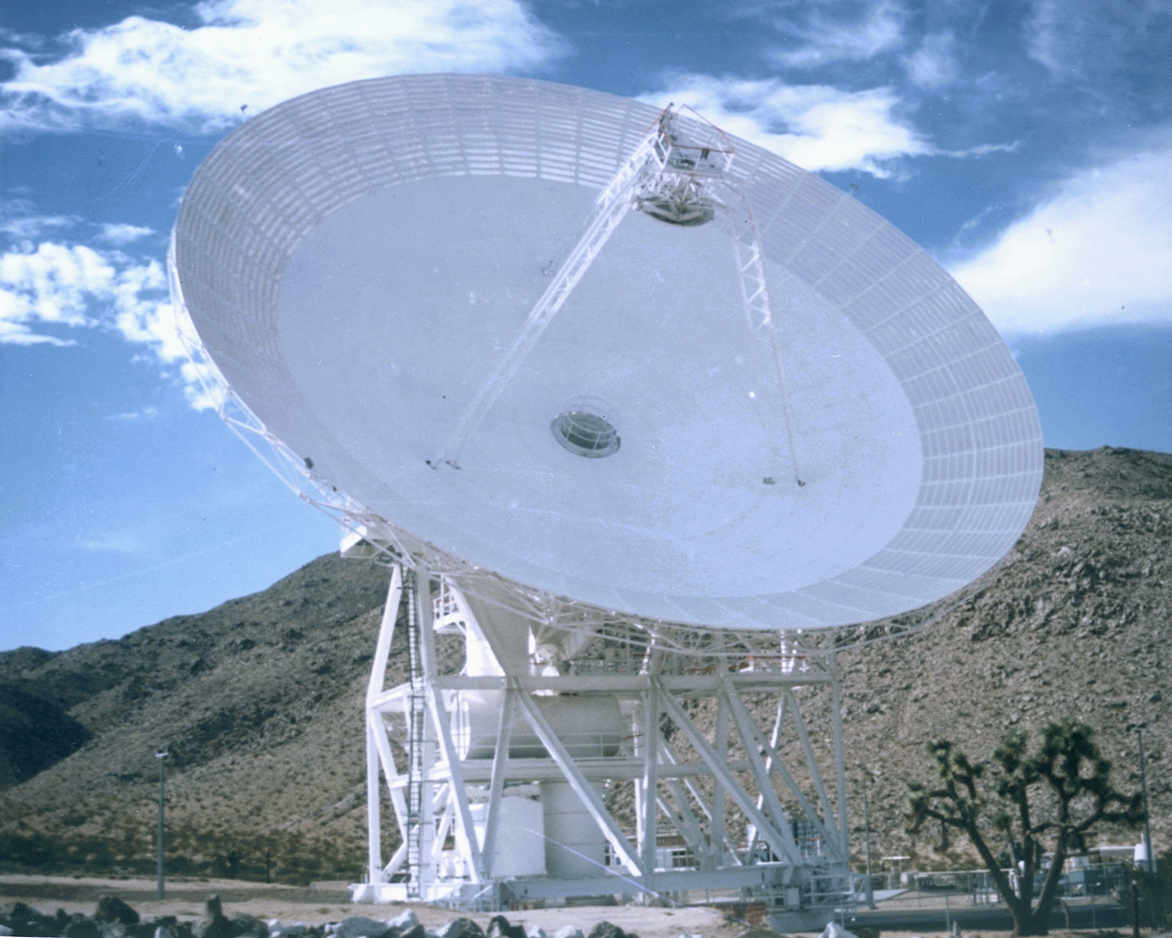

Jet Propulsion Laboratory
California Institute of Technology
Streamlined DSS-28 Development &
Deployment Plan –
Preliminary Assignments
Peter T. Poon
September 29, 2006
GAVRT

Slide 2
DSS-28 Development & Deployment Plan
WRITING ASSIGNMENTS Streamlined DDP (Version 1.0 - Prelim)
1.0 Introduction (P. Poon – he will integrate all inputs in preparing the
entire document)
Purpose of DSS-28 Implementation Task (P. Poon)
Scope (P. Poon)
Applicable Documents (P. Poon)
2.0 DSS-28 Implementation Task Overview
Objectives and Background of DSS-28 Task (M. Hofstadter with inputs from LCER and All Scientists)
Key Requirements and Constraints (A. Freiley)
Functional Block Diagrams (A. Freiley)
Responsibility Changes at End of Task (P. Poon)

Slide 3
DSS-28 Development & Deployment Plan
3.0 DSS-28 Implementation Plan
DSS-28 Implementation Task Organization, Roles, and Responsibilities ( P. Poon)
(Task Organization Chart, roles and responsibilities of key functional
personnel, support organizations and personnel, special facilities)
For each system/subsystem, provide the following inputs where applicable e.g. if your task in H/W only then S/W deliverables are not applicable
Neil Bucknam AMR Sandy Weinreb RSS
John Lauf FTS Farroh Baher ACSS
John Leflang ACSS & MCS
.
Summary Schedule of Deliverables
(Dates by which new functional capabilities will be operational)
Summary of H/W and S/W deliverables

Slide 4
DSS-28 Development & Deployment Plan
3.0 (Cont’d) DSS-28 Implementation Plan
Review Plan ( L. Teitelbaum)
DSS-28 Task Schedule (L. Teitelbaum)
DSS-28 Budget Plan (L.Teitelbaum)
Resources
Cost Estimates
Reserves

Slide 5
DSS-28 Development & Deployment Plan
4.0 DSS-28 Design and Development Approach (A. Freiley )
General
Task Planning and Subsystem Design
Hardware Development
Software Development
Subsystem / System Integration and Testing
Acceptance Testing

Slide 6
DSS-28 Development & Deployment Plan
5.0 DSS-28 Procurement
Neil Bucknam AMR Sandy Weinreb RSS
John Lauf FTS Farroh Baher ACSS
John Leflang ACSS & MCS
Planned major procurements (> $ 100K), including contracted work
Types of procurement and estimated dollar value
Documentation associated with the procurement,
e.g. SOW, RFPs
QA Approach
GFE items (if any) that must be supplied to the vendor

Slide 7
DSS-28 Development & Deployment Plan
6.0 Configuration Management A. Freiley
Describe approach for configuration management
(requirements, hardware, software, data…)
Inputs to 7.0, 8.0, 9.0 11.0 to be provided (where applicable) by:
Neil Bucknam AMR Sandy Weinreb RSS
John Lauf FTS Farroh Baher ACSS
John Leflang ACSS & MCS
7.0 Product Documentation
List all documents and drawings to be produced with scheduled dates of
completion
Provide a list of Spares
8.0 Product Quality Assurance
List QA activities to be conducted on system/ subsystem-level products,
HW deliverables and SW deliverables.

Slide 8
DSS-28 Development & Deployment Plan
9.0 IT Security
Identify any special security requirements
Address how the security requirements will be met
Security refers to sensitive, critical, or ITAR information
10.0 Safety (Ezra Abrahamy, Frederick Battle)
System Safety Checklist

Slide 9
DSS-28 Development & Deployment Plan
11.0 Facility Modification
Power Distribution Modifications
HVAC Modifications
Cabling Infrastructure
Control Room Layouts
Other Items
12.0 Product Delivery
DDR (L. Teitelbaum)
DSN: Maintenance & Spares Agreement (A. Freiley)
Appendix A: Abbreviations and Acronyms (P. Poon)

