Slide 1
Proposed Versatile 1.2 to 14 GHz
Radio Telescope Receiver
S. Weinreb, JPL/Caltech, Draft July 5, 2005
Contents
Introduction and intended applications
Block diagram
Description of new technology
Key technical issues
Schedule
Cost

Slide 2
Introduction
Technology developments during the past few years have made possible an extremely versatile and sensitive radio astronomy receiver with an instantaneous frequency range of 1.2 to 14 GHz in one instrument.
Advances in digital signal processing allow this entire frequency range to be analyzed during one integration period without frequency scanning.
These revolutionary technology advances greatly expand and facilitate the science which can be performed with a 34m radio telescope.

Slide 3
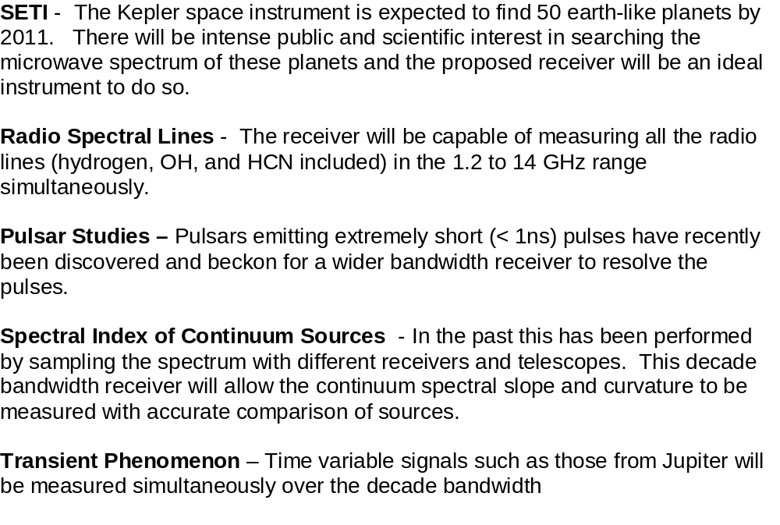
Key Applications for the Proposed Receiver

Slide 4
New Technology to be Described in This Proposal
Compact, efficient antenna feeds with decade or more frequency range have been developed at Chalmers University, Sweden
Low noise amplifiers also with decade bandwidth, < 10K noise at cryogenic temperatures, and differential input have been developed at Caltech
Microwave monolithic integrated circuits (MMIC’s) which facilitate downconversion to baseband.
Digital signal processors capable of analyzing 10 GHz of more of bandwidth at affordable costs

Slide 5
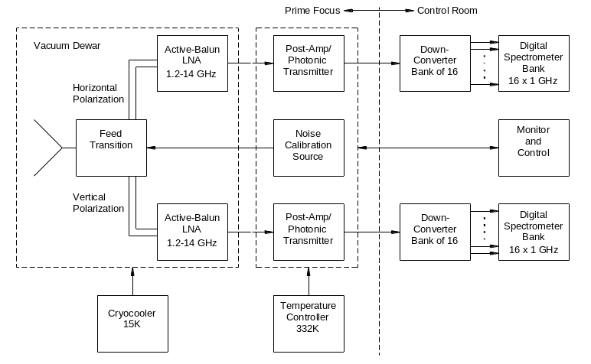
Wideband Receiver Block Diagram

Slide 6
Measurements of a 1 to 13 GHz Model of a Dual Polarized Low-profile Log-periodic Feed for US-SKA
Rikard Olsson¹, Per-Simon Kildal² and Sander Weinreb³
^{1,2}Chalmers University of Technology, Göteborg, Sweden
³California Institute of Technology, Pasadena, California
Abstract
We present measured results for a dual polarized 1 to 13 GHz laboratory model of a feed for use in reflector antennas. The main goals of the laboratory model were achieved: it provides dual polarization and can provide more than a decade bandwidth. The aperture efficiency in a primary fed reflector system is greater than 56% over the entire band, and the input reflection coefficient of the feed is better than -5.5 dB. The results agree well with computed values.

Slide 7

Chalmers 1 to 13 GHz Feed
Feed is currently being integrated with cryogenic LNA’s at Caltech.

Slide 8
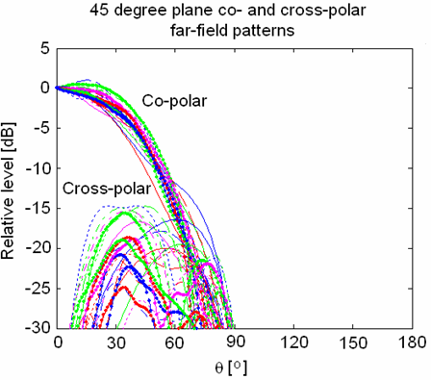
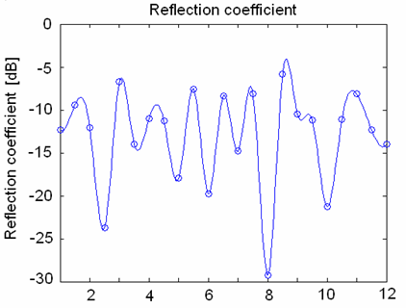
Chalmers Feed Study Computed Results
Calculated pattern gives 57% prime focus efficiency, 3K spillover, and 0.3K mesh leakage in 12/16m symmetric antenna from 0.5 to 1.5 GHz
Gain is 10.5 +/- 0.5 dB and reflection coefficient better than 6 dB over 1:12 frequency range. Provides 65% efficiency at half-angles of 42^{O} to 55^{O}

Slide 9
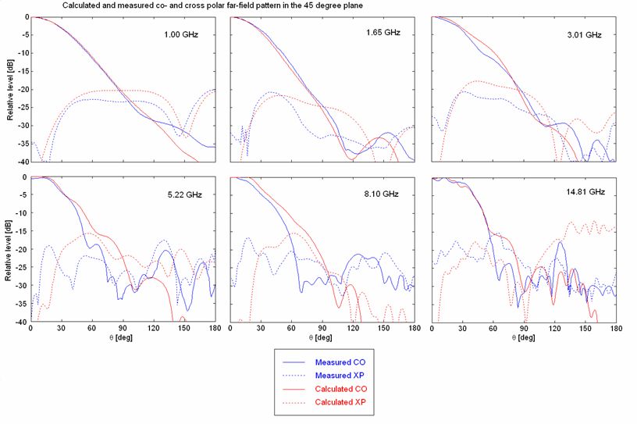
Computed and Measured Antenna Patterns from 1 to 14.8 GHz

Slide 10
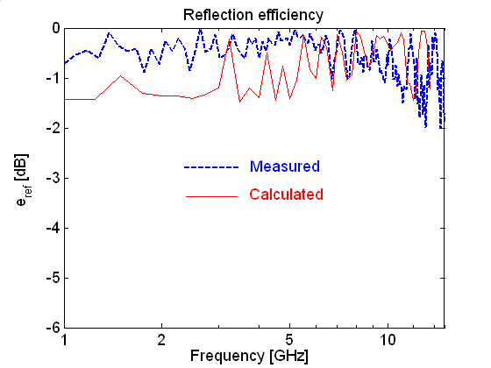
Computed and Measured Loss Reflection Loss from 1 to 13 GHz

Slide 11
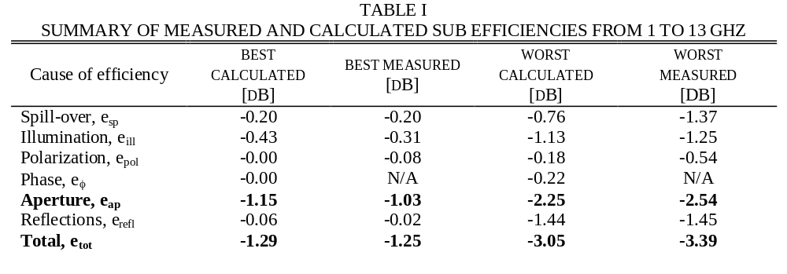
Efficiency of the Chalmers Feed

Slide 12
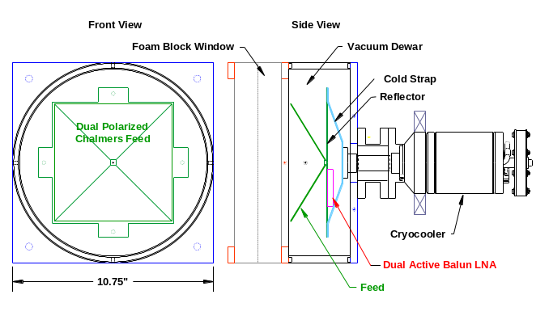
Breadboard Feed/LNA Cryogenic System
Under Construction at Caltech

Slide 13
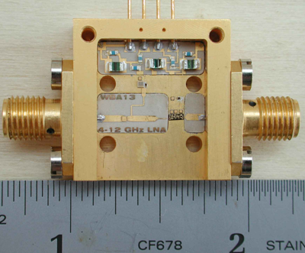
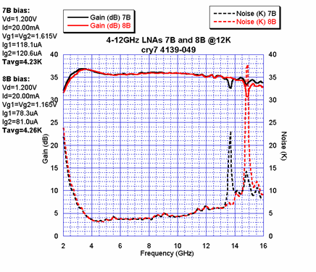
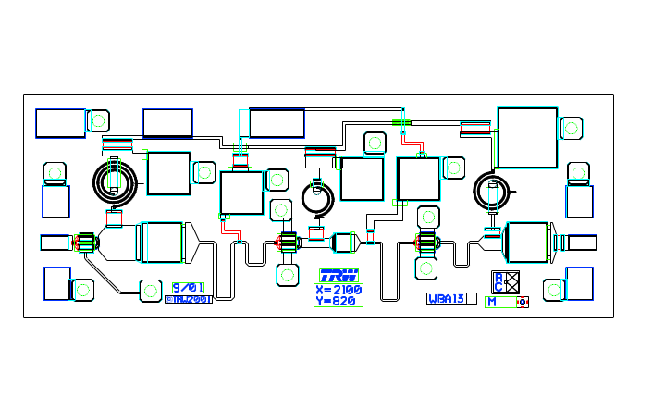
MMIC Wideband Low Noise Amplifiers
Low-cost assembly MMIC package
Amplifier provides 5K noise from 4 to 12 GHz when cooled to 12K
Three-stage LNA in 2mm chip

Slide 14
Active Balun Function - Needed for Wideband Feeds
A Microwave Low-Noise Cryogenic Differential Amplifier
Wideband Feed with Output Balanced with Respect to Ground
+
Active
Balun
-
Wideband antenna feeds have balanced output which cannot connect to a low-noise amplifier without a passive balun
Passive baluns are large, lossy, and add noise to the system

Slide 15
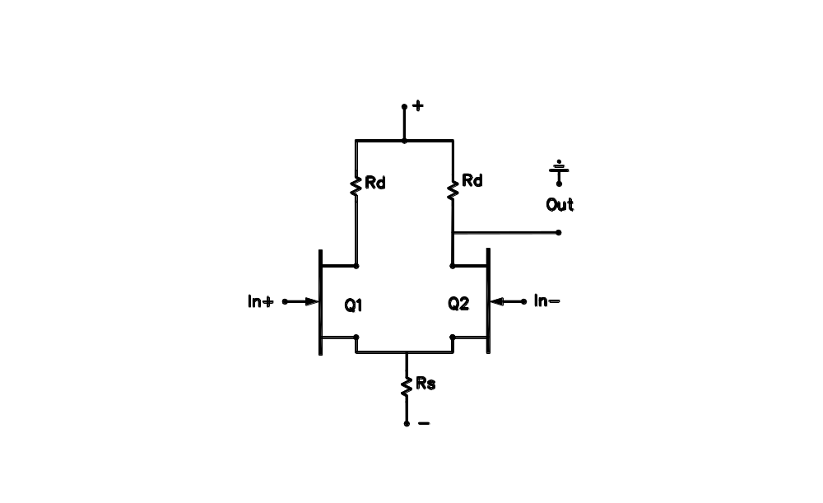
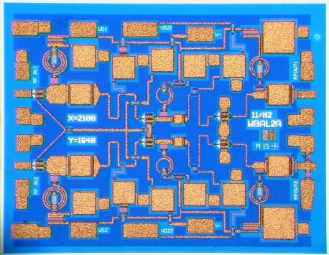
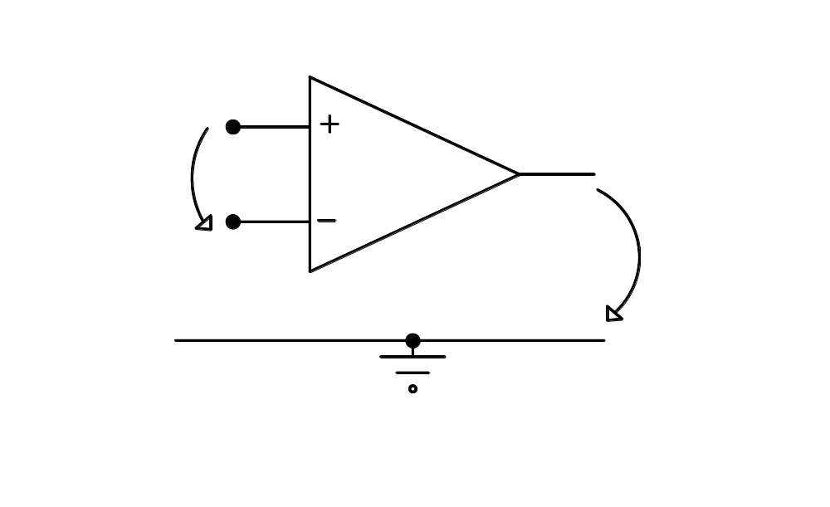
WBAL2, 0.5-11 GHz active balun
differential pair stage
IN
2*1.6 mm chip size
CMRR=gm*Rs (low frequencies)
Requires matched components
Same noise as a common source stage
OUT

Slide 16
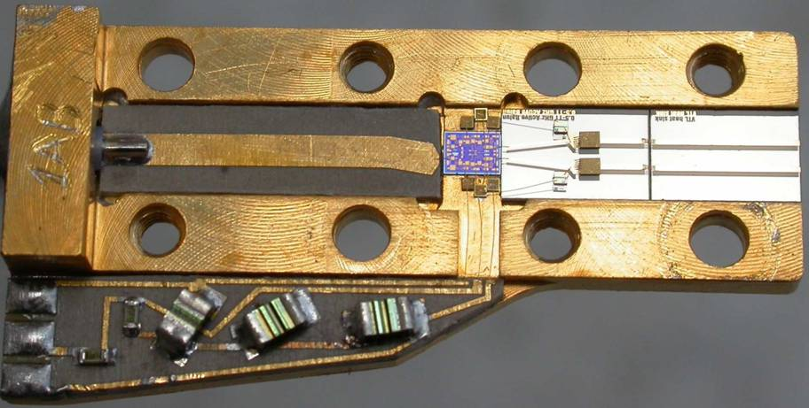
Active Balun-LNA on Carrier
WBAL2 NGST
InP HEMT MMIC
Output microstrip
Input lines from feed

Slide 17
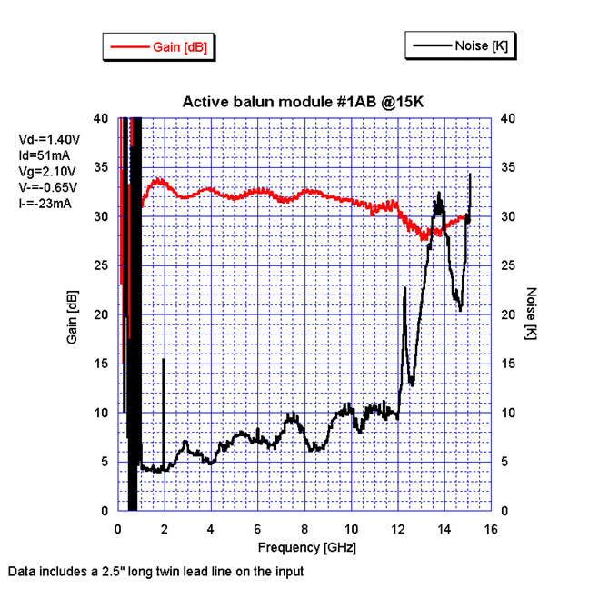
Measured Active Balun Noise and Gain at 15K
Noise peaks above 12 GHz are believed due to resonance in an input coupling capacitor and can be eliminated,

Slide 18
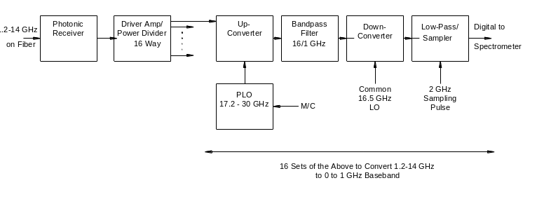
Downconverter Bank Block Diagram

Slide 19
Key Technical Issues
Antenna efficiency and noise temperature
  DSS28 has F/D of 0.3 which results in an 160^{O} subtended angle at prime focus. With current Chalmers feed this would result in low spillover but with taper efficiency < 50%.
  A Cassegrain system with an optimum subreflector for the wideband feed should be investigated
Continuum receiver sensitivity
  Theoretical ΔT with Tsys = 30K, 1 GHz bandwidth, and 1 second integration time is .001K. It is difficult to achieve this theoretical sensitivity with a total power radiometer because of gain fluctuations and atmospheric noise fluctuation.
Digital spectrometer architecture
  1 GHz bandwidth is available with both autocorrelator and FFT processing.
  Final mixing can either be I/Q or conventional baseband

Slide 20
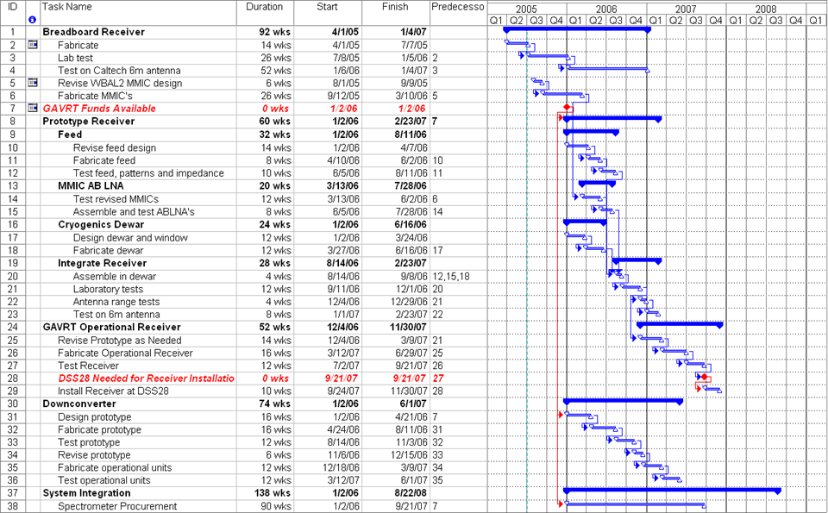
Receiver Schedule

Slide 21
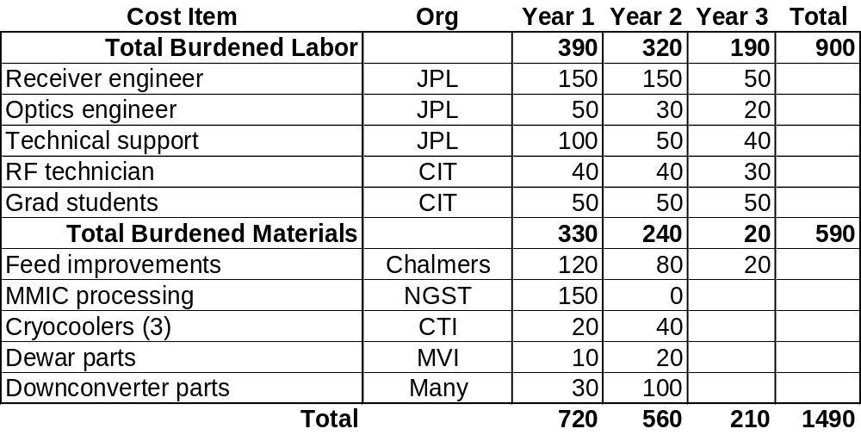
Cost Estimate

