Slide 1
Wideband Receiver for GAVRT
FY06 Plan
Main Objectives in FY06
Mitigate risks due to feed performance and RFI
Produce detailed system block diagram
Generate detailed cost and schedule for implementation

Slide 2
Risk Mitigation – Feed and RFI
Monitor RFI at Goldstone over the 0.7 to 20 GHz to determine required pre-LNA an post-LNA filtering and fraction of time usable for radio astronomy as a function of frequency.
Test Breadboard Front-Ends using both the Kildal and Ingerson wideband feeds integrated with Caltech wideband active-balun LNA’s. Measure feed+LNA noise and antenna patterns and then calculate the sensitivity parameter, A/T, as a function of frequency.
Plan 3 Octave-Band Backup - Develop a backup in case the RFI is too strong or decade feed performance is not acceptable. Obtain pattern and reflection data and cost quotations for commercial octave-band feeds.
Optics Design - Develop a subreflector and secondary focus design for either of the 3 options (Kildal, Ingerson, or 3 octave).

Slide 3
Detailed Receiver Block Diagram
Goal is simultaneous spectral analysis of as much of the 1.2 to 14 GHz frequency range as feasible given the RFI and feed study results.
Much can be gained from concurrent work at Caltech for the U. of Arizona Supercam project which requires 64 sets of downconverters and 1 GHz spectrometers for a focal plane array.
A reasonable goal for the GAVRT telescope would be 8 tunable downconverters feeding 8 1 GHz bandwidth spectrometers.

Slide 4
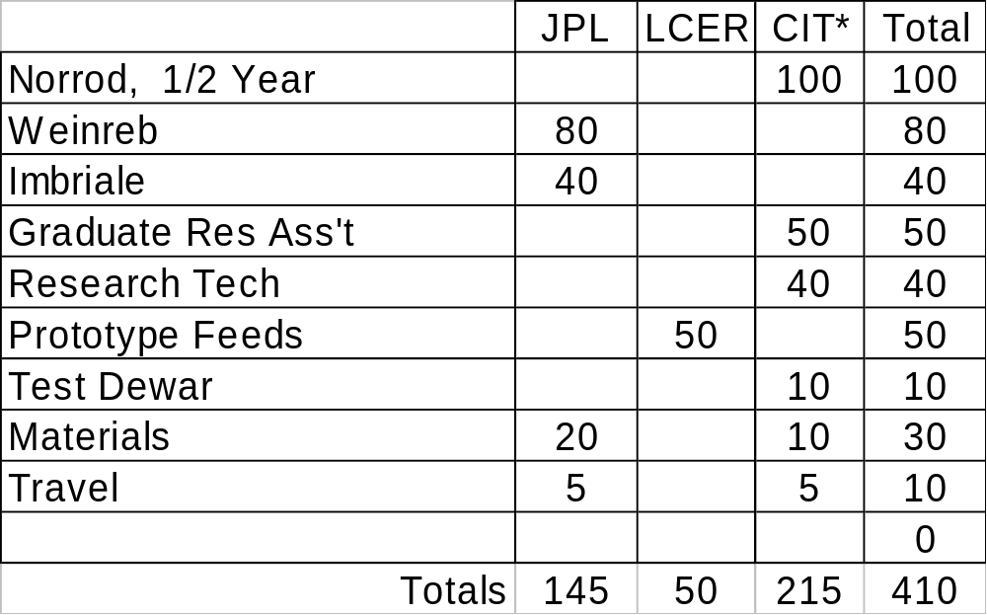
FY06 Budget
*CIT funded directly from Lewis Center

