Slide 1



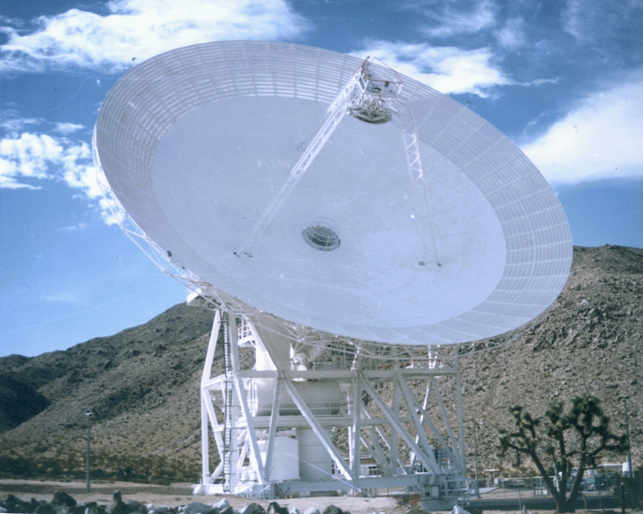

Jet Propulsion Laboratory
California Institute of Technology
GAVRT: DSS-28 PDCR Planning
Larry Teitelbaum
October 28, 2005
GAVRT

Slide 2
Agenda
Process, standards, reviews (Teitelbaum)
Inputs required for next review (Teitelbaum)
Summary of remaining trades (Teitelbaum)
Assignment of responsibilities (All)
Commit to or defer 11/15/2005 PDCR date (All)
FY06 plan for broadband feed option (Weinreb)

Slide 3
Process, Standards, Reviews
Two meetings held with representation from 920, 923, 902, GAVRT, SE
DDOSO (920, 923) concerns
  Diversion of critical workforce from higher priority tasks
  Cost and commitments risk due to non-standard implementation
DSMS and DDOSO want us to follow standard implementation model
  SDD process (PDCR)
  SCD process (subsequent events)
  But, can tailor model (including review standards) for the DSS-28 job
Preliminary agreement
  Tailoring documented in DSMS Development and Deployment Plan (DDP)
  Three reviews:
    PDCR (combined PMSR and SRR on project model, Phase A/B)
    Combined PDR/CDR (Phase B/C)
    DDR - DSMS Delivery Review (ORR, Phase D/E transition)

Slide 4
Process, Standards, Reviews (Cont’d)
Specific expectations from DSMS program office
  Technical
    Description of flight article and pertinent information driving design
    Block diagrams with functions and design details
    Equipment list including EM, spares, GSE, test bed
    Documentation list
    Component technology readiness and heritage
    Challenging technologies and mitigation plan
  Implementation
    Organization placement
    WBS placement
    Schedule of key reviews and deliveries
    Cost assumptions, budgeted schedule and cost, PCAT or equivalent, basis of estimate
    Method of acquisition
  Is this standard appropriate? Why higher now than for Klein/Freiley reviews?

Slide 5
Inputs Required for Next Review
Requirements definition process
Level 1 and Level 2 requirements
Point design
Results from peer reviews
Integrated schedule
Integrated cost
  PCAT, including resolution of color-of-money issues
Draft DDP

Slide 6
Summary of Remaining Trades
Microwave: Broadband vs. narrowband option
Broadband microwave: Cassegrain vs. prime focus
Antenna controller: DSN-leveraged APC vs. DSS-28-unique
Radiometer: TPR vs. gain-stabilized radiometer
Initial backend implementation:
  DSS-28-resident radiometer plus IF distribution to DSS-13 vs. ??

Slide 7
Assignment of Responsibilities
Provisional WBS
1) Leadership/task management - Preston, MacLaren, Teitelbaum, Hofstadter
2) System Engineering - Freiley, Connally
3) Science Team - Hofstadter, Levin, Kuiper, Jones, Jauncey, Preston
4) Antenna Mechanical - Hames, Saldua, Bucknam
5) Optics and Performance Estimation - Imbriale
6) Microwave (including down conversion) - Weinreb, Brown
7) Antenna Control - Morgan, Baher, Leflang
8) Monitor & Control - Leflang, Trinh
9) Gain-stabilized Radiometer - Skjerve, Rochblatt
10) Networking and signal distribution - Teitelbaum, Bucknam
11) Integration & Test - Britcliffe, Sosnowski
12) Operations & Maintenance - TBD, but must include LCER, ITT, DSN Safety
Identify lead single point-of-contact for each WSB element

Slide 8
Level 1 Requirements
Proposed augmentation to the existing GAVRT project shall support anticipated program growth
Proposed augmentation shall provide observational capability sufficient to perform publishable research with data quality at least equivalent to
  DSS-12 for existing curriculum elements
  DSS-13 for Cassini-JMOC
Proposed augmentation shall support the following curriculum elements
  Jupiter Quest
  Uranus
  QVS
  Microwave spectroscopy of methanol masers
  Interferometry (at frequencies instrumented for single-dish programs)
  SETI
  Pulsar timing

