Slide 1



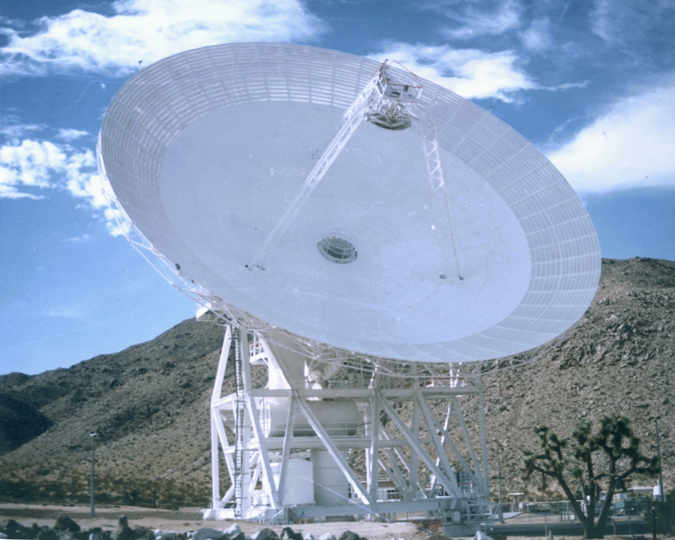

Jet Propulsion Laboratory
California Institute of Technology
GAVRT: DSS-28 PDCR Planning
Larry Teitelbaum
November 14, 2005
GAVRT

Slide 2
Agenda
Ultra low-cost, high performance microwave options for DSS-28 (Britcliffe)
DSS-28 receiver plan (Weinreb)
Fundamental assumptions driving non-BWG focus ideas (Teitelbaum,all)
And a few more things (All)

Slide 3
Assumptions Driving non-BWG Focus
Frequency reach of DSS-28 main reflector is ≤ 15 GHz
  No motivation to preserve ability to develop new feed positions
Availability of “transition” frequencies from ~ 4 – 6 GHz is crucial to long-term success of QVS campaign
Access to full RF spectrum from ~ 1.2 – 15 GHz is important to development of future GAVRT spectroscopy campaign
Capability to support a SETI campaign over ~ 1.2 – 15 GHz is important to long-term development of GAVRT program
Good S-band performance is essential for success of existing GAVRT campaigns and curriculum elements

Slide 4
A Few More Things
Based on last week’s discussion, a clarification
  We still have working groups
  A single peer review, perhaps, for the microwave subsystem
Unless compelling reason is brought forward, commit to DSN-standard APC
Can we begin implementing mature subsystems prior to PDCR?
Baseline backend for PDCR will include gain-stabilized 4-channel radiometer
  Leverage Lyle Skjerve’s planned DSS-13 FY06 prototype NAR effort
  Leverage Dave Rochblatt’s shipping antenna calibration 4-channel systems
  Cost signal distribution to DSS-13 now
  Can defer addition of emerging technology spectrometer until PDR/CDR
With the exception of microwave, updates requested for cost and schedule for everything else - Objective: First integrated cost and schedule
  Cost in PCAT
  Schedule in any tool of choice (but moving toward Microsoft Project or equivalent)
Develop outline for DDP

Slide 5
Background Material from Earlier Meetings

Slide 6
Peer Review Process
Draw from, as appropriate, review standards summarized in DSMS process documents
  812-101-Draft-09-12.doc
  813-101-D-2.pdf
Purpose
Success criteria (derived from PDCR)
Culminating review meeting
  Materials, agenda
  Output to PDCR

Slide 7
Strawman High-Level Schedule

Slide 8
Inputs Required for PDCR
Requirements definition process (Connally, Freiley)
Level 1 and Level 2 requirements (Connally, Freiley)
Point design (All)
Results from peer reviews (Leads of technical working groups)
Integrated schedule (John Sosnowski)
Integrated cost (Teitelbaum)
  PCAT, including resolution of color-of-money issues
Draft DDP ( Mark Hofstadter, Peter Poon)

