Slide 1
GAVRT DSS28 Receiver Plan
S. Weinreb
November 14, 2005
Summarize Known Available Radiometer Components
  LNA’s and commercial octave-band feeds
  Caltech/U.of Arizona downconverter and spectrometers
FY06 Design Study Work Statement
A Current Benchmark Point Design
Budget and Business Plan for FY06

Slide 2
Available, Applicable Radiometer Components to Facilitate DSS28 Radiometer System Design
Caltech wideband, cryogenic LNA’s – 0.5 to 11, 4 to 14, and 6 to 20 GHz fully developed models. 5K noise from 1 to 12 GHz for $5K!
Commercial feeds for ~octave bands, compact and coolable, illuminating the same optics (~90 degree angle) as decade feeds
Downconverter, IF, and power meter design for 1 GHz bandwidth with highly integrated, low cost, 8 on a PC board construction.
UAZ/Caltech Supercam project spinoff.
Digital spectrometers – 1 GHz bandwidth, 8K channels, <$10K per unit. From Omnisys for UAZ/Caltech Supercam project

Slide 3
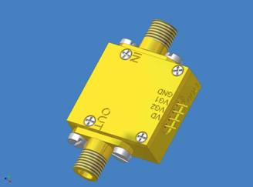
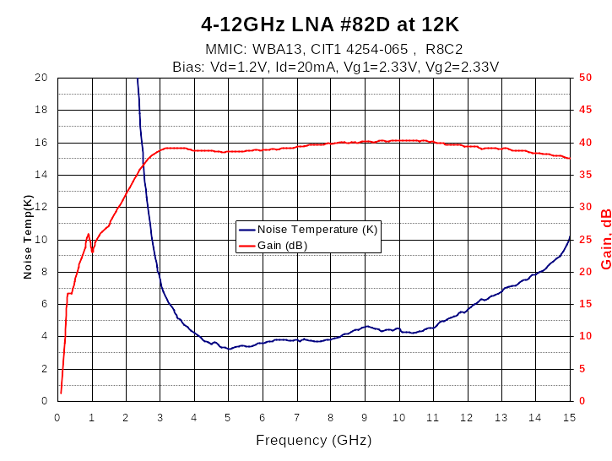
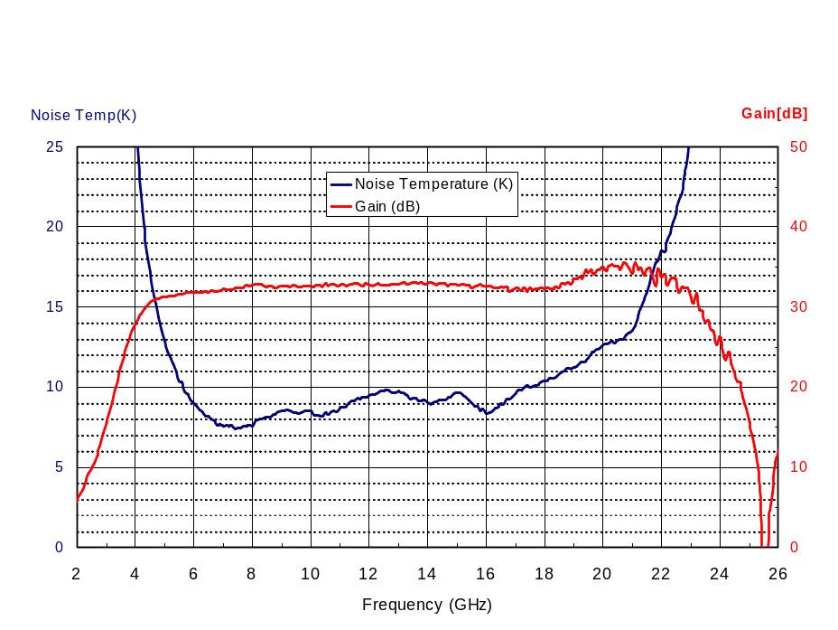
Caltech Cryogenic LNA’s
3 Models, @ 12K
0.5 to 11 GHz, Tn < 5K
4 to 14 GHz, Tn < 8K
6 to 20 GHz, Tn < 12K

Slide 4
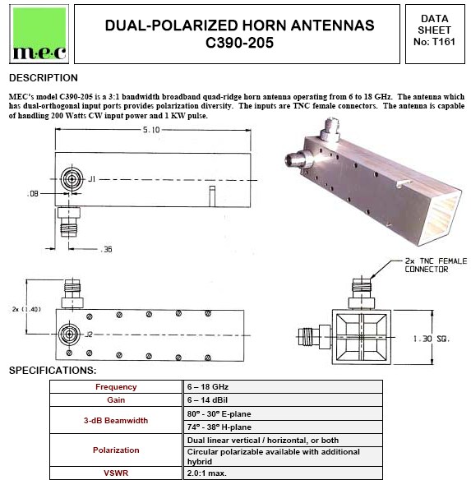
Commercial 6 to 18 GHz Feed
Could be scaled to 4.5 to 13.5 GHz
C, X , and Ku Bands
Small size accommodates cryogenic cooling

Slide 5
Tsys Comparisons at X Band
System | Optics/LNA | Tsys | Instant BW | Tuning Range | ΔT @1sec | Time to Measure Uranus *
Current DSS12 | Cassegrain/ Dichroic 300K LNA | 120K | 100 MHz |  | 12mK | 576 s
Current DSN Array Prototype | Gregorian 12K LNA and Feed | 20K | 500 MHz | 8.0-8.8 GHz | 0.9mK | 5.2 s
Cooled Octave Band Feed and LNA | Cassegrain Octave Band Feed @ 12K | 30K | 1000 MHz | 4.5 – 9 GHz | 1 mK | 6.4 s
Cooled Decade Band Feed and LNA | Cassegrain Decade Band Feed @12k | 60K? | 1000 MHz | 2 -14 GHz | 1.7 mK | 25.6 s
March 3, 2005 Proposal | Beam WG 300K LNA | 90K? | 1000 MHz |  | 3 mK | 36 s
* Total integration time for on/off measurment of assumed 0.1 Jansky flux. Requires sufficient receiver and atmospheric stability for the measurement

Slide 6
FY06 Design Study
RFI Study at Goldstone
  Process started to get statistics of RFI vs frequency.
  Determine frequencies of strong, consistent, emitters and find wide bands that are RFI free >90% of time.
Decade Bandwidth Feeds
  Purchase 1.2 to 14 GHz units from both Kildal and Ingerson
  Test these feeds integrated with cryogenic LNA
~Octave Bandwidth Feeds
  Survey commercial existing designs. Buy two units and evaluate for patterns, cooling effects, and impedance match.
Optics Study
  Compare efficiency and noise of beam waveguide, octave feeds, and decade feeds optimizing subreflector in each case
System Design
  Develop complete block diagram, cost estimate, and implementation plan including personnel.

Slide 7
Baseline, Point Design System Concept
November 13, 2005
4.5 to 13.5 GHz quad-ridge, dual-linear, feed, cooled with Caltech 4 to 14 GHz LNA’s, Tsys < 40K
1.2 to 2.4 GHz uncooled feed and LNA, either dichroic or surrounding the cooled feed, Tsys < 60K
New subreflector and secondary focus cone to accommodate the above or decade bandwidth feeds
16 channel down-converter system including power detectors, gain control, filters, digital spectrometer interface, and fibers to DSS13
16 x 1 GHz x 8K channel digital spectrometers

Slide 8
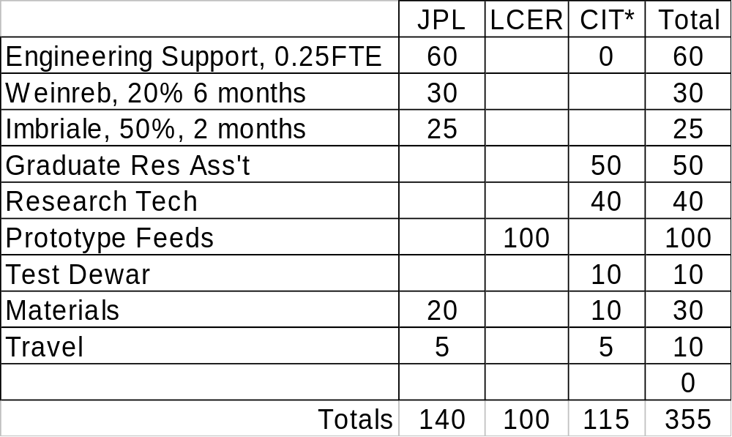
FY06 Receiver Budget
*CIT funded directly from Lewis Center

Slide 9
FY06 Business Action Plan
Overall objective is to design a state-of-the-art radiometer system, easily operated and maintained, all within a $3.2M cost cap.
Leads to PDR/CDR at end of FY06 and implementation in FY07.
Caltech must submit a proposal to LCER for period 1/1/06 to 9/30/06. This will be for $115K of work at Caltech and $100K of prototype feed procurements to be funded directly by LCER.
An account must be set up by 12/1/05 at JPL with $140K to fund JPL labor for the receiver development.
A receiver steering committee consisting of the scientists that will use the facility and representatives of LCER should meet monthly to receive progress reports and guide tradeoff decisions.
Use balance of FY06 JPL funds for labor to start known mechanical revisions of DSS28; provide procurement budget to LCER

