Slide 1





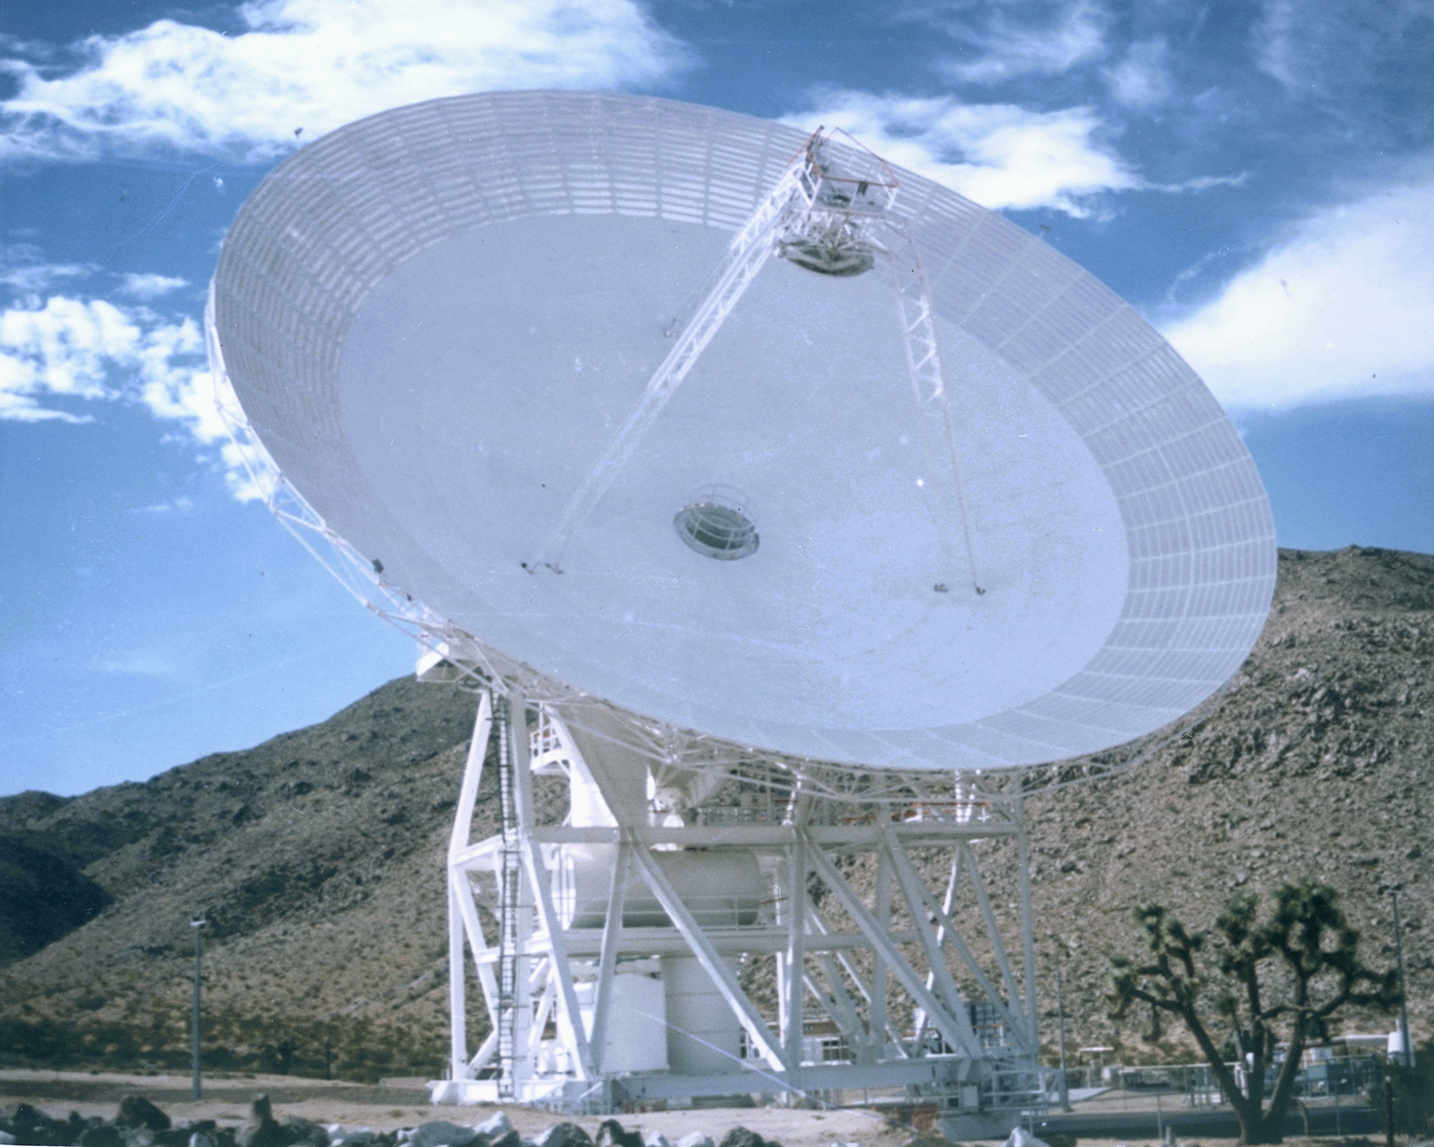

Jet Propulsion Laboratory
California Institute of Technology
DSS-28 Implementation
Preliminary Definition & Cost Review
Project Development & Deployment Plan - Peter T. Poon
April 14, 2006
GAVRT

Slide 2
DSS-28 Development & Deployment Plan
A streamlined development and deployment approach is adopted since DSS-28 development is an R&D task and funding and workforce are very limited
The key features of this streamlined approach are as follows:
Significant procurements performed by Lewis Center for Educational Research (LCER)
- Cost savings anticipated since LCER will perform procurements for Radiometer Subsystem, most of Antenna Control Subsystem, Monitor & Control Subsystem, and Back-end Subsystem, and part of the Antenna Mechanical Restoration Subsystem.

Slide 3
DSS-28 Development & Deployment Plan
Development of Radiometer Subsystem, a major subsystem for DSS-28, will be performed by Caltech through a subcontract to LCER under the direction of Sandy Weinreb. Subcontracting of Antenna Control Subystem, Monitor & Control Subsystem will be performed by LCER.
- JPL will provide technical oversight
Instead of a separate PDR and CDR, a combined PDR and CDR is planned
- Frequent Status Reviews as well as Peer Reviews will be held which ensure that the design will meet requirements, is complete and meet schedule and budget constraintsNo Test Readiness Review (TRR) will be held
- Status reviews will include reviewing test readiness
- Subsystem tests, system Integration & Test will be performed
- Test plans and test descriptions will be included in informal test documents
- Test Reports including performance verification will be generated
No Down Time Readiness Review (DTRR) will be held
- There is no down time

Slide 4
DSS-28 Development & Deployment Plan
No Modkit will be delivered
- Installation procedures and instructions will be provided
- Deliver and install directly to the station; no transfer process is needed
- A reporting database will be generated
- Drawings and Operations Maintenance Manual will be produced
There will be no compromise on safety
- Safety codes and standards will be adhered to
- System Safety Checklist will be generated
Instead of a formal Acceptance Test Plan, the following will be generated:
- Requirements verification plan will be developed
- Informal test documents will be generated; subsystem tests, system Integration & Test will be performed;
- Test Reports including performance verification & acceptance (by GAVRT as a joint JPL/IND – LCER partnerhsip) will be generated

Slide 5
DSS-28 Development & Deployment Plan
Outline of Streamlined DDP (Version 1.0 - Prelim)
1.0 Introduction
Purpose of DSS-28 Implementation Task
Scope
Applicable Documents
2.0 DSS-28 Implementation Task Overview
Objectives and Background of DSS-28 Task
Key Requirements and Constraints
Functional Block Diagrams
Responsibility Changes at End of Task

Slide 6
DSS-28 Development & Deployment Plan
3.0 DSS-28 Implementation Plan
Approach (Refer to 4.0)
Summary Schedule of Deliverables
(Dates by which new functional capabilities will be operational)
Summary of H/W and S/W deliverables
DSS-28 Implementation Task Organization, Roles, and Responsibilities
(Task Organization Chart, roles and responsibilities of key functional
personnel, support organizations and personnel, special facilities)

Slide 7
DSS-28 Development & Deployment Plan
3.0 (Cont’d) DSS-28 Implementation Plan
Review Plan
DSS-28 Task Schedule
DSS-28 Budget Plan
Resources
Cost Estimates
Reserves

Slide 8
DSS-28 Development & Deployment Plan
4.0 DSS-28 Design and Development Approach
General
Task Planning and Subsystem Design
Hardware Development
Software Development
Subsystem / System Integration and Testing
Acceptance Testing

Slide 9
DSS-28 Development & Deployment Plan
5.0 DSS-28 Procurement
Planned major procurements (> $ 100K), including contracted work
Types of procurement and estimated dollar value
Documentation associated with the procurement,
e.g. SOW, RFPs
QA Approach
GFE items (if any) that must be supplied to the vendor

Slide 10
DSS-28 Development & Deployment Plan
6.0 Configuration Management
Describe approach for configuration management
(requirements, hardware, software, data…)
7.0 Product Documentation
List all documents and drawings to be produced with scheduled dates of
completion
Provide a list of Spares
8.0 Product Quality Assurance
List QA activities to be conducted on system/subsystem-level products,
HW deliverables and SW deliverables.

Slide 11
DSS-28 Development & Deployment Plan
9.0 IT Security
Identify any special security requirements
Address how the security requirements will be met
Security refers to sensitive, critical, or ITAR information
10.0 Safety
System Safety Checklist

Slide 12
DSS-28 Development & Deployment Plan
11.0 Facility Modification
Power Distribution Modifications
HVAC Modifications
Cabling Infrastructure
Control Room Layouts
Other Items
12.0 Product Delivery
DDR
DSN: Maintenance & Spares Agreement
Appendix A: Abbreviations and Acronyms

