Slide 1




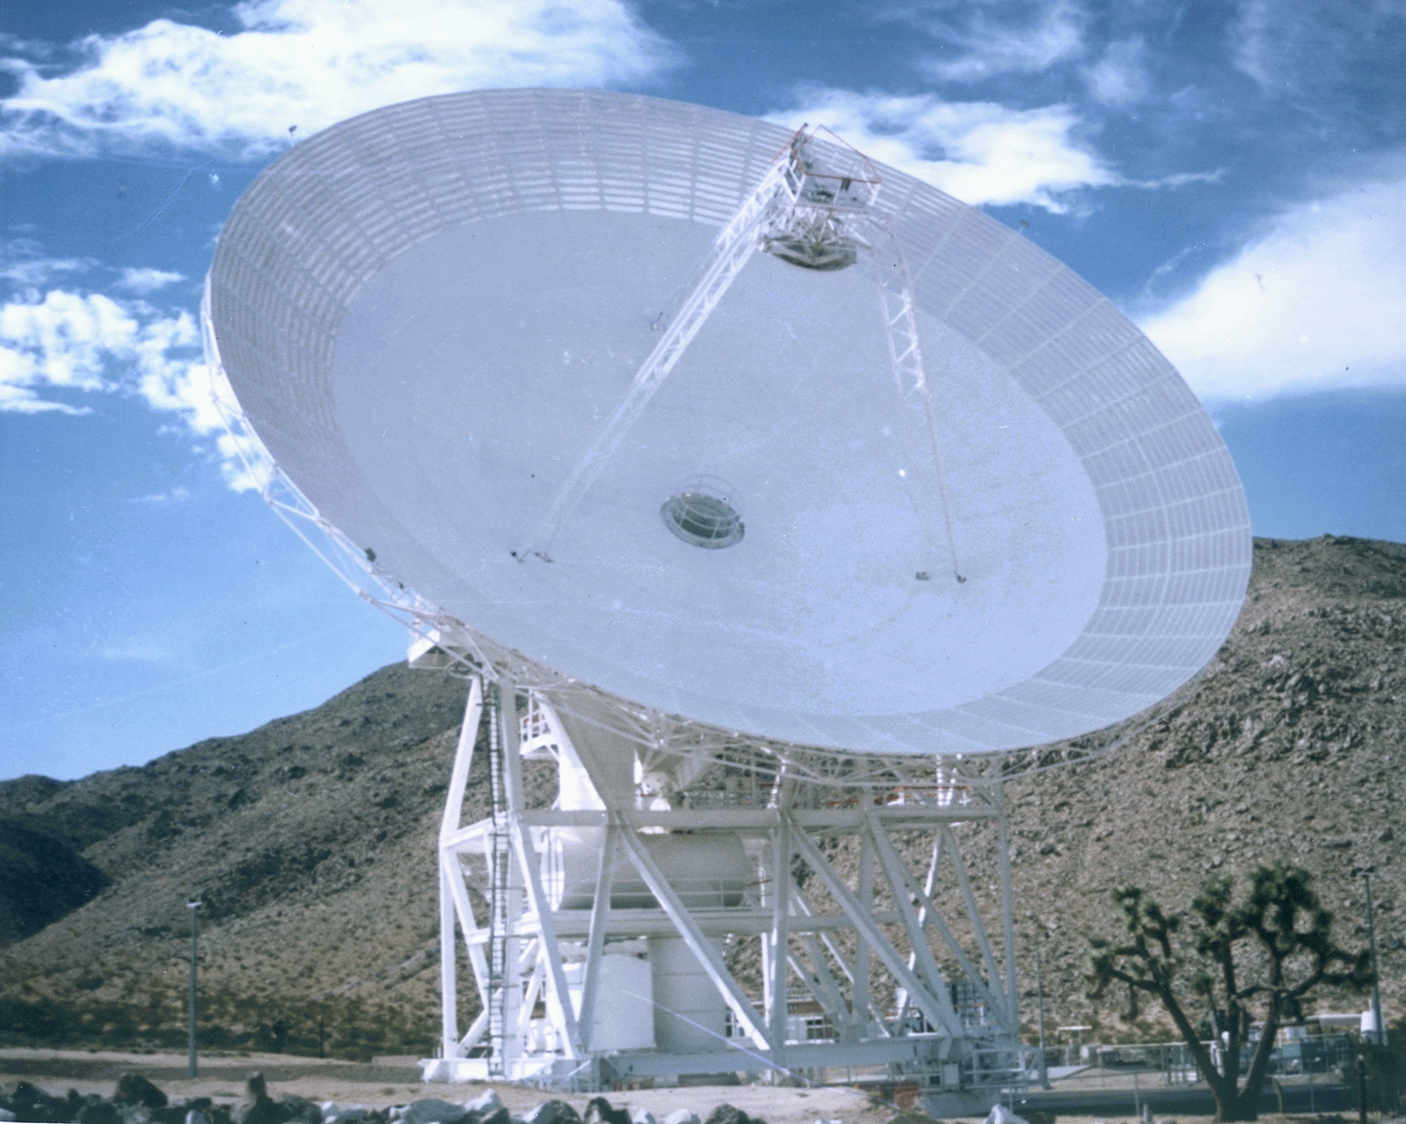

Jet Propulsion Laboratory
California Institute of Technology
DSS-28 Implementation
Preliminary Definition & Cost Review
Peter T. Poon
February 15, 2006
GAVRT

Slide 2
PDCR Outline & Assignments
Introduction - Teitelbaum (15)
Objectives and Level 1 Requirements - Hofstadter (15)
Detailed Project Requirements - Connally (15)
Microwave Optics, Configuration Options, Performance - Imbriale (15)
Antenna Mechanical Restoration - Hames/Gama (20)
Radiometer System - Weinreb (30)
Antenna Control System - Baher (20)
Monitor & Control System - Leflang (15)
Back-End System - Kuiper (15)
Project Development and Deployment Plan - Poon (15)
Cost, Schedule, Requirements Compliance, Summary - Teitelbaum (30)
Requirements section
Implementation section
Project section

Slide 3
DSS-28 Development & Deployment Plan
Streamlined DSS-28 Development and Deployment Plan
DSMS System Engineering Management agreed that the Development and Deployment Plan (DDP) should be streamlined for the DSS-28 Implementation task
Approach to streamlining the DDP
  Identify essential topics
  A powerpoint version of the streamlined DDP covering all the essential topics will be produced for the DSS-28 implementation task prior to the Preliminary Design Review
  An outline of a streamlined DDP is provided at the PDCR

Slide 4
DSS-28 Development & Deployment Plan
Outline of Streamlined DDP (Version 1.0)
1.0 Introduction
Purpose of DSS-28 Implementation Task,
Scope
Applicable Documents
2.0 DSS-28 Implementation Task Overview
Objectives and Background of DSS 28 Task
Key Requirements and Constraints
Functional Block Diagrams
Responsibility Changes at End of Task

Slide 5
DSS-28 Development & Deployment Plan
3.0 DSS-28 Implementation Plan
Approach
(Describe approach to accomplishing DSS-28 implementation)
Summary Schedule of Deliverables
(Dates by which new functional capabilities will be operational)
Summary of H/W and S/W deliverables
DSS-28 Implementation Task Organization, Roles, and Responsibilities
(Task Organization Chart, roles and responsibilities of key functional
personnel, support organizations and personnel, special facilities)
DSS-28 Staffing Plan
(Staffing chart for JPL, LCER, ITT and Other Contractors)
Development Team Training Needs/ Plan

Slide 6
DSS-28 Development & Deployment Plan
3.0 (Cont’d) DSS-28 Implementation Plan
DSS-28 Task Schedule
Master Schedule
(Master Schedule of the overall task)
Reportable Milestones
DSS-28 Budget Plan
Resources
Cost Estimates
Reserves
Other Required Resources
DSS-28 Risk Assessment
Risk Sources and Categories

Slide 7
DSS-28 Development & Deployment Plan
4.0 DSS-28 Task Management
Refer to Section 3.0
5.0 DSS-28 Design and Development Approach
General
Task Planning and Subsystem Design
Hardware Development
Software Development
Subsystem/ System Integration and Testing

Slide 8
DSS-28 Development & Deployment Plan
6.0 DSS-28 Procurement Plan
Planned major procurements (> $ 100K), including contracted work
Types of procurement and estimated dollar value
Documentation associated with the procurement,
e.g. SOW, RFPs
QA Approach
GFE items that must be supplied to the vendor
Key milestones for major procurements

Slide 9
DSS-28 Development & Deployment Plan
7.0 Configuration Management Plan
Describe approach for configuration management
(requirements, hardware, software, data…)
8.0 Product Documentation Plan
List all documents and drawings to be produced with scheduled dates of
completion; include dependencies where applicable
9.0 DSS-28 Review Plan
Refer to Section 3.0
10.0 Product Quality Assurance Plan
List QA activities to be conducted on system/subsystem-level products,
HW deliverables and SW deliverables.

Slide 10
DSS-28 Development & Deployment Plan
11.0 IT Security Plan
Identify any special security requirements on the development systems and
operational systems; address how the security requirements will be met
Security refers to sensitive, critical, or ITAR information
12.0 Safety Plan
Code and Standards Compliance
Safety-related Procedures and Tools
Activities of DSMS Safety Engineer
System Safety Checklist

Slide 11
DSS-28 Development & Deployment Plan
13.0 DSS-28 Test Plan
Test levels and approach for HW, SW, subsystem/ system testing
Integration (Development-Level) testing
Hardware first article acceptance testing
Acceptance testing
14.0 Facility Modification Plan
Power Distribution Modifications
HVAC Modifications
Cabling Infrastructure
Control Room Layouts
Other Items

Slide 12
DSS-28 Development & Deployment Plan
15.0 Product Delivery Plan
User and /or Operator and Maintenance Personnel Training Plan
LCER Delivery Plan
DSN: Transfer Agreement and Modkit Plan
DSN: Maintenance & Spares Agreement
Product Transition Scenarios
Hardware Transfer and Modkit Definition
Software Delivery and Transfer Definition
Engineering Transition Plan
Appendix A: Abbreviations and Acronyms

