Slide 1


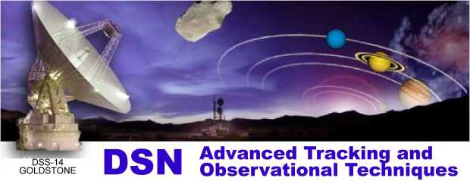
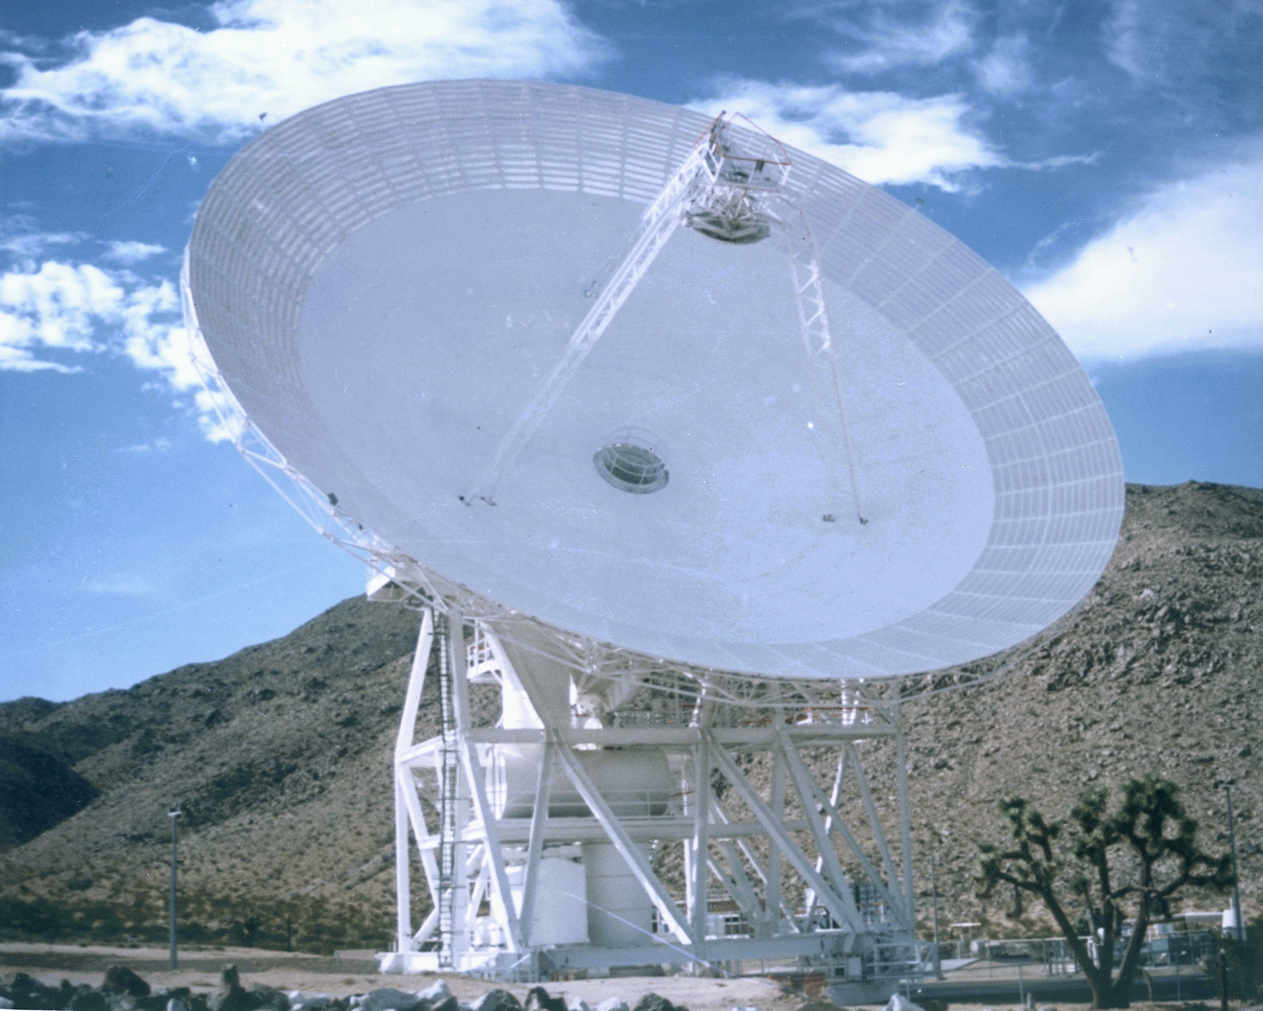
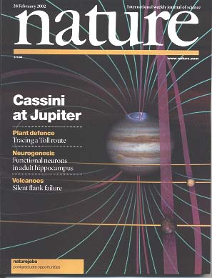
Jet Propulsion Laboratory
California Institute of Technology
DSS-28 Implementation
Preliminary Definition & Cost Review
Your Name Here
February 15, 2006
GAVRT

Slide 2
PDCR Outline & Assignments
Introduction - Teitelbaum (15)
Objectives and Level 1 Requirements - Hofstadter (15)
Detailed Project Requirements - Connally (15)
Microwave Optics, Configuration Options, Performance - Imbriale (15)
Antenna Mechanical Restoration - Hames/Gama (20)
Radiometer System - Weinreb (30)
Antenna Control System - Baher (20)
Monitor & Control System - Leflang (15)
Back-End System - Kuiper (15)
Project Implementation Plan - Poon (15)
Cost, Schedule, Requirements Compliance, Summary - Teitelbaum (30)
Requirements section
Implementation section
Project section

Slide 3
Example
Level 1
  Level 2
    Level 3
      Level 4
        Level 5

