Slide 1





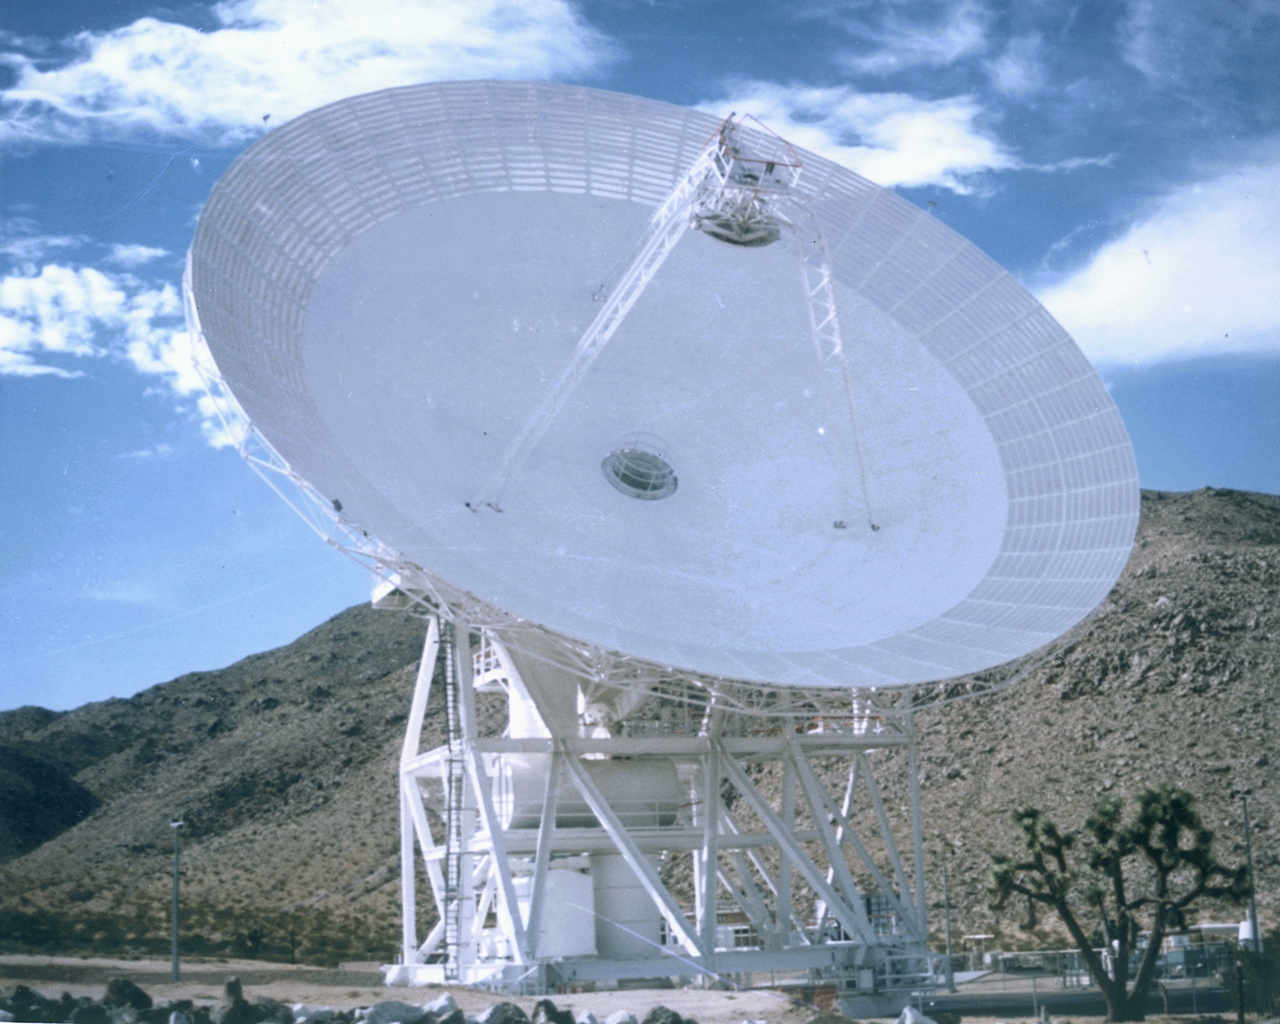

Jet Propulsion Laboratory
California Institute of Technology
DSS-28 GAVRT-II Implementation
Preliminary/Critical Design Review
Back End Sub System
Tom Kuiper
February 14, 2007
GAVRT

Slide 2
Overview
Required Implementation
  To support new spectroscopy curriculum element
  Eight IFs via fiber to DSS-13 assumed
  Matrix switch at DSS-13 to select between fibers and local IFs.
  Monitor and control and data acquisition software
  Resource allocation
Recommended Additional Implementation
  To observe time and frequency structure in continuum emission.
  Four dual-polarization, I/Q input spectrometer per sideband, 1 GHz BW, 2048 ch.
  Fast (sub-ns) pulsar processing capability
  Cost

Slide 3
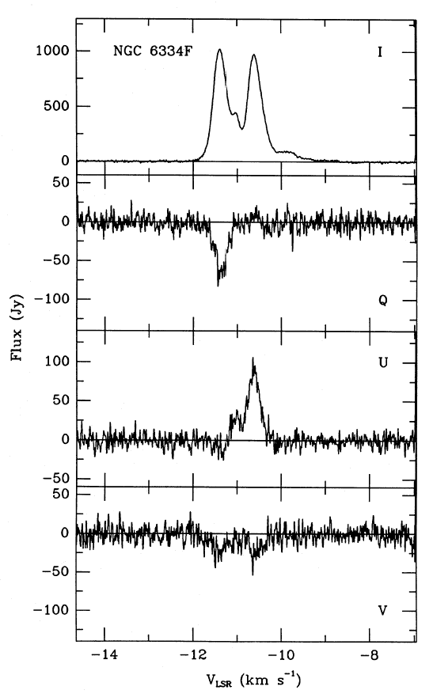
Spectroscopy Curriculum
Measures narrow-band emission from quantum transitions of atoms and molecules
Example: 12.2 GHz methanol maser emission. (There is also 6.7 GHz maser emission.)
Associated with star forming regions
May be polarized, as in this example.
At 12.2 GHz, 1 km s⁻¹ redshift = 37.3 kHz
4 kHz resolution * 1024 ch = 4 MHz bandwidth
Requirements Summary
Spectroscopy curriculum needs polarization measuring equipment with bandwidths between 1 and 16 MHz, i.e. the WVR

Slide 4
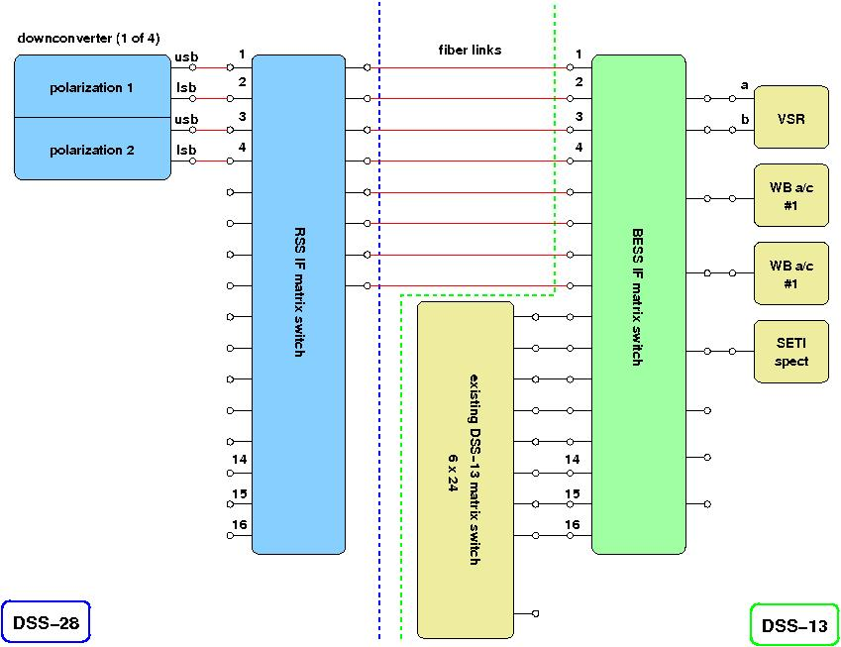
Signal Distribution for Spectroscopy

Slide 5
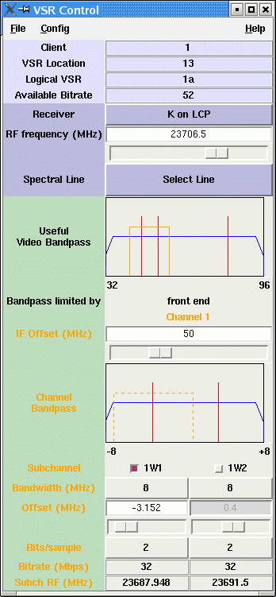
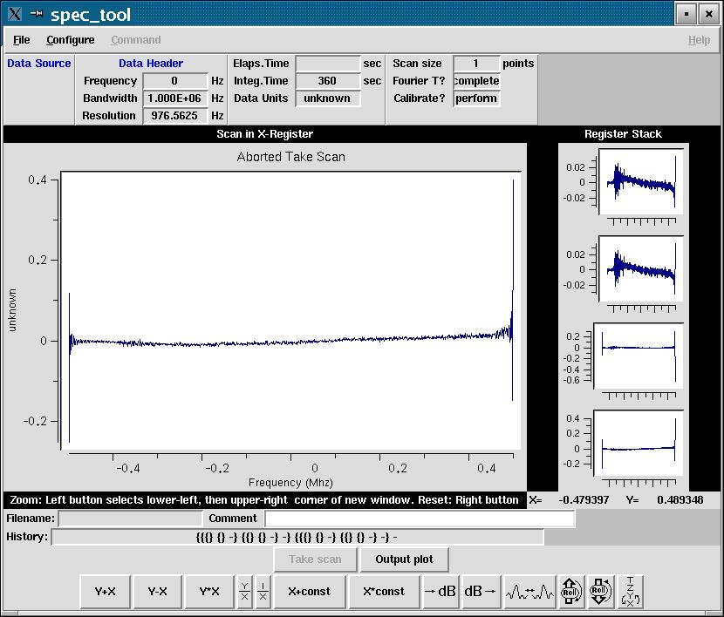
M&C Software for Spectroscopy

Slide 6
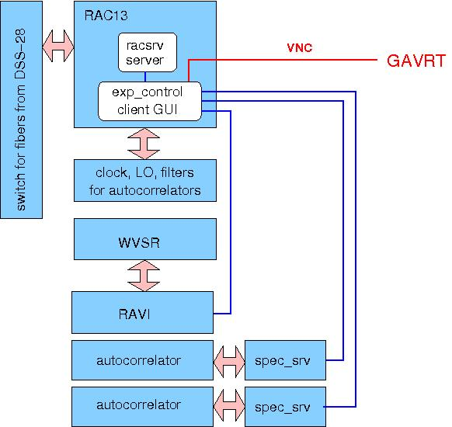
M&C Software for Spectroscopy
Monitor and Control software at DSS-13 exists or will be developed as a radio astronomy task. Interface to GAVRT needs to be defined and implemented

Slide 7
M&C Software for Spectroscopy – GAVRT
Issues for Spectroscopy M&C at GAVRT:
Is the current spectroscopy M&C software usable by GAVRT staff or too complex?
What are the essential M&C features for GAVRT staff?
What displays and controls should be exported to the classrooms?
Should schools use one of the existing data reduction packages? Probably not -- too complex.
GAVRT spectroscopy integration issues remain to be resolved, pending curriculum development.
Recommend that GAVRT spectroscopy software integration not be part of the DSS-28 implementation task.

Slide 8
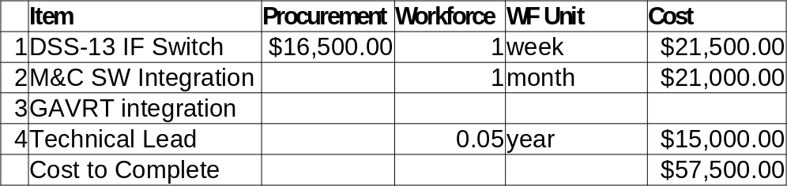
Budget for Required Implementation
Assumptions and Notes
Task 1 hardware cost is based on similar switch in the RSS and it is assumed to be packaged as a unit ready for use.
Tasks 2 overlaps with ATOT RA task and may be done at no cost to the DSS-28 Implementation (if all goes well).
Task 3 is specific to GAVRT requirements and is assumed to be done by GAVRT (with technical support from task lead).

Slide 9
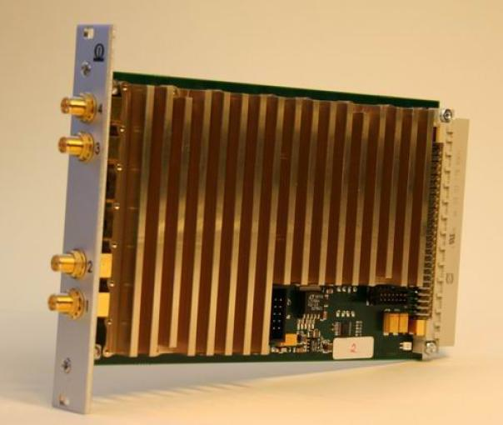
Wideband Spectroscopy: Hardware Example
Example: Omnisys, Sweden:
FPGA-based
1 x 2 GHz (2048 ch)
2 x 1 GHz (2048 ch ea)
4 x 0.5 GHz (2048 ch ea)
100 Mb/s Ethernet
1600 spectra/sec max
sixteen board unit built for Steward Observatory 64-feed mm-wave receiver “Supercam”
FPGA reprogramming required to support cross-products for polarization, 2 inputs per board

Slide 10
Wideband Spectrometer Cost Example
Based on modules in Omnisys (Sweden) spectrometer delivered to University of Arizona Supercam project.
4 down-converters X 2 1-GHz sidebands = 8 polarization pairs
for each polarization pair, one 2-IF 1000 MHz module @ $20K
eight modules = $160K
one crate = $6K
NRE = $12 K for cross-product FPGA programming
TOTAL = $180K
Emphasis: This is an example based on technology commercially available today.

Slide 11
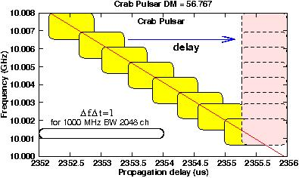
Wideband Spectroscopy: Pulsar Requirements
Even at high frequen-cies, dispersion is significant for high time and frequency resolution. This must be removed to achieve very short ∆t which requires large ∆f.
Incoherent de-dispersion delays samples in each frequency bin so they line up in time. ∆t is limited by the slope of the dispersion. In the example above the minimum ∆t is about 750 ns. The oval in the lower left shows the channel width and time resolution of the Omnisys.

Slide 12
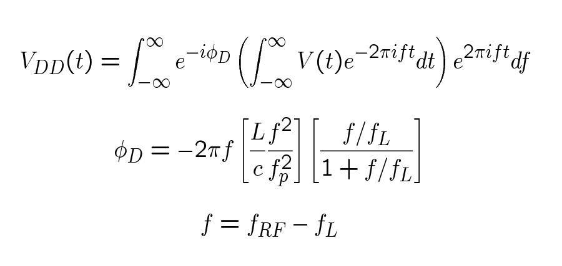
Pulars: Coherent De-Dispersion
Removes the phase delay φ_{D} imposed by the interstellar medium from the signal.

Slide 13
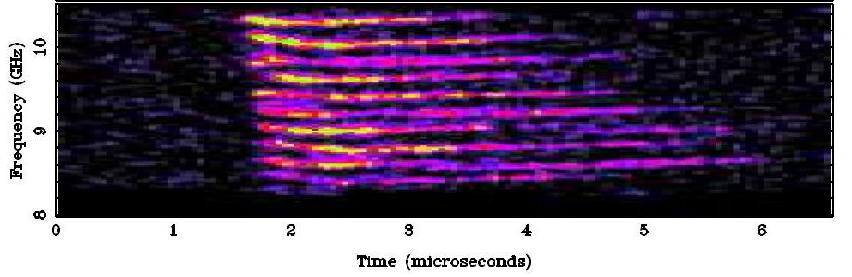
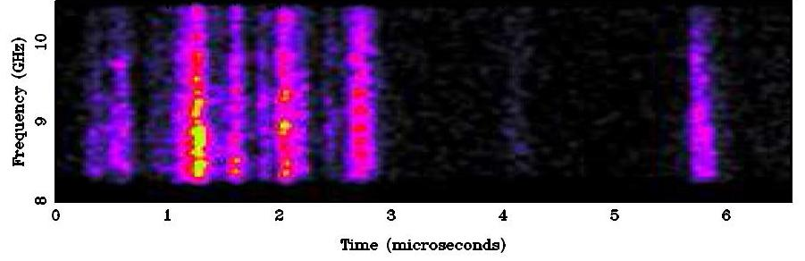
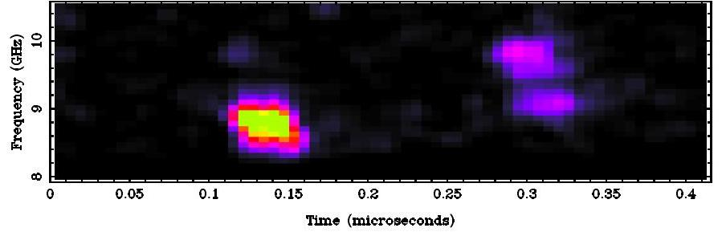
Wideband Spectroscopy: Pulsars

Slide 14
Wideband Spectroscopy: Strategy
Capability of hardware for high-speed signal processing, such as samplers and FPGAs, is doubling at least once per year.
As a very rough approximation, the cost for a given capability may be expected to halve each year.
Planning on acquiring hardware now under development, or in design for development, carries risks but potentially very large rewards.
Risks can be accepted because the basic spectroscopy curriculum requirements are covered.
Strategy: Keep funds (estimated at $200K) uncommitted while exploring technology options. (Meeting at Berkeley next week.)

