Slide 1




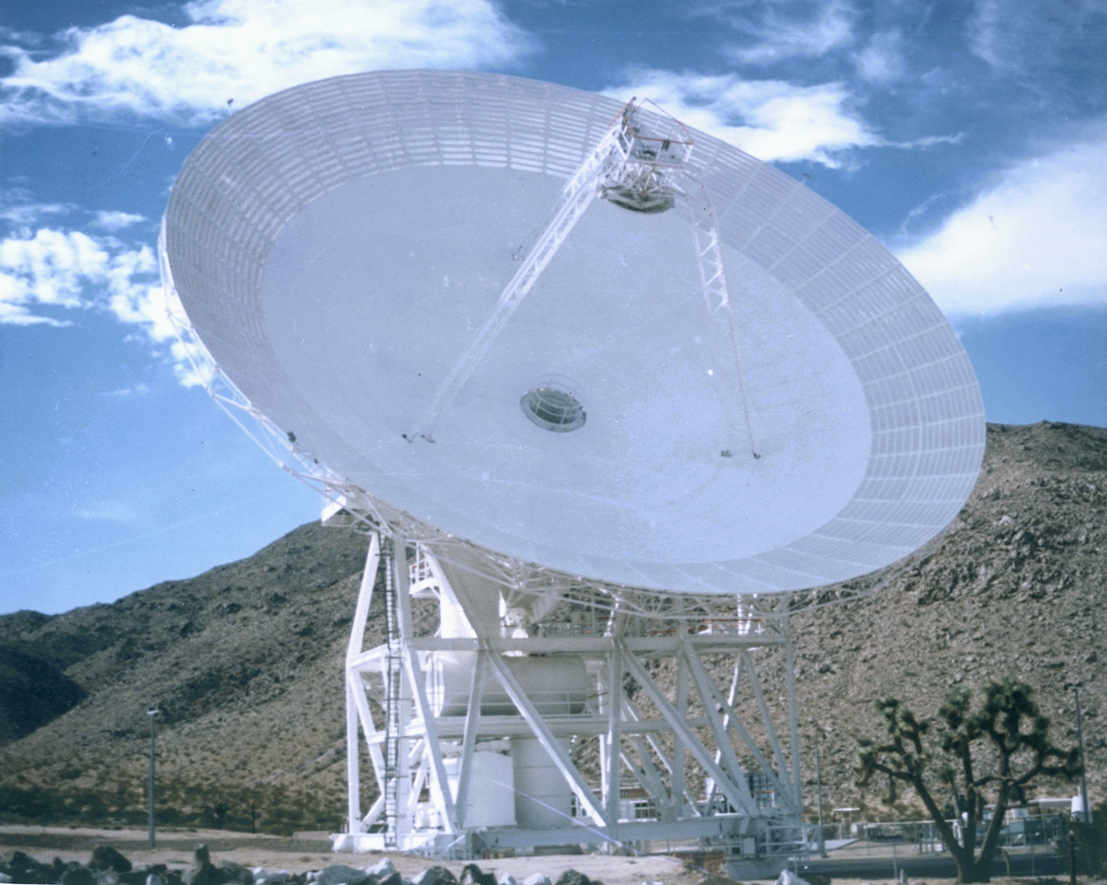

Jet Propulsion Laboratory
California Institute of Technology
DSS-28 GAVRT-II Implementation
Preliminary/Critical Design Review
Title
Name
February 14, 2007
GAVRT

