Slide 1








GUI HTML
Mail
+
XMPP
FetchURL
+
Rome
Notify
Fetch
FeedItem
FeedUser
FeedSource

Slide 2
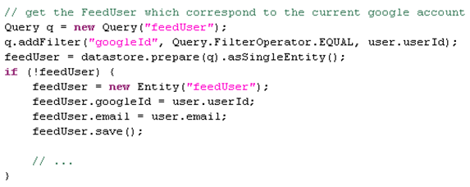


GUI HTML
FeedUser
FeedSource

Slide 3
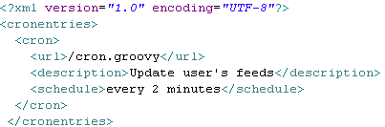
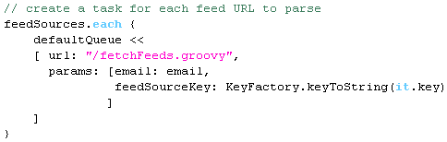
FetchURL
+
Rome
Fetch
FeedItem
FeedUser
FeedSource

Slide 4

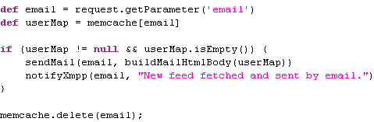
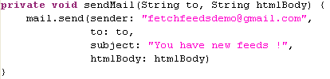
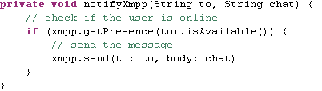
Mail
+
XMPP
Notify
FeedItem

Slide 5

FetchFeeds : OSS+GAE = Open Run
FetchFeeds is published under Apache license V2.0
FetchFeeds is GAE enabled
Build your own tool, and/or run it for free!
Open Run :
Free software as in free speech
Free runtime as in free beer!

