Slide 1


ClipHop (VidChap) Video Chaptering Tool
Team AISC5
MidTerm Presentation
Date

Slide 2
Our Team
Team Lead: Dilpreet Singh Hardoi
Tech Lead: Rohit
AI Team: Yash Mahendra
Frontend: Marmik Upadhyay
Backend: Aum Kiritbhai Babariya
DevOps: Aman Belwal
QA: Yohankhan Habibkhan

Slide 3
Problem Statement
Watching long videos to find key information is inefficient.
Manual chaptering is time consuming and inconsistent.
Existing tools lack precision or require manual input.
Need for an automated solution for efficient video navigation.

Slide 4
Market Demand for Video Chaptering
Increasing video content consumption across platforms.
Need for structured, navigable video content in education, corporate training, and media.
AIdriven solutions are gaining traction in content management.

Slide 5
Solution ClipHop
An AIpowered tool that automatically detects key moments and creates chapters.
Provides seamless video navigation and content segmentation.
Allows customization and edits for enhanced user control.
Focus on accuracy, efficiency, and ease of use.

Slide 6
Competitive Landscape
Existing solutions: YouTube autochapters, free chaptering sites.
Competitor issues: Accuracy, lack of customization, paywalls.
ClipHop differentiation: Automated, highprecision, userfriendly.

Slide 7
Key Features
AIdriven chapter detection.
Easy upload and processing interface.
Editable chapter suggestions.
Integration potential for various industries.

Slide 8
Workflow
1. Upload video.
1
2. AI processes and detects key moments.
2
3. Chapters are generated and displayed.
3
4. Users can edit/refine the output.
4
5. Export or share the chaptered video.
5

Slide 9
Progress
Phase 1: Data collection and model research.
Phase 2: Initial model development, backend setup.
Phase 3: UI development, testing, and refining AI model.
Demo ready with early chaptering results.

Slide 10
Expected Impact
Improved video accessibility and engagement.
Timesaving for educators, businesses, and content creators.
Scalable solution for multiple industries.
Future expansion to multilanguage support and API integration.

Slide 11
Demo Showcase
Live demonstration of ClipHop.
Key functionalities and performance overview.
Current limitations and areas for improvement.

Slide 12

Summary of Key Takeaways:
ClipHop is an AI-powered video chaptering tool designed to improve video navigation and content accessibility.
The tool automates chapter creation, saving time and effort for content creators.
Differentiates from competitors with higher precision and customization options.

Slide 13
Ongoing Improvements:
Continuous refinement of AI model accuracy.
Enhancing user interface for better user experience.

Slide 14
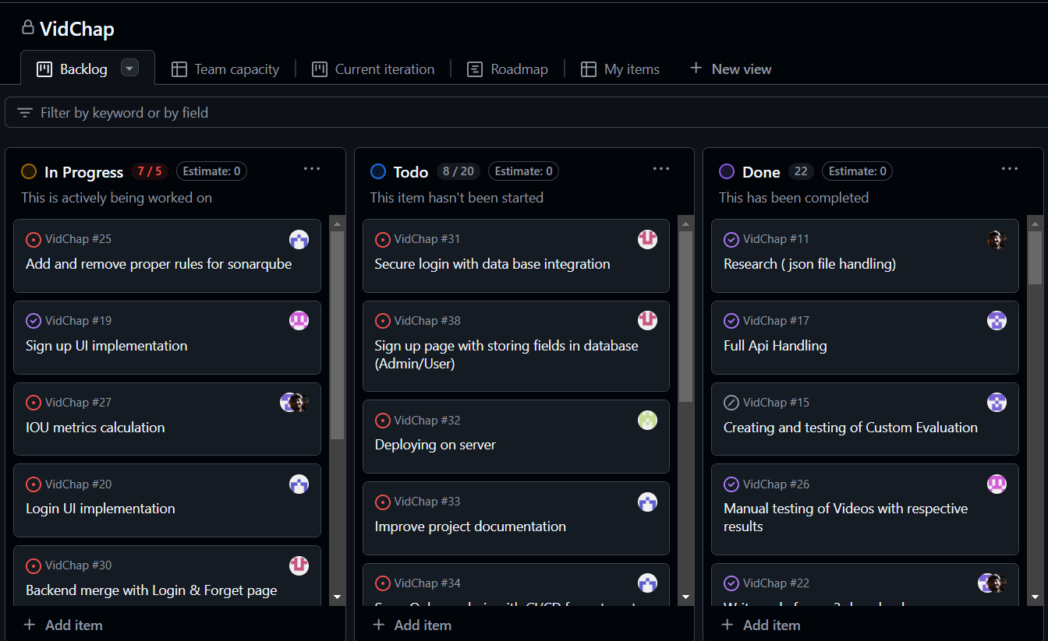
Job board

Slide 15
Next Steps:
Further testing and feedback collection for model enhancement.
Expansion of features, including multi-language support and API integration.

Slide 16
Future Vision:
Scaling ClipHop to cater to various industries like education, media, and corporate training.
Exploring potential monetization strategies.

Slide 17

Q&A Session:
Open floor for any questions and discussions.

