Slide 1
Information Retrieval
Younghoon Kim
(nongausian@hanyang.ac.kr)

Slide 2
Textbook
Introduction to Information Retrieval
Christopher D. Manning, Prabhakar Raghavan and Hinrich Schutze
Cambridge University Press. 2008.
Download: http://nlp.stanford.edu/IR-book/information-retrieval-book.html

Slide 3
Schedule
Class hours
Mon., Thu. 10:30am (1공학관 305호)
Office hr: by appointment
Language
Lecture, slides and exam: English

Slide 4
Grading
Team
1~2 members: a team will get the same score on term project
Ratio
Attendance: 10
Good attitude: 10
Term project with 4~5 modules: 40
A0 will be guaranteed to the top 3 rankers in the project
Final exam: 40
Attendance
Allowed to miss classes up to 3 times
Including any excuse
No need to submit any document for the absence
- 2 points from the 4th miss
F from the 9th miss

Slide 5
Build Your Own Search Engine!
Tokenization & Normalization
DocID=1:
Collect the triples of terms and their positions
<build, 1, 1>
<your, 1, 2>
<own, 1, 3>
<search, 1, 4>
<engine, 1, 5>
…
<want, 1023, 7>
<to, 1023, 8>
<search, 1023, 9>
<for, 1023, 10>
…
build
your
own
search
engine
…
documents
DocID=2:
…
Stage 1
B+ tree
External sort by
term, DocId, position
Build dictionary
& posting lists
…
<a,0>, …, <build, 40301>, …
<a, 2, 4>, <a, 3, 1>, …,
<build, 1, 1>, <build, 49, 2>, <build, 49, 10>, …
<search, 1, 4>, <search, 1023, 9>, …
<2, 4>, <3, 1>, …,
<1, 1>, <49, 2>, <49, 10>, …
<1, 4>, <1023, 9>, …
Stage 2
Stage 3

Slide 6
Build Your Own Search Engine!
Test setting
Datasize: 100Mb
Heapsize: 16Mb
Blocksize: 4kb, 8kb
# of blocks: 1000, 1200, …, 2000
Tokenization & Normalization
DocID=1:
Collect the triples of terms and their positions
<build, 1, 1>
<your, 1, 2>
<own, 1, 3>
<search, 1, 4>
<engine, 1, 5>
…
<want, 1023, 7>
<to, 1023, 8>
<search, 1023, 9>
<for, 1023, 10>
…
build
your
own
search
engine
…
documents
DocID=2:
…
Stage 1
B+ tree
External sort by
term, DocId, position
Build dictionary
& posting lists
…
<a,0>, …, <build, 40301>, …
<a, 2, 4>, <a, 3, 1>, …,
<build, 1, 1>, <build, 49, 2>, <build, 49, 10>, …
<search, 1, 4>, <search, 1023, 9>, …
<2, 4>, <3, 1>, …,
<1, 1>, <49, 2>, <49, 10>, …
<1, 4>, <1023, 9>, …
Stage 2
Stage 3

Slide 7
Build Your Own Search Engine!
Retrieve posting lists
build AND engine
build: <1, 1>, <49, 2>, <49, 10>, <83, 149>, …
engine: <1, 5>, <51, 2>, <58, 55>, <83, 4>, …
B+ tree
Query processing
…
1, 83, …
<a,0>, …, <build, 40301>, …
Stage 4
<2, 4>, <3, 1>, …,
<1, 1>, <49, 2>, <49, 10>, …
<1, 4>, <1023, 9>, …
Rank by relevance
1, 83, …

Slide 8




TinySE
Java – Interface/Abstract class
Students: Fork & push to your Github respo.
TinySE-submit
TinySE-framework
public interface QueryProcess {
public void op_and_wo_pos (DocumentCursor op1, DocumentCursor op2, IntermediateList out);
...
}
public class TinySEQueryProcess
implements QueryProcess {
public void op_and_wo_pos (
DocumentCursor op1,
DocumentCursor op2,
IntermediateList out) throws IOException {
/* FILL THE BLANK */
}
...
}
public abstract class DocumentCursor {
public abstract int get_docid() throws IOException;
public abstract void go_next() throws IOException;
...
}
QueryProcessor
...
tree = (QueryProcess) Class.forName("edu.hanyang.answer.TinySEQueryProcess").newInstance();
...
JUnitTest
$ mvn test
.
.
0 Failures
$

Slide 9
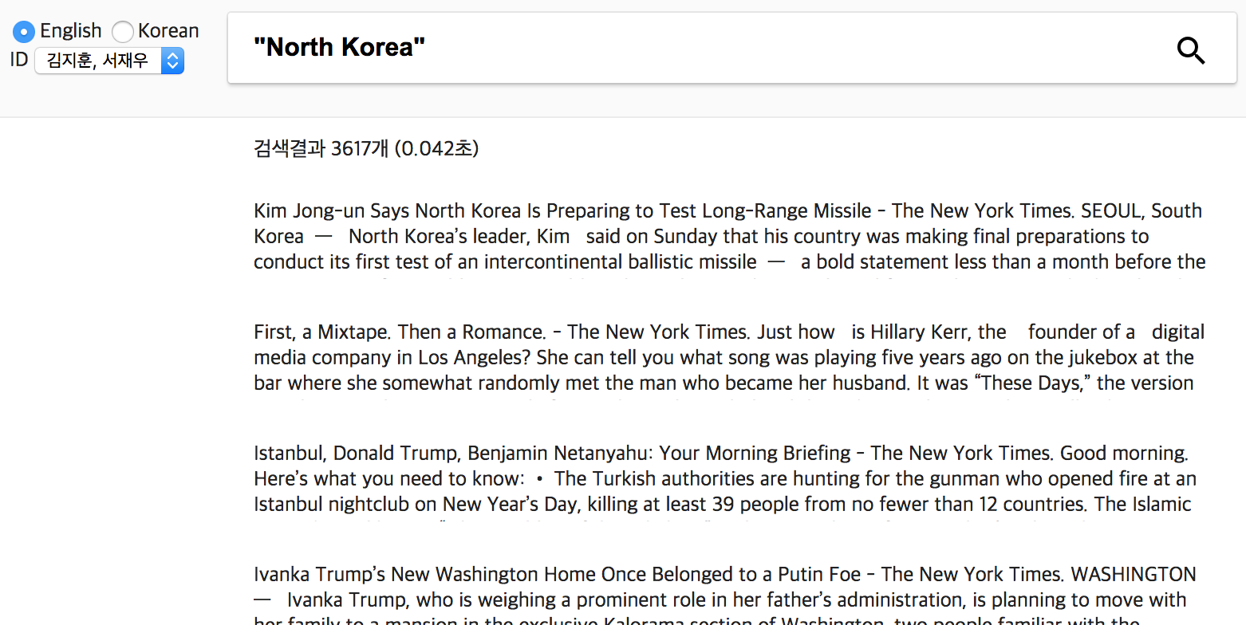

Run Your Own Search Engine!

Slide 10
Tools
Java >= 1.8
Implementing “interface”
File access on disk (File I/O)
Maven
Convention for directory structure
External package
Unit testing
Github
Code submission
Bug reporting

