Slide 1
Milestone 3
Group 6
Sneha Painuli [C0933116]
Amita [C0935607]
Japjeet Kaur (C0937720]
Manjot Kaur [C0938094]
Anju Bala [C0935847]
Nicolas [ C0922995]
Brian Martinez [C0940439]
Krishna Mohan Gadepalli [C0937251]

Slide 2
HAKES: Scalable Vector Database for Embedding Search Service
Presented by
Krishna Mohan Gadepalli (C0937251)

Slide 3
HAKES: Scalable Vector Database
For Embedding Search Services
Authors: Guoyu Hu, Shaofeng Cai, et al.
Institutions: NUS, Deakin, Zhejiang Univ
Based on arXiv:2505.12524v1
Overview of architecture, index design
Title

Slide 4
HAKES: a scalable and accurate vector database
Designed for high-dimensional embedding search
Targets applications like RAG and recommendation
Supports concurrent updates and searches
Focused on high recall and throughput
Introduction

Slide 5
Explosion in use of deep learning embeddings
Traditional indexes suffer under scale and concurrency
Need for fast, accurate, update-friendly ANN search
Embedding dimensions continue to grow
Vector DBs must scale across servers
Motivation

Slide 6
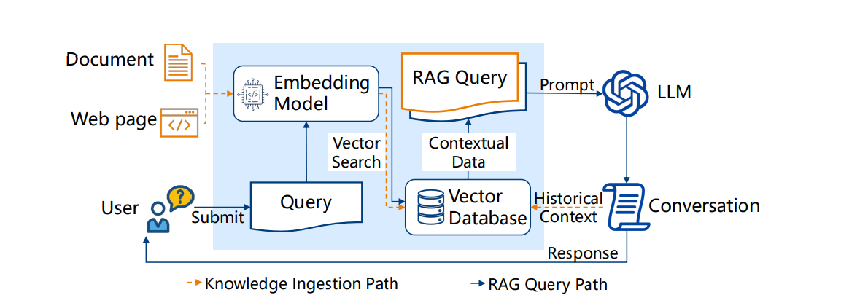
Vector database in retrieval augmented generation

Slide 7
Embeddings live in high-dimensional vector space
Exact NN search is expensive → use Approximate NN
Measures: inner product, cosine, Euclidean
Recall used to evaluate ANN quality
ANN indexes aim for speed vs recall balance
ANN Search

Slide 8
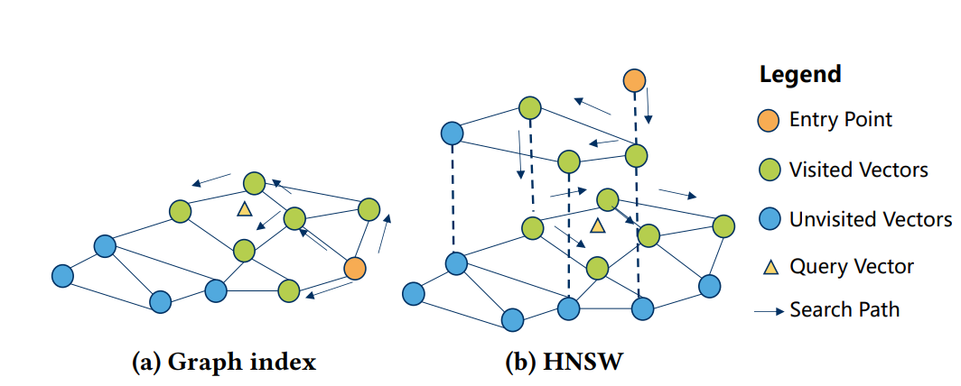
Hierarchical structure
Beam search with greedy traversal
Costly updates and locking
Good for high-recall reads
Example: HNSW structure diagram
Graph-based ANN index

Slide 9
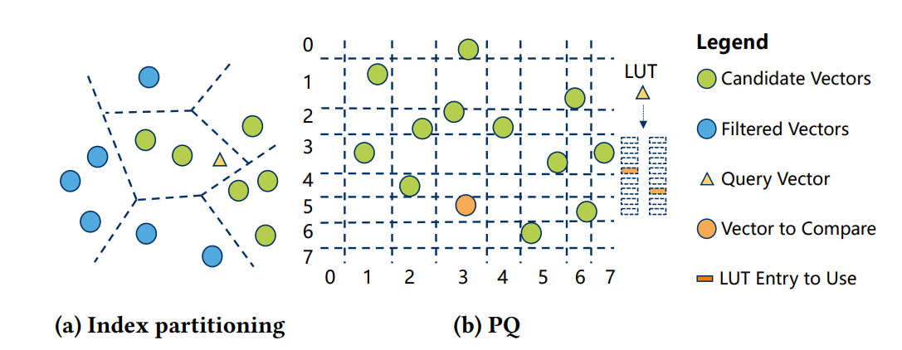
K-means clustering → IVF
Product Quantization → compressed
vectors
Fast similarity approximation
High throughput using SIMD
Used together for scalability
Partitioning-based ANN index

Slide 10
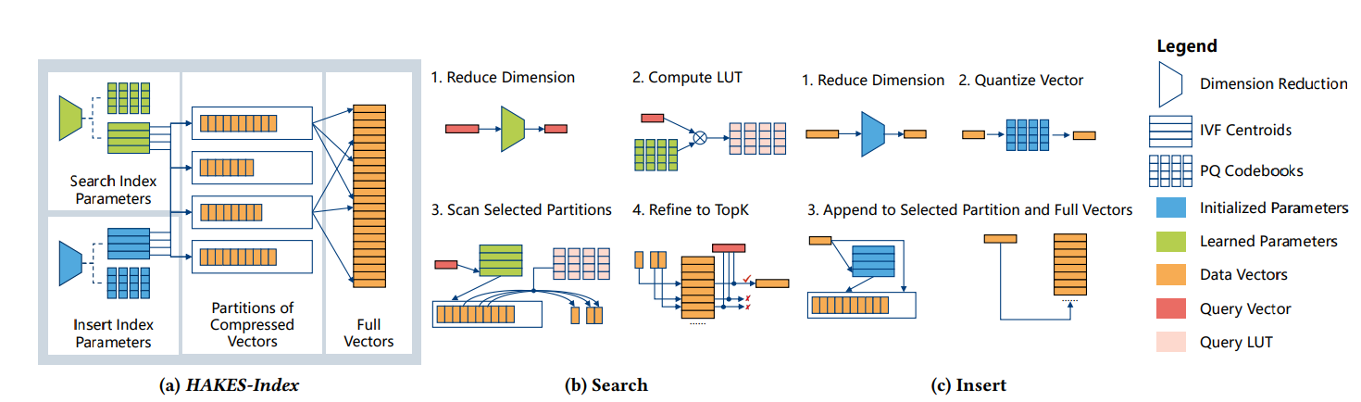
HAKES-Index overview

Slide 11
1. Search Index Parameters (Top Section):
Dimension Reduction: A learned transformation reduces the dimensionality of the query vector.
IVF Centroids: Inverted File (IVF) centroids help partition the vector space for fast lookup.
PQ Codebooks: Product Quantization (PQ) codebooks are used to compress vectors for fast search.
2. Insert Index Parameters (Bottom Section):
Similar to the search parameters, but with a separate (possibly less optimized) set of components dedicated for efficient and incremental vector insertion.
3. Partitions of Compressed Vectors:
After quantization, vectors are stored in partitions based on IVF assignments and compressed using PQ.
4. Full Vectors:
The system also stores full (original or high-fidelity) vectors, used for refinement in the final search stage or insertion.
HAKES-Index overview

Slide 12
1. Reduce Dimension:
The incoming query vector (red) is reduced in dimension using a trained model.
2. Compute LUT (Look-Up Table):
A LUT is computed using PQ codebooks and the reduced query. This speeds up distance calculations during search.
3. Scan Selected Partitions:
IVF centroids identify the most relevant partitions (based on proximity to the query). Only those are scanned using PQ distance approximation from the LUT.
4. Refine to TopK:
From the approximate matches, a shortlist is created. Then, full vectors are used to re-rank candidates using accurate distances to retrieve the final Top-K nearest neighbors.
Search Workflow

Slide 13
1. Reduce Dimension:
Similar to search, the new vector is first reduced in dimensionality.
2. Quantize Vector:
The reduced vector is quantized using the PQ codebooks, creating a compressed representation.
3. Append to Selected Partition and Full Vectors:
The compressed vector is assigned to the correct IVF partition and appended to the corresponding storage.
The full version of the vector is also stored for future refinement during search.
Insert Workflow

Slide 14
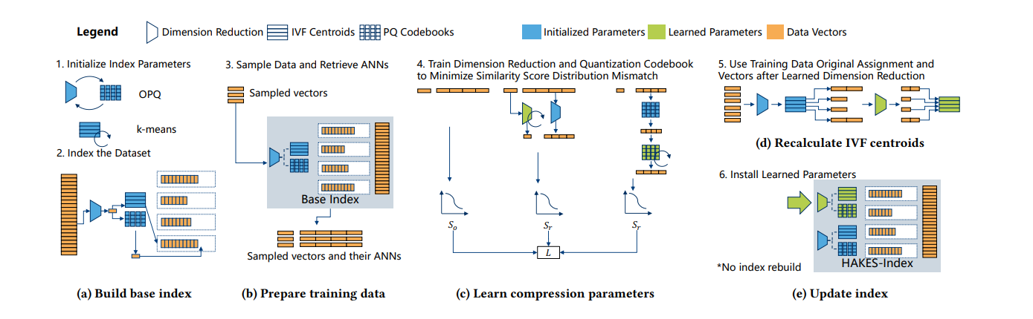
End-to-end index construction

Slide 15
Step 1: Initialize Index Parameters
OPQ (Optimized Product Quantization) and k-means clustering are initialized.
OPQ: Applies rotation and dimensional reordering for better compression.
k-means: Used to compute IVF centroids (coarse clusters) from raw data vectors.
Step 2: Index the Dataset
The dataset is clustered into IVF cells (coarse centroids) using k-means.
Each vector is assigned to the nearest centroid.
Inside each cell, PQ codebooks (sub-vector quantizers) are created to compress and store data vectors.
Build Base Index

Slide 16
Step 3. Sample Data and Retrieve ANNs
A subset of the full dataset is randomly sampled to use as training data.
For each sampled vector, its approximate nearest neighbors (ANNs) are retrieved from the base index.
These ANNs serve as weak approximations of the true neighbors and act as targets for training.
Both the sampled vectors and their corresponding ANNs are stored for use in the training phase.
This pairing helps measure and minimize errors between real and compressed-space similarity distributions.
Prepare Training Data

Slide 17
Step 4. Train Dimension Reduction and Quantization Codebook
Apply optimization to learn a better OPQ matrix that improves downstream similarity accuracy.
Simultaneously train PQ codebooks to quantize the reduced vectors more effectively.
Calculate original similarity score using high-dimensional sampled data.
Compute reconstructed similarity score after dimension reduction and quantization.
Minimize the loss i.e., the difference in similarity distributions between original and compressed spaces.
Learn Compression Parameters

Slide 18
Step 5. Use Training Data Original Assignment and Vectors After Learned Dimension Reduction
Apply the learned OPQ transformation to the training vectors.
Reassign vectors to IVF cells in this newly reduced-dimensional space.
Recalculate the IVF centroids using these reassigned vectors.
This step improves the clustering quality and alignment with the compressed representation.
These new centroids better reflect the updated structure of the data under learned compression.
Recalculate IVF Centroids

Slide 19
Step 6. Install Learned Parameters
Replace the initialized OPQ matrix in the base index with the learned OPQ matrix.
Swap in the learned IVF centroids to improve vector-to-cell assignment.
Update the PQ codebooks inside each IVF cell with the trained versions.
No need to rebuild the entire index—existing structure is reused, minimizing compute cost.
The result is the final HAKES-index, which offers better ANN accuracy without rebuilding from scratch.
Update Index

Slide 20
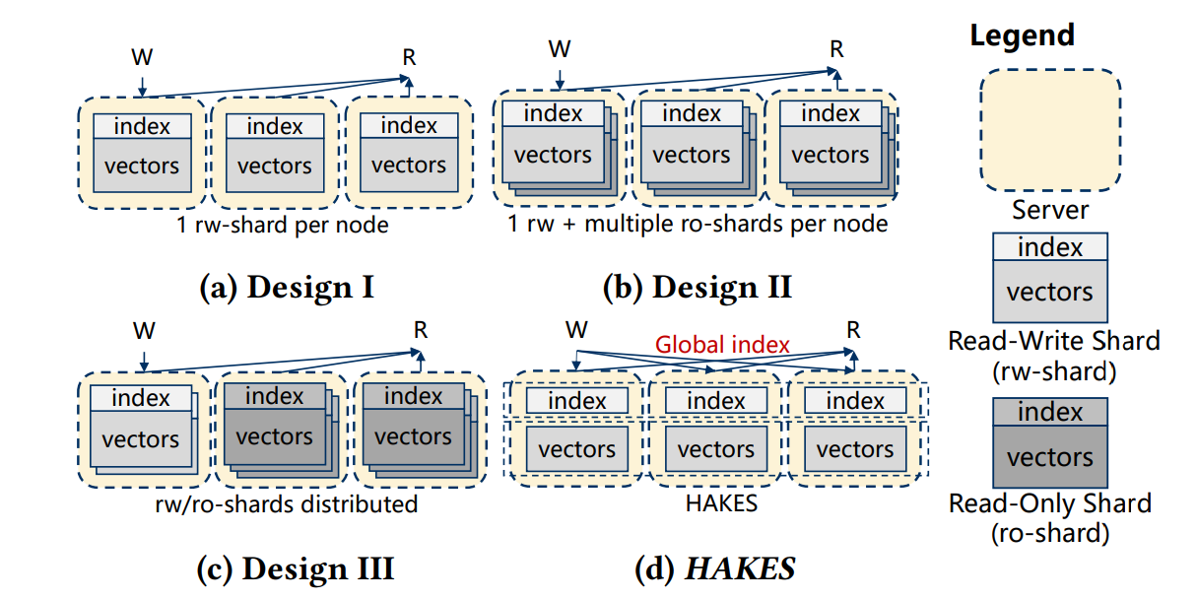
Different architectures of distributed vector databases

Slide 21
Each server hosts only one read-write (rw) shard that contains both the vectors and index.
Both read (R) and write (W) operations are directed to the same rw-shard on the node.
No shard sharing or redundancy exists—each node is self-contained.
Simple design, but limits query parallelism and load balancing, since reads and writes compete on the same resource.
Poor resource utilization in high-read scenarios due to lack of read-only replicas.
(a) Design I: One RW Shard per Node

Slide 22
Each node has one rw-shard and multiple ro-shards, improving read throughput.
Write operations go only to the rw-shard; read operations can hit any of the ro-shards.
RO shards are replicas of rw-shards, allowing read scalability and faster queries.
This approach improves query latency but increases replication overhead.
Updates must propagate from the rw-shard to all corresponding ro-shards, leading to synchronization complexity.
(b) Design II: RW + Multiple RO Shards per Node

Slide 23
Read-write and read-only shards are distributed across servers, not confined per node.
A server can host multiple shards of any type (rw or ro), improving load balancing.
Write and read requests are routed to different shards dynamically across nodes.
This design enables flexibility and resource efficiency, especially in heterogeneous environments.
However, it introduces index lookup overhead, as there’s no global coordination of data placement.
(c) Design III: Distributed RW/RO Shards

Slide 24
HAKES introduces a Global Index that maintains the mapping from vector IDs to shard locations.
Write operations are routed via the Global Index to the appropriate rw-shard that stores the target vector.
Read operations are also routed by the Global Index to the optimal shard (rw or ro), maximizing throughput.
This design decouples indexing and storage, enabling better scalability and routing efficiency.
With the global index, HAKES minimizes data duplication, improves query response time, and supports multi-shard fan-out intelligently.
(d) HAKES Design: Global Index with RW/RO Separation

Slide 25
HAKES supports scalable, update-efficient ANN search
HAKES = high-throughput, high-recall, scalable vector DB
Filter-refine design is efficient and accurate
Decoupling search/insert = better concurrency
Scales well with inserts and writes
Outperforms all tested baselines
Suitable for modern AI systems like RAG
Better than graph-based ANN
Conclusion & Takeaways

Slide 26
THANK YOU

