Slide 1
Milestone 3
Group 6
Sneha Painuli [C0933116]
Amita [C0935607]
Japjeet Kaur (C0937720]
Manjot Kaur [C0938094]
Anju Bala [C0935847]
Nicolas [ C0922995]
Brian Martinez [C0940439]
Krishna Mohan Gadepalli [C0937251]

Slide 2
HAKES: Scalable Vector Database for Embedding Search Service
Presented by
Krishna Mohan Gadepalli (C0937251)

Slide 3
HAKES: Scalable Vector Database
For Embedding Search Services
Authors: Guoyu Hu, Shaofeng Cai, et al.
Institutions: NUS, Deakin, Zhejiang Univ
Based on arXiv:2505.12524v1
Overview of architecture, index design
Title

Slide 4
HAKES: a scalable and accurate vector database
Designed for high-dimensional embedding search
Targets applications like RAG and recommendation
Supports concurrent updates and searches
Focused on high recall and throughput
Introduction

Slide 5
Explosion in use of deep learning embeddings
Traditional indexes suffer under scale and concurrency
Need for fast, accurate, update-friendly ANN search
Embedding dimensions continue to grow
Vector DBs must scale across servers
Motivation

Slide 6
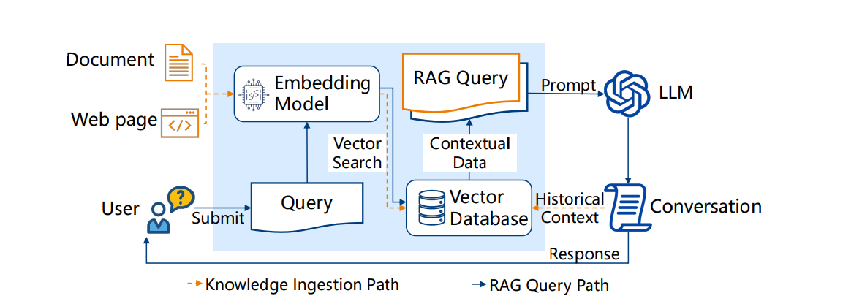
Vector database in retrieval augmented generation

Slide 7
Embeddings live in high-dimensional vector space
Exact NN search is expensive → use Approximate NN
Measures: inner product, cosine, Euclidean
Recall used to evaluate ANN quality
ANN indexes aim for speed vs recall balance
ANN Search

Slide 8
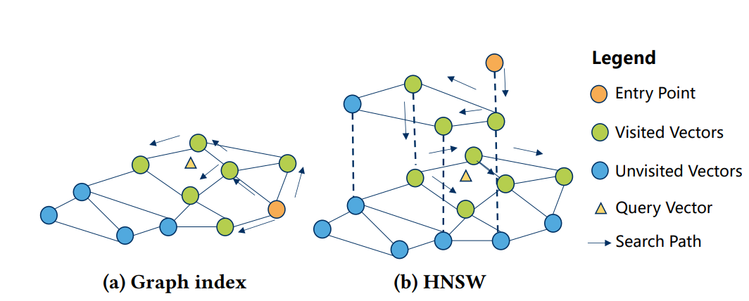
Hierarchical structure
Beam search with greedy traversal
Costly updates and locking
Good for high-recall reads
Example: HNSW structure diagram
Graph-based ANN index

Slide 9
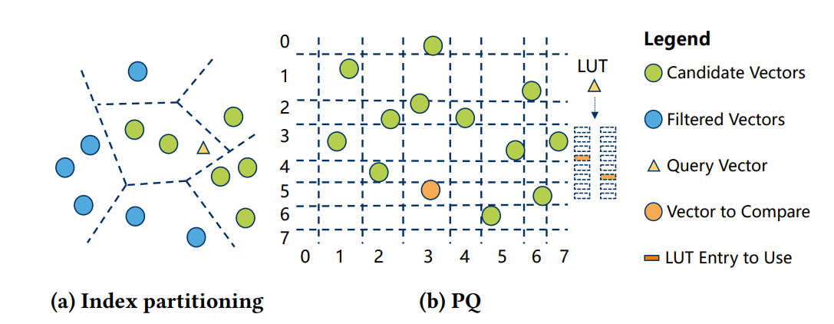
K-means clustering → IVF
Product Quantization → compressed
vectors
Fast similarity approximation
High throughput using SIMD
Used together for scalability
Partitioning-based ANN index

Slide 10
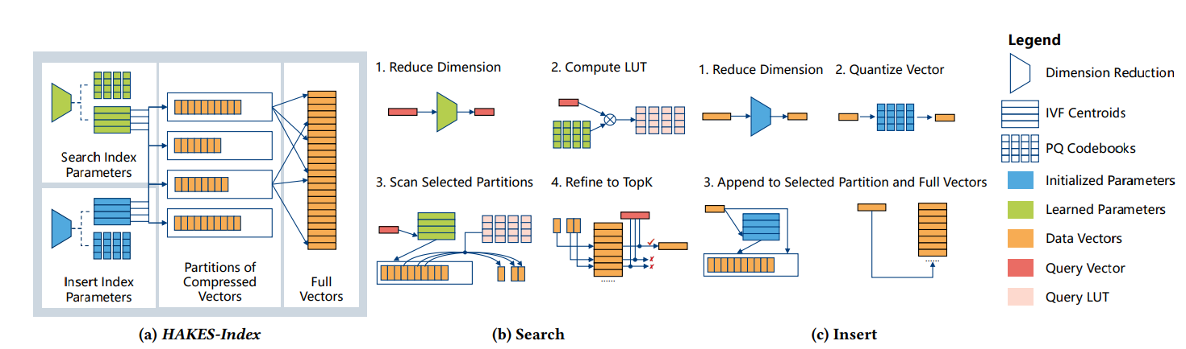
HAKES-Index overview

Slide 11
1. Search Index Parameters (Top Section):
Dimension Reduction: A learned transformation reduces the dimensionality of the query vector.
IVF Centroids: Inverted File (IVF) centroids help partition the vector space for fast lookup.
PQ Codebooks: Product Quantization (PQ) codebooks are used to compress vectors for fast search.
2. Insert Index Parameters (Bottom Section):
Similar to the search parameters, but with a separate (possibly less optimized) set of components dedicated for efficient and incremental vector insertion.
3. Partitions of Compressed Vectors:
After quantization, vectors are stored in partitions based on IVF assignments and compressed using PQ.
4. Full Vectors:
The system also stores full (original or high-fidelity) vectors, used for refinement in the final search stage or insertion.
HAKES-Index overview

Slide 12
1. Reduce Dimension:
The incoming query vector (red) is reduced in dimension using a trained model.
2. Compute LUT (Look-Up Table):
A LUT is computed using PQ codebooks and the reduced query. This speeds up distance calculations during search.
3. Scan Selected Partitions:
IVF centroids identify the most relevant partitions (based on proximity to the query). Only those are scanned using PQ distance approximation from the LUT.
4. Refine to TopK:
From the approximate matches, a shortlist is created. Then, full vectors are used to re-rank candidates using accurate distances to retrieve the final Top-K nearest neighbors.
Search Workflow

Slide 13
1. Reduce Dimension:
Similar to search, the new vector is first reduced in dimensionality.
2. Quantize Vector:
The reduced vector is quantized using the PQ codebooks, creating a compressed representation.
3. Append to Selected Partition and Full Vectors:
The compressed vector is assigned to the correct IVF partition and appended to the corresponding storage.
The full version of the vector is also stored for future refinement during search.
Insert Workflow

Slide 14
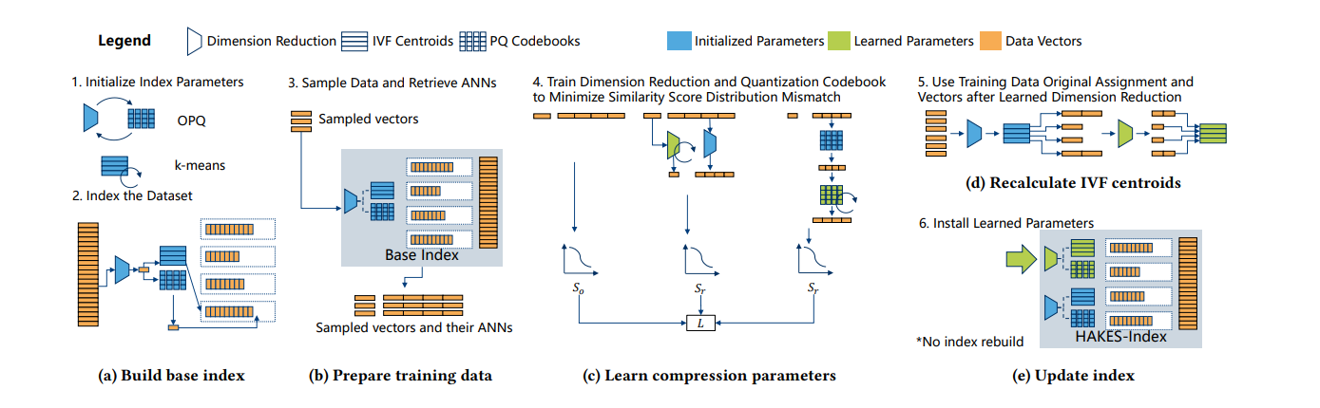
End-to-end index construction

Slide 15
Step 1: Initialize Index Parameters
OPQ (Optimized Product Quantization) and k-means clustering are initialized.
OPQ: Applies rotation and dimensional reordering for better compression.
k-means: Used to compute IVF centroids (coarse clusters) from raw data vectors.
Step 2: Index the Dataset
The dataset is clustered into IVF cells (coarse centroids) using k-means.
Each vector is assigned to the nearest centroid.
Inside each cell, PQ codebooks (sub-vector quantizers) are created to compress and store data vectors.
Build Base Index

Slide 16
Step 3. Sample Data and Retrieve ANNs
A subset of the full dataset is randomly sampled to use as training data.
For each sampled vector, its approximate nearest neighbors (ANNs) are retrieved from the base index.
These ANNs serve as weak approximations of the true neighbors and act as targets for training.
Both the sampled vectors and their corresponding ANNs are stored for use in the training phase.
This pairing helps measure and minimize errors between real and compressed-space similarity distributions.
Prepare Training Data

Slide 17
Step 4. Train Dimension Reduction and Quantization Codebook
Apply optimization to learn a better OPQ matrix that improves downstream similarity accuracy.
Simultaneously train PQ codebooks to quantize the reduced vectors more effectively.
Calculate original similarity score using high-dimensional sampled data.
Compute reconstructed similarity score after dimension reduction and quantization.
Minimize the loss i.e., the difference in similarity distributions between original and compressed spaces.
Learn Compression Parameters

Slide 18
Step 5. Use Training Data Original Assignment and Vectors After Learned Dimension Reduction
Apply the learned OPQ transformation to the training vectors.
Reassign vectors to IVF cells in this newly reduced-dimensional space.
Recalculate the IVF centroids using these reassigned vectors.
This step improves the clustering quality and alignment with the compressed representation.
These new centroids better reflect the updated structure of the data under learned compression.
Recalculate IVF Centroids

Slide 19
Step 6. Install Learned Parameters
Replace the initialized OPQ matrix in the base index with the learned OPQ matrix.
Swap in the learned IVF centroids to improve vector-to-cell assignment.
Update the PQ codebooks inside each IVF cell with the trained versions.
No need to rebuild the entire index—existing structure is reused, minimizing compute cost.
The result is the final HAKES-index, which offers better ANN accuracy without rebuilding from scratch.
Update Index

Slide 20
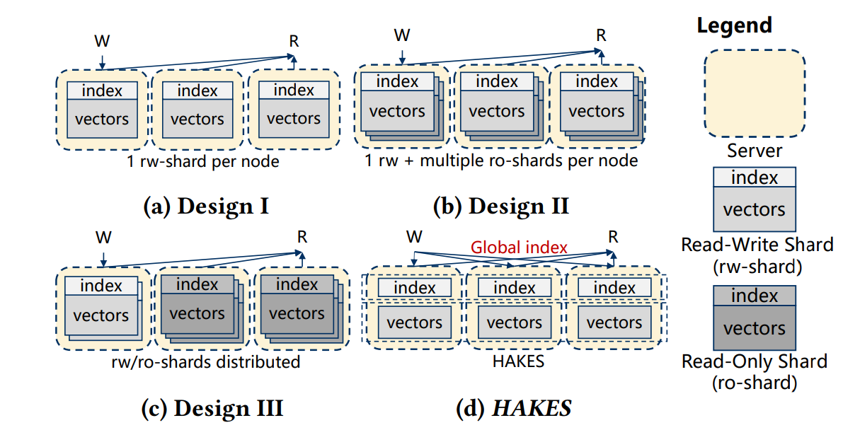
Different architectures of distributed vector databases

Slide 21
Each server hosts only one read-write (rw) shard that contains both the vectors and index.
Both read (R) and write (W) operations are directed to the same rw-shard on the node.
No shard sharing or redundancy exists—each node is self-contained.
Simple design, but limits query parallelism and load balancing, since reads and writes compete on the same resource.
Poor resource utilization in high-read scenarios due to lack of read-only replicas.
(a) Design I: One RW Shard per Node

Slide 22
Each node has one rw-shard and multiple ro-shards, improving read throughput.
Write operations go only to the rw-shard; read operations can hit any of the ro-shards.
RO shards are replicas of rw-shards, allowing read scalability and faster queries.
This approach improves query latency but increases replication overhead.
Updates must propagate from the rw-shard to all corresponding ro-shards, leading to synchronization complexity.
(b) Design II: RW + Multiple RO Shards per Node

Slide 23
Read-write and read-only shards are distributed across servers, not confined per node.
A server can host multiple shards of any type (rw or ro), improving load balancing.
Write and read requests are routed to different shards dynamically across nodes.
This design enables flexibility and resource efficiency, especially in heterogeneous environments.
However, it introduces index lookup overhead, as there’s no global coordination of data placement.
(c) Design III: Distributed RW/RO Shards

Slide 24
HAKES introduces a Global Index that maintains the mapping from vector IDs to shard locations.
Write operations are routed via the Global Index to the appropriate rw-shard that stores the target vector.
Read operations are also routed by the Global Index to the optimal shard (rw or ro), maximizing throughput.
This design decouples indexing and storage, enabling better scalability and routing efficiency.
With the global index, HAKES minimizes data duplication, improves query response time, and supports multi-shard fan-out intelligently.
(d) HAKES Design: Global Index with RW/RO Separation

Slide 25
HAKES supports scalable, update-efficient ANN search
HAKES = high-throughput, high-recall, scalable vector DB
Filter-refine design is efficient and accurate
Decoupling search/insert = better concurrency
Scales well with inserts and writes
Outperforms all tested baselines
Suitable for modern AI systems like RAG
Better than graph-based ANN
Conclusion & Takeaways

Slide 26
Searching for Best Practices in Retrieval-Augmented Generation
Authors : Xiaohua Wang, Zhenghua Wang, Xuan Gao, Feiran Zhang, Yixin Wu, Zhibo Xu, Tianyuan Shi, Zhengyuan Wang,Shizheng Li, Qi Qian, Ruicheng Yin, Changze Lv, Xiaoqing Zheng*, Xuanjing Huang
Affiliations: School of Computer Science, Fudan University, Shanghai, China Shanghai Key Laboratory of Intelligent Information Processing

Slide 27
Introduction
Large Language Models (LLMs) often hallucinate or lack up-to-date knowledge
Retrieval-Augmented Generation (RAG) enhances LLMs by retrieving relevant external documents
RAG is powerful for:
Reducing hallucinations
Handling time-sensitive or domain-specific queries
Boosting quality with grounded responses
Current Challenges in RAG Systems:
Complex and fragmented implementations
High inference latency
Lack of unified best practices

Slide 28
Objectives
Investigate and evaluate modular components of RAG workflows.
Identify optimal methods for each RAG module.
Recommend best practices for:
High-performance setups
Balanced performance-efficiency setups
Provide a standardized evaluation framework for RAG.

Slide 29
Problem Statement
Many RAG approaches exist but differ in design and results.
No comprehensive study to determine the best practices across all modules.
Trade-offs between performance (accuracy, quality) and efficiency (latency, cost).
This paper aims to systematically identify the best-performing RAG pipeline settings through extensive experimentation.

Slide 30
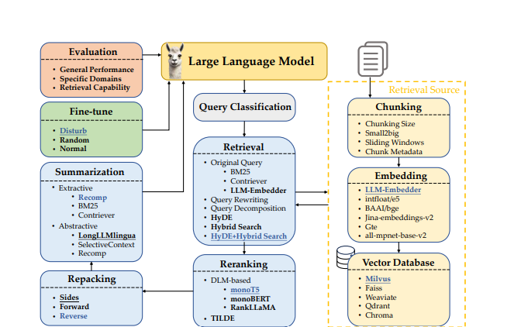
RAG Workflow Overview
Query Classification
Chunking
Embedding
Vector Database
Retrieval
Reranking
Repacking
Summarization
Generation (Fine-Tuning)

Slide 31
Research Methodology
Modular design: RAG pipeline is split into independent components.
• Step 1: Candidate Selection
– Select top-performing techniques for each module (e.g., retrieval, reranking).
• Step 2: Isolated Evaluation
– Test one method at a time while keeping others fixed.
– Identify its individual impact on performance.
• Step 3: Pipeline Integration
– Combine best methods across modules into a full RAG system.
– Optimize for either maximum performance or efficiency.
• Evaluation:
– Tasks: Commonsense, Fact-checking, QA (open-domain, multi-hop, medical)
– Metrics: Accuracy, EM, F1, Faithfulness, Latency

Slide 32
Query Classification
Motivation:
Retrieval-Augmented Generation (RAG) improves accuracy but increases latency.
Not all queries require retrieval—some are fully answerable using the LLM’s internal knowledge.
Objective: Automatically classify whether a query requires retrieval or can be handled directly by the LLM.
Approach: Define Task Sufficiency::
Sufficient: Task is answerable from user input alone → No Retrieval
Insufficient: Task requires external knowledge → Retrieval
Task Type | Example Query | Retrieval Needed? | Reasoning
Rewriting | Rewrite: The cat sat on the mat. It was boring. | No | Task is fully based on input; no external data required.
Introduction | Introduce Sora, a new AI model by OpenAI. | Yes | Requires knowledge about Sora, not seen in training data.

Slide 33
Query Classification
Dataset Overview:
111K total samples across 15 task types
64K labeled as retrieval required
47K labeled as no retrieval required
Data Sources:Code: code_alpaca_20k, Medical: medical_questions_pairs,Suggestions: oasst_quality_with_suggestions, Roleplay: roleplay_alpaca,Multi-task: Databricks-Dolly-15K, Synthetic: GPT-4 for uncovered tasks Model & Training:
Model: BERT-base-multilingual-cased
Batch size: 16
Learning rate: 1e-5
Metric | Score
Accuracy | 95%
Precision | 96%
Recall | 94%
F1 Score | 95%

Slide 34
Chunking
Strategy | Description | Pros | Cons | Why Chosen / Not Chosen
Small2Big | Matches small chunks, returns larger surrounding blocks | Retains context, boosts relevance | Slightly more complex retrieval logic | Effective but more complex; not primary choice for simplicity
Sliding Window | Overlapping chunks with fixed stride and window size | High recall, good for long contexts | May include redundant content | Useful for recall but adds redundancy and overhead
Sentence-level | Splits documents at sentence boundaries | Simple, preserves semantic coherence | May lose deeper semantic blocks | Chosen for balancing simplicity and semantic preservation
Token-level | Splits based on token count (e.g., 512 tokens) | Fast, easy to implement | Often breaks sentences and semantics | Too coarse, hurts retrieval quality due to broken semantics

Slide 35
Experimental Results
Chunking Technique | Faithfulness (%) | Relevancy (%) | Comment
Original | 95.74 | 95.37 | Baseline performance
Small2Big | 96.67 | 95.37 | Better context via large block return
Sliding Window | 97.41 | 96.85 | Best overall, though adds redundancy
Key Insight:
Sliding Window performs best but adds overhead.
Small2Big is also strong but slightly more complex.
Sentence-level chunking with sliding window gives top results

Slide 36
Embedding
Model | Type | Strengths | Weaknesses | Why Chosen / Not Chosen
BAAI/bge | Contrastive LLM | High performance on multiple retrieval benchmarks | Higher memory and compute requirements | Not chosen due to higher resource consumption
GTE | Lightweight LLM | Very efficient; small model size | Lower retrieval accuracy | Not chosen due to weaker semantic matching
LLM-Embedder | Contrastive LLM | Best trade-off between performance and model size; strong semantic alignment | Slightly slower than smaller models | Chosen for its balanced performance, generalization, and compact size

Slide 37
Embedding
Model | Type | Strengths | Weaknesses | Why Chosen / Not Chosen
Jina-v2 | General-purpose | Supports long-document embeddings | Can underperform on domain-specific queries | Not chosen; lacks consistency across RAG use cases
all-mpnet-base-v2 | General-purpose | Popular and well-tested for generic semantic search | Weaker performance on specialized or nuanced retrieval | Not chosen due to insufficient accuracy in comparison to contrastive LLMs like LLM-Embedder

Slide 38
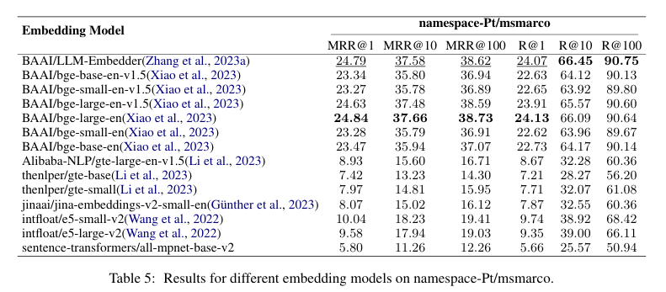
Experimental Results
LLM-Embedder outperforms other models with a strong balance between accuracy and efficiency, making it the most practical choice for real-world RAG systems.
While larger models like BAAI/bge offer slight accuracy gains, they require more memory and add latency with diminishing returns.

Slide 39
Experimental Results
Chunk Size (Tokens) | Average Faithfulness (%) | Average Relevancy (%)
2048 | 80.37 | 91.11
1024 | 94.26 | 95.56
512 | 97.59 | 97.41
256 | 97.22 | 97.78
128 | 95.74 | 97.22
Key Insight:
Larger chunks (2048) lack faithfulness due to excessive context.
Smaller chunks (128) slightly reduce faithfulness, likely due to insufficient context.

Slide 40
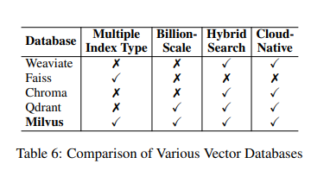
Vector Databases
Purpose:Efficiently store and retrieve embedding vectors with metadata using ANN (Approximate Nearest Neighbor) search.
Selection Criteria:
Multiple Index Types: Adaptable to data & use case
Billion-scale Vector Support: Scalability for LLM corpora
Hybrid Search: Combines vector + keyword (semantic + exact match)
Cloud-native Capabilities: Easy integration, scalability
Databases Evaluated: Weaviate ,Faiss ,Chroma,Qdrant,Milvus
Conclusion: Milvus selected → Best overall performance across all 4 criteria → Most suitable for large-scale, production-ready RAG systems

Slide 41
Retrieval Methods
Technique | Problem | Solution | Goal
Query Rewriting | Original queries lack clarity or semantics | Use LLM (Zephyr-7B-alpha) to rewrite user queries | Increase alignment with relevant documents
Query Decomposition | Complex questions contain multiple intents | Use GPT-3.5-turbo to split into sub-queries | Retrieve more granular and relevant chunks
Pseudo-document Generation (HyDE) | Query might not match phrasing in corpus | Generate hypothetical answer with GPT-3.5-turbo-instruct, then embed it for retrieval | Improve semantic retrieval with answer-like context
Hybrid Search | Leverage strengths of lexical & semantic | Combine BM25 (sparse) + Dense retrieval (LLM-Embedder) | Enhance overall retrieval quality

Slide 42
Retrieval Methods — Experimental Results
Method | mAP (TREC DL 2019) | mAP (TREC DL 2020) | Latency
BM25 (sparse) | 30.13 | 28.56 | 0.07s
Contriever (unsupervised) | 23.99 | 23.98 | 1–3s
LLM-Embedder (supervised) | 44.66 | 45.60 | ~0.7s
+ Query Rewriting | 44.56 | 45.16 | ~2–7s
+ Query Decomposition | 41.93 | 43.30 | >14s
+ HyDE | 50.87 | 50.94 | ~7s
+ Hybrid Search | 47.14 | 47.72 | ~3s
Hybrid + HyDE | 52.13 | 53.13 | ~3s–11s

Slide 43
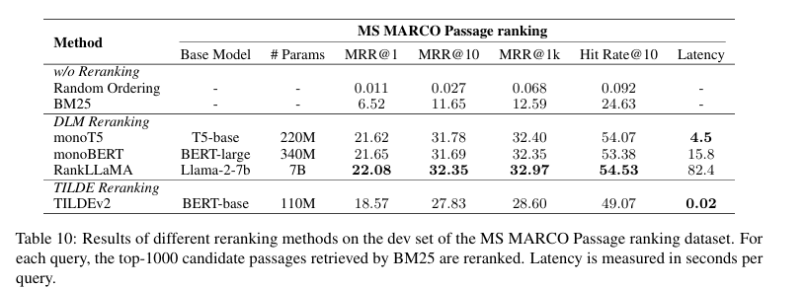
Reranking
Goal: Reorder retrieved documents to maximize relevance at the top using advanced semantic or probabilistic models.
Approach | Description | Trade‑off
DLM Reranking | Uses fine-tuned deep language models (e.g., monoT5, monoBERT, RankLLaMA) to rerank documents. These models are trained to predict whether a document is relevant ("true"/"false") based on the input query + document pair. | Highest accuracy; Lower efficiency
TILDE Reranking | A lightweight, precomputed query likelihood approach (TILDEv2) that enables fast reranking by summing log-probabilities of query tokens. Designed for speed and small index size. | Extremely fast; Slightly lower accuracy
Final Choice: monoT5
Chosen for its strong trade-off between effectiveness and efficiency, making it suitable for most production and research scenarios.

Slide 44
Document Repacking
Objective:Improve downstream QA performance by optimizing document order with repacking methods
Repacking Methods Compared
Method | Description | Avg. Score | Latency (s)
Sides | Place relevant info at both head & tail (default) | 0.443 | 11.71
Forward | Descending relevancy order | 0.437 | 11.68
Reverse | Ascending relevancy order | 0.446 | 11.70
Key Insights:
All repacking methods improve QA performance over no repacking.
Reverse ordering slightly outperforms others in average score but with similar latency.
Sides method chosen as default due to balance of performance and theoretical motivation from Liu et al. (2024a).
Repacking integrated with classification, retrieval, and reranking modules boosts overall system accuracy and F1 scores.
Latency remains stable (~11.7s per query), maintaining efficiency

Slide 45
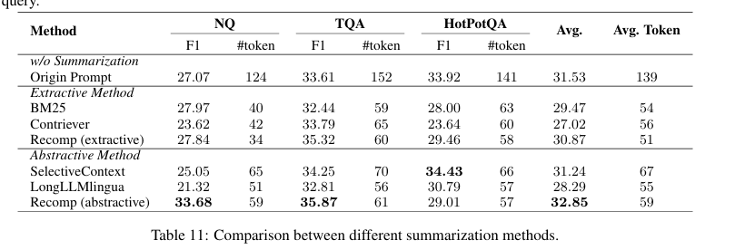
Summarization
Goal: Reduce redundancy and prompt length to improve LLM response quality and speed.
Methods (Query-Based Focus)
Recomp: Extractive: Selects key sentences Abstractive: Synthesizes cross-document info
LongLLMLingua: Emphasizes query-relevant content
SelectiveContext (Non-query-based): Removes low-info tokens using a causal LM
Setup : Model: LLaMA 3–8B-Instruct, Ratio: 0.4, Datasets: NQ, TriviaQA, HotpotQA, Metrics: F1, token count
Result : Recomp (Abstractive) as the best summarization method due to its superior performance across all datasets

Slide 46
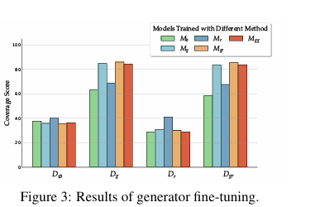
Generator Fine-Tuning
Objective: Enhance LLM generation quality by studying the impact of relevant vs. irrelevant contexts during fine-tuning.
Model & Setup:
Base Model: LLaMA-2-7B (Touvron et al., 2023b)
Technique: LoRA + int8 quantization
Training: 3 epochs, batch size 4, max seq length 1600, learning rate 5e-5
Evaluation: Zero-shot on validation sets
using Ground-Truth Coverage (lenient EM)
Context Configurations (D):
Dg = {dgold}: Only relevant doc
Dr = {drandom}: Only random doc
Dgr = {dgold, drandom}: Relevant + random
Dgg = {dgold, dgold}: Duplicated relevant doc
D∅ = No retrieval (baseline)

Slide 47
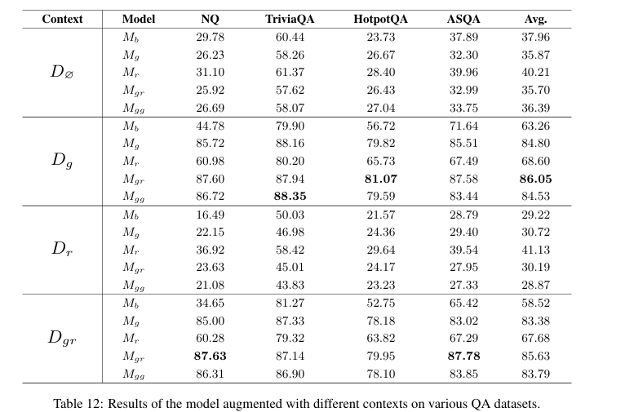
Generator Fine-Tuning
Datasets (Train/Eval):
ASQA (2,090 / 483)
HotpotQA (15k / 7,405)
TriviaQA (9k / 6,368)
NQ (15k / 8,006)
NarrativeQA, SQuAD, TruthfulQA (used in training only)
Best Performance:
Model trained with Dgr (relevant + random)
Most robust across clean and noisy input contexts

Slide 48
RAG System Evaluation Summary
Tasks: Commonsense, Fact Checking, Open-Domain QA, MultiHop QA, Medical QA
Metrics:
Accuracy (Commonsense, Fact Checking, Medical QA)
EM & F1 (Open-Domain & MultiHop QA)
RAG Score: Avg. of
Faithfulness
Context & Answer Relevancy
Answer Correctness
Retrieval Similarity
Setup: Same corpus used; max 500 samples per dataset

Slide 49
Results & Key Findings
Query Classification
Improves accuracy (0.428 → 0.443)
Reduces latency (16.41s → 11.58s)
Filters out unnecessary retrieval for faster response
2. Retrieval Module
Hybrid (Dense + BM25) balances semantics & term-matching
Hybrid+HyDE achieves highest RAG score (0.58) but slower
Original/Hybrid recommended for efficiency
3. Reranking Module
Essential for quality results
monoT5 outperforms monoBERT & RankLLaMA due to architecture and scale

Slide 50
Results & Key Findings
4. Repacking Strategy
Reverse order gives best RAG score (0.560) by placing relevant context first
5. Summarization Module
Recomp (Extractive) > LongLLMLingua
Preserves meaning and fits length constraints
Can be skipped to reduce latency when needed
Conclusion: Each module contributes to performance. Best config: Classification + Hybrid Retrieval + monoT5 + Reverse Packing + Recomp

Slide 51
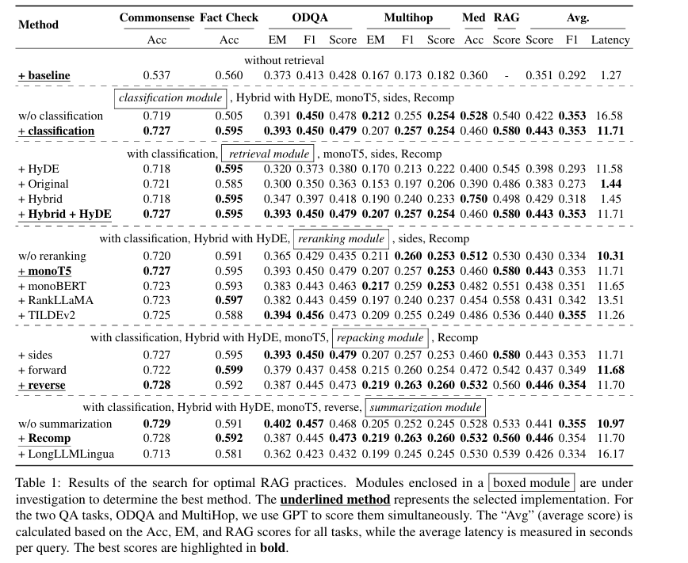
Results & Key Findings

Slide 52
Multimodal RAG: Retrieval as Generation
Objective: Enhance RAG to process image-text pairs for retrieval and generation, improving performance in multimodal (text + image) tasks.
Component | Details
Text-to-Image Retrieval | • Text query → search image DB using similarity (e.g., CLIP) • If high match → return retrieved image • Else → generate image via model
Image-to-Text Retrieval | • Input image → match with images in DB • If high similarity → return pre-stored caption • Else → generate new caption with captioning model
Evaluation Metrics | • Answer Correctness: Accuracy vs. ground truth
Implementation Setup | • Max tokens: 100 (OpenQA/MultiHop), 50 (others) • Truncate docs to 2048 words • Greedy decoding, 0-shot evaluation • Regex used to standardize generated answers

Slide 53
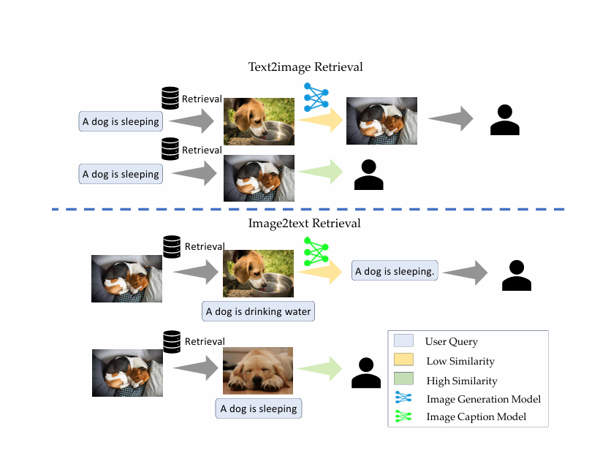
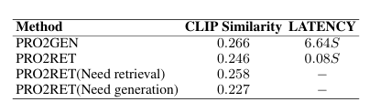
Multimodal RAG: Retrieval as Generation
Key Takeaways
Retrieval is significantly faster than generation.
Quality is comparable—and better when relevant content exists in retrieval base.
Retrieval performance improves by expanding and refining the dataset.

Slide 54
Limitations
Limited Chunking Scope: Only a few chunking techniques were tested (e.g., sentence-level, sliding window).
Retriever Fine-Tuning was not explored in depth; focus was only on generator fine-tuning.
Experiments used only text modality for most of the evaluation.
High cost of building large vector DBs and running evaluations limited broader comparisons.

Slide 55
Future Work
Joint Retriever–Generator Fine-Tuning: Study effects of co-training both components.
More Chunking Techniques: Explore semantic chunking, query-aware chunking, and metadata enrichment.
Expand Multimodal RAG: Extend current methods to handle video, speech, and cross-modal retrieval tasks.
Dynamic Module Switching: Adapt pipeline configuration at runtime based on query type or latency constraints.

Slide 56
THANK YOU

