Slide 1
LeetCode：算法思想
游标
Partition
双指针
滑动窗口
动态规划
贪心
回溯
BFS
102. Binary Tree Level Order Traversal
279. Perfect Squares
DFS

Slide 2
BFS
102. Binary Tree Level Order Traversal
https://leetcode.com/problems/binary-tree-level-order-traversal/
二叉树的层序遍历
Input: binary tree [3,9,20,null,null,15,7]
Output: [[3], [9,20], [15,7]]
Res
[]
[[]]
[[3]]
[[3],[]]
[[3],[9]]
[[3],[9,20]]
[[3],[9,20],[]]
0 == res.size()
2 == res.size()
1 == res.size()
[[3],[9,20],[15,7]]
3
20.left
2
root.right
1
node
level
root
0
20.right
2
root.left
1
9
20
20.left
2
root.right
1
root.left
1
20.right
2
Queue
root
0
15
7

Slide 3
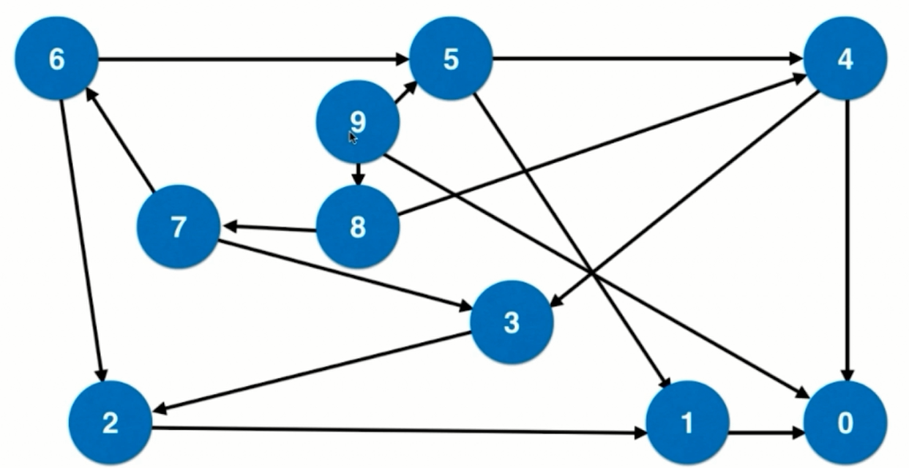
BFS
279. Perfect Squares
https://leetcode.com/problems/perfect-squares/
给定一个正整数n，求其由最少个完全平方数组成的和等于n的个数
Input: n = 13
Output: 2
Explanation: 13 = 4 + 9.

