Slide 1



Apollo’s
Orchestra
Final Presentatiom
Presented by Eduardo Ramos & Lucas Sousa

Slide 2
Context
For this project we decided on developing a music database that provides a rich collection of information, including detailed profiles of artists, albums, singles, and record labels. It also categorizes music by genres, highlights the role of instruments, and features an extensive archive of songs and recordings.

Slide 3
Features Implemented
Functional Requirements
Technical Features
Non-Functional Features
01
Data Integration
02
Search Capabilities
01
Data Consistency
01
Data Retrieval
03
Data Presentation
02
Interoperability
02
Data Linking
03
04
Ontology Design
API support
05
RDF Support

Slide 4
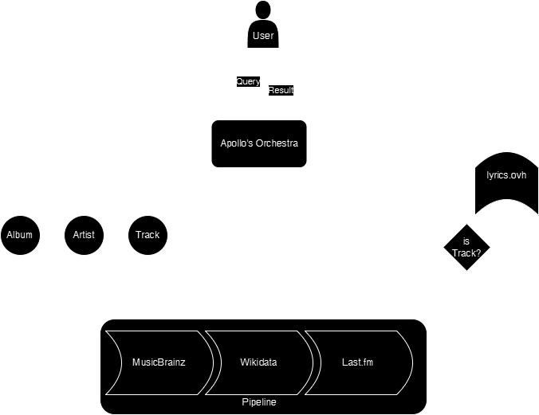
Architecture

Slide 5
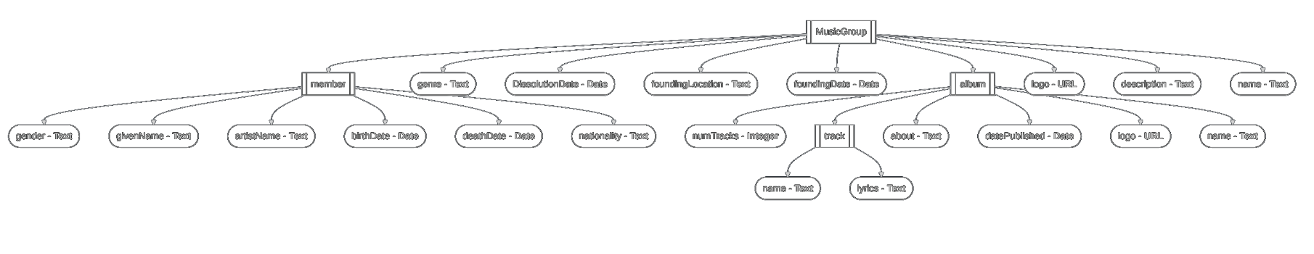
Ontology

Slide 6





Knowledge Bases Used
MusicBrainz API
WIKIDATA
API
Lyrics.ovh
API
Last.fm
API
AcousticBrainz
API

Slide 7
Challenges
afwa
Data Inconsistency
Data Incompleteness
Defining Concepts
Some information was missing from lots of entries. And that problem aggravated for lesser known artists or tracks
Our solution had to be able to handle differences in the definition of music concepts:
Group or single artist, album or release, etc.
Data was stored inconsistently across different knowledge bases, in some cases, even within itself.

Slide 8
DEMO

Slide 9
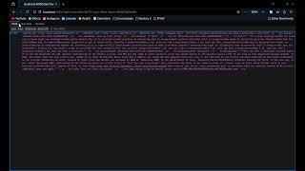

Slide 10
Thank
You!

