Slide 1
SR Project
Group 4: Fábio Sá up202007658@up.pt Inês Gaspar up202007210@up.pt
José Gaspar up202008561@up.pt
Lucas Sousa up202004682@up.pt

Slide 2
LockBit Group
Tactics and techniques
Attack process has 3 main stages
Information gathering, exploiting vulnerabilities
Encrypting stolen data to make it inaccessible
Threatening to leak data unless ransom is paid
Cybercriminal group specializing in ransomware as a service (RaaS)
Sells malicious programs to other criminal groups
Involved in numerous cybercrimes
Most common ransomware worldwide in 2022
Expected to be responsible for 44% of ransomware occurrences in early 2023
Comprised of unethical hackers from various locations
Not attributed to any nation-state by government agencies
Impact
1,700 ransomware attacks in the US between January 2020 and May 2023
Generated US$91 million in ransom during that period
Victims include major companies like Continental, Accenture, Boeing, etc.
Highlights the need for robust cybersecurity measures to counter such threats

Slide 3
Task Force Attack
The growth of this group in the world of cybercrime has led to the emergence of a task force
This taskforce is made up of agencies from 10 countries
Operation Cronos: to control the attacks carried out by LockBit.
This operation lasted several months and resulted in the compromise of LockBit's main platform and other critical infrastructures
This taskforce attack consisted of exploiting a software vulnerability (CVE-2023-3824).
A critical PHP vulnerability that could lead to stack buffer overflow and potentially memory corruption or remote code execution.
Result:
34 servers around the world were brought down;
Authorities has taken control of the technical infrastructure, as well as their dark web leak site, where they stored data stolen from victims in ransomware attacks.

Slide 4
CVE-2021-22986: Description
Focusing on the BIG-IP Software
BIG-IP optimizes application delivery and streamlines control and automation
This attack impacted numerous versions, including the one exploited in the project: 15.1.1
Severity: 9.8/10
Vulnerability: enabling unauthenticated access to the iControl REST interface
Method: attack vector through a pre-authentication server-side request forgery (SSRF) vulnerability in the iControl REST API
Assumptions: attacker has network access
Mitigation: apply software updates

Slide 5
CVE-2021-22986: Indicators of Compromise
F5 iHealth Flags: F5 iHealth tool includes heuristics to detect potential compromise indicators in uploaded QKView diagnostic files, facilitating early threat detection and mitigation.
Manual Checking: examining logs for instances where X-F5-Auth-Token lacks a value, comparing logs to determine potential impact, and monitoring for unexpected modifications to files, configurations, or processes.

Slide 6
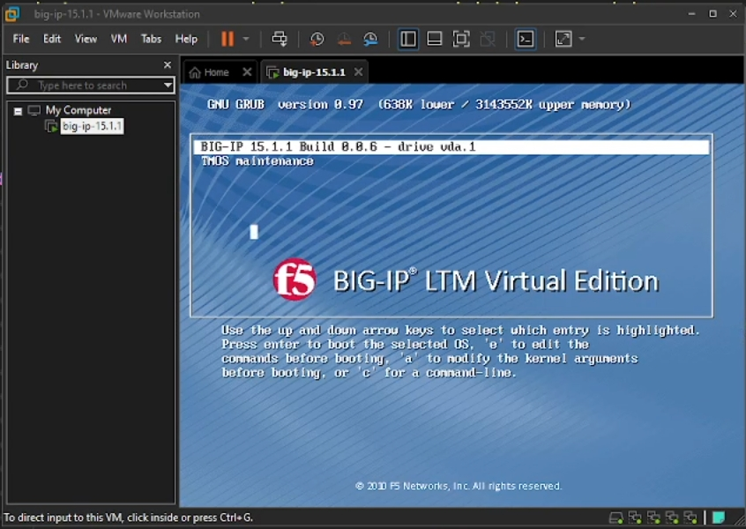
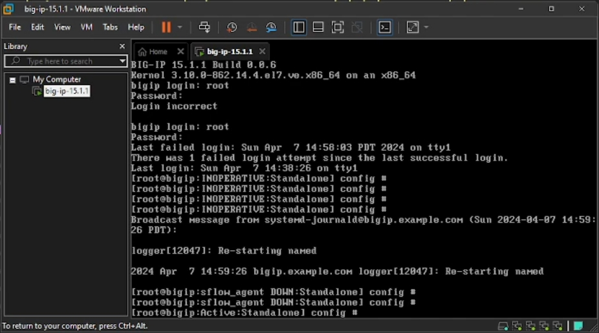
Practical Part
Part 1: Setup
Big-IP 15.1.1 running on VMware
VMnet0 bridge
Management address: 172.16.1.245
Setup password for root/admin user
uploaded flag.txt to ifile system

Slide 7
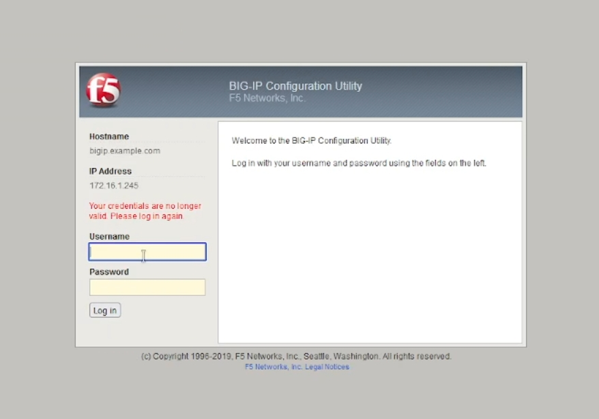

Slide 8
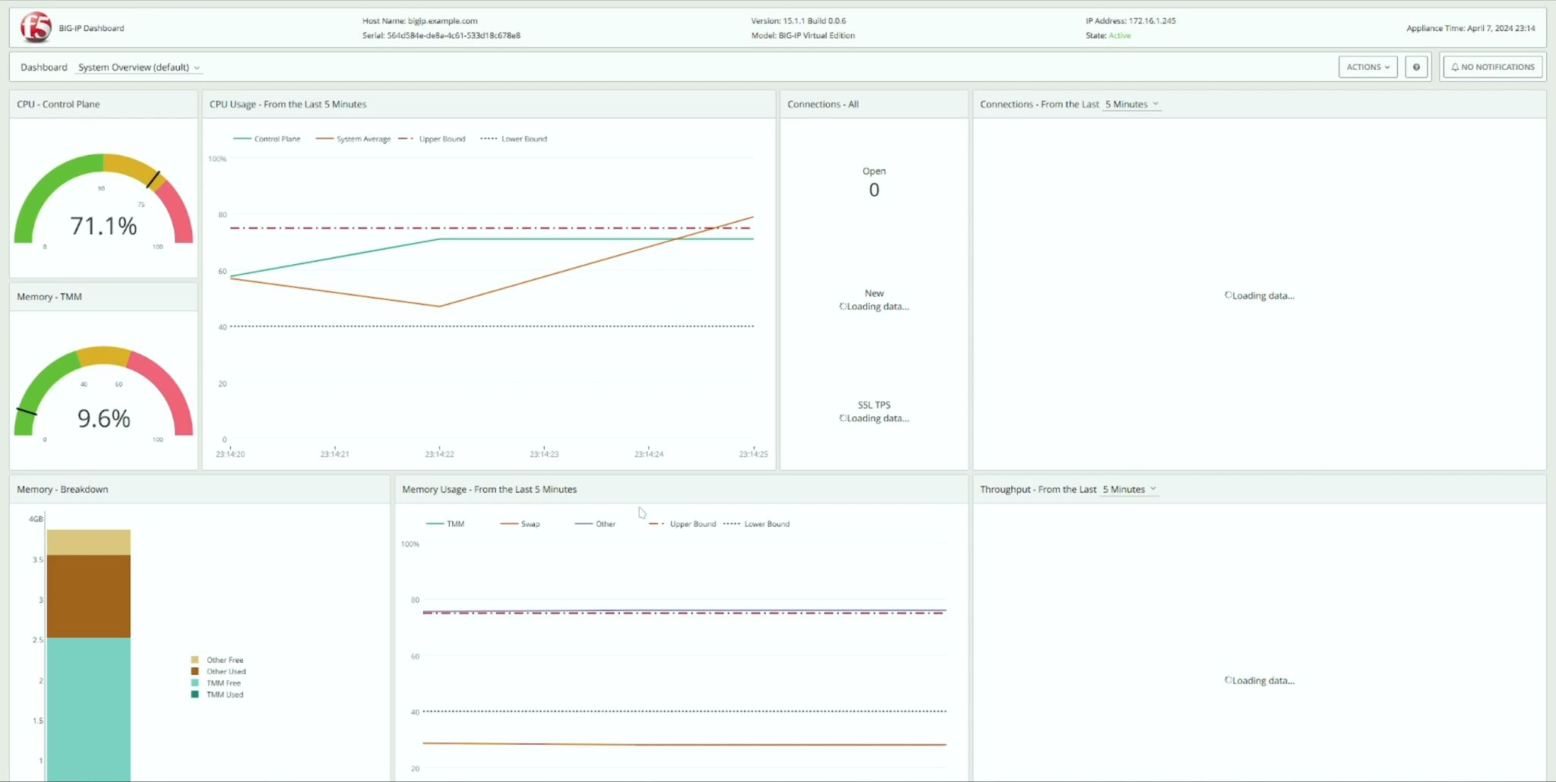

Slide 9
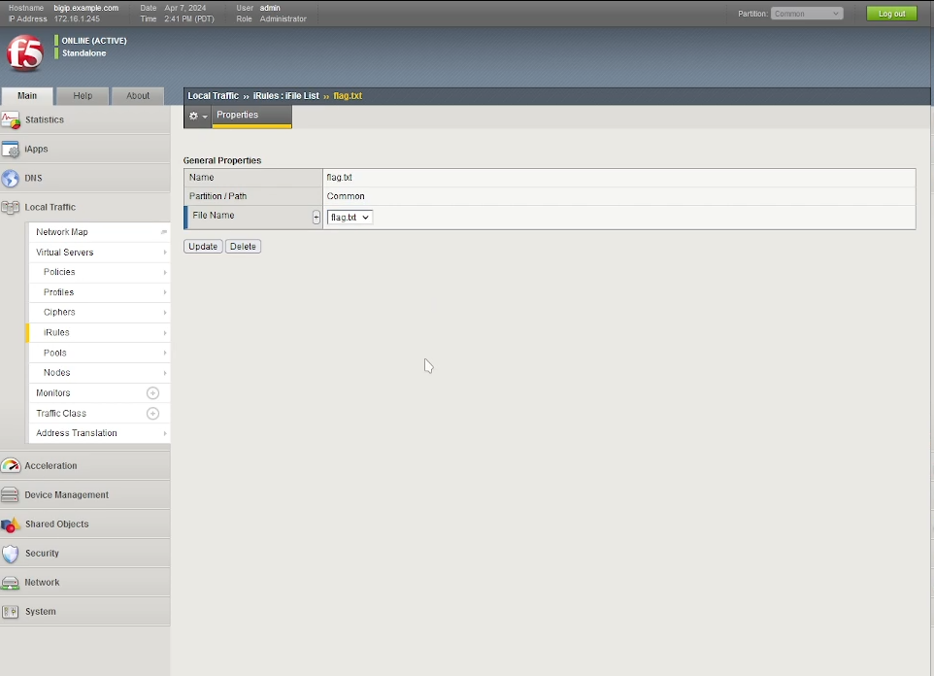

Slide 10
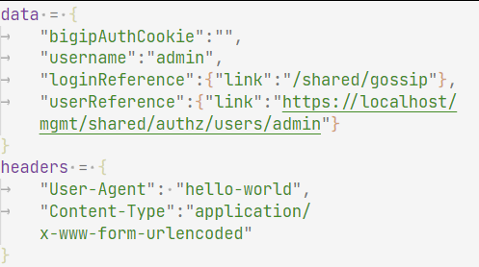
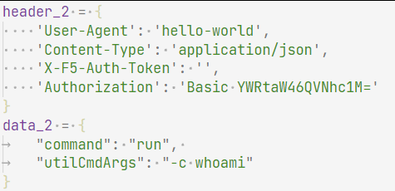
Practical Part
Part 2: Exploit
SSRF: Authorization bypass by leaking a X-F5-Auth-Token
Targeted urls:
https://172.16.1.245/mgmt/shared/authn/login
https://172.16.1.245/mgmt/tm/util/bash

Slide 11
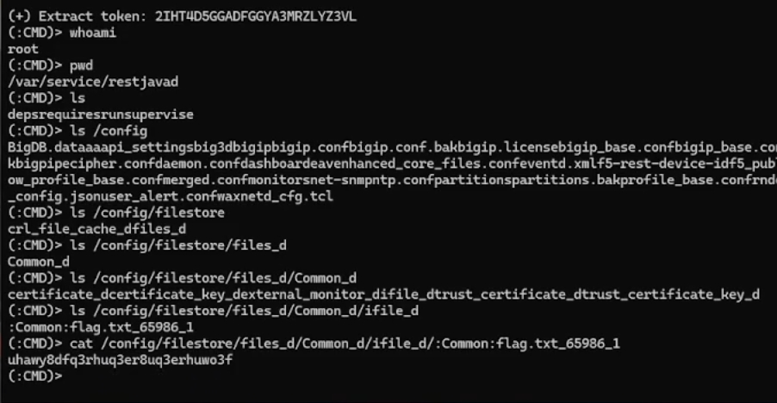
Practical Part
Part 2: Exploit
One of the requests should return a valid token
With the Token, we can execute commands on the management server by making a request to https://172.16.1.245/mgmt/tm/util/bash with the run command.
We achieve remote command execution
Gained access to the flag.txt file
/config/filestore/files_d/Common_d/ifile_d/:Common:flag.txt_65986_1

Slide 12
Practical Part
Part 3: Indicators of Compromise
Check logs for suspicious activity:
/var/log/restjavad-audit.0.log
/var/log/audit
Look for suspicious commands and access at, roughly, the same time

Slide 13
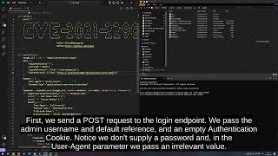
Exploit Replication

