Slide 1
Analysis and modelling of an online courses
platform
Presented by: Cernei Liviu st. gr. FAF-161

Slide 2
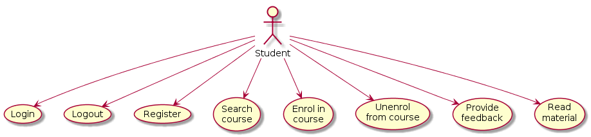
Student Use Case Diagram

Slide 3
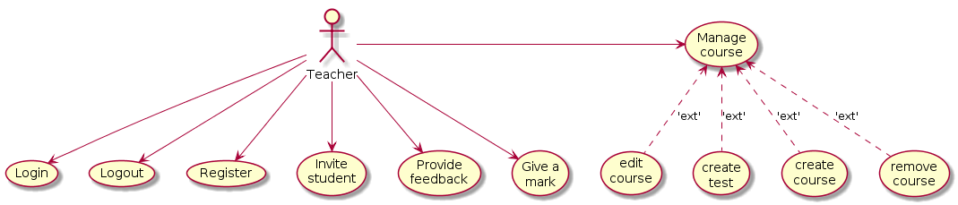
Teacher Use Case Diagram

Slide 4
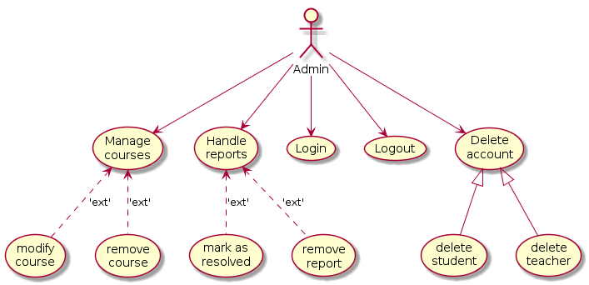
Admin Use Case Diagram

Slide 5
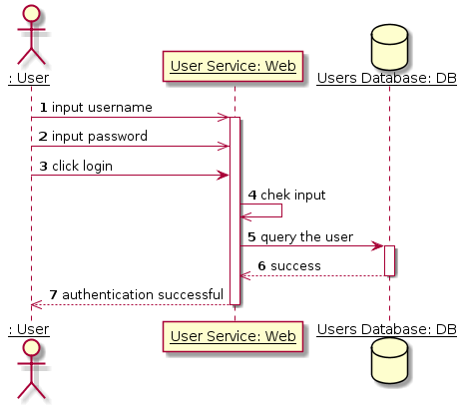
Login Sequence Diagram

Slide 6
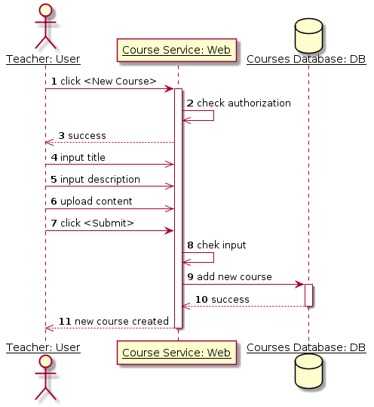
New Course Sequence Diagram

Slide 7
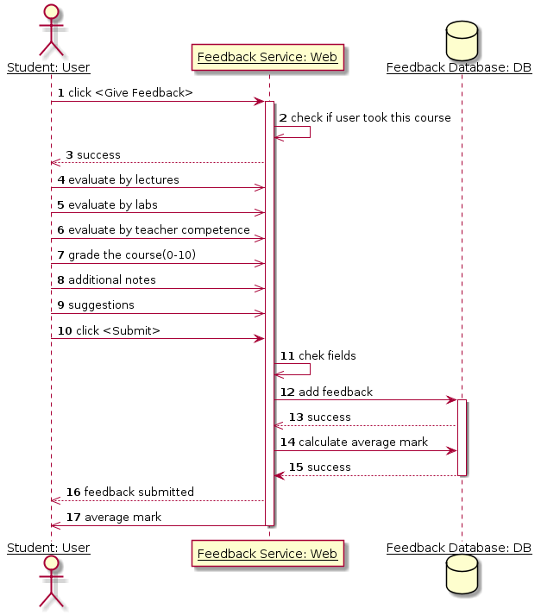
Feedback Sequence Diagram

Slide 8
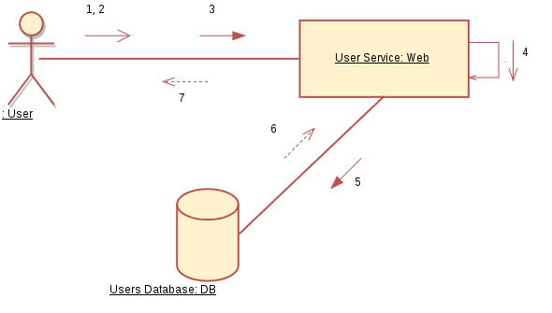
Login Collaboration Diagram

Slide 9
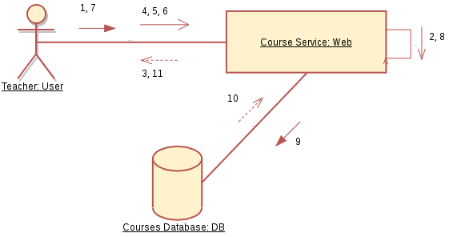
New Course Collaboration Diagram

Slide 10
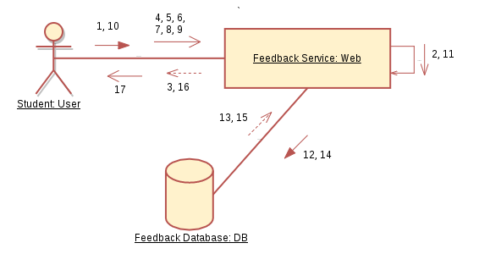
Feedback Collaboration Diagram

Slide 11
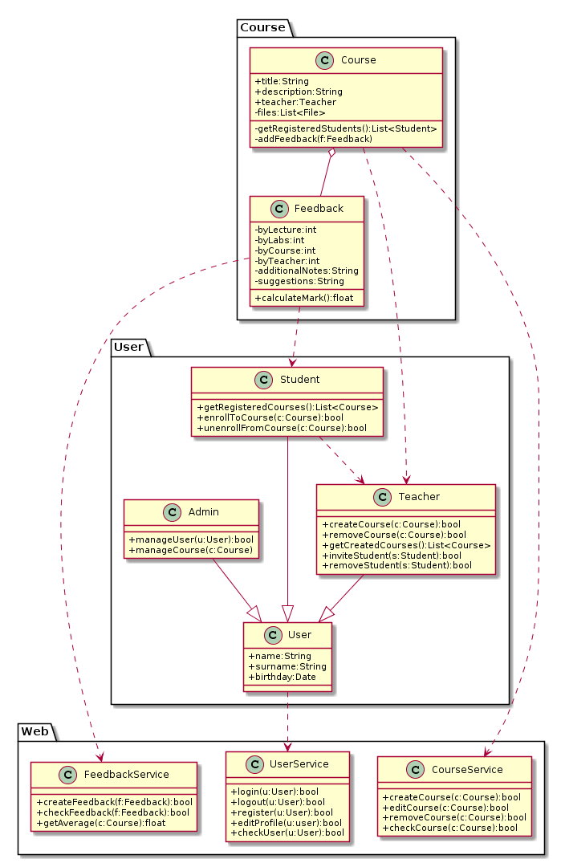
Class Diagram

Slide 12
Class Diagram

Slide 13
Class Diagram

Slide 14
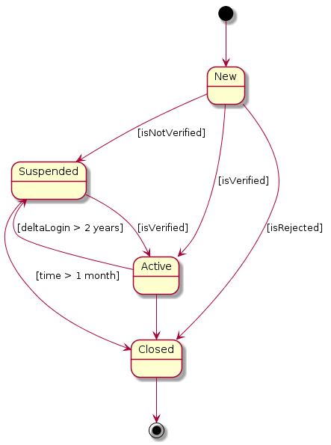
User Account Statechart Diagram

Slide 15
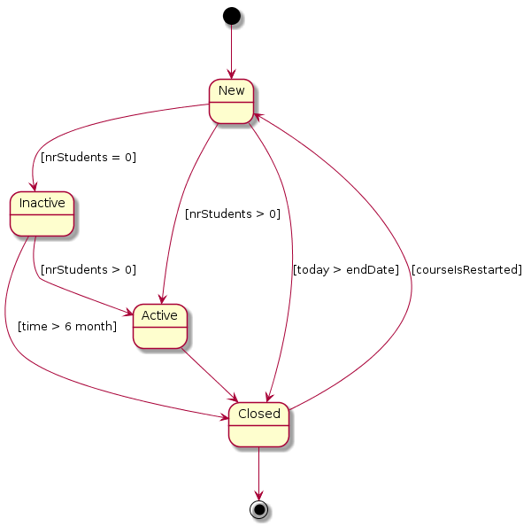
Courses Statechart Diagram

Slide 16
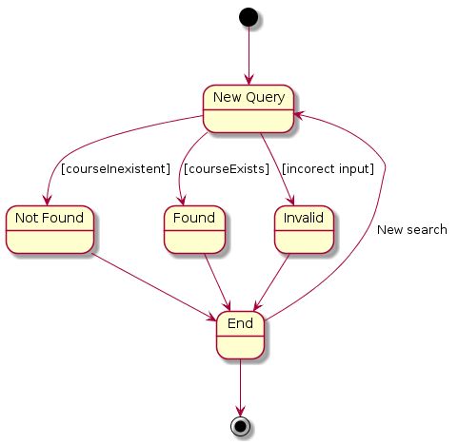
Search Operation Statechart Diagram

Slide 17
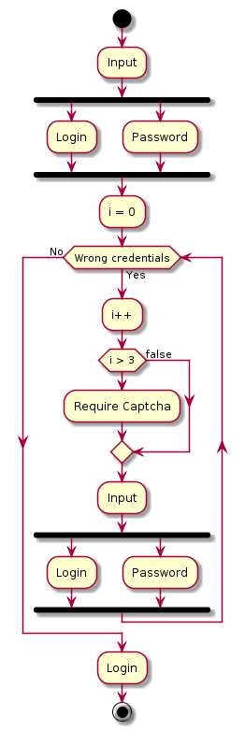
Login Activity Diagram

Slide 18
Login Activity Diagram

Slide 19
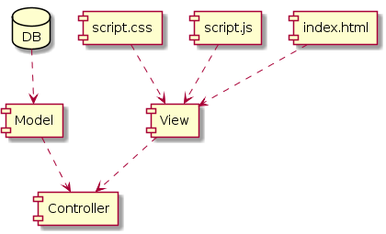
MVC Component Diagram

Slide 20
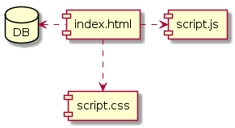
Compiled Files Component Diagram

Slide 21
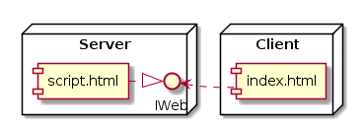
Website Deployment Diagram

Slide 22
END

