Slide 1
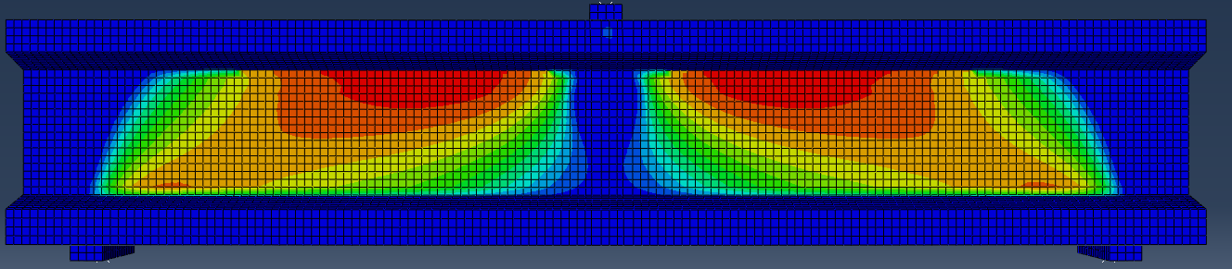
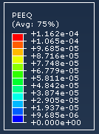
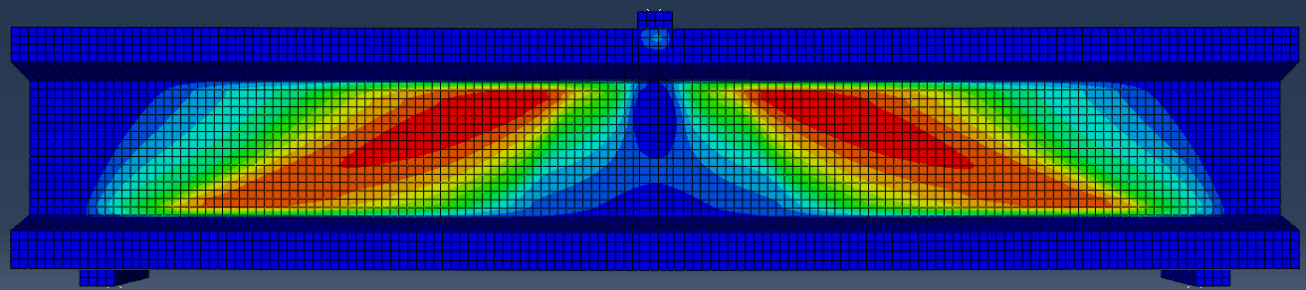
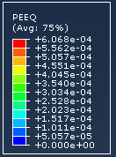
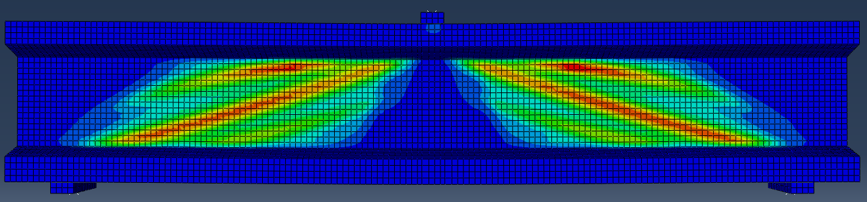
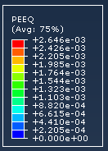
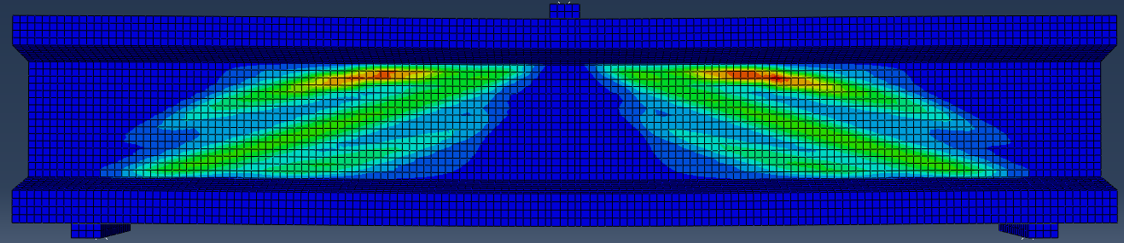
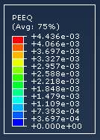
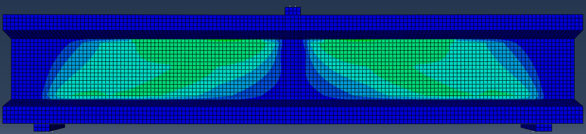
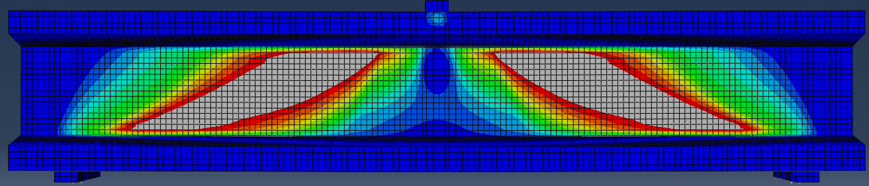
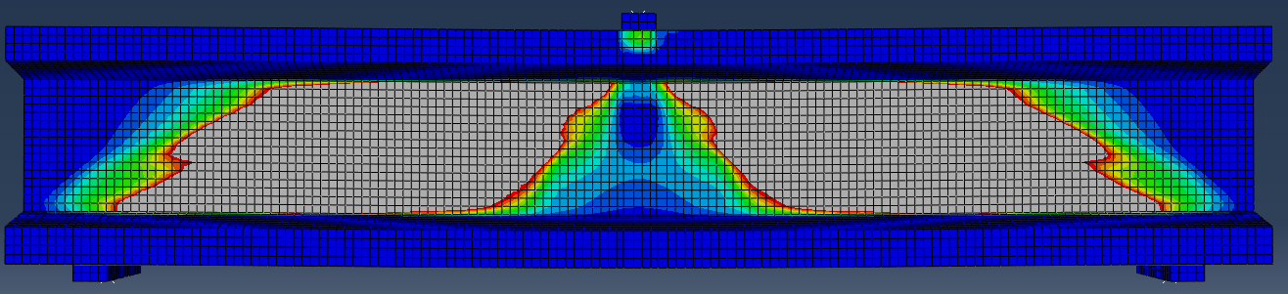
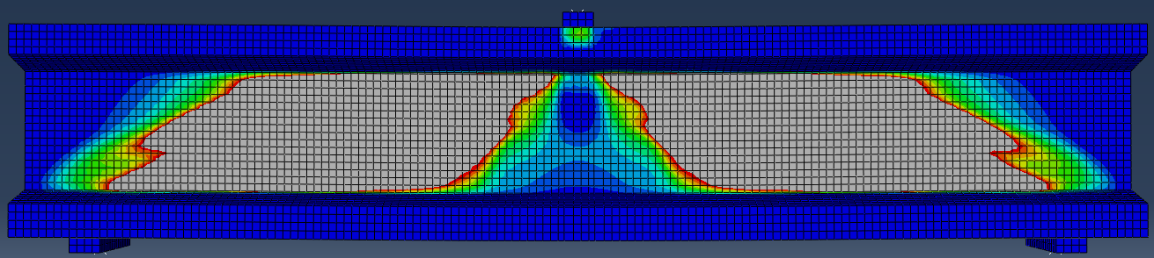
P=800kN
Validation of Yoo et al. beams
P=1000kN
P=1275kN
P=1200kN

Slide 2
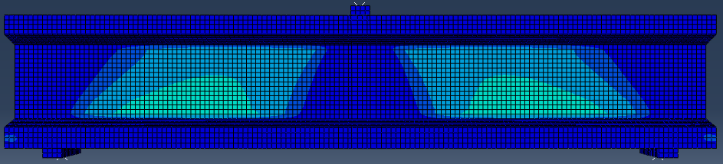
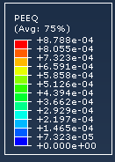
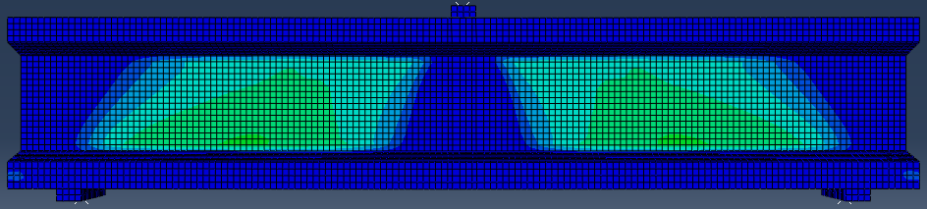
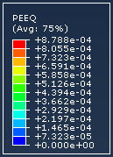
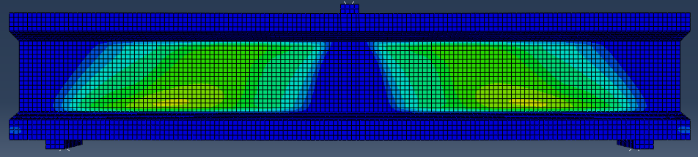

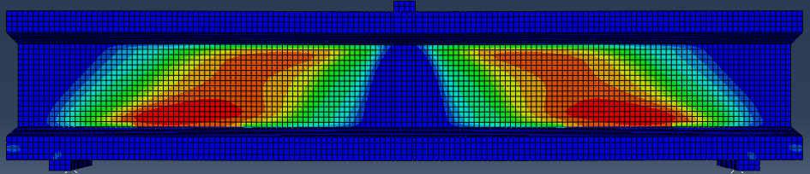
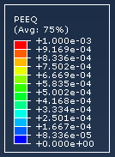
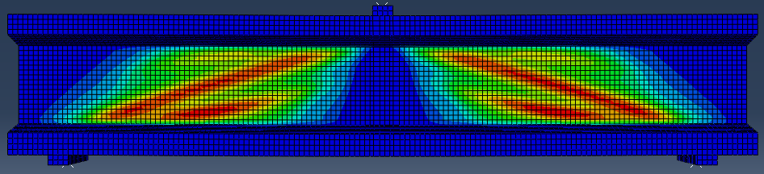
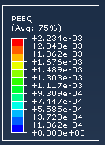
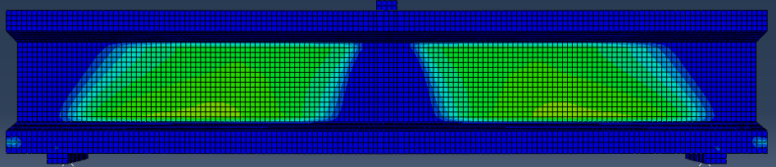
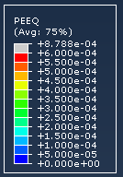
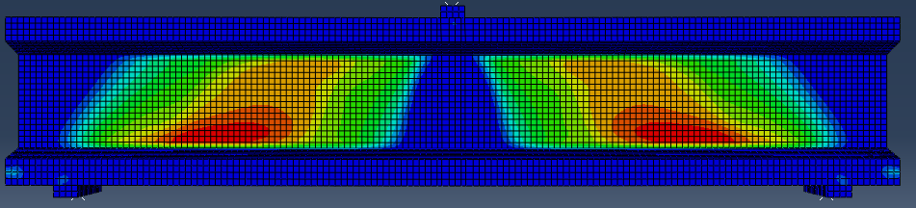
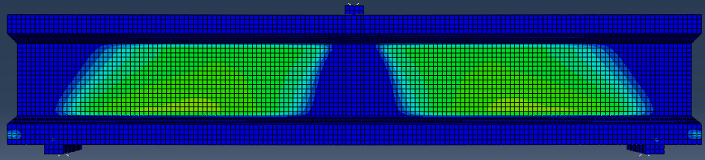
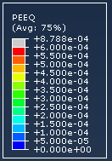
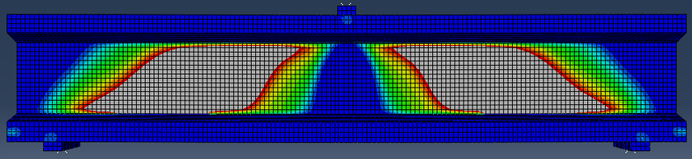
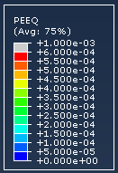
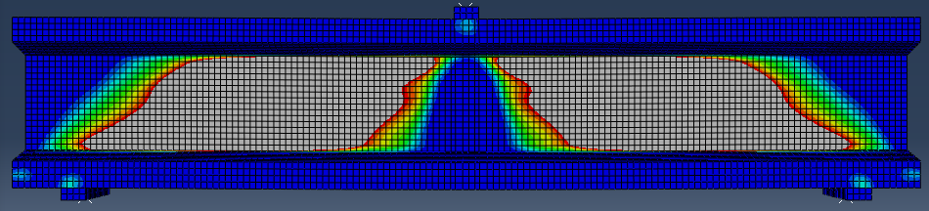
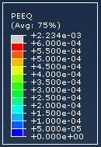
Voo et al. Prestressed concrete beams validation
P=600kN
P=1000kN
P=1200kN
P=1400kN
P=1000kN
P=800kN
P=1200kN
P=1400kN

Slide 3
Beam ID | Exp | FEM | FEM/Exp | VEM | VEM/Exp | French | French/Exp
S25F15PO | 1228 | 1271.4 | 1.03 | 1100.8 | 0.89 | 1067.2 | 0.87
S25F15PS | 1424 | 1454.2 | 1.02 | 1693.0 | 1.18 | 1053.2 | 0.74

Slide 4
300
70
a/d = 2.0
P
30
250
1000
1000
250
P/2
P/2
270
a/d = 2.5
P
250
1250
1250
250
30
P/2
P/2
160
73
100
Considered parameters:
fcm = 160MPa, ft = 12MPa, Vf = 2.0%,
No of PSC Strands = 4
Yield strength of strand = 1600MPa
Ap = 110 mm2
a/d = 2, 2.5
300

Slide 5
VEM and French code shear capacity calculations are shown for different level of prestressing stress
VEM Model
a/d | level of Prestressing |  | Pu
2 | 0fy | 0 | 700
 | 0.1fy | 160 | 720
 | 0.2fy | 320 | 745
 | 0.3fy | 480 | 770
 | 0.4fy | 640 | 800
 | 0.5fy | 800 | 827
 | 0.6fy | 960 | 860
 | 0.7fy | 1120 | 892
 | 0.8fy | 1280 | 930
 | 0.9fy | 1440 | 965
2.5 | 0fy | 0 | 645
 | 0.1fy | 160 | 660
 | 0.2fy | 320 | 680
 | 0.3fy | 480 | 700
 | 0.4fy | 640 | 722
 | 0.5fy | 800 | 745.3
 | 0.6fy | 960 | 770
 | 0.7fy | 1120 | 800
 | 0.8fy | 1280 | 820
 | 0.9fy | 1440 | 850
French Code
a/d | Level of Prestressing |  | Pu
2 | 0fy | 0 | 796.4
 | 0.1fy | 160 | 798.5
 | 0.2fy | 320 | 800
 | 0.3fy | 480 | 802.8
 | 0.4fy | 640 | 804.9
 | 0.5fy | 800 | 807
 | 0.6fy | 960 | 809.2
 | 0.7fy | 1120 | 811.4
 | 0.8fy | 1280 | 813.5
 | 0.9fy | 1440 | 815.6
Preferred parameters:
a/d ratio = 2.5, level of prestressing = 0.3fy , 0.5fy and 0.7fy

