Slide 1
Computer Graphics and Geometric Modeling
ComS 557
Final Project
Le Chen
lechen@iastate.edu

Slide 2
My Final Project- My World
To make an open world game similar to Minecraft, where users are free to move and build the world.

Slide 3
Details
Components of the game:
A three dimensional environment, and open world in which a character can explore.
Three dimensional character model
Three dimensional robot model as component in the game
Three dimensional plane as component in the game
Dynamic camera

Slide 4
Functionalities:
Control the character using keyboard
Switch camera positions
Trackball view of environment using mouse
Zoom in and out using mouse
Free to stack stones or throw bricks in the world
Simulation of gravity
Simulation of sun and moon
Control plane in the world

Slide 5
Models
The character:
Consists of: head(hair, eyes and mouth), body, left arm, right arm, left leg and right leg.
Center of the head, arms and legs depend on the body.
First defined by geometric coordinates and then manually converted to obj file.
Character able to walk and put stone or bricks using mouse
Building
Consists of cubes created by loops .
The plane:
Consists of: head, body, tail and wings(up and down)
Simulation gravity by given an acceleration, controlled by user.
Light:
Using global ambient(sun or moon) and the light distance is 50.
Calculate time to change between sun and moon.
Add diffuse specular and emission

Slide 6
Interactions
Left and right click mouse to zoom in and out
Use “w””s””a””d” on keyboard to move the character
Use “f” on the keyboard to simulate the plane fly
Use “p” on the keyboard to reset the plane
Use “v” on the keyboard to change perspective view
When it is first person perspective view, right click mouse to put a stone, right click to put a stick
Use “esc” on the keyboard to exist

Slide 7
Techniques
Add first person and third person perspective view.
Simulate the light change between sun and moon by a angle counter
Use a generic object loader for loading objects
Add background music

Slide 8
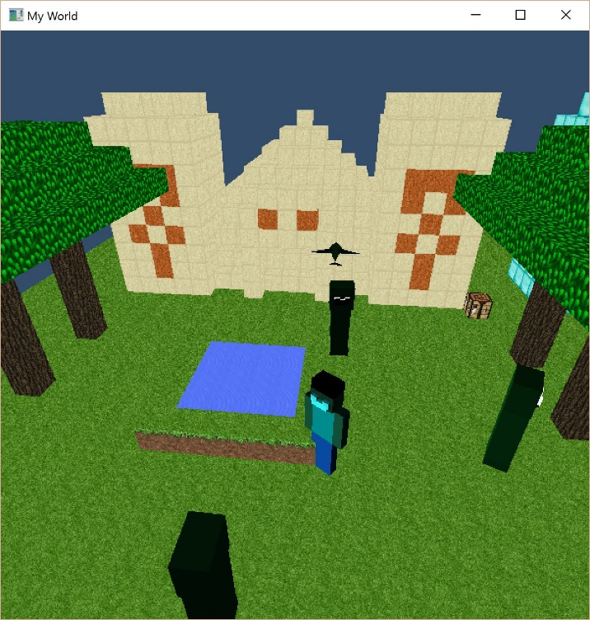
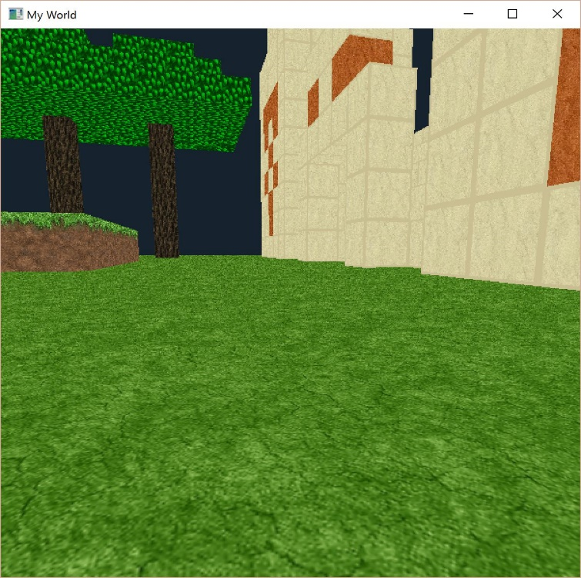
Demos
The world and 3-rd perspective view
Zoom and out

Slide 9
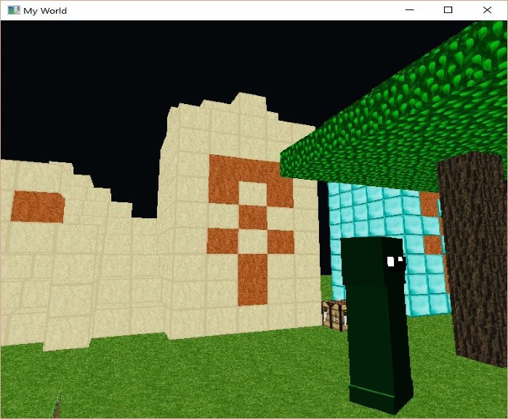
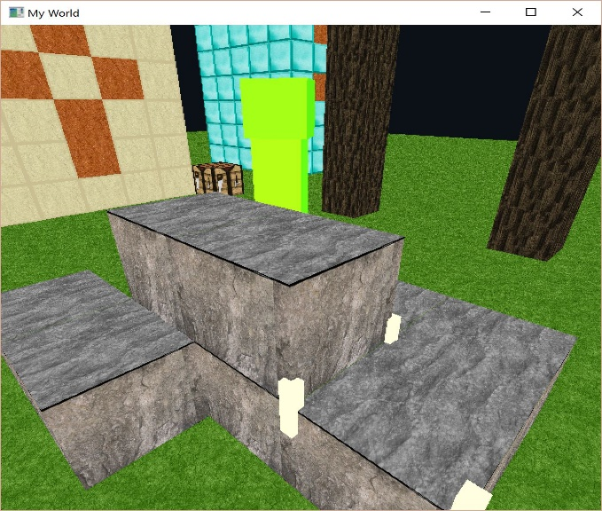
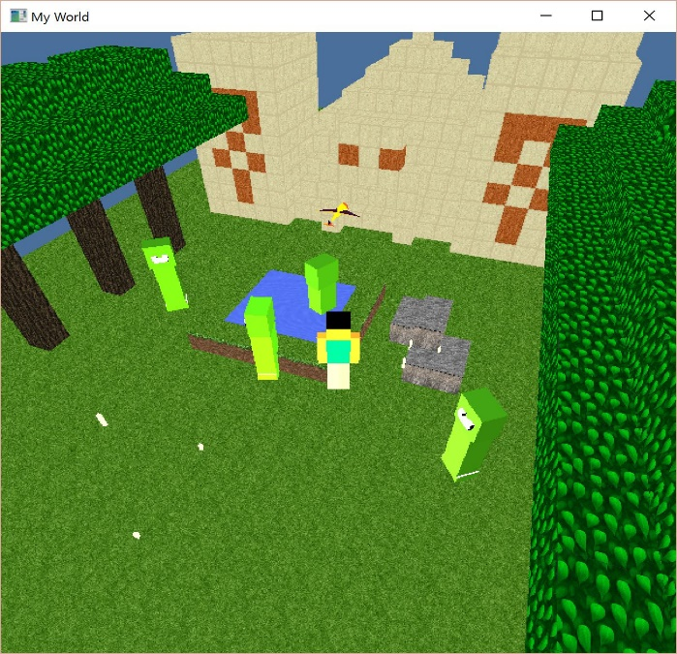
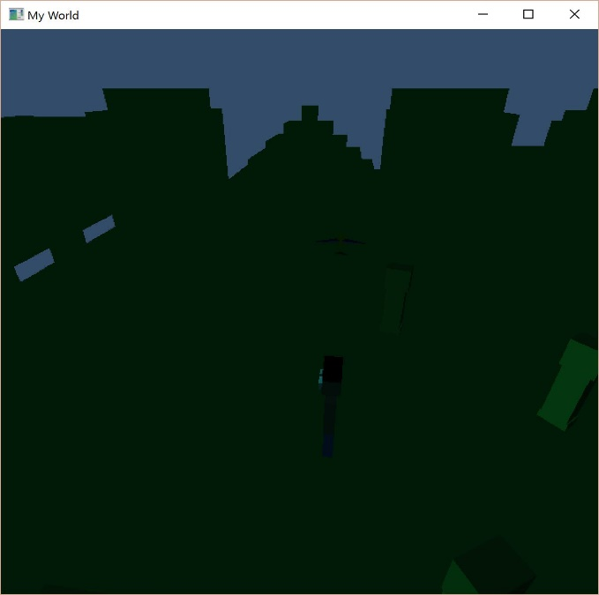
1st perspective view
Build the world
Time: noon
Time: midnight

Slide 10
Thanks

