Slide 1



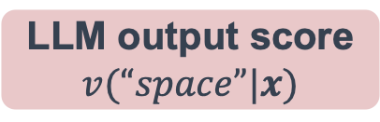





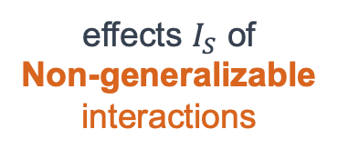

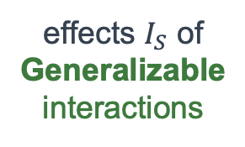
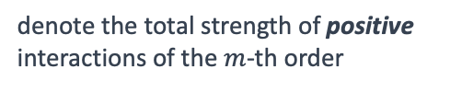





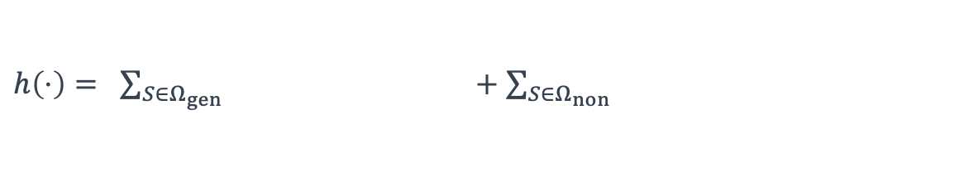









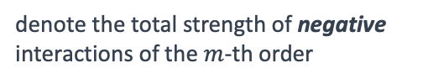
LLM output score
$v(“space”|x)$
AND-OR logical model
$$h\left(“space”|x\right)$$
Distribution of all interactions
denote the total strength of positive interactions of the $m$-th order
$$A^{\left(m\right),+}$$
Equivalent modeling
+
denote the total strength of negative interactions of the $m$-th order
LLM
0
$$A^{\left(m\right),−}$$
$I_{S}^{or}$= 0.89
$I_{S}^{and}$= 0.32
$I_{S}^{and}$= 0.30
$I_{S}^{and}$= 1.77
effects $I_{S}$ of Generalizable interactions
effects $I_{S}$ of
Non-generalizable interactions
Einstein’s
Relativity
Einstein’s
of
Theory
Relativity
warping
$h\left(⋅\right)= \sum_{S∈Ω_{gen}}{ } +\sum_{S∈Ω_{non}}{ }$
$I_{S}^{or}$= 0.70
$I_{S}^{and}$= 1.36
$I_{S}^{or}$= 0.21
$I_{S}^{or}$= -0.99
Einstein’s
proposes
Einstein’s
the
General
Relativity
warping
of
$I_{S}^{or}$= 0.11
warping
of
$I_{S}^{or}$= 0.08
$I_{S}^{and}$= 2.38
follow a decay-shaped distri.
follow a spindle-shaped distri.
Input prompt $x$
Einstein’s
Theory
of
$$…$$
General
of
of
$$A_{gen}^{\left(m\right),+}$$
$$A_{non}^{\left(m\right),+}$$
Input prompt $x:$ “Einstein’s Theory of General Relativity proposes that gravity is the warping of”
Llama-7B LLM’s predict: “space”
0
0
$$A_{gen}^{\left(m\right),−}$$
$$A_{non}^{\left(m\right),−}$$
1 Order $m$ 8
1 Order $m$ 8

