Slide 1

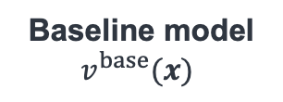
Input prompt $x:$ “Einstein’s Theory of General Relativity proposes that gravity is the warping of ” Target token: “space”
Shared across different models
Observed only in individual models
Target model
$v(x)$
+
Theory + Relativity
General + Relativity
gravity + warping
Einstein’s + of
Theory + proposes + of
the + warping + of
Baseline model
$$v^{base}(x)$$
+
Theory + Relativity
General + Relativity
gravity + warping
—
—
—
Generalizable interactions
an interaction is consistently learned by different models trained on the same task
Non-generalizable interactions
an interaction is specific to individual DNNs and less likely to transfer

