Slide 1
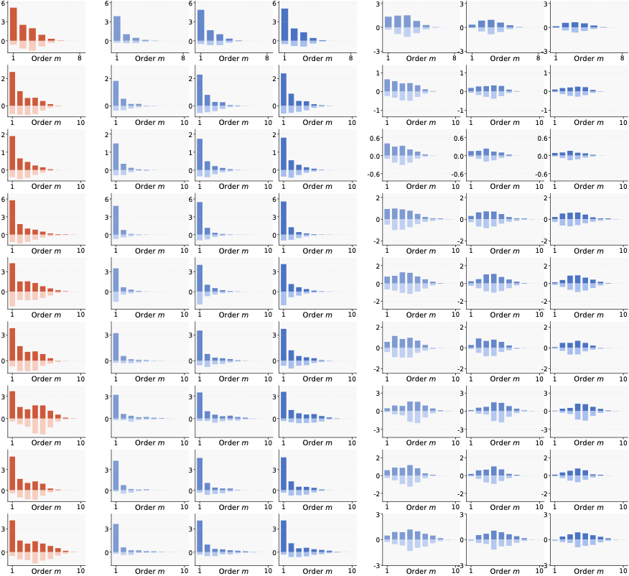

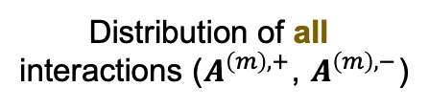





﻿Distribution of all
interactions ($A_{ }^{\left(m\right),+}$, $A_{ }^{\left(m\right),−}$)
=
Distribution of Generalizable interactions
+
Distribution of Non-generalizable interactions
$$k=1$$
$$k=3$$
$$k=5$$
$$k=1$$
$$k=3$$
$$k=5$$
ResNet-20 on MNIST
ResNet-20 on CIFAR-10
VGG-11 on CIFAR-10
Bert-Medium on SST-2
Bert-Base on SST-2
Qwen2.5-7B on Finance
Llama-3-8B on Finance
GLM-Z1-9B on Finance
Phi-4-14B on Finance

