Slide 1
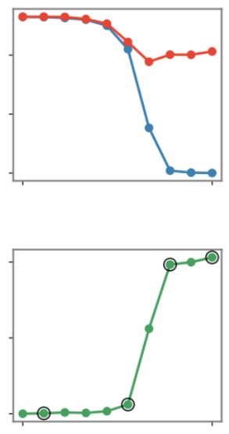
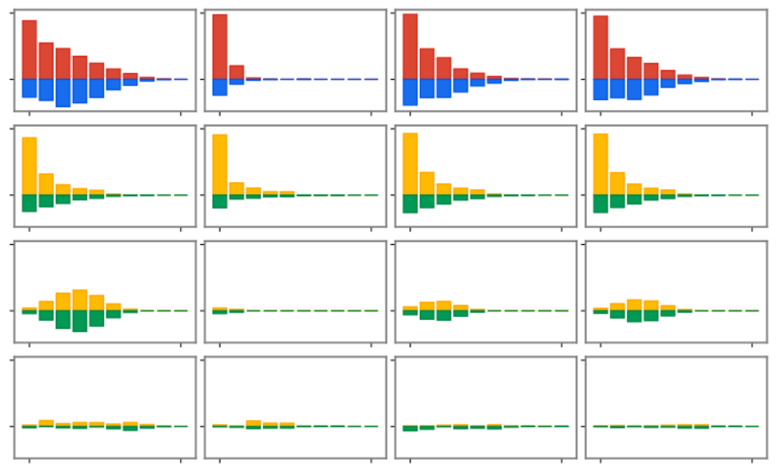
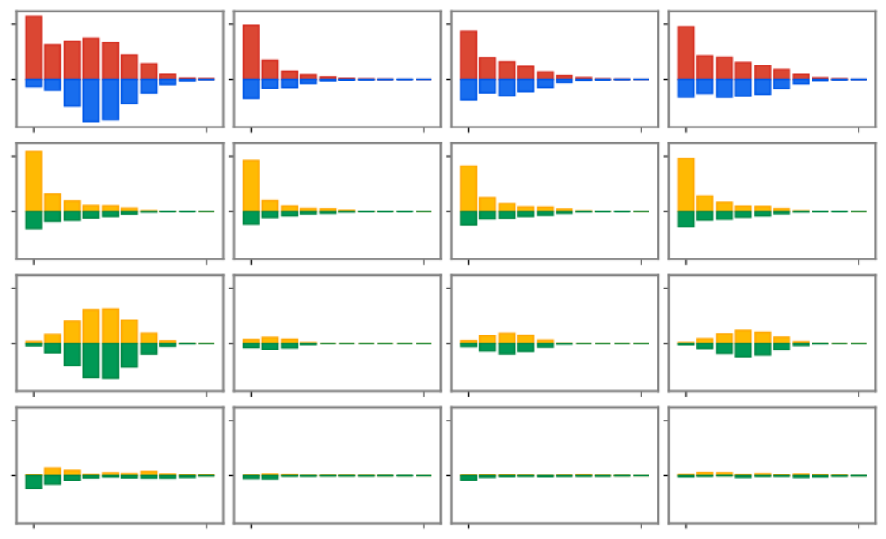
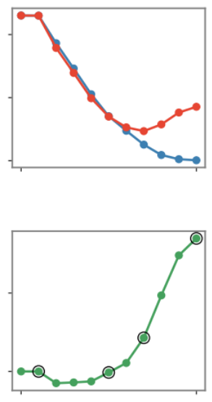







VGG-16 trained on CUB200-2011
VGG-11 trained on CIFAR-10
Normal learning phase
Over-fitting phase
Normal learning phase
Over-fitting phase
Testing loss
Testing loss
Training loss
Timepoint A
Timepoint B
Timepoint C
Timepoint D
Training loss
Timepoint A
Timepoint B
Timepoint C
Timepoint D
all
all
decay
decay
Loss gap
Loss gap
spindle
C
spindle
D
Four
timepoints
Four
timepoints
D
residual
C
residual
A
B
A
B
1 epoch 256
1 epoch 256
1 order $n$
1 order $n$
1 order $n$
1 order $n$
1 order $n$
1 order $n$
1 order $n$
1 order $n$
Normal learning phase: penalizing interactions in the spindle-shaped distri.
Over-fitting phase: enhancing interactions in the spindle-shaped distri.
small matching error
Notes:
1. 数据集不需要强调（高亮）
2. 字体字号统一（caption字号）
3. -train, -test不要重复
4. 四个A标在图上
5. 去掉A，B里面保证同时两种分布
6. 框框attention
7. Loss, Loss Gap去掉纵坐标数值。写横坐标意义。
8. 粗箭头 between loss and loss gap
9. D, Newly emerged, E, Newly merge

Slide 2
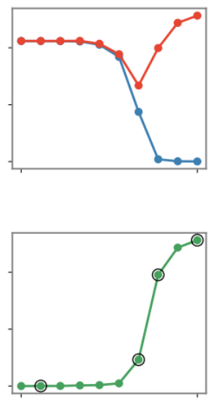
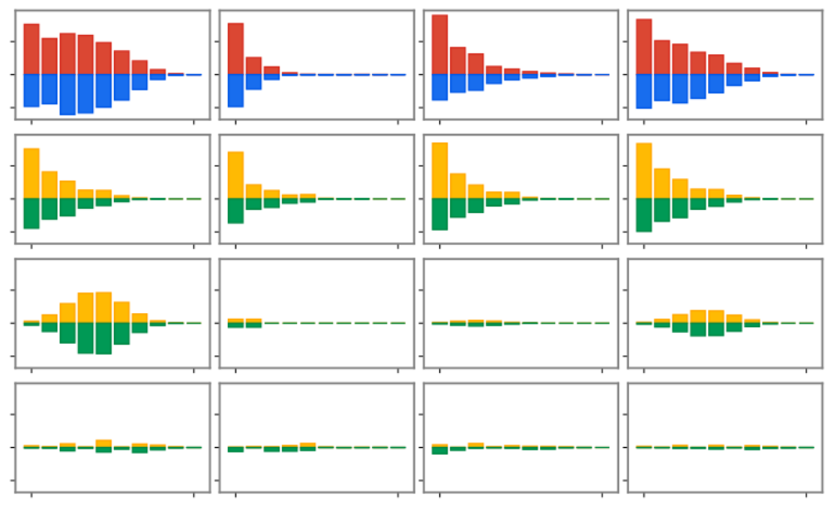
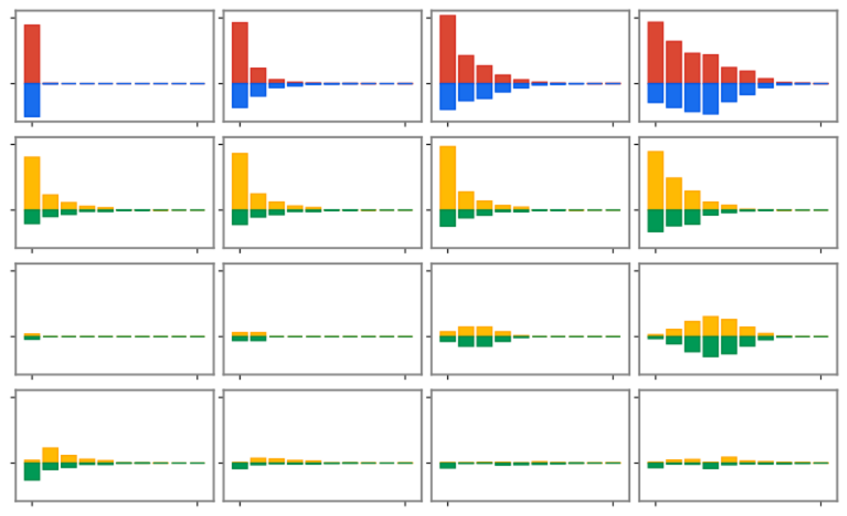
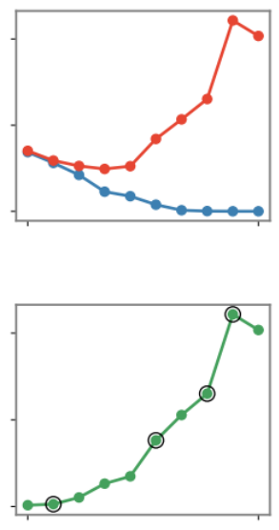
AlexNet trained on CUB200-2011
Bert-Medium trained on SST-2
Normal learning phase
Over-fitting phase
Normal learning phase
Over-fitting phase
Testing loss
Testing loss
Training loss
Timepoint A
Timepoint B
Timepoint C
Timepoint D
Training loss
Timepoint A
Timepoint B
Timepoint C
Timepoint D
all
all
decay
decay
Loss gap
Loss gap
spindle
C
spindle
D
Four
timepoints
Four
timepoints
D
C
residual
B
residual
B
A
A
1 epoch 256
1 epoch 256
1 order $n$
1 order $n$
1 order $n$
1 order $n$
1 order $n$
1 order $n$
1 order $n$
1 order $n$
Normal learning phase: penalizing interactions in the spindle-shaped distri.
Over-fitting phase: enhancing interactions in the spindle-shaped distri.
small matching error
Notes:
1. 数据集不需要强调（高亮）
2. 字体字号统一（caption字号）
3. -train, -test不要重复
4. 四个A标在图上
5. 去掉A，B里面保证同时两种分布
6. 框框attention
7. Loss, Loss Gap去掉纵坐标数值。写横坐标意义。
8. 粗箭头 between loss and loss gap
9. D, Newly emerged, E, Newly merge

Slide 3
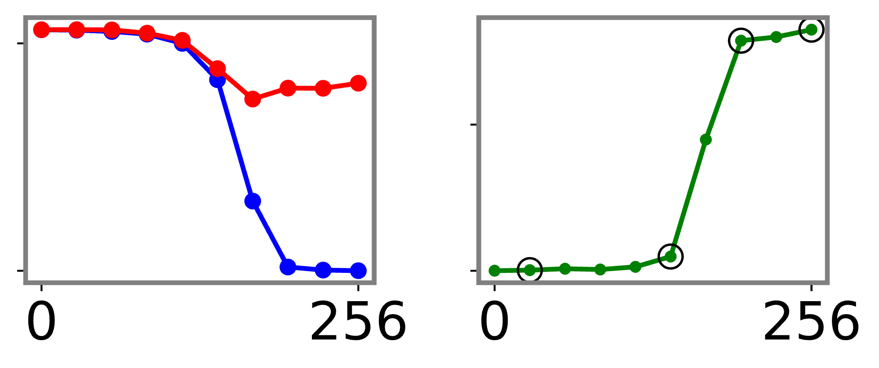
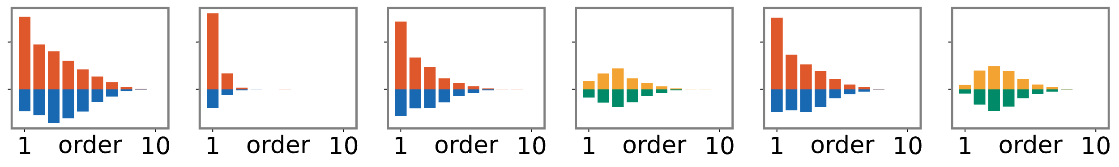
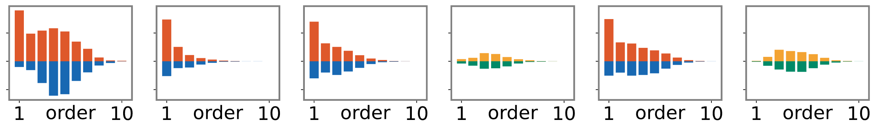
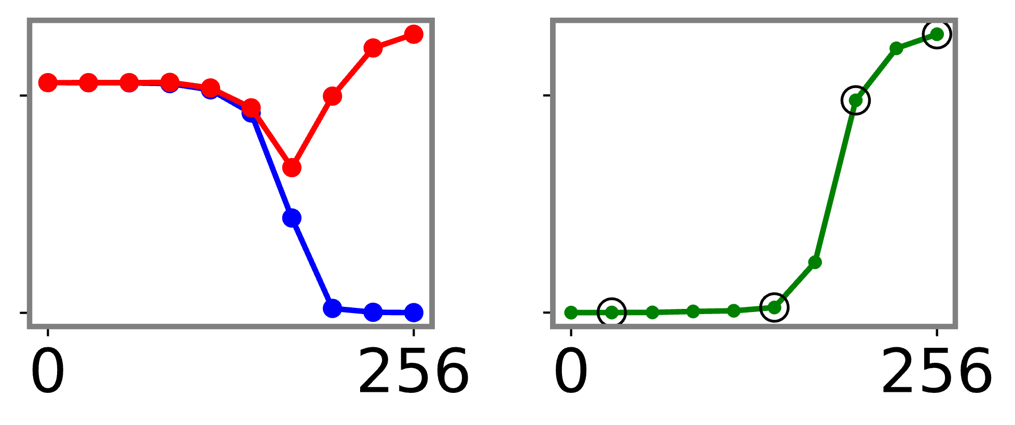
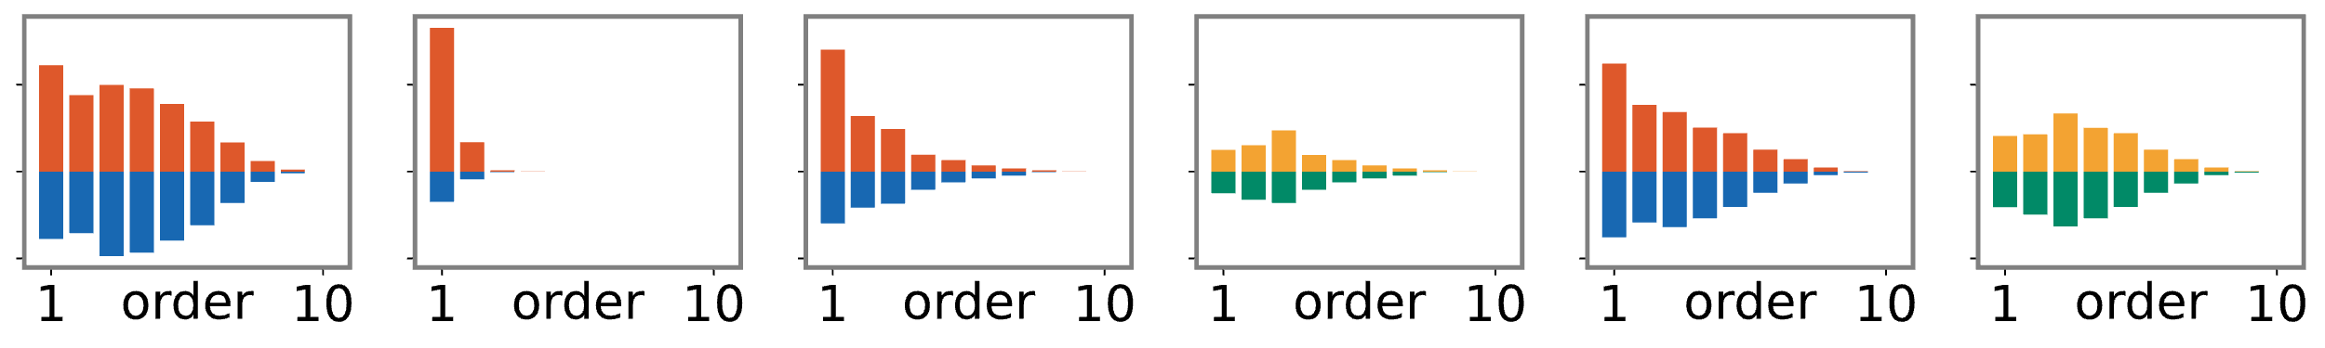
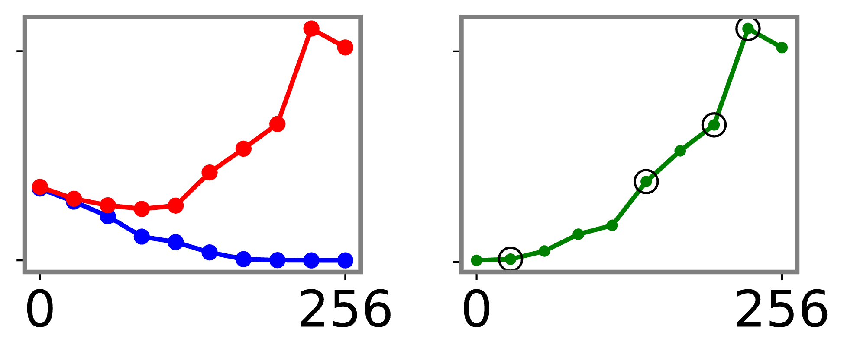
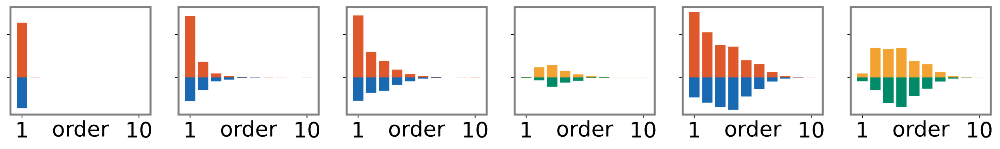




Normal learning phase
Over-fitting phase
Testing loss
Loss gap
Training loss
Newly emerged in C w.r.t. interactions in B
Newly emerged in D w.r.t. interactions in B
Loss
Loss gap
C
Four
timepoints
D
$$A^{\left(m\right),+}$$
Timepoint C
Timepoint D
VGG-16
CUB200-2011
Timepoint A
Timepoint B
$${ΔA}^{\left(m\right),+}$$
A
B
$$A^{\left(m\right),−}$$
$${ΔA}^{\left(m\right),−}$$
epoch
epoch
D
VGG-11
CIFAR-10
A
B
C
D
A
B
C
epoch
epoch
AlexNet
CUB200-2011
D
A
B
C
D
C
A
B
epoch
epoch
D
A
B
C
D
Bert-Medium
SST-2
C
A
B
epoch
epoch
Notes:
1. 数据集不需要强调（高亮）
2. 字体字号统一（caption字号）
3. -train, -test不要重复
4. 四个A标在图上
5. 去掉A，B里面保证同时两种分布
6. 框框attention
7. Loss, Loss Gap去掉纵坐标数值。写横坐标意义。
8. 粗箭头 between loss and loss gap
9. D, Newly emerged, E, Newly merge

Slide 4
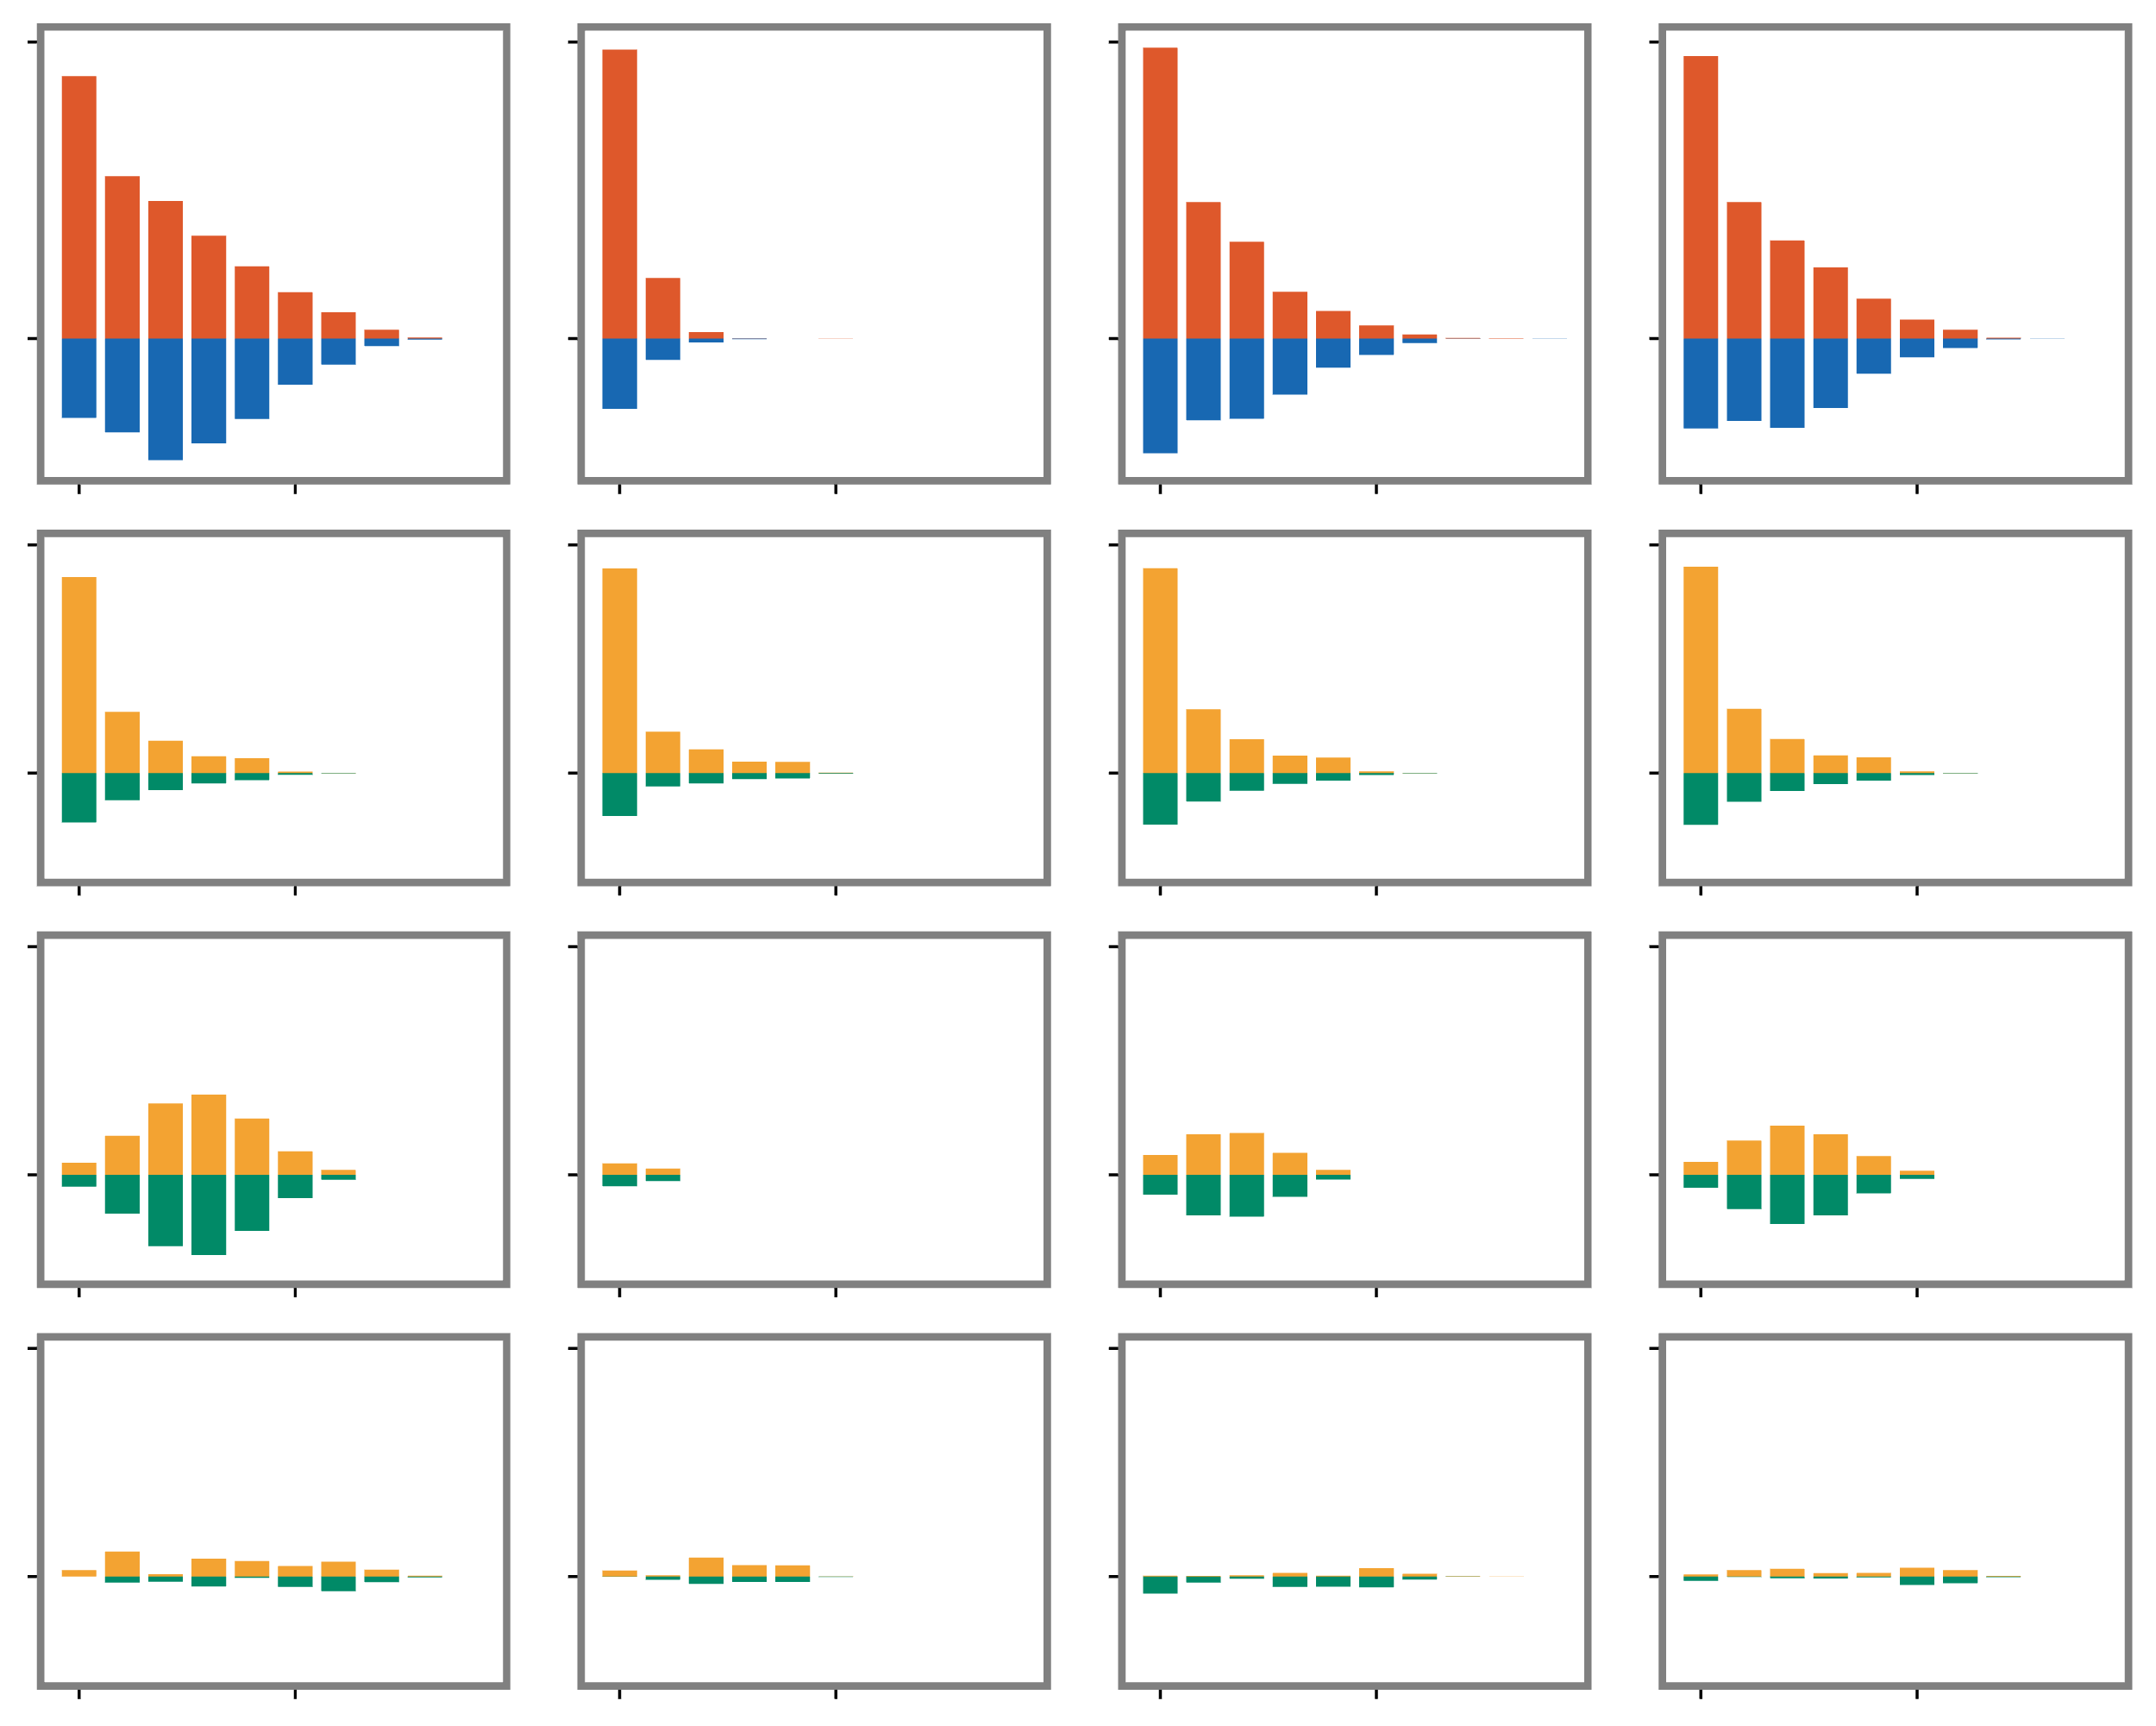
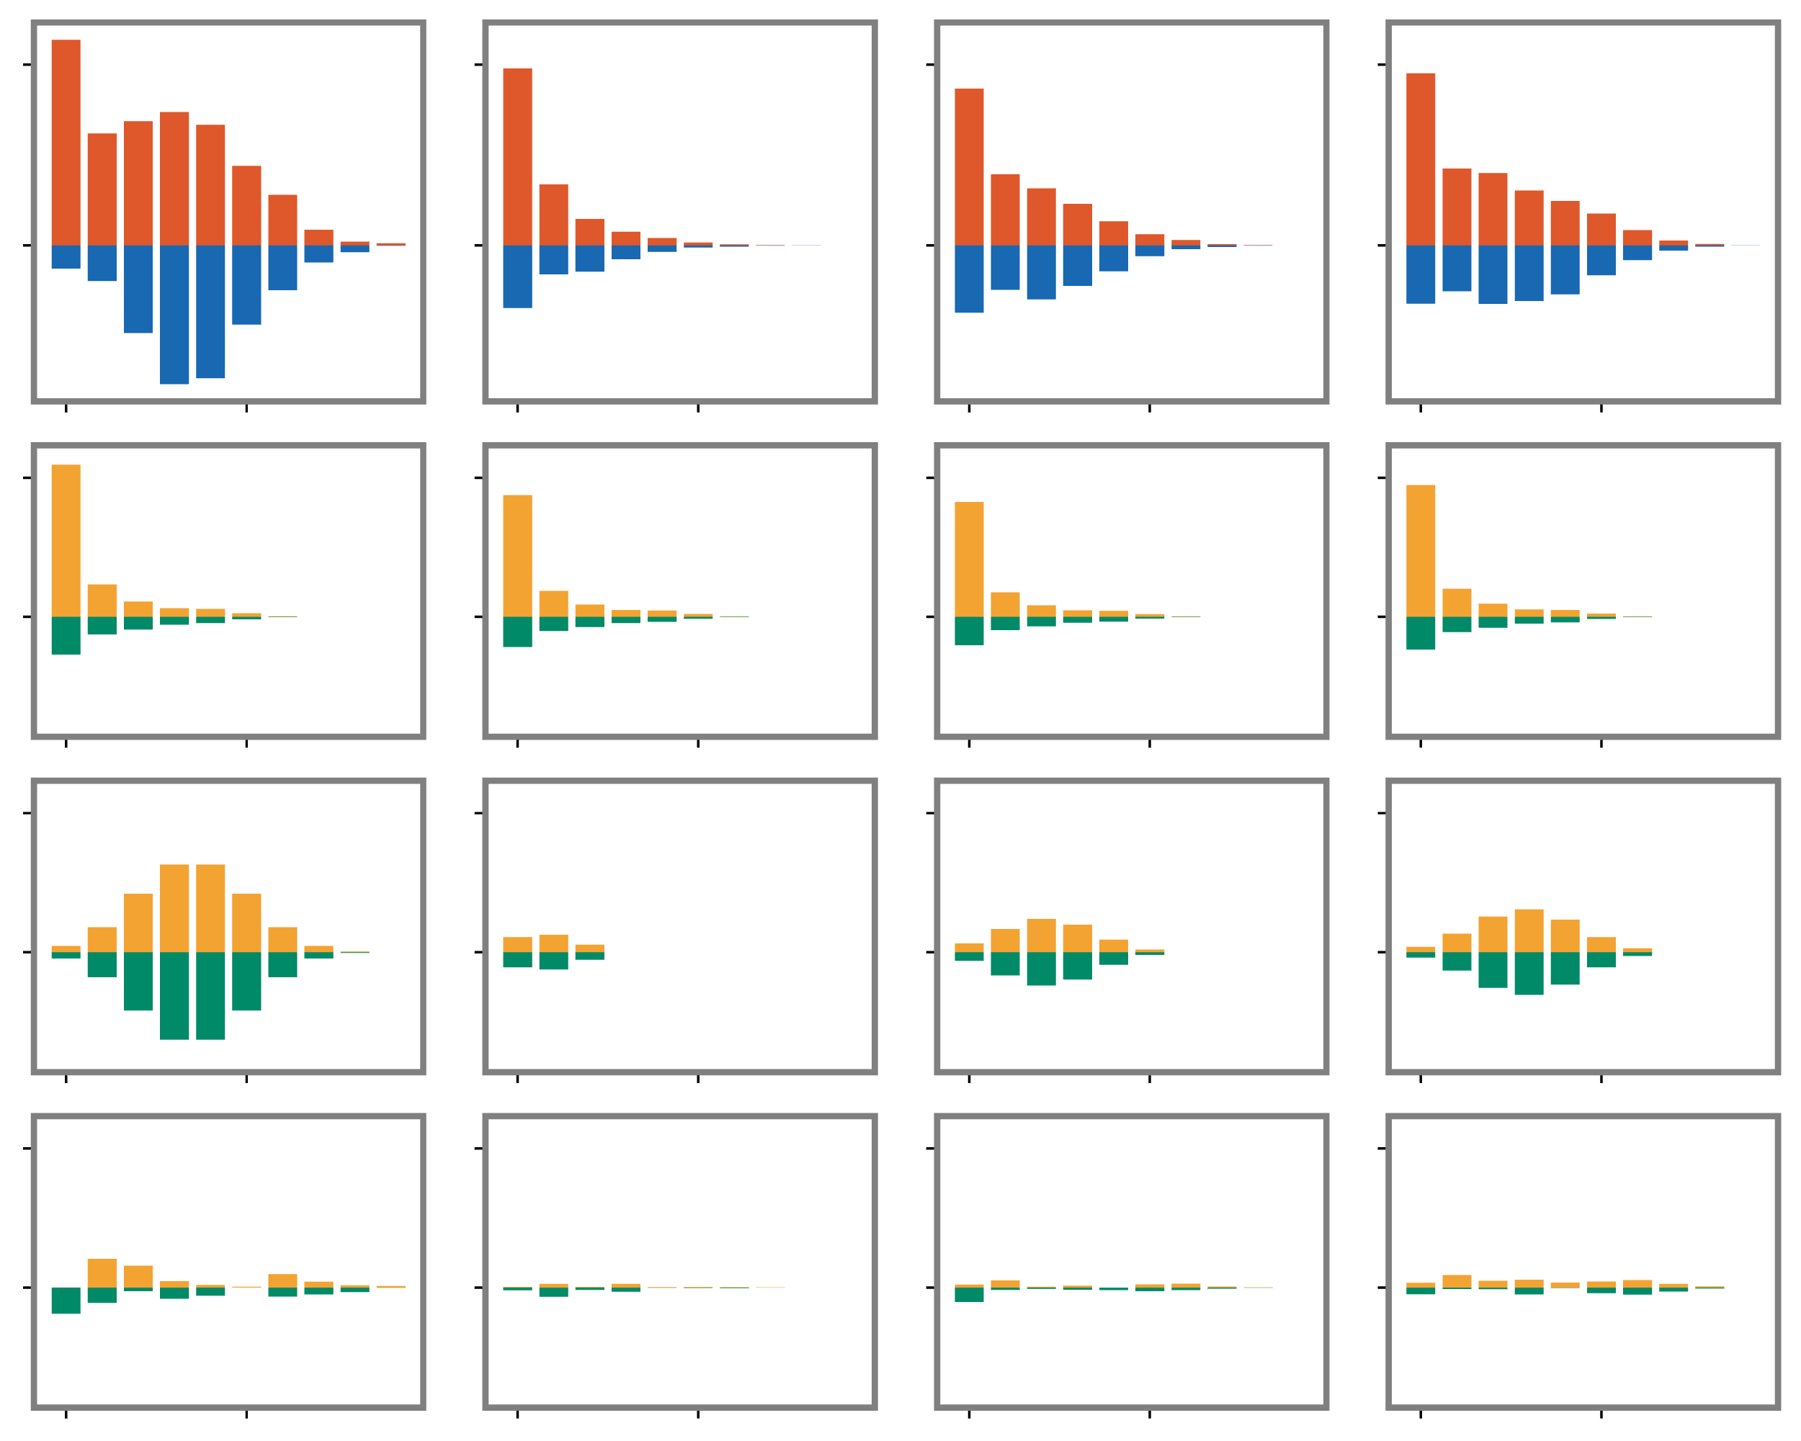
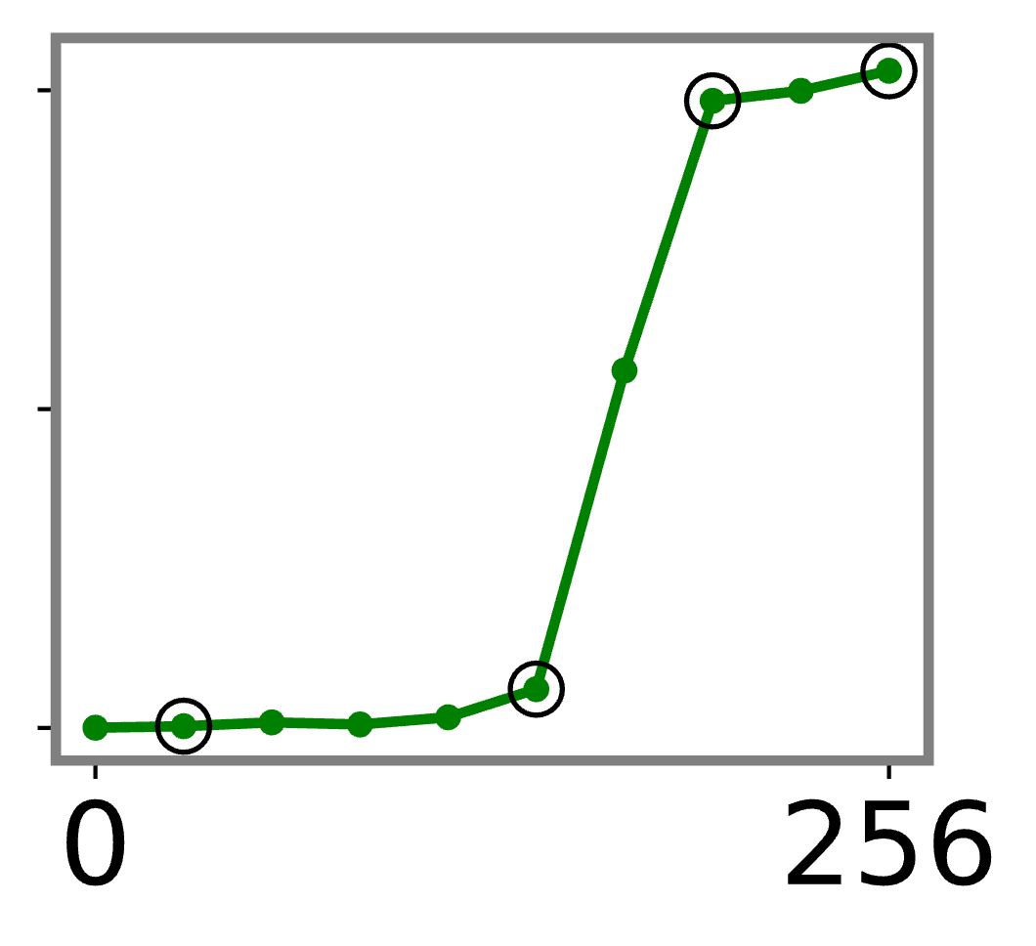
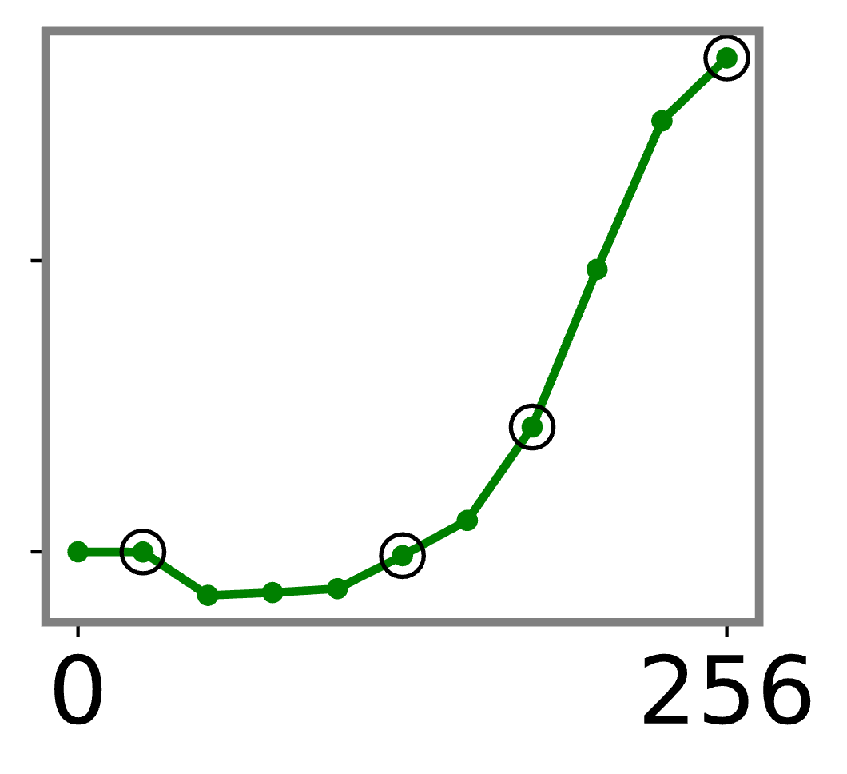


VGG-16 trained on CUB200-2011
VGG-11 trained on CIFAR-10
Normal learning phase
Over-fitting phase
Normal learning phase
Over-fitting phase
Timepoint A
Timepoint B
Timepoint D
Normal learning phase:
penalizing interactions in the spindle-shaped distribution
Timepoint A
Timepoint B
Timepoint D
Timepoint C
Timepoint C
$$A^{\left(m\right),+}$$
$$A^{\left(m\right),−}$$
Loss gap
Over-fitting phase:
enhancing interactions in the spindle-shaped distribution
Loss gap
Four
timepoints
Four
timepoints
D
C
D
decay
C
spindle
A
B
A
B
Small matching error
between the real distribution
and the theoretically
estimated distributions
epoch
epoch
resdual
Notes:
1. 数据集不需要强调（高亮）
2. 字体字号统一（caption字号）
3. -train, -test不要重复
4. 四个A标在图上
5. 去掉A，B里面保证同时两种分布
6. 框框attention
7. Loss, Loss Gap去掉纵坐标数值。写横坐标意义。
8. 粗箭头 between loss and loss gap
9. D, Newly emerged, E, Newly merge

