Slide 1
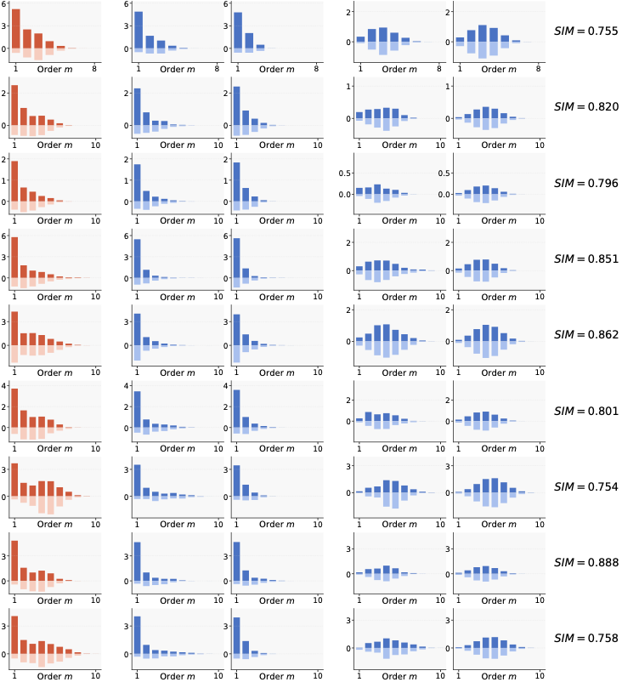
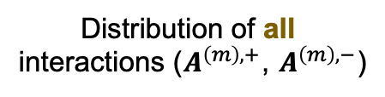
﻿Distribution of all
interactions ($A_{ }^{\left(m\right),+}$, $A_{ }^{\left(m\right),−}$)
=
+
Distri. of Generalizable interactions
Distri. of Non-general. interactions
Real
Theoretical
Real
Theoretical
ResNet-20 on MNIST
ResNet-20 on CIFAR-10
VGG-11 on CIFAR-10
Bert-Medium on SST-2
Bert-Base on SST-2
Qwen2.5-7B on Finance
Llama-3-8B on Finance
GLM-Z1-9B on Finance
Phi-4-14B on Finance

