Slide 1
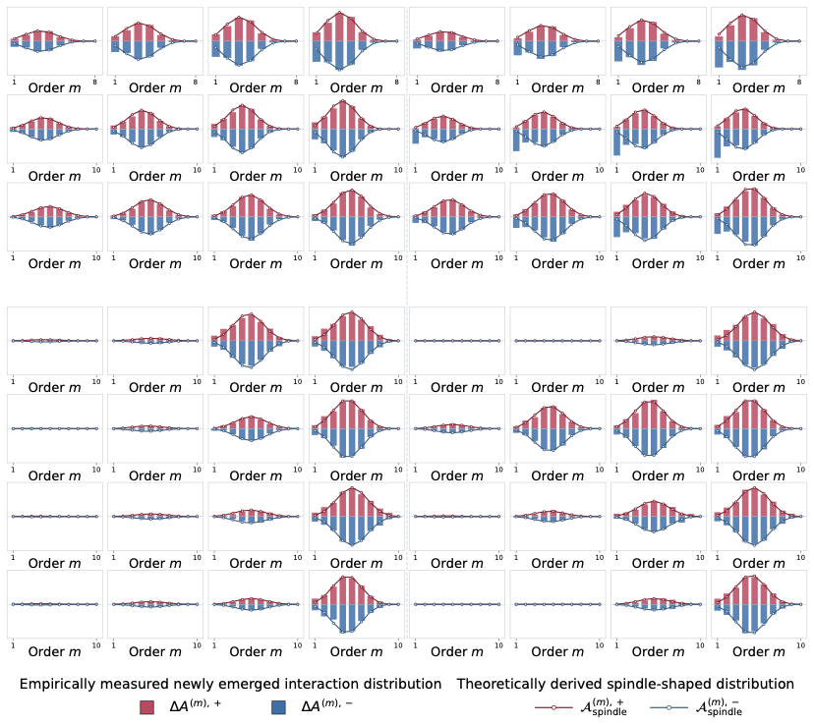


















(a) Tracking the distributions of newly emerged interactions when we injected more non-generalizable representations to DNN’s parameters.
(b) Tracking the distributions of newly emerged interactions when we injected more non-generalizable representations to input samples.
Increasing noise magnitude $σ$
Increasing noise magnitude $σ$
$$σ=0.01$$
$$σ=0.02$$
$$σ=0.03$$
$$σ=0.04$$
$$σ=1/255$$
$$σ=2/255$$
$$σ=3/255$$
$$σ=4/255$$
ResNet-20 on MNIST
ResNet-20 on CIFAR-10
VGG-11 on CIFAR-10
$$σ=1×{10}^{−8}$$
$$σ=3×{10}^{−8}$$
$$σ=1×{10}^{−7}$$
$$σ=3×{10}^{−7}$$
$$σ=1×{10}^{−8}$$
$$σ=3×{10}^{−8}$$
$$σ=1×{10}^{−7}$$
$$σ=3×{10}^{−7}$$
Qwen2.5-7B on Finance
Llama-3-8B on Finance
GLM-Z1-9B on Finance
Phi-4-14B on Finance

