Slide 1
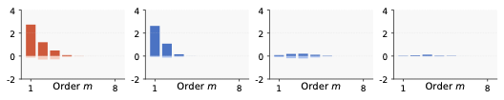
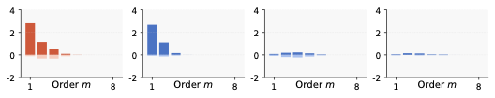
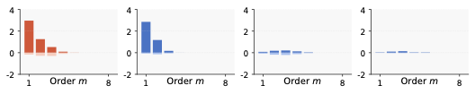
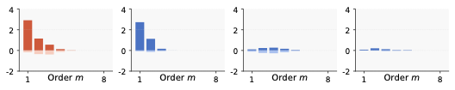
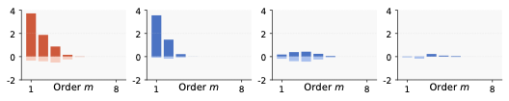
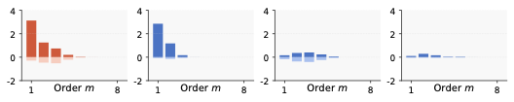
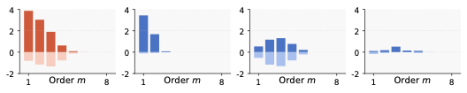
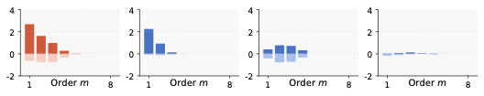
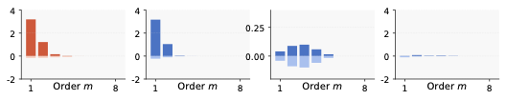
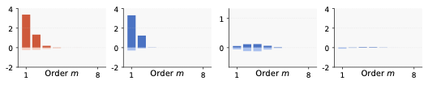
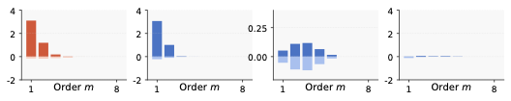
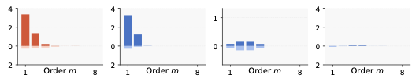

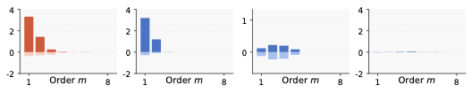
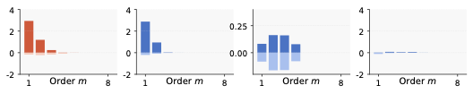
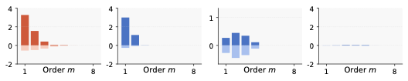


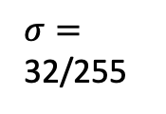
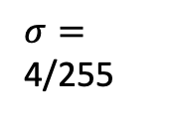
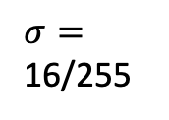
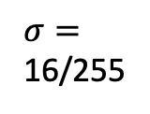


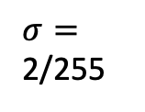
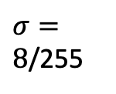

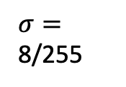



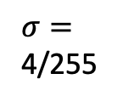
(a) Tracking the change of two distributions when we injected more non-generalizable representations to DNN’s parameters.
(b) Tracking the change of two distributions when we injected more non-generalizable representations to input samples.
ResNet-20 on MNIST
All interactions
=
Gen
+
Non-gen
+
Residual
All interactions
=
Gen
+
Non-gen
+
Residual
$σ=$ 3.0
$σ=$ 4/255
$σ=$ 4.0
$σ=$
8/255
$σ=$ 5.0
$σ=$ 16/255
$σ=$ 6.0
$σ=$
32/255
VGG-11 on MNIST
All interactions
=
Gen
+
Non-gen
+
Residual
All interactions
=
Gen
+
Non-gen
+
Residual
$σ=$ 3.0
$σ=$ 2/255
$σ=$ 4.0
$σ=$
4/255
$σ=$ 5.0
$σ=8$/255
$σ=$ 6.0
$σ=$
16/255

