Slide 1
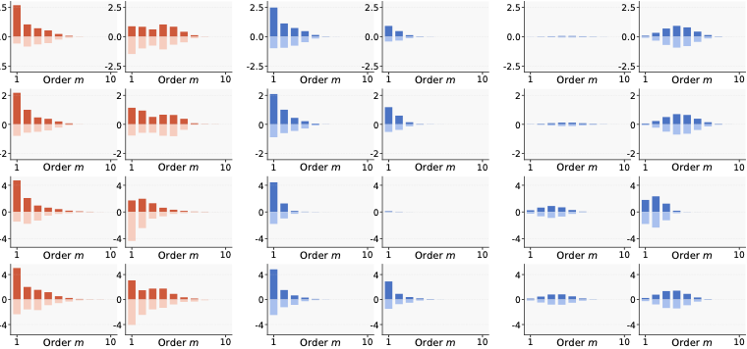
﻿Distribution of all interactions
=
Distri. of Generalizable interactions
+
Distri. of Non-gen. interactions
Correctly classified
Misclassified
Correctly classified
Misclassified
Correctly classified
Misclassified
ResNet-20 on CIFAR-10
VGG-11 on CIFAR-10
Bert-Medium on SST-2
Bert-Base on SST-2

