Slide 1
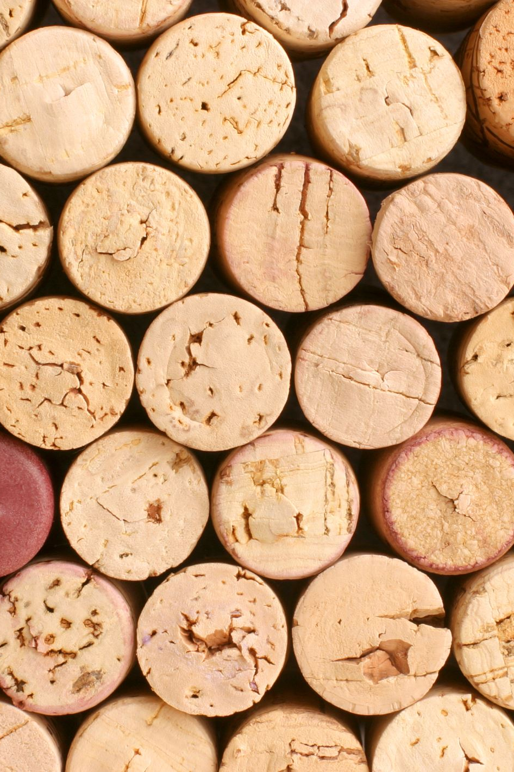


Winology
Your best friend while choosing wine.

Slide 2
Winology – Why?
Wine DB for you and your friends.
Register your wine:
Food;
Time;
Wine characteristics;
Ratings;
Ask Winlogy:
I invited some friends tonight, which can be the best for all of us?
I am about to buy a wine, will I enjoy it?

Slide 3
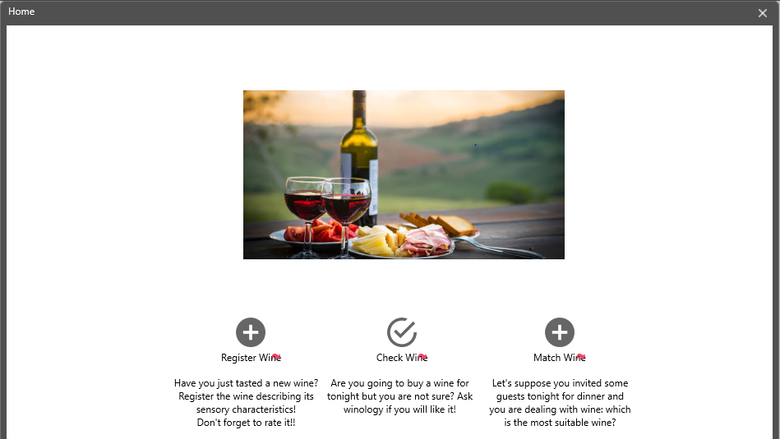
Winology – Mockup: Home
Notes:
Mockups used in order to explain which would be the main functionalities of Winology. A Java GUI (JavaFX) would be parallel developed to PROLOG outside the AI project itself.
I am actually going to learn JAVA (private interest, not within university or work scopes).
The JPL Library would be fundamental for winology: https://jpl7.org

Slide 4
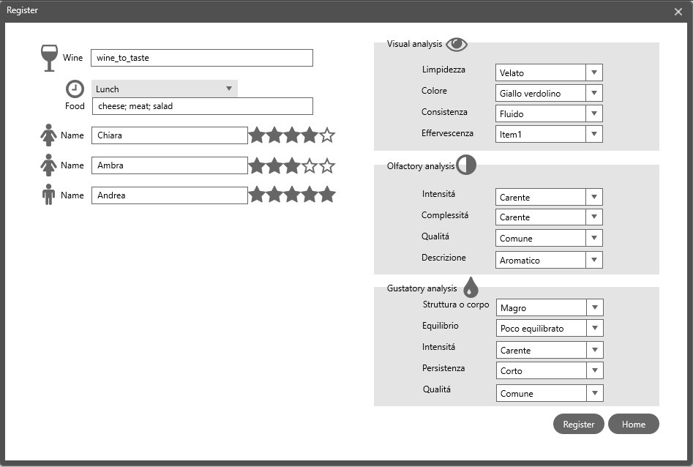
Winology – Register a new wine
Mockup:
Register

Slide 5
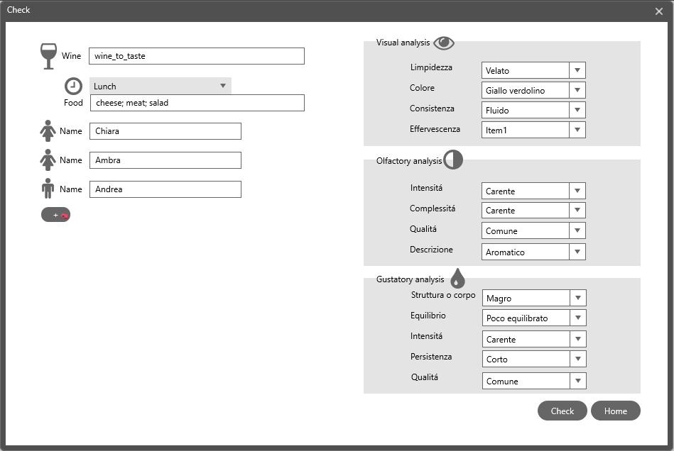
Winology – Register a new wine
Mockup:
Check

Slide 6
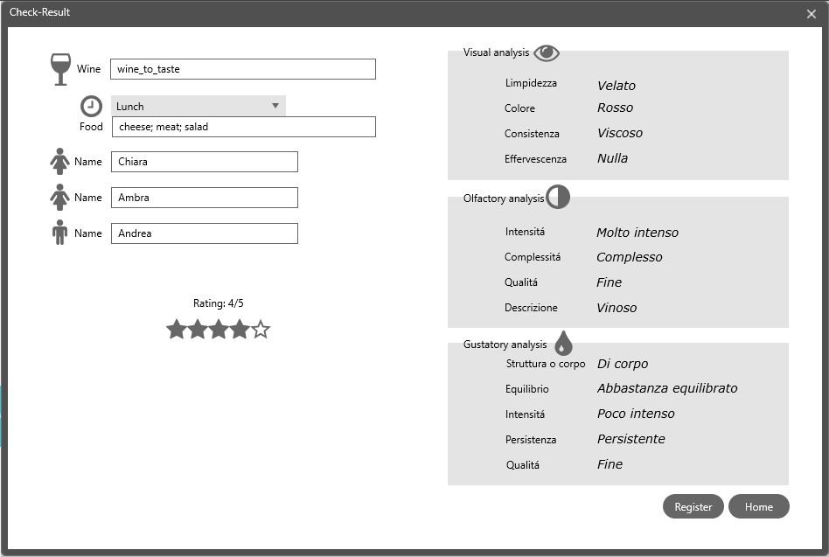
Winology – Register a new wine
Mockup:
Check
Result

Slide 7
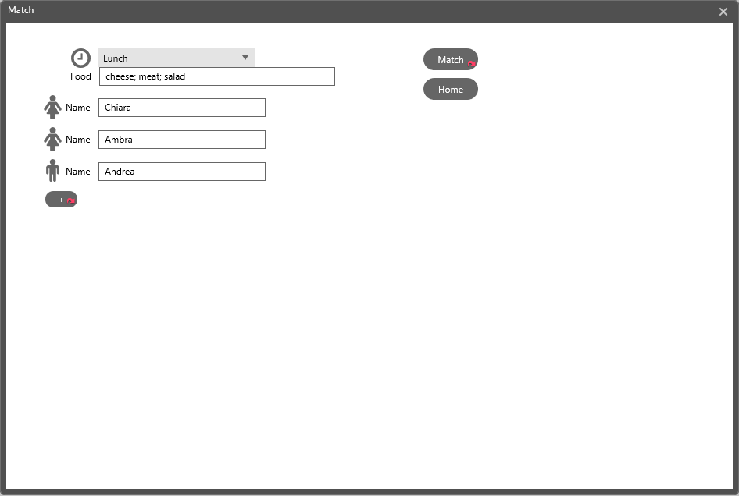
Winology – Register a new wine
Mockup:
Match

Slide 8
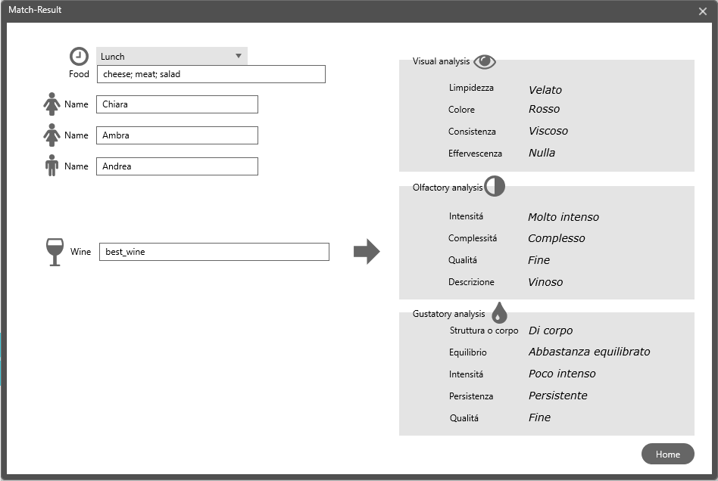
Winology – Register a new wine
Mockup:
Match
Result

Slide 9
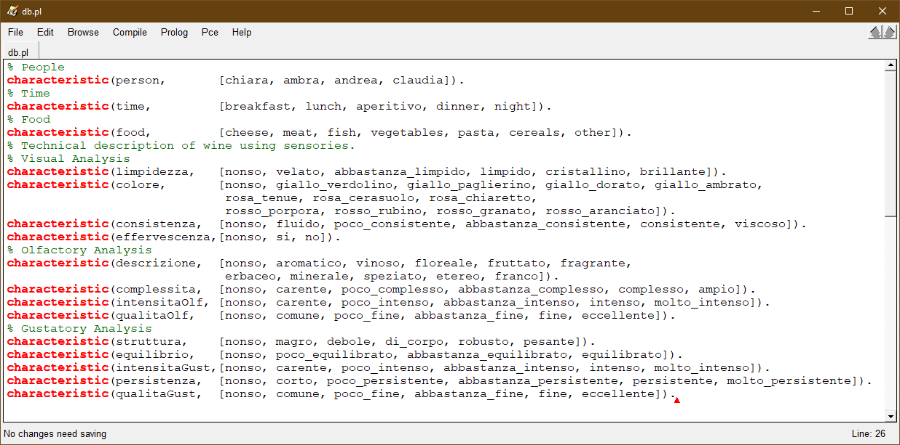
PROLOG: Attributes

Slide 10
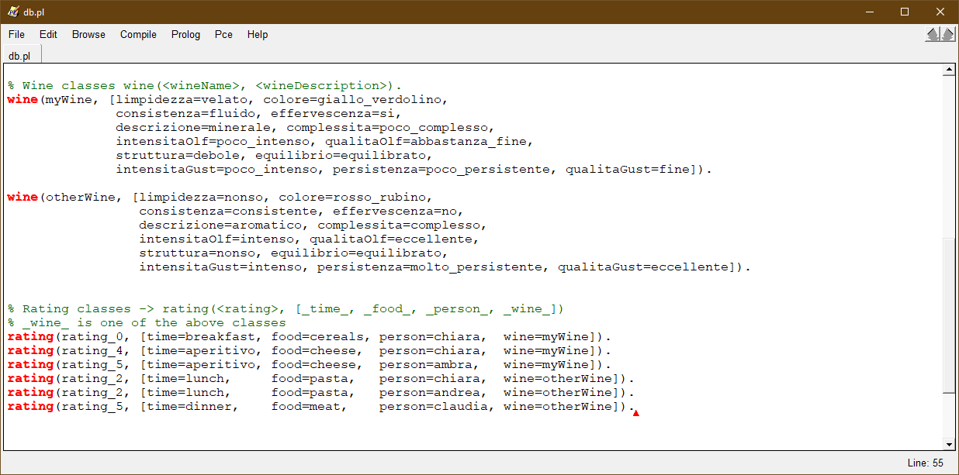

PROLOG: CLASSES
Examples Æ Training set

Slide 11
PROLOG: check
Rule induction:
given a new wine description <time>, <food>, <people>, <wine>
get the rating class
<Wine> is a class
⚠Some information could be missing (wine description could be not 100% given)

Slide 12
PROLOG: match
Decision tree:
Given a situation <time>, <food>, <people>,
Match the best wine.
No „yes“/„no“ but yes ~= rating_4/rating_5
⚠Too few attributes?

