Slide 1
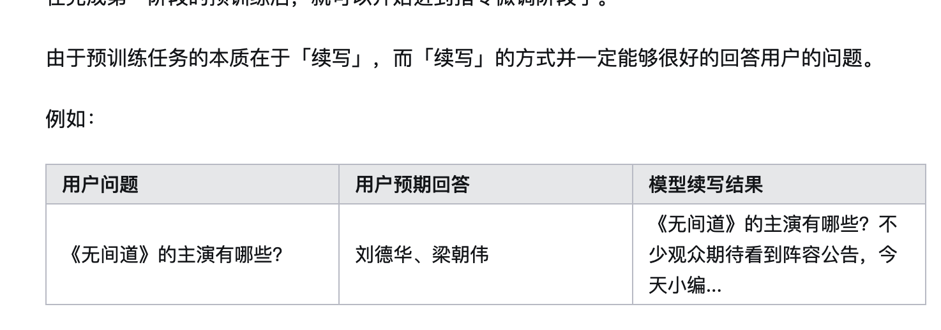
Large language models
预处理，tokenization -> autoregressive models & auto encoder models -> sft -> rlhf -> moe
计算模型的大小粗略公式 推理消耗 量化模型
模型种类派别 gpt llama glm
模型权重合并
Huggingface的实验室、complexiity，chatbot免费使用

Slide 2
Large language models

Slide 3
Large language models

Slide 4
Large language models

